Slide 1
Notes on evaluating machine learning models
John Mark Agosta
ISE201
27 Mar 2024

Slide 2
Manual programming v/s Machine Learning
Current features
Algorithm
Current features
Output
Output
Model
Historic features
Programmer
Historic features
Train
Data labels
In traditional programming the programmer comes up with the algorithm
In Supervised Machine Learning, the program is generated by from labels applied to historic data

Slide 3
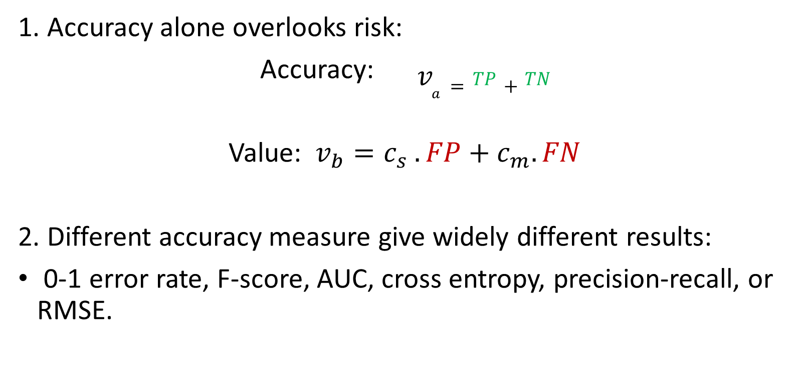
When Accuracy doesn’t cut it.
Confusion matrix | Detected Positive | Detected Negative
Actual True | TP | FN
Actual False | FP | TN
1. Accuracy alone overlooks risk:
Accuracy: $v_{a}=TP+TN$
Value: $v_{b}=c_{s} .FP+c_{m}.FN$
2. Different accuracy measure give widely different results:
0-1 error rate, F-score, AUC, cross entropy, precision-recall, or RMSE.

Slide 4
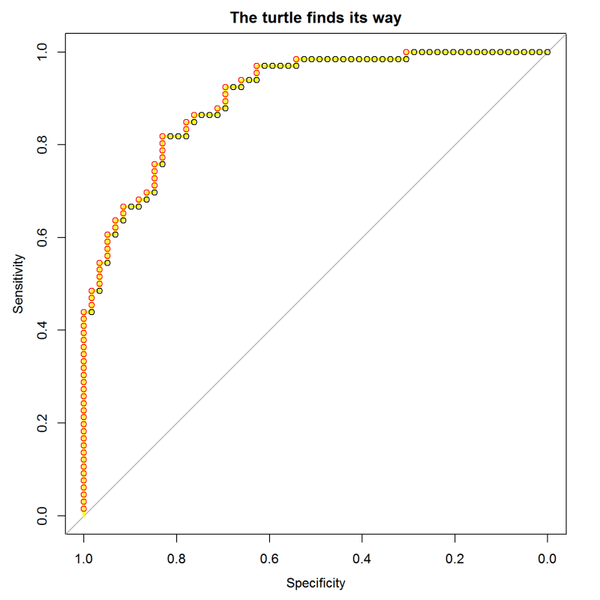

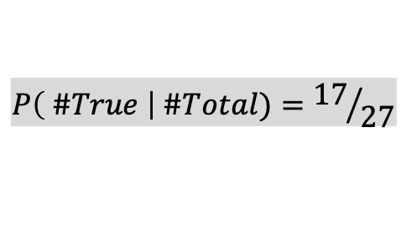
ROC Curve:
sort test cases by their score from the model
march along the sequence, stepping up for positives and right for negatives
This is the same as scanning across possible cutoff threshold values.
The slope of the curve shows the concentration of positives.
17 up
$$P\left( \#True \right| \#Total)={17}/{27}$$
10 over
TPR
0.0 0.2 0.4 0.6 0.8 1.0
FPR
Notes:
This is the “turtle graphics” explanation of ROC curves. Once the cases are sorted by their scores, the turtle uses them to plot its course. Starting at (0,0) it reads the sorted labels. If it sees a positive one (red in this figure), it goes up. If it sees a negative(black) case it goes to the right. It scales its steps along each axis so that by the time it has seen all of the positive cases it will be at 1.0 on the y axis, and by the time it has seen all the negative cases it will be at 1.0 on the x axis.
The “turtle’s eye view” of ROC curves is described here:
https://blog.revolutionanalytics.com/2016/08/roc-curves-in-two-lines-of-code.html

