Slide 1
ADHD/ADD Detection
Juan Manuel Guillermo Aleixandre
August 2024

Slide 2
Contents
Background and Objective
Data source
Exploratory Data Analysis (EDA)
Modeling
Summary of findings
Credits and references

Slide 3

Background and OBJECTIVE

Slide 4
Background
Machine learning (ML) and artificial intelligence (AI) are transforming the healthcare landscape, offering powerful tools to assist in the diagnosis and management of complex neurological conditions like Attention Deficit Hyperactivity Disorder (ADHD) and Attention Deficit Disorder (ADD). These disorders, which affect millions of individuals worldwide, are traditionally diagnosed through behavioral assessments and questionnaires.

Slide 5
Potential use of ML/AI techniques in ADHD/ADD detection
Enhanced Diagnostic Accuracy: ML algorithms can analyze large datasets, identifying subtle patterns and biomarkers that might be missed in traditional diagnostic methods, leading to more accurate and timely detection
Early Detection: AI models can potentially detect early signs of ADHD and ADD in children by analyzing behavioral data and cognitive tests, allowing for earlier interventions that could improve long-term outcomes.
Personalized Treatment Plans: Machine learning can assess an individual's unique data, such as genetic factors and environmental influences, to tailor personalized treatment plans that address their specific needs.
Non-Invasive Brain Analysis: AI-driven tools, such as those analyzing brain imaging data (e.g., fMRI or EEG), can help in identifying brain patterns associated with ADHD and ADD without the need for invasive procedures.

Slide 6
Scope and objective
The scope of this study is to conduct a comprehensive analysis of multi-dimensional data points that could potentially aid in the detection and diagnosis of ADHD and ADD in children and adolescents aged 0 to 17 years. These data points may include behavioral patterns, cognitive assessments, genetic factors, and environmental influences, which will be systematically evaluated for their relevance in identifying early signs of these neurodevelopmental disorders.
The overarching objective is to design and implement a predictive model that can flag at-risk profiles, providing healthcare professionals with an advanced tool to support the early diagnosis and treatment of ADHD and ADD. This model aims to improve the accuracy and timeliness of identifying these conditions, ultimately contributing to more personalized and effective intervention strategies.

Slide 7

Data source

Slide 8
Data Source
For this study, the National Survey of Children’s Health (NSCH) survey has been used, ranging data from 2016 to 2022 (1).
The National Survey of Children's Health (NSCH) is a comprehensive, nationally representative survey that provides rich data on the physical and emotional health of children in the United States, as well as the social and environmental factors that impact their well-being. Conducted by the U.S. Census Bureau on behalf of the Health Resources and Services Administration’s Maternal and Child Health Bureau (MCHB), the NSCH focuses on gathering information on various aspects of children's health, including access to healthcare, developmental milestones, family dynamics, and the community and school environments.

Slide 9
Key content areas
Physical and Mental Health: physical and chronic health conditions, including mental health status (e.g.: asthma, ADHD, autism, developmental delays, etc.)
Healthcare Access and Utilization: Focus on the quality and consistency of healthcare, unmet needs for medical and mental health services, and access to specialists.
Development and Well-being: behavioral, emotional, and social development. Assesses developmental delays, emotional challenges, and social skills.
Family and Household Environment: impact of family structure, parental involvement, and economic conditions. Covers topics such as family stress, parental health, and the relationship between household income and child outcomes.
Community and Neighborhood Environment: assesses how environmental factors, such as exposure to violence or poor housing conditions, affect children’s health.
Health Promotion and Prevention: Focuses on preventive health measures, such as immunizations, nutrition, physical activity, and dental care.

Slide 10
STRUCTURE
NSHC survey includes a screener and topical surveys. The scope of this analysis is limited to topical survey data, since most of screener information is also included in the topical survey data (2).
Data includes surveys to households with children between 0 and 17 years old, from 2016 to 2022.
Initial set of data contains 551 columns/categories, distributed in areas such race/ethnicity, geography, family, financial, coexisting conditions, pregnancy, habits, social, education, behavior, insurance coverage, surgery, skills (motor and intellectual), psychological, Exercise/workout/activity, etc. (3)
Over the years, a series of additions, adjustments and imputations have been made to minimize bias and provide corrections, which might result in inaccuracies when considering multi-year analysis. This includes race and ethnicity, height, weight and BMI, breastfeeding corrections, and children with Special Health Care Needs (CSHCN)(4)(5)

Slide 11
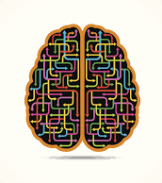
Exploratory Data Analysis (EDA)

Slide 12
Exploratory Data Analysis (EDA)
Data from topical surveys from 2016 to 2022 has been combined into a single data frame.
Target column: K2Q31A ‐ ADD/ADHD (T1 T2 T3)
Has a doctor or other health care provider EVER told you that this child has Attention Deficit Disorder or Attention‐Deficit/Hyperactivity Disorder, that is, ADD or ADHD? 1 = Yes; 2 = No
Initial set of data after combination:
551 columns (550 categories + 1 Target)
279546 rows
Target is NaN in 1881 records (0.6%)

Slide 13
Exploratory Data Analysis (EDA) (cont.)
Decisions:
Rename target column as ‘y’
Define ‘hhid’ as dataframe index
Drop records with target column = NaN
Family Poverty Ratio was averaged across FPL_I1 to FPL_I6 to new column ‘fpl’
Drop categories which are not common across evaluated timespan (2016-2022)
Drop imputation flags
Drop columns asking for currently existing conditions after confirming existing conditions (*_curr)
Drop columns related to the current diagnosis of ADHD/ADD, as they might introduce confirmation bias if considered as categories instead of target
Converted non-numerical categories to numerical ('stratum', 'formtype’)
Replace NaN by median values
Normalize all columns

Slide 14
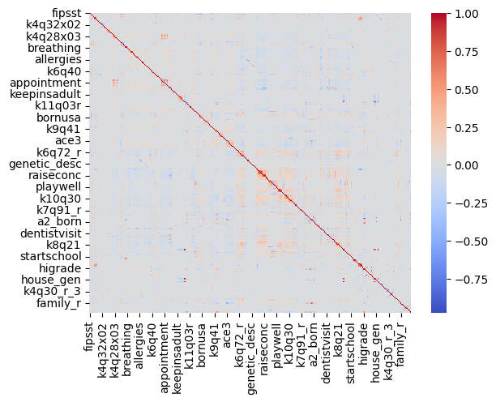
Exploratory Data Analysis (EDA) (cont.)
Final dataset: 277665 rows by 331 columns
Target ‘y’
330 numerical normalized categories
Data exploration shows very low levels of correlation for the most part, with the existence of isolated clusters of higher positive and negative correlation values:

Slide 15
Exploratory Data Analysis (EDA) (cont.)
Compared histograms for some categories between records with target ‘y’=1 (ADHD/ADD diagnosed) and records with target ‘y’=2 (ADHD/ADD never diagnosed).
For this exploration, the following 2 set of 8 categories where selected.
Situations the children has experienced
ACE1 ‐ Hard to Cover Basics Like Food or Housing
ACE3 ‐ Child Experienced ‐ Parent or Guardian Divorced
ACE4 ‐ Child Experienced ‐ Parent or Guardian Died
ACE6 ‐ Child Experienced ‐ Adults Slap, Hit, Kick, Punch Others
ACE7 ‐ Child Experienced ‐ Victim of Violence
ACE8 ‐ Child Experienced ‐ Lived with Mentally Ill
ACE9 ‐ Child Experienced ‐ Lived with Person with Alcohol/Drug Problem
ACE10 ‐ Child Experienced ‐ Treated Unfairly Because of Race

Slide 16
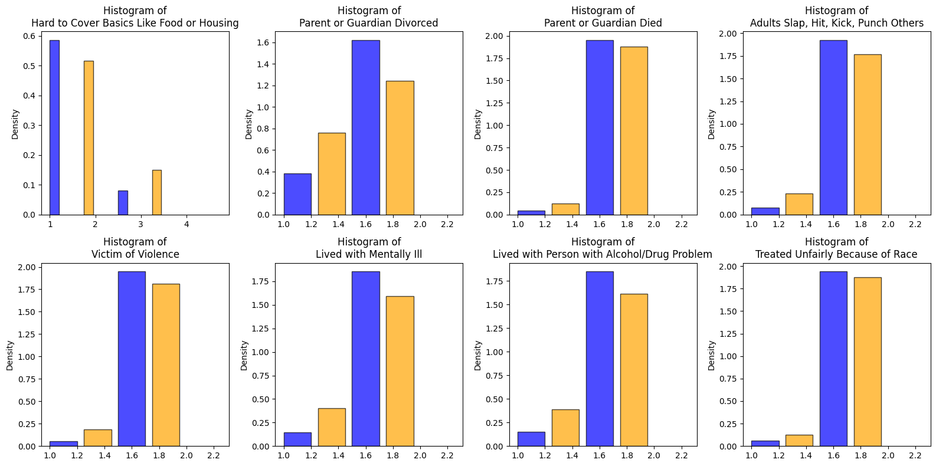
Exploratory Data Analysis (EDA) (cont.)
No ADHD/ADD diagnosed
ADHD/ADD diagnosed
Note: 1 = Yes, 2 = No.
Values slightly deviated due to NaN filled using median
Proportionally, ADHD/ADD diagnosed children seem to have experienced these situation more often than non-ADHD/ADD diagnosed children

Slide 17
Exploratory Data Analysis (EDA) (cont.)
Children behavioral traits
K7Q70_R ‐ Argues Too Much
K7Q82_R ‐ Cares About Doing Well in School
K7Q83_R ‐ Does All Required Homework
K7Q84_R ‐ Works to Finish Tasks Started
K7Q85_R ‐ Stays Calm and In Control When Challenged
K6Q70_R ‐ Affectionate
K6Q71_R ‐ Show Interest and Curiosity
K6Q72_R ‐ Smiles Laughs

Slide 18
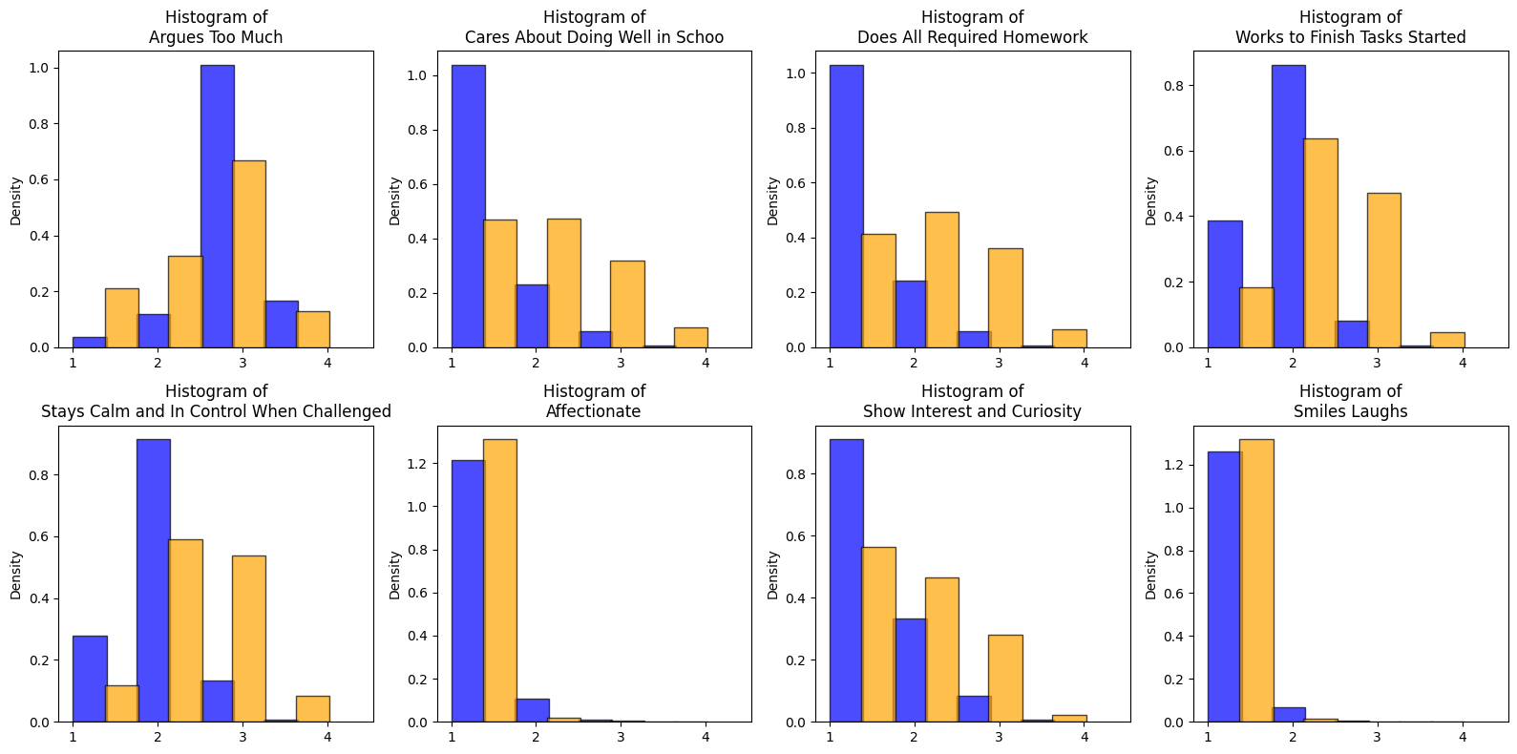
Exploratory Data Analysis (EDA) (cont.)
No ADHD/ADD diagnosed
ADHD/ADD diagnosed
Note: 1 = Yes, 2 = No.
Values slightly deviated due to NaN filled using median
ADHD/ADD diagnosed children seem to argue more, care less about their tasks and performance, and show less interest than non-ADHD/ADD diagnosed children

Slide 19

MODELING

Slide 20
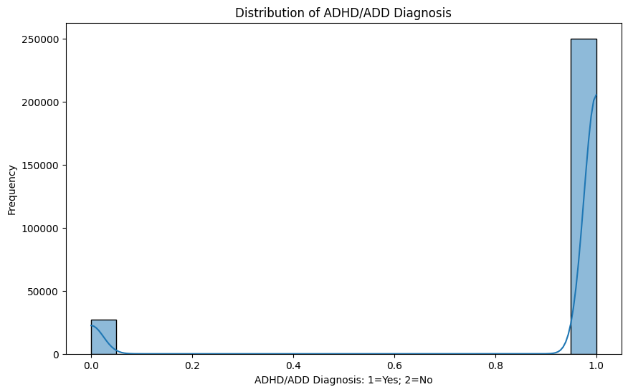
Modeling
ADHD/ADD Diagnosis
Family
Insurance
Skills
Behavior
Education
Finance
Social context
Activities
Habits
The objective of the model is to analyze if a diagnose of ADHD/ADD could be advanced because of the children socio-economic context, behavioral patterns and skills.
This is a classification problem with high unbalance.

Slide 21
Model specifications
Defined ADHD/ADD diagnose as target
Generated train/test sets, split at 30%
Generated a grid using:
Random Forest
Estimators: 50, 100; Max depth: 5, 10, 15
Logistic Regression
C: 0.01, 0.1, 1; solver: liblinear
KNN
# neighbors: 3, 5, 7, 11; weights: uniform, distance
Decision Tree
Max depth: 5, 10, 15; min sample split: 2, 5
Gradient Boosting
Estimators: 50, 100; learning rate: 0.01, 0.1; Max depth: 3, 5, 7

Slide 22
Model results
Model | Best Params | Accuracy | Precision | Recall | F1 Score | Execution Time (s) | Confusion Matrix
RandomForest | {'max_depth': 15, 'n_estimators': 100} | 0.916759 | 0.903485 | 0.916759 | 0.897836 | 184.991215 | [[2005, 6143], [791, 74361]]
LogisticRegression | {'C': 0.1, 'solver': 'liblinear'} | 0.920984 | 0.909663 | 0.920984 | 0.910855 | 82.769711 | [[3077, 5071], [1511, 73641]]
KNN | {'n_neighbors': 7, 'weights': 'uniform'} | 0.907371 | 0.886118 | 0.907371 | 0.877184 | 1282.91104 | [[951, 7197], [519, 74633]]
DecisionTree | {'max_depth': 5, 'min_samples_split': 2} | 0.912257 | 0.896317 | 0.912257 | 0.898723 | 41.201288 | [[2449, 5699], [1610, 73542]]
GradientBoosting | {'learning_rate': 0.1, 'max_depth': 7, 'n_esti... | 0.922893 | 0.912925 | 0.922893 | 0.914646 | 2921.930661 | [[3391, 4757], [1666, 73486]]
Best Performance (score vs. execution time)
Best Accuracy
* Only best params combinations for each model are included in the table

Slide 23
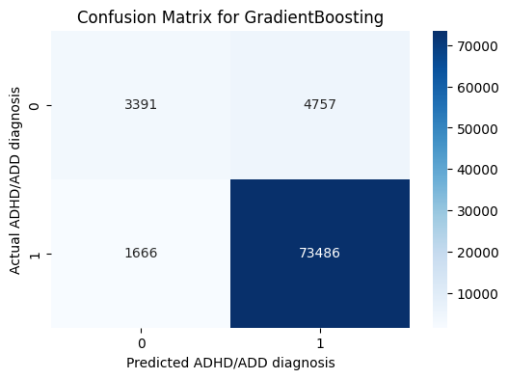
Gradient Boosting– confusion matrix
3391 out of 8148 children are accurately flagged as ADHD/ADD
4757 out of 8148 children are misclassified as non-ADHD/ADD
1666 out of 75152 children are mistakenly flagged as ADHD/ADD
73486 out of 75152 children are accurately flagged as non-ADHD/ADD
1.0: ADHD/ADD diagnosed
2.0: non-ADHD/ADD diagnosed

Slide 24
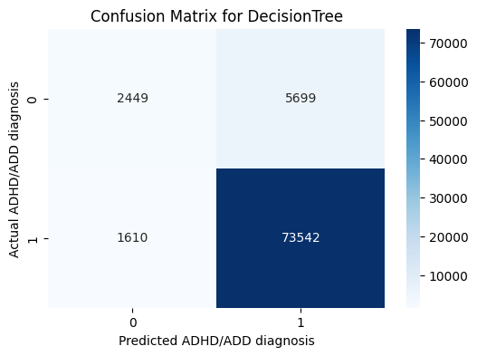
Decision Tree – confusion matrix
2449 out of 8148 children are accurately flagged as ADHD/ADD
5699 out of 8148 children are misclassified as non-ADHD/ADD
1610 out of 75152 children are mistakenly flagged as ADHD/ADD
73542 out of 75152 children are accurately flagged as non-ADHD/ADD
1.0: ADHD/ADD diagnosed
2.0: non-ADHD/ADD diagnosed

Slide 25
Feature Selection (top 5 per model)
Random Forest |  | Logistic Regression |  | Decision Tree |  | Gradient Boosting
Feature | Importance | Feature | Coefficient | Feature | Importance | Feature | Importance
hcability | 0.067337 | distracted | 2.107995 | hcability | 0.515294 | hcability | 0.215119
k7q83_r | 0.049016 | k6q60_r | 0.887171 | k7q83_r | 0.262160 | k7q83_r | 0.116823
k7q04r_r | 0.046137 | k7q02r_r | 0.873854 | k7q84_r | 0.063570 | k7q04r_r | 0.061516
k7q84_r | 0.042736 | clearexp | 0.835117 | k7q70_r | 0.036171 | hcextent | 0.055737
hcextent | 0.041992 | usepencil | 0.716862 | k7q04r_r | 0.031782 | k7q84_r | 0.052701
* KNN does not provide feature importances natively, so we skip it

Slide 26
Feature Selection (top 5 per model) (cont.)
Features are present as top features in all models:
hcability: DURING THE PAST 12 MONTHS, how often have this child's health conditions or problems affected their ability to do things other children their same age do? (No health conditions, Never, Sometimes, Usually, Always)
k7q83_r: Does this child do all required homework? (Always, Usually, Sometimes, Never)
K7q04r_r: DURING THE PAST 12 MONTHS, how many times has this child's school contacted you or another adult in your household about any problems they are having with school? (None, 1 time, 2 or more times)
k7q84_r: Does this child work to finish tasks they start he or she starts? (Always, Usually, Sometimes, Never)
It is worth noting that, while Random Forest, Decision Tree and Gradient Boosting identify almost the same features as important, Logistic Regression identifies a completely different set of features as its best coefficients (distracted, k6q60_r, k7q02_r, clearexp and usepencil).

Slide 27

Summary of Findings

Slide 28
Findings
With only about 1% difference in the different scoring dimensions, and considering the dramatic difference in terms of performance, the best overall model is Decision Tree with {'max_depth': 5, 'min_samples_split': 2}, achieving the following results in about 41s of execution:
Accuracy: 0.912257
Precision: 0.896317
Recall: 0.912257
F1 Score: 0.898723
Second best model, especially considering the gap in execution times, with very similar scoring results, is Logistic Regression.
Most relevant features across models are: hcability, k7q83_r, K7q04r_r, and k7q84_r
Socio-economic, educational context together with behavioral profiling could be used to automatically flag candidates of suffering some degree of ADHD/ADD. Early intervention in the share of psychological therapy or access to medication could improve both children and their family experience
The confusion matrix highlights a relatively high number of false positives. These results need to be handled with care.
In one hand, there seems to be a trend in over-diagnosing patients of all ages with some levels of the ADHD/ADD spectrum, particularly in private practice (6).
On the other hand, due to the ambiguous nature of these conditions and recent further understanding of the same, they go unnoticed and underdiagnosed (7), resulting in patients ignoring some conditions and not getting treated for them, which could translate in challenging experiences in many different aspects of life which could be improved through appropriate medication or therapy.

Slide 29
Findings (cont.)
In all cases, such insight as the one that can be achieved by applying models to contextual, socio-economic, and/or behavioral surveys should never be taken as a diagnosis, but rather as a flag for further screening and assessment.
Results obtained in the confusion matrix seem to support the thesis covered in (6) and (7), where a part of the diagnosed ADHD/ADD patients could be mistakenly diagnosed, while it could seem that in general ADHD/ADD cases could be more widely under-diagnosed as (7) suggests.

Slide 30
Special considerations
Branching. Given the nature of the survey, some questions were only applicable based on age range of the selected child or based on inputs from previous questions. The study does not implement any special treatment for this situation.
All questions asking or related to medical condition diagnosis have been removed, as they could be highly correlated to the target feature (directly related or resulting effect of ADHD/ADD), to avoid confirmation bias.
When running the model in the entire data set (combination of .dta files from 2016 to 2022) I reached timeouts in my executions when including SVM, after running the grid for 12+ hours. As a result, I decided to exclude that model from the grid.
Additionally, SVM was run in a 30% sampled dataset, not throwing any better results than Gradient Bossting, Decision Tree or LR models, at a significantly higher computational effort.

Slide 31
References and Credits

Slide 32
References
https://www.census.gov/programs-surveys/nsch.html
https://www.census.gov/programs-surveys/nsch/data/datasets.html
https://www2.census.gov/programs-surveys/nsch/technical-documentation/codebook/2022-NSCH-Topical-Variable-List.pdf
https://www2.census.gov/programs-surveys/nsch/technical-documentation/NSCH_Enhancements_Technical_Document.pdf
https://www2.census.gov/programs-surveys/nsch/technical-documentation/NSCH_Weighting_Revisions.pdf
https://www.bbc.com/news/health-65534449
https://www.ncbi.nlm.nih.gov/pmc/articles/PMC4195639/#:~:text=Attention%2Ddeficit%2Fhyperactivity%20disorder%20(ADHD)%20is%20an%20underdiagnosed,and%20debilitating%20condition%20in%20adults.

Slide 33
Credits for Images
Slide 3 - https://www.forbes.com/health/mind/adhd-statistics/
Slide 7 - https://flourishmentalhealth.com/specialties/adhd-2/
Slide 11 - https://www.additudemag.com/3-types-of-adhd/
Slide 19 - https://www.adhdevidence.org/blog/eight-pictures-describe-brain-mechanisms-in-adhd
Slide 29 - https://www.cnet.com/health/mental/8-signs-of-adhd-you-may-have-and-how-to-manage-it/

