Slide 1
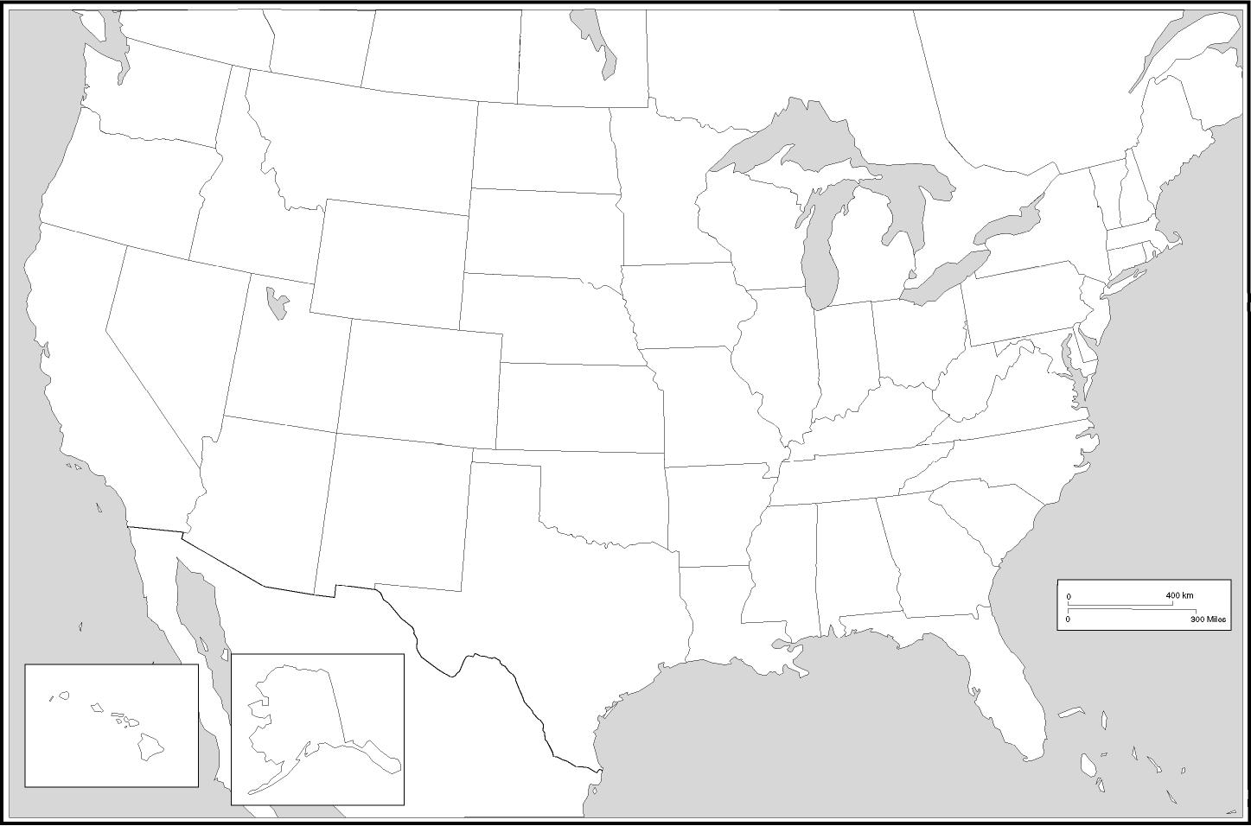
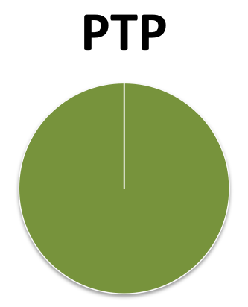
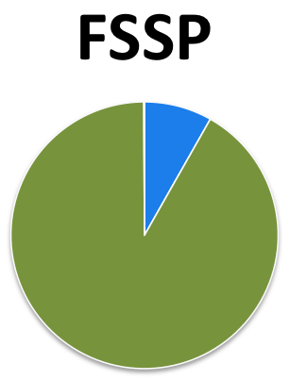
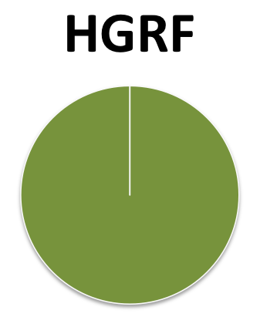
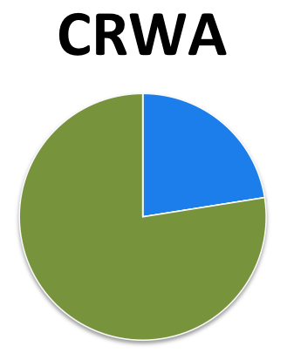
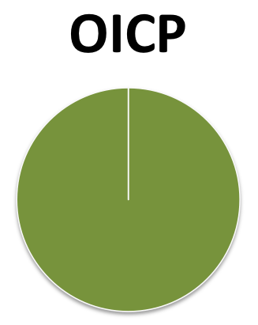
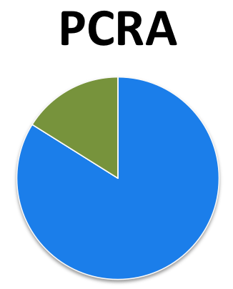
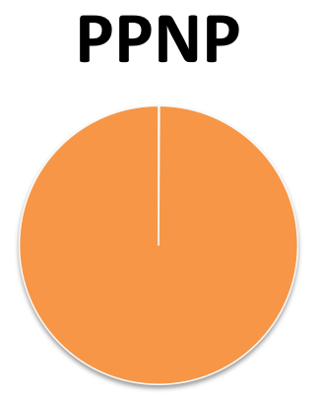
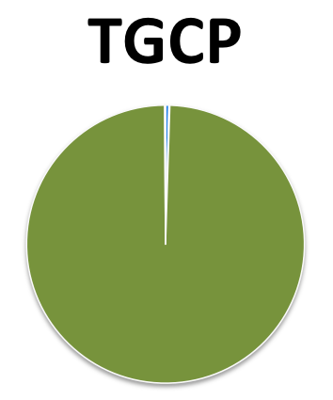
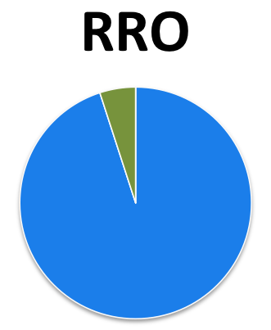
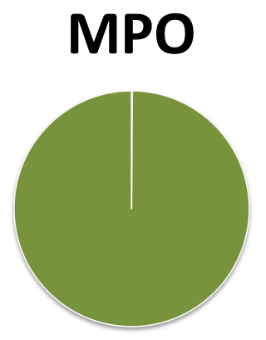
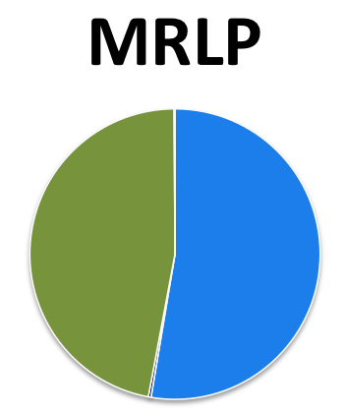
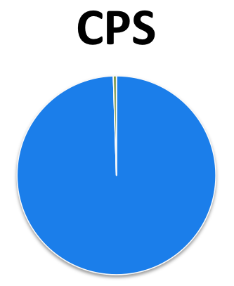
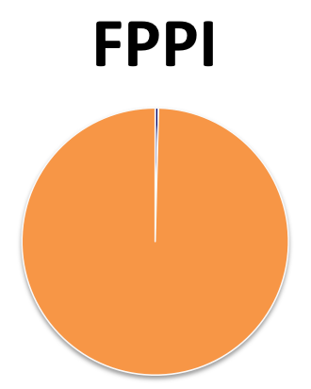
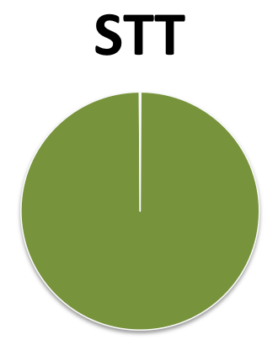
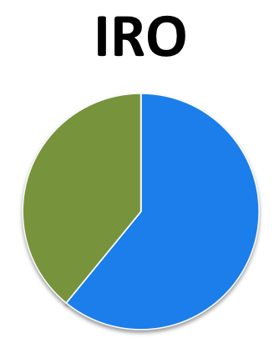
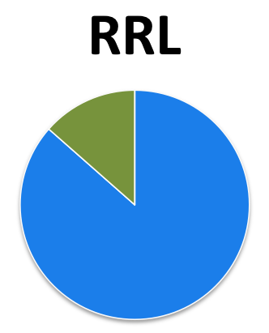
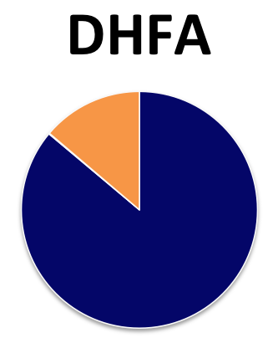
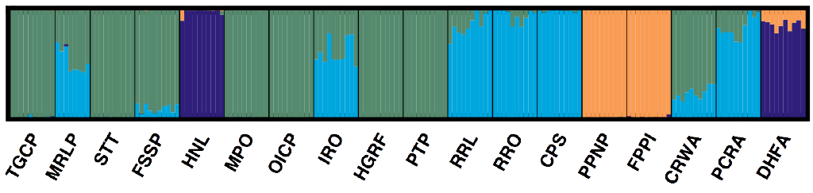
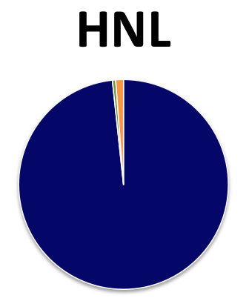
Population Genomic Structure of Webbhelix multilineata (Emberton, 1988)
Dataset info:
18 populations
178 individuals
10 indiv. per pop.
8,480 SNPs (after filtering SNPs in high LD pairs and SNPs with extreme HWE deviation)
STRUCTURE analysis info:
Tested K1 – K18, 20 iterations each
100,000 burn-in & 500,000 MCMC
Default STRUCTURE settings
K4 most likely number of true populations, based on highest Delta K and smaller Stdev LnP(K) (model choice criterion) than next highest Delta K

Slide 3
H_{O}
H_{S}
G_{IS}
0.006
0.018
0.006
0.020
-0.010
0.131
0.008
0.024
0.008
0.025
-0.018
0.043
0.016
0.017
0.007
0.031
0.021
0.033
0.023
0.052
0.083
0.027
0.024
0.025
0.028
-0.079
0.125
0.016
0.021
0.033
0.022
0.017
0.025
0.037
0.024
0.069
0.176
0.116
0.098
0.018
0.031
0.034
0.018
0.034
0.037
0.045
0.080
0.084
Observed Heterozygosity
0.050
Expected Heterozygosity
0.053
Inbreeding Coefficient
0.059
0.051 – 0.060
0.051 – 0.060
0.161 – 0.200
0.041 – 0.050
0.046
0.041 – 0.050
0.049
0.121 – 0.160
0.072
0.031 – 0.040
0.031 – 0.040
0.081 – 0.120
0.021 – 0.030
0.021 – 0.030
0.041 – 0.080
0.011 – 0.020
0.011 – 0.020
0.001 – 0.040
0.001 – 0.010
0.001 – 0.010
≤ 0

Slide 5
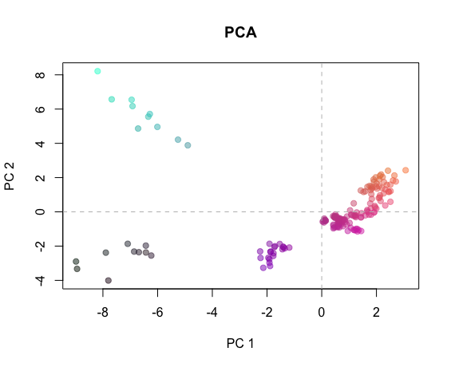
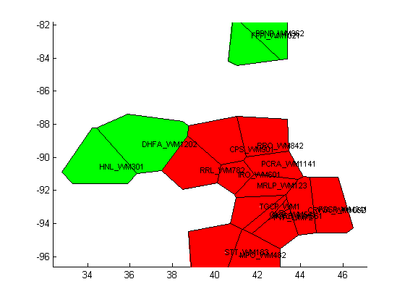
Pairwise F_{ST}
PCA
STRUCTURE
HNL
0.20
0.17
Remaining Pops
0.13
0.11
DHFA
PPNP +
FPPI
0.04
0.15
0.20
0.10
0.10
BAPS
0.13
0.09
0.11
0.17

Slide 7
M1
M2
M3
M4
M5
M6
M7
M8

