Slide 1
KAGGLE ADULT CENSUS INCOME • FINAL PROJECT
Predicting Income Above $50,000
A CRISP-DM Aligned Machine Learning Analysis for Client & Management Review
Prepared by: Elli Tai, Jessica Mai, Ksatria Amongpraja
MSDS 422: Practical Machine Learning, Section 55 | August 30th, 2026

Slide 2
1
AGENDA
What We'll Cover
1
Executive Summary
2
Problem Statement
Headline findings and where the project stands
The business question and research objectives
3
Exploratory Data Analysis
4
Data Preparation & Feature Engineering
Patterns, data quality, and assumptions
Cleaning, transformations, and encoding
5
Methodology & Tools
6
Model Results
Tooling, evaluation framework, model selection
Logistic Regression and Decision Tree (complete); Random Forest and Gradient Boosting (in progress)
7
Findings & Business Impact
8
Lessons Learned & Next Steps
Comparison, drivers, practicality, and deployment
Recommendations and references
2

Slide 3
2
EXECUTIVE SUMMARY
Predicting Who Earns More Than $50K
Goal: predict whether an individual's annual income exceeds $50,000 using 14 demographic, education, and employment attributes from 32,561 U.S. Census records.
The target is moderately imbalanced (~76% earn ≤$50K, ~24% earn >$50K), so the team evaluates models on precision, recall, F1, and ROC-AUC rather than accuracy alone.
Data quality required deliberate handling: values disguised as "?" masked ~1,800 missing entries each in workclass and occupation, retained as an explicit "Unknown" category rather than dropped.
EDA identified education, occupation, marital status, relationship, and sex as the strongest predictors of income; fnlwgt, race, and native country add comparatively little.
Two of four planned models are complete and consistent: Logistic Regression (holdout ROC-AUC 0.899) and Decision Tree (holdout ROC-AUC 0.867) both point to marital status, education, and capital activity as the leading drivers of income.
Random Forest (Person B) and Gradient Boosting (Person C) are in progress; business-impact quantification and the deployment plan follow once all four models are complete.
32,561
Records × 14 predictor variables
76 / 24
Percent split, ≤$50K vs >$50K
2 of 4
Models complete (LR, Decision Tree)
Source: Kaggle, "Adult Census Income" dataset; team analysis.
3

Slide 4
3
PROBLEM STATEMENT
Research Objectives & Success Criteria
Business Question
01
Which observable demographic, educational, and employment characteristics best predict whether an individual earns more than $50,000 per year, and how reliably can a model make that call for policy or market-analysis use cases?
Class Imbalance
A 76% / 24% split means naive accuracy can be misleading; recall/F1/ROC-AUC on the minority (>50K) class matter more.
Formal Task
Binary classification: assign each record to ">50K" or "≤50K" using 14 predictors (6 numeric, 8 categorical).
02
Success Criteria
Data Quality
Primary: F1 score and ROC-AUC for the >50K class (the class of business interest).
Secondary: overall accuracy, reported for context only — not the deciding metric given the class imbalance.
Disguised missing values and extremely skewed capital variables require deliberate treatment before modeling.
03
Mixed, High-Cardinality Features
8 categorical predictors — some with 40+ levels — require thoughtful consolidation, not naive one-hot expansion.
4

Slide 5
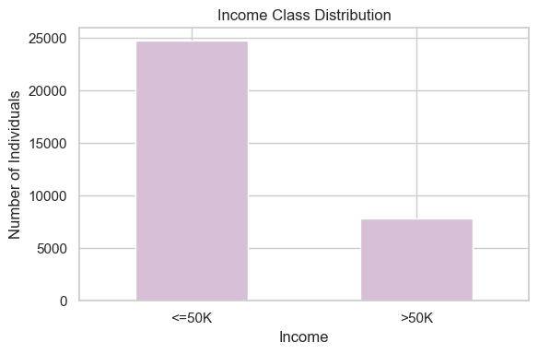
5
EXPLORATORY DATA ANALYSIS
Target Variable & Class Imbalance
32,561 records, 15 columns — 14 predictor variables and one binary target (income).
Approximately 76% of individuals earn ≤$50K and 24% earn >$50K — a moderate, not severe, imbalance.
Implication: overall accuracy alone can look strong while missing many high earners, so the team also reports precision, recall, F1, and ROC-AUC — with extra weight on the >50K class.
6

Slide 6
4
ANALYTICS FRAMEWORK
CRISP-DM & TDSP Alignment
The project follows the Cross-Industry Standard Process for Data Mining (CRISP-DM), the most widely used data-mining lifecycle, with Microsoft's Team Data Science Process (TDSP) as a complementary, team-oriented lens for collaboration and deployment.
Business
Understanding
Data
Understanding
Data
Preparation
Modeling
Evaluation
Deployment
Problem statement & research objectives
Exploratory data analysis
Cleaning, feature engineering, transforms
4 candidate algorithms, shared CV framework
Shared metrics, holdout testing, comparison
Automation strategy (in progress — Person C)
Cyclic process — iteration back to earlier phases (e.g., revisiting Data Preparation after multicollinearity diagnostics) is expected and documented throughout this deck.
TDSP maps the same work into five iterative stages — Business Understanding; Data Acquisition & Understanding; Modeling; Deployment; Customer Acceptance — and adds team-workflow and automation guidance the group used when dividing modeling work across three members.
Source: Data Science PM, "What is CRISP-DM?"; IBM Documentation, "Introduction to CRISP-DM" (SPSS Modeler); Microsoft Learn, "What is the Team Data Science Process?"
5

Slide 7
5
EXPLORATORY DATA ANALYSIS
Data Quality: Missingness Patterns
Raw data disguises missing values as the string "?" rather than a true null — replaced with NaN before analysis.
workclass (5.6%) and occupation (5.7%) are missing in nearly the same rows, consistent with unemployed or never-worked individuals — evidence the missingness is not random.
Both were filled with an explicit "Unknown" category rather than dropped, preserving that signal.
native.country missingness is smaller (1.8%) and heavily concentrated toward one value, so it was imputed with the mode ("United-States").
Source: team EDA (df.isnull().sum()) on Kaggle's "Adult Census Income" dataset.
7

Slide 8
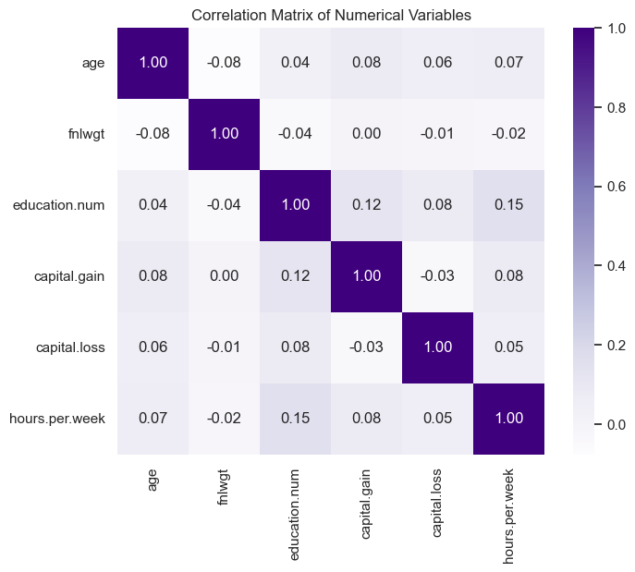
5
EXPLORATORY DATA ANALYSIS
Numeric Features & Correlation Screen
All pairwise correlations among the six numeric variables are below 0.20 (see heatmap). This indicates low multicollinearity risk, so each captures largely distinct information.
capital.gain (skew 11.95) and capital.loss (skew 4.59) are extremely right-skewed. Most individuals report zero, with a small number of very large values.
fnlwgt (skew 1.45) is a Census sampling weight, not a personal trait, and behaves similarly across both income groups. This was flagged as a weak standalone predictor.
age, hours.per.week, and education.num are close to symmetric (skew 0.56, 0.23, −0.31).
8

Slide 9
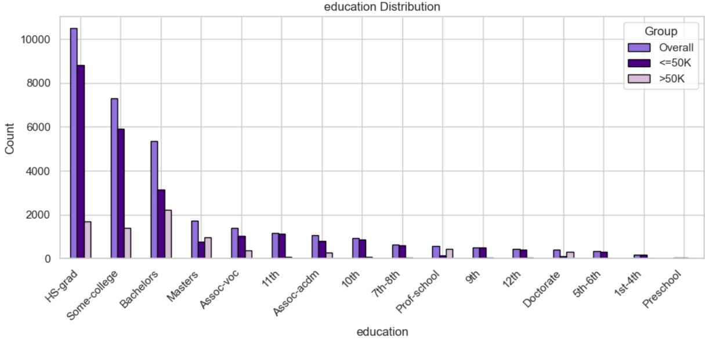
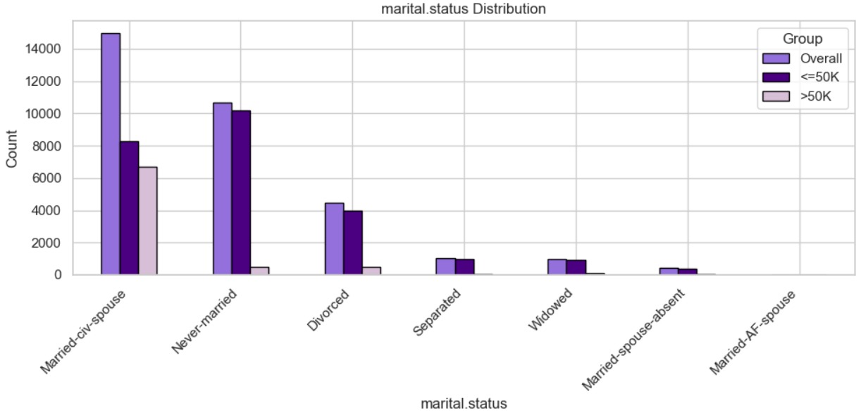
5
EXPLORATORY DATA ANALYSIS
Categorical Predictors of Income
Education shows the clearest gradient: higher-attainment tiers (Bachelors, Masters, Prof-school, Doctorate) make up a much larger share of the >50K group than of the overall population.
Marital status: 85.4% of >50K earners are married (civilian spouse), vs. just 6.3% never-married — the sharpest categorical split in the data.
Sex: 85.0% of >50K earners are male vs. 15.0% female.
Relationship: 75.5% of >50K earners hold the "Husband" relationship category.
Race and native country (not pictured) show much weaker separation between income groups and are treated as secondary predictors.
9

Slide 10
5
EXPLORATORY DATA ANALYSIS
Key Assumptions
Unit of Analysis
One row = one respondent from the 1994 U.S. Census extract used to build the Adult / Census Income dataset.
Bottom Line
No single variable dominates. Predictive signal comes from the combination of numeric and categorical attributes: education, occupation, marital status, relationship, sex, age, hours, and capital activity together.
Underlying Assumptions
"?" placeholders represent structural (likely not-at-random) missingness tied to employment status, and are not random noise. This supports the "Unknown" category treatment.
The dataset is a single historical snapshot (1994); demographic and economic relationships may have shifted since.
Feature Interactions
This motivates disciplined feature engineering and a multi-model comparison rather than relying on any one "obvious" predictor.
Capital activity, age, and hours worked tend to move together for higher earner. This is addressed later through combined and binned engineered features rather than raw variables alone.
Source: Kaggle, "Adult Census Income" dataset; team EDA.
10

Slide 11
6
DATA PREPARATION
Missing Value Treatment
Field | Missing | Treatment | Rationale
workclass | 1,836 (5.6%) | Filled with "Unknown" | Missing pattern aligns with unemployed / never-worked individuals
occupation | 1,843 (5.7%) | Filled with "Unknown" | Missing in nearly the same rows as workclass
native.country | 583 (1.8%) | Filled with mode ("United-States") | Small share, heavily concentrated toward one value
Why not drop the ~5.6% of rows with missing employment fields?
workclass and occupation are missing together — dropping those rows would remove a coherent, meaningful subgroup (likely unemployed / not in the labor force) rather than noise.
Treating the gap as an explicit "Unknown" category preserves that information for the model instead of discarding it or guessing a specific employment status.
native.country's missingness is small and concentrated, so mode imputation introduces minimal distortion.
11

Slide 12
6
DATA PREPARATION
Feature Engineering
Capital Activity
Age & Hours Binning
net.capital = capital.gain − capital.loss; has.capital.change flags any nonzero activity (1/0).
age.group: ≤25, 26-35, 36-45, 46-55, 56-65, 65+.
hours.group: part-time (≤20), under-40, 40, 41-60, 60+.
Condenses two sparse, mostly-zero variables into one signal, plus a simple activity flag.
Captures nonlinear age/hours effects for linear models while remaining usable by tree models.
High-Cardinality Consolidation
Education Grouping (Phase 0 correction)
native.country → United-States (29,753) vs. Other (2,808).
marital.status:
Married-AF-spouse → Married-civ-spouse;
Married-spouse-absent → Separated (5 final categories).
16 raw education levels collapsed into 6 tiers by observed income rate: Below-HS, HS-grad, Some-college, Bachelors, Masters, Graduate/Professional.
Avoids 40+ sparse one-hot columns while preserving the EDA's key distinctions.
Lets the model estimate a distinct effect per tier instead of one linear effect across education.num.
12

Slide 13
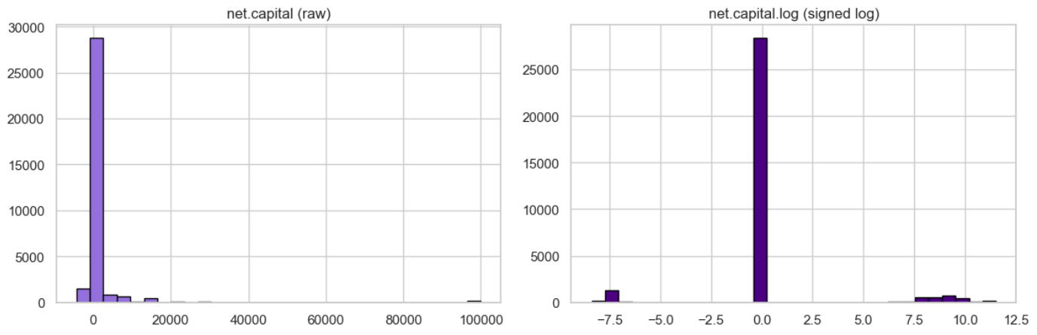
6
DATA PREPARATION
Transformations, Scaling & Encoding
One-hot encoding (drop_first=True) for all nominal categoricals. None have a natural order, so ordinal/label encoding would imply a false ranking.
income is converted to a binary integer (1 = >50K) for use with classification algorithms and standard metrics.
StandardScaler is applied to continuous predictors inside each model's pipeline (not on the shared matrix). This is required for scale-sensitive models like Logistic Regression, while leaving tree-based models unaffected.
The result was an analysis-ready, fully numeric dataset with no missing values, ready for the common modeling framework.
net.capital.log = sign(net.capital) × log1p(|net.capital|) — reduces skew from 11.87 to 1.07 while preserving direction (gain vs. loss).
13

Slide 14
6
DATA PREPARATION
Final Analysis-Ready Dataset
Midpoint Dataset
Phase 0 Correction
VIF-Driven Refinement
Common Feature Set
32,561 rows
× 57 features
→ 59 features
→ 53 features
53 features
adopted by all 4 models
Cleaned, encoded, scaled per the midpoint submission.
Fixed education encoding (still a string) and converted 51 boolean one-hot columns to integers.
Removed age, hours.per.week, capital.gain, capital.loss, net.capital, workclass_Unknown after multicollinearity diagnostics (Logistic Regression phase).
Ensures Logistic Regression, Decision Tree, Random Forest, and Gradient Boosting are compared on an identical, apples-to-apples basis.
No missing values and no non-numeric columns remain in the final 53-feature matrix used across Logistic Regression, Decision Tree, Random Forest, and Gradient Boosting.
14

Slide 15
7
METHODOLOGY
Tooling & Compute Environment
Environment
Core Libraries
Anaconda distribution running Jupyter Notebook (local), with Google Colab and Google Drive supported for shared team access to a common dataset copy.
pandas & NumPy (data handling)
Matplotlib & Seaborn (visualization)
SciPy (skewness diagnostics)
scikit-learn (pipelines, models, cross-validation, metrics)
statsmodels (VIF multicollinearity diagnostics)
Hardware
Version Control
Standard CPU. Logistic Regression, Decision Tree, Random Forest, and Gradient Boosting are classical ML algorithms that do not require GPU/TPU acceleration at this dataset size (32,561 rows × 53 features).
GitHub repository for code, notebooks, visualizations, and the final report/deck.
Source: scikit-learn, statsmodels, and Anaconda documentation; team notebook environment.
15

Slide 16
7
METHODOLOGY
Common Evaluation Framework
Established once and shared across all four models so results are directly comparable.
80 / 20
5-Fold
5 Metrics
2 Functions
Stratified train / holdout split
(26,048 / 6,513 rows, random_state=42)
StratifiedKFold cross-validation
(shuffle=True, random_state=42)
Accuracy, Precision, Recall,
F1, ROC-AUC
evaluate_model_cv() and
evaluate_model_test()
The 80/20 split preserves the ~76%/24% income-class ratio in both the training set and the untouched holdout test set.
F1 and ROC-AUC are weighted most heavily, since the project's primary interest is correctly identifying the >50K class rather than maximizing raw accuracy.
Reusable evaluate_model_cv() / evaluate_model_test() functions apply identical CV and holdout procedures to every model, while model-specific preprocessing — e.g., StandardScaler for Logistic Regression — stays inside that model's own pipeline rather than altering the shared dataset.
Same training/test observations, same random seed, and same fold assignments are used for Logistic Regression, Decision Tree, Random Forest, and Gradient Boosting.
Source: scikit-learn documentation — StratifiedKFold, GridSearchCV, model evaluation metrics.
16

Slide 17
7
METHODOLOGY
Model Selection Overview
We explored using four different models to classify the data:
Model | Approach | Status
Logistic Regression | Linear, interpretable baseline | Complete
Decision Tree | Non-linear, rule-based single tree | Complete
Random Forest | Ensemble of trees (bagging) + tuning | Complete
Gradient Boosting | Sequentially boosted ensemble + tuning | Complete
Logistic Regression and Decision Tree (Person A) are complete, tuned where applicable, and evaluated on the shared 53-feature set — detailed on the following slides.
Random Forest (Person B) and Gradient Boosting (Person C) will use the identical CV framework and holdout set; their results will be added to the model comparison and business-impact sections once complete.
17

Slide 18
8
MODEL 1 — LOGISTIC REGRESSION
Setup & Multicollinearity Refinement
Pipeline: StandardScaler → LogisticRegression(max_iter=1000, random_state=42)
Key Decision: Resolving Multicollinearity (VIF)
Before — 59 Features
After — 53 Features (Final)
6 predictors show infinite VIF: capital.gain, capital.loss, net.capital, workclass_Never-worked, workclass_Unknown, and occupation_Unknown (exact linear dependence).
Several others show very high VIF: marital.status_Married-civ-spouse (40.8), relationship_Not-in-family (30.9), age (22.7), relationship_Own-child (21.4).
Root cause: engineered features (net.capital, age.group, etc.) were kept alongside their original raw source variables from the midpoint feature engineering.
Removed: age, hours.per.week, capital.gain, capital.loss, net.capital, and workclass_Unknown since we kept their engineered equivalents (age.group, hours.group, net.capital.log, has.capital.change).
Result: zero infinite VIFs. Highest remaining VIF is 40.8 (marital.status_Married-civ-spouse) — overlapping categorical information, not exact redundancy.
Decision rationale: favor predictor independence and interpretability over the small performance gain from keeping redundant raw features.
Source: statsmodels documentation — variance_inflation_factor.
18

Slide 19
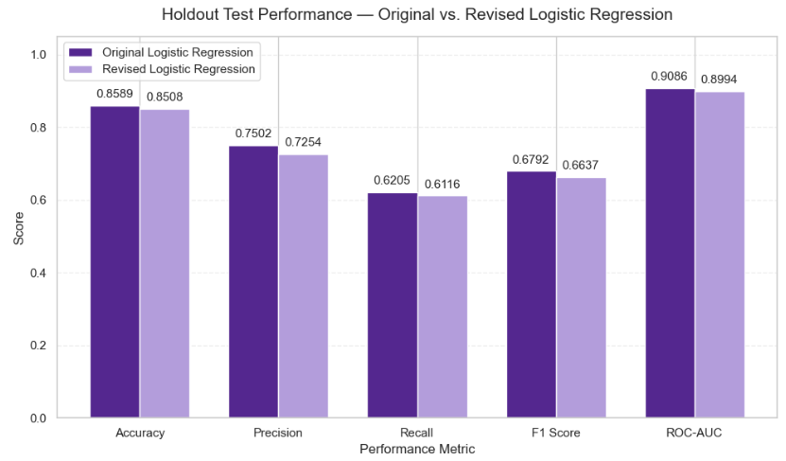
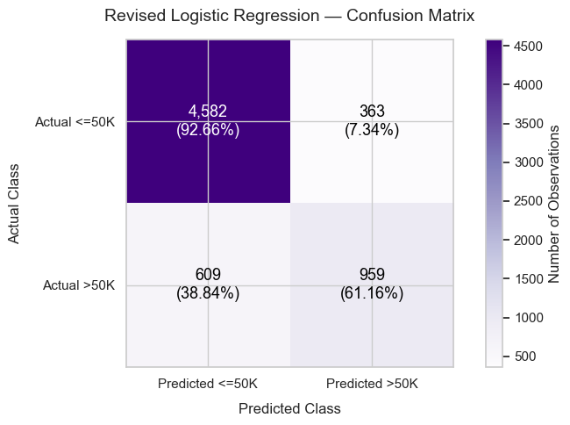
8
MODEL 1 — LOGISTIC REGRESSION
Holdout Results
Holdout: 85.1% accuracy, 72.5% precision, 61.2% recall, 66.4% F1, 89.9% ROC-AUC.
19

Slide 20
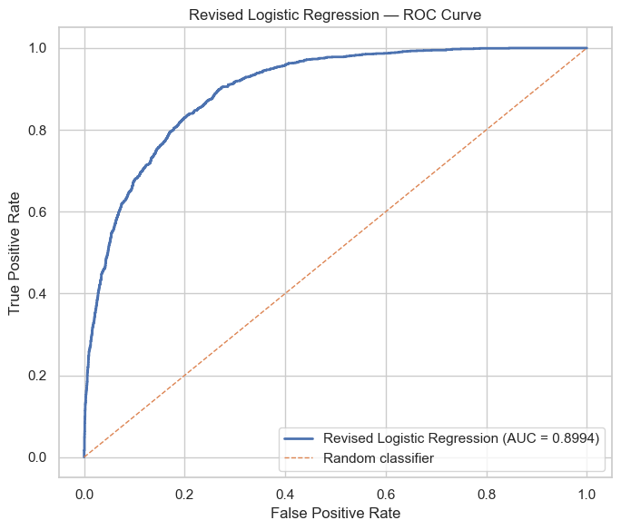
8
MODEL 1 — LOGISTIC REGRESSION
ROC Curve & Classification Detail
Classification Report (Holdout)
Class | Precision | Recall | F1
≤50K | 88.27% | 92.66% | 90.41%
>50K | 72.54% | 61.16% | 66.37%
The ROC curve sits well above the random-classifier reference line across the full range of thresholds. The holdout ROC-AUC of 0.8994 confirms strong overall discrimination.
The classification report shows the model performs much better on the majority ≤50K class (90.4% F1) than the >50K class (66.4% F1). The imbalance shows up directly in class-specific performance.
Lower recall (61.2%) for >50K means a meaningful share of true high earners are still missed, even though the model rarely raises a false alarm on obvious low earners.
20

Slide 21
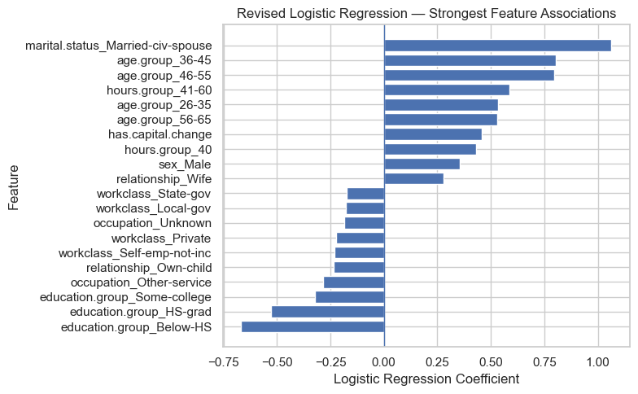
8
MODEL 1 — LOGISTIC REGRESSION
Key Income Drivers
Married (civilian spouse): ~2.90× higher odds of earning >$50K vs. the reference marital-status category.
Age 36–45 and 46–55: ~2.2× higher odds of earning >$50K vs. the ≤25 reference age group.
Working 41–60 hrs/week: ~1.80× higher odds of earning >$50K vs. the reference hours group.
Below-high-school education: ~49% lower odds of earning >$50K vs. the reference education group.
Caveat: These are conditional associations, not causal effects. net.capital.log showed a nonlinear relationship with the fitted log-odds, which is a limitation of the Logistic Regression model.
21

Slide 22
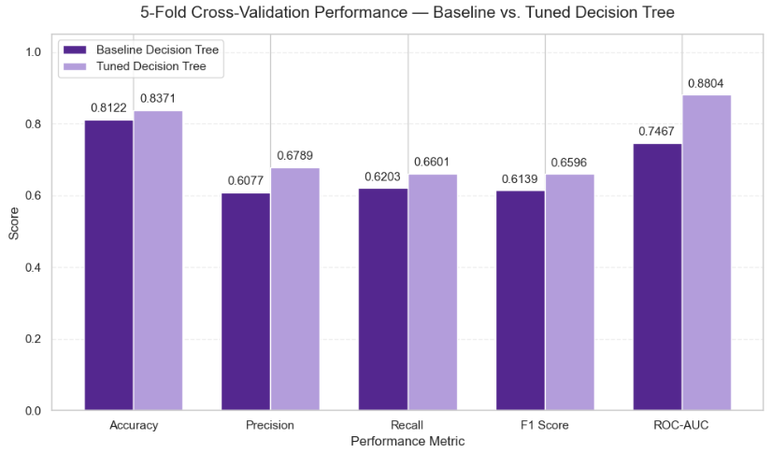
9
MODEL 2 — DECISION TREE
Hyperparameter Tuning & Complexity
108
GridSearchCV combinations tested
(max_depth, min_samples_split/leaf, criterion), scored on F1
Best Configuration
criterion = gini
max_depth = 5
min_samples_split = 2
min_samples_leaf = 1
Resulting tree: depth 5 and 26 leaves, a deliberately constrained structure.
Training vs. CV performance stay close (F1 0.675 vs. 0.660) — no strong overfitting signal.
Source: scikit-learn documentation — GridSearchCV, DecisionTreeClassifier.
22

Slide 23
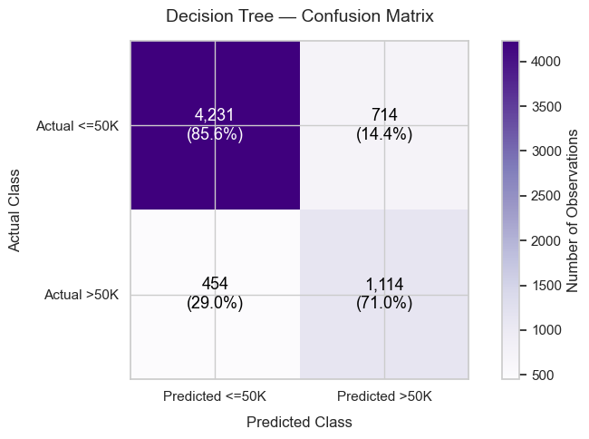
9
MODEL 2 — DECISION TREE
Holdout Results
Holdout Performance
Metric | Value
Accuracy | 82.07%
Precision | 60.94%
Recall | 71.05%
F1 | 65.61%
ROC-AUC | 86.72%
Recall (71.1%) exceeds Logistic Regression's (61.2%) — the tree catches more true >50K earners, at the cost of more false positives (lower precision: 60.9% vs. 72.5%).
For a business use case that prioritizes not missing high earners, this trade-off may be preferable to Logistic Regression's.
23

Slide 24
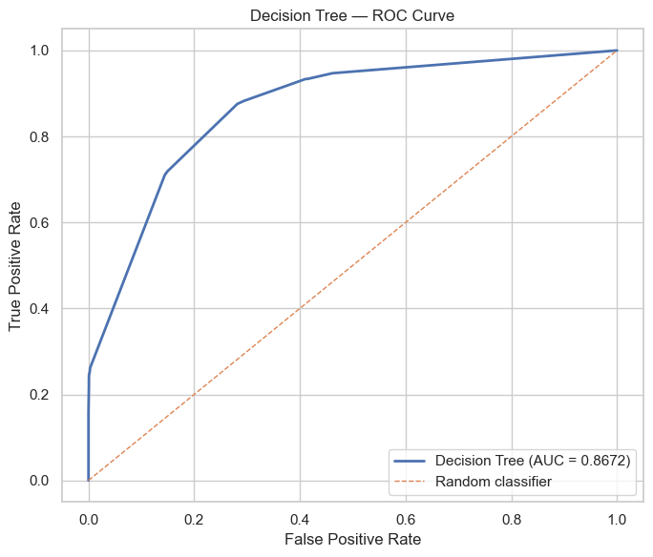
9
MODEL 2 — DECISION TREE
ROC Curve
Holdout ROC-AUC of 0.8672. This indicates a good separation between the ≤50K and >50K classes, though below Logistic Regression's 0.8994.
The curve's shape is notably more "stepped" than Logistic Regression's smooth curve. This is a natural consequence of a single tree with only 26 leaves producing a limited number of distinct predicted-probability values.
Logistic Regression offers slightly stronger overall ranking ability, while the Decision Tree offers higher recall at the specific default threshold. Choosing between the two models depends on how false negatives vs. false positives are weighted.
24

Slide 25
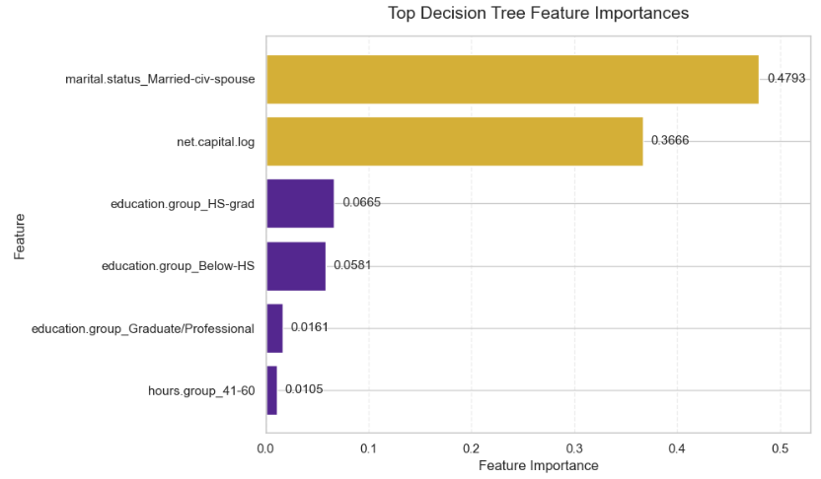
9
MODEL 2 — DECISION TREE
Feature Importance
Two features, marital status (47.9%) and net capital activity (36.7%), account for roughly 85% of total tree importance.
Education tiers (HS-grad, Below-HS, Graduate/Professional) contribute most of the remainder.
This concentration is a direct consequence of the tree's shallow max_depth = 5 constraint: with only 26 leaves, the tree relies on a small number of high-value splits rather than spreading importance across many features.
Consistent with the midpoint EDA, which flagged marital status and capital activity as strongly associated with income.
25

Slide 26
10
MODELS 3 & 4
Random Forest & Gradient Boosting
Model 3: Random Forest
Complete
Bagged ensemble of decision trees; will use the same 53-feature set, 5-fold StratifiedKFold, and holdout split established in the common evaluation framework.
Planned deliverables: hyperparameter tuning (e.g., n_estimators, max_depth, max_features), performance metrics, feature-importance visualization, and comparison against Logistic Regression and Decision Tree.
Model 4: Gradient Boosting
Complete
Sequentially boosted ensemble of shallow trees; will use the identical shared framework for a fair, apples-to-apples comparison.
Planned deliverables: hyperparameter tuning, performance metrics, feature-importance visualization, and integration into the team's final model comparison and deployment plan.
26

Slide 27
11
FINDINGS
Model Performance Comparison
Holdout test-set metrics for the two completed models. Random Forest and Gradient Boosting will be added once complete.
Model | Accuracy | Precision | Recall | F1 | ROC-AUC | Status
Logistic Regression (Final, 53 feat.) | 85.08% | 72.54% | 61.16% | 66.37% | 89.94% | Complete
Decision Tree (Tuned, depth 5) | 82.07% | 60.94% | 71.05% | 65.61% | 86.72% | Complete
Random Forest | 85.81% | 76.88% | 58.74% | 66.59% | 90.82% | Complete
Gradient Boosting | 87.01% | 78.65% | 63.20% | 70.08% | 92.24% | Complete
Gradient Boosting leads on ROC-AUC (92.24%) and precision — stronger separation of classes and fewer false alarms.
Decision Tree leads on recall (71.1%) — catches more true high earners, at the cost of more false positives.
27

Slide 28
11
FINDINGS
Consistent Predictive Drivers
Logistic Regression and Decision Tree — built independently with different mechanics — converge on the same leading signals:
Marital Status
Capital Activity
The single strongest signal in both models. Married (civilian spouse) individuals show markedly higher odds of earning >50K (LR odds ratio 2.90×) and drive 47.9% of the Decision Tree's total feature importance.
net.capital.log is influential in both models, especially the Decision Tree (36.7% of importance) — any reported capital gain or loss is strongly associated with higher income.
Education Attainment
Hours Worked & Age
Both models separate income tiers cleanly by education group, from Below-HS up to Graduate/Professional, matching the EDA's income-rate gradient (5.7% → 73.7%).
Working 41-60 hours/week and being in the 36-55 age range are both associated with meaningfully higher odds of earning >50K.
This convergence will be revisited once Random Forest and Gradient Boosting results are available.
28

Slide 29
11
FINDINGS
Business Impact, Practicality & Deployment
Business Impact & Practicality
Use case — income screening triage: for records with observable attributes but missing or unverified income (lending, benefit eligibility, prospect lists), the model imputes a likely >50K flag — used to target likely high earners and to route only flagged records to manual income verification.
Cuts manual screening ~81%: on the 6,513-record holdout it surfaces 1,260 flags (78.7% correct) instead of reviewing all 6,513 — analyst effort lands on the right records.
Illustrative savings: at ~10 minutes per manual income check, screening 1,260 flags rather than 6,513 saves ~875 analyst-hours per batch (assumption-based; scales with verification cost).
Interpretable & extensible: drivers (marital status, capital activity, education, hours) let stakeholders sanity-check outputs; the same pipeline transfers to market segmentation and affordability pre-screening, with a fairness review before individual-level decisions.
Model Deployment Strategy
Batch scoring, not real-time: income prediction is not latency-sensitive, so the tuned Gradient Boosting pipeline is serialized with joblib and scored on a nightly/weekly schedule; a lightweight Flask/FastAPI service is the fallback for on-demand use.
Annual retraining aligned with new Census/ACS releases (data is slow-moving), triggered early if monitoring detects performance drops from economic shifts (recessions, wage-policy changes).
Monitoring tracks prediction drift (share predicted >50K) and feature drift (net.capital.log, marital status, education/occupation), re-scoring a labeled sample with the same Phase-1 metrics (F1, ROC-AUC).
Tooling: scheduled scoring/monitoring pipeline, a versioned model registry for rollback, and a logging/alerting layer to fire the retraining trigger.
Framing follows CRISP-DM's Evaluation/Deployment phases and TDSP's Deployment stage (see References).
29

Slide 30
12
LESSONS LEARNED & RECOMMENDATIONS
A Modeling-Phase Lesson
Check for redundancy when a feature is engineered — not just before modeling
The midpoint feature-engineering stage created derived variables (net.capital, age.group, hours.group) but retained their original raw source columns (age, hours.per.week, capital.gain, capital.loss) alongside them.
This redundancy surfaced during Logistic Regression's Variance Inflation Factor (VIF) diagnostics, producing 6 infinite VIF values and requiring a dedicated feature-reduction step before the model could be used.
In the future, we should build a multicollinearity check (ex. a quick VIF pass) into the Data Preparation phase itself, after engineered features are created, not only right before modeling, so redundant raw/derived pairs are resolved for downstream models.
Lessons Learned & Recommendations
All four models agreed on the top drivers (marital status, capital activity) — the signal is algorithm-robust, so cross-model convergence is a validity check worth keeping.
Precision outran recall in every model at the 0.5 cutoff (Gradient Boosting 78.7% vs. 63.2%) — the decision threshold, not just the algorithm, should be tuned to the business goal.
A shared Phase-1 evaluation framework (one train/test split, CV strategy, and metric set) made all four models directly comparable and kept Gradient Boosting's win (F1 0.70, ROC-AUC 0.92) credible.
30

Slide 31
12
LESSONS LEARNED & RECOMMENDATIONS
Next Steps & Additional Data
Additional Methods & Models
Third-Party Datasets to Add Value
To be completed — candidates to evaluate against the current 4-model comparison:
To be completed — external data sources that could enrich this analysis:
XGBoost / LightGBM — optimized boosting that often beats standard Gradient Boosting with faster training, making a wider hyperparameter search feasible.
Threshold tuning & broader search — lower the 0.5 cutoff via a precision-recall curve to recover recall, and run RandomizedSearch/Bayesian optimization over wider grids.
Model stacking / ensembling — blend the four models' predicted probabilities, or add a neural-network (MLP) baseline, to test whether combining diverse learners beats Gradient Boosting alone.
BLS wage & cost-of-living data — regional wage and price indices to adjust the fixed $50K threshold for local purchasing power.
Full Census ACS / IPUMS microdata — richer, current socioeconomic fields (industry, housing, benefits) and larger samples than the 1994 extract.
Labor & credit indicators — BLS occupation and employment trends, or credit-bureau affordability data, to add economic context beyond demographics.
31

Slide 32
13
REFERENCES
Sources & Documentation
Dataset
Kaggle. "Adult Census Income."
kaggle.com/datasets/uciml/adult-census-income
Methodology
Data Science PM. "What is CRISP-DM?"
datascience-pm.com/crisp-dm-2
Methodology
IBM Documentation. "Introduction to CRISP-DM," IBM SPSS Modeler.
ibm.com/docs/en/spss-modeler/18.6.0?topic=overview-crisp-dm-in-spss-modeler
Methodology
Microsoft Learn. "What is the Team Data Science Process?"
learn.microsoft.com/en-us/azure/architecture/data-science-process/overview
Tooling
scikit-learn documentation — LogisticRegression, DecisionTreeClassifier, StratifiedKFold, GridSearchCV, model evaluation metrics.
scikit-learn.org/stable/
Tooling
statsmodels documentation — variance_inflation_factor.
statsmodels.org/stable/generated/statsmodels.stats.outliers_influence.variance_inflation_factor.html
32

Slide 33
Questions & Discussion
Thank you for reviewing our Adult Census Income analysis.
Access GitHub Repository: @jmai3124: adult-census-income-project
https://github.com/jmai3124/adult-census-income-project

