Slide 1
How to train Tensorflow models and apply them to Android Apps
Jason Mai
Jason.mai2010@gmail.com
https://github.com/jmai6/windsor_dev_fest_2019

Slide 2





Slide 3
Agenda
What is Machine Learning?
What is Tensorflow?
How machine learning works? (demo)
How to build Tensorflow/TensorflowLite models? (demo)
How to build Android apps with models? (demo)
Q & A

Slide 4
What is Machine Learning?
A system can recognize pattern.
A system learns from data to produce reliable, repeatable decisions and results.
A system automatically learns and progresses from experience without being explicitly programmed.
Supervised learning and unsupervised learning.
Basic algorithms: linear regression (to evaluate continuous values) and logistic regression (to evaluate discrete values).

Slide 5
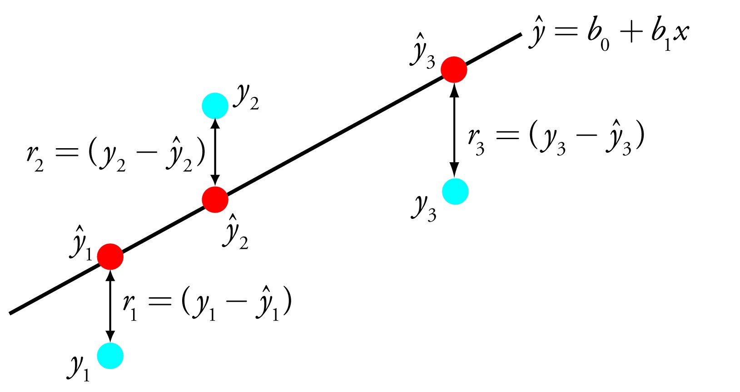
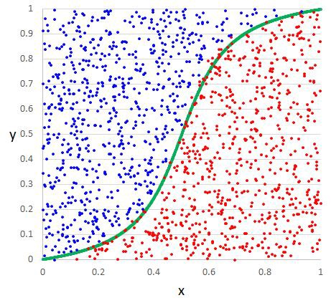
linear regression example
logistic regression example
From https://towardsdatascience.com/a-tour-of-the-top-10-algorithms-for-machine-learning-newbies-dde4edffae11

Slide 6
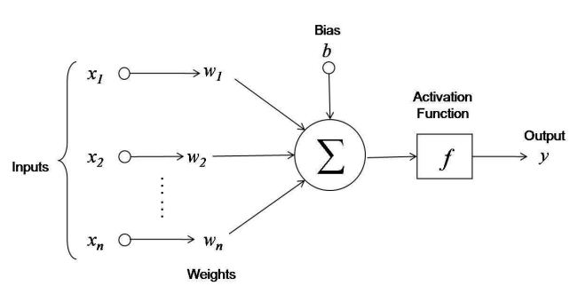
linear function, logistic function or other functions (Tanh, ReLU, etc)
w₁x₁ + w₂x₂ + … + w_{n}x_{n} + b

Slide 7
y = ActivationFuntion(w₁x₁ + w₂x₂ + … + w_{n}x_{n} + b)
input data
expected results
weights, bias
(x₁)⁰, (x₂)⁰, … (x_{n})⁰ y⁰
w₁
w₂
(x₁)¹, (x₂)¹, … (x_{n})¹ y¹
w₃
(x₁)², (x₂)², … (x_{n})² y²
.
.
…
.
…
w_{n}
(x₁)^{m}, (x₂)^{m}, … (x_{n})^{m} y^{m}
b

Slide 8
y = ActivationFuntion(w₁x₁ + w₂x₂ + … + w_{n}x_{n} + b)
weights, bias
input data
learned results
expected results
w₁
(x₁)⁰, (x₂)⁰, … (x_{n})⁰
w₂
(x₁)¹, (x₂)¹, … (x_{n})¹
y⁰_{r}
y⁰
w₃
y¹_{r}
y¹
.
(x₁)², (x₂)², … (x_{n})²
y²_{r}
y²
.
…
.
…
w_{n}
b
(x₁)^{m}, (x₂)^{m}, … (x_{n})^{m}
y^{m}_{r}
y^{m}
optimization
cost
Gradient Decent
Back Propagation

Slide 9
Artificial Neuron
linear function, logistic function or other functions (Tanh, ReLU, etc)
w₁x₁ + w₂x₂ + … + w_{n}x_{n} + b

Slide 10
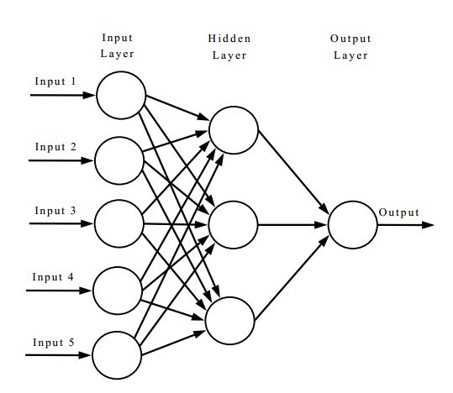
Artificial Neural Network

Slide 11
Training Data
Situation Data
Hypothesis
Model
Trained
Model
Intelligent Result

Slide 12
What is Tensorflow?
A Python front-end framework/library (for setting up learning task)
A high-performance C++ back-end (for executing learning process)
Contains many well-known machine learning models and algorithms
Created by the Google Brain Team

Slide 13
tf.keras API
tflearn API
tensorflow API
C++
http://tflearn.org/
https://www.tensorflow.org/guide/keras

Slide 14
How machine learning works? (demo)
learning

Slide 15
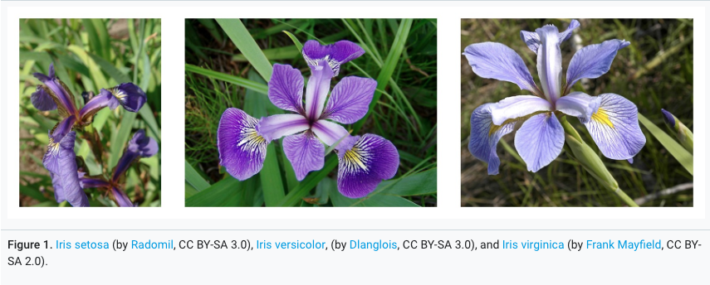
Iris Species Classification Models
Features
sepal_length
sepal_width
petal_length
petal_width
Species
Iris setosa
Iris versicolor
Iris virginica
https://archive.ics.uci.edu/ml/datasets/iris

Slide 16
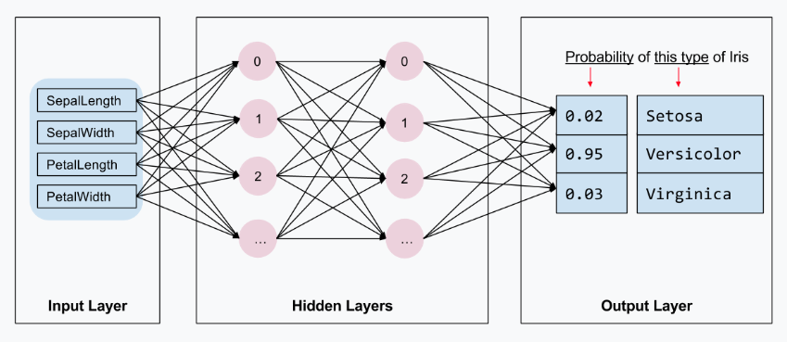
https://www.tensorflow.org/tutorials/eager/custom_training_walkthrough

Slide 17
How to build tensorflow mobile model/tensorflowlite model? (demo)

Slide 18

Tensorflow Graph
freeze
Tensorflow Model
convert
TensorflowLite Model

Slide 19
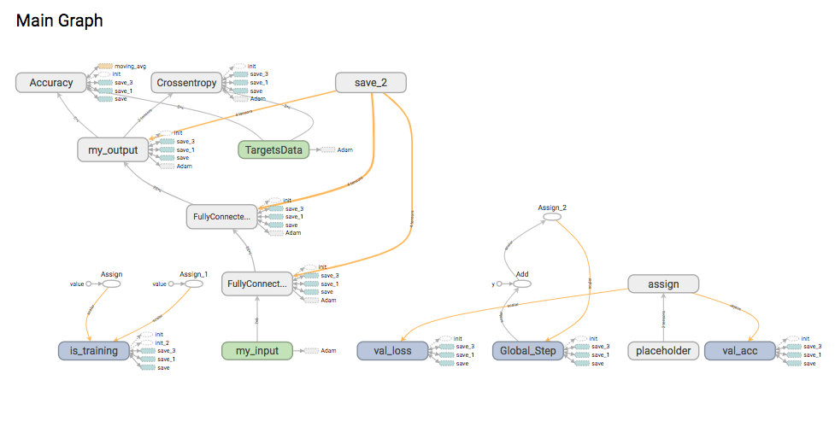

Slide 20
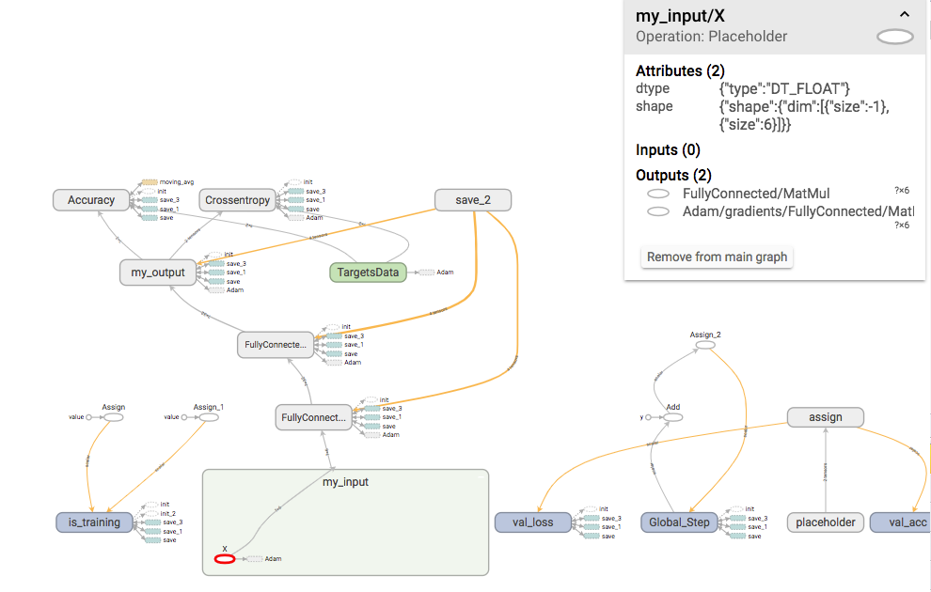

Slide 21
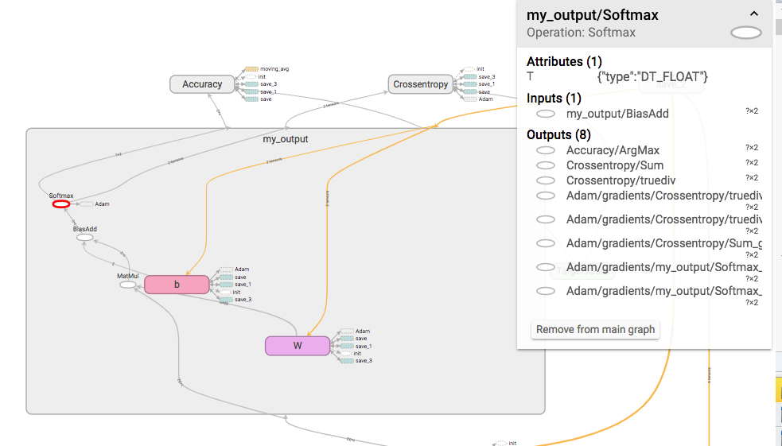

Slide 22
How to build Android apps with models? (demo)

Slide 23
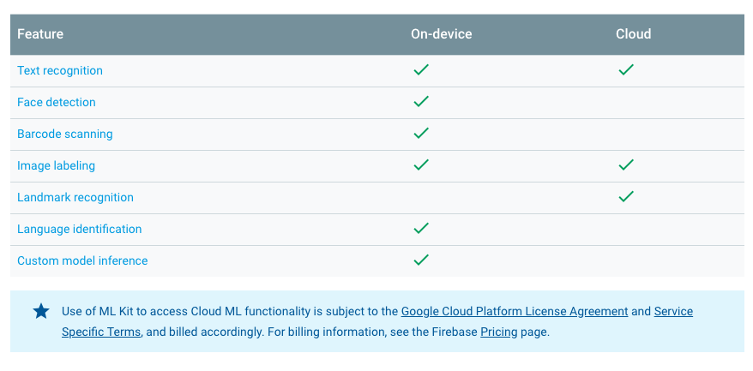
ML Kit for Firebase
https://firebase.google.com/docs/ml-kit/

Slide 24
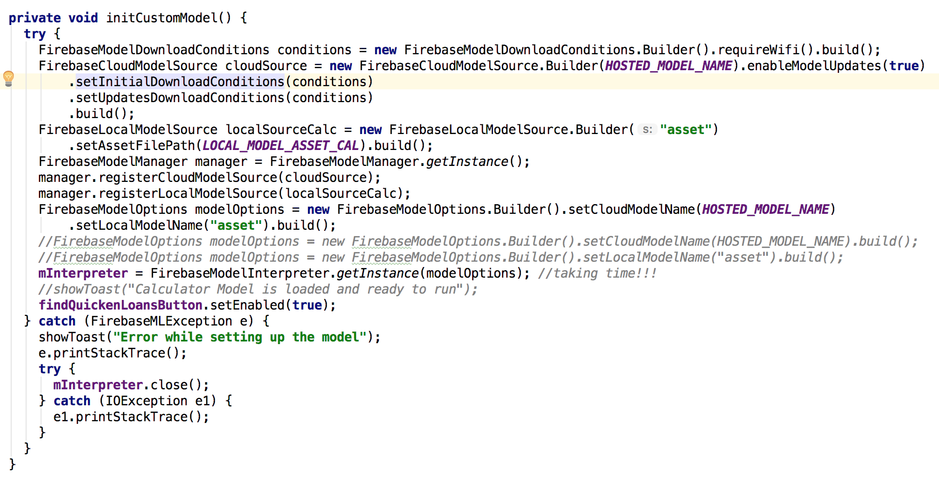

Slide 25
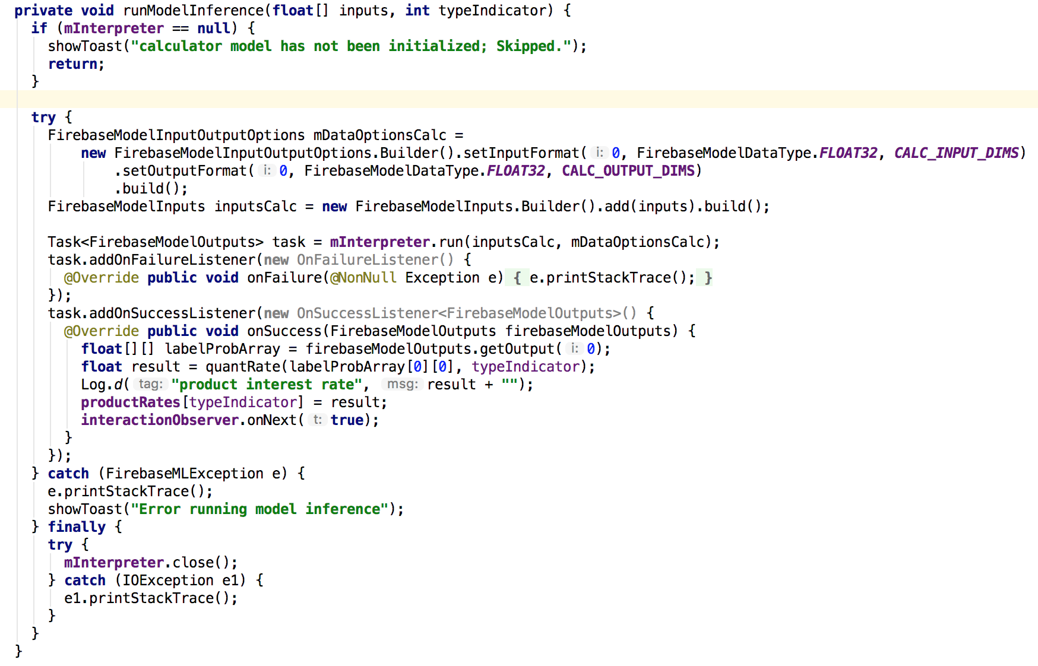

Slide 26
Thank You
Happy Learning
Special Thanks to Don Ward
https://github.com/jmai6/windsor_dev_fest_2019

