Slide 1
How to Train TensorFlow Models and Apply them to Android Apps
By: Jason Mai
jason.mai2010@gmail.com
https://github.com/jmai6/windsor_devfest_2019

Slide 2





Slide 3
Agenda
What is Machine Learning?
What is TensorFlow?
How does Machine Learning work? (demo)
How to build a TensorFlow/TensorFlowLite model for mobile. (demo)
How to build Android apps with models. (demo)
Q & A

Slide 4
What is Machine Learning?
A system that can learn to recognize patterns.
A system that learns from data to produce reliable, repeatable decisions and results.
A system that automatically learns and progresses from experiences without being explicitly programmed.
Supervised and unsupervised learning.
Basic algorithms: linear regression (to evaluate continuous values) and logistic regression (to evaluate discrete values).

Slide 5
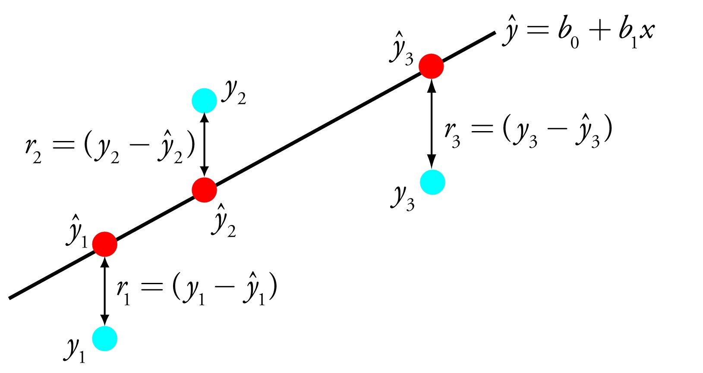
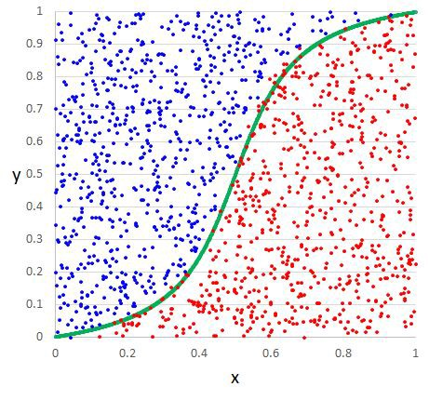
linear regression example
logistic regression example
From https://towardsdatascience.com/a-tour-of-the-top-10-algorithms-for-machine-learning-newbies-dde4edffae11

Slide 6
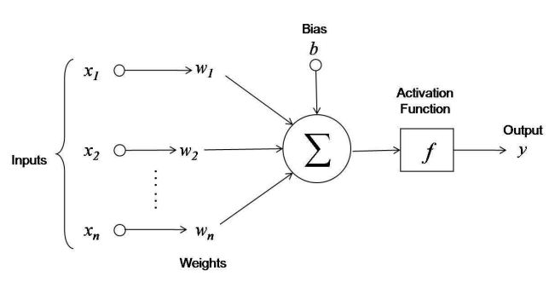
linear function, logistic function or other functions (Tanh, ReLU, etc)
w₁x₁ + w₂x₂ + … + w_{n}x_{n} + b

Slide 7
y = ActivationFuntion(w₁x₁ + w₂x₂ + … + w_{n}x_{n} + b)
input data
expected results
weights, bias
(x₁)⁰, (x₂)⁰, … (x_{n})⁰ y⁰
w₁
w₂
(x₁)¹, (x₂)¹, … (x_{n})¹ y¹
w₃
(x₁)², (x₂)², … (x_{n})² y²
.
.
…
.
…
w_{n}
(x₁)^{m}, (x₂)^{m}, … (x_{n})^{m} y^{m}
b

Slide 8
y = ActivationFuntion(w₁x₁ + w₂x₂ + … + w_{n}x_{n} + b)
weights, bias
input data
learned results
expected results
w₁
(x₁)⁰, (x₂)⁰, … (x_{n})⁰
w₂
(x₁)¹, (x₂)¹, … (x_{n})¹
y⁰_{r}
y⁰
w₃
y¹_{r}
y¹
.
(x₁)², (x₂)², … (x_{n})²
y²_{r}
y²
.
…
.
…
w_{n}
b
(x₁)^{m}, (x₂)^{m}, … (x_{n})^{m}
y^{m}_{r}
y^{m}
optimization
cost
Gradient Decent
Back Propagation

Slide 9
Artificial Neuron
linear function, logistic function or other functions (Tanh, ReLU, etc)
w₁x₁ + w₂x₂ + … + w_{n}x_{n} + b

Slide 10
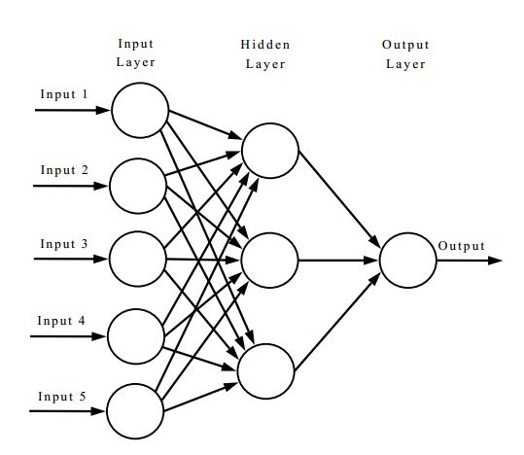
Artificial Neural Network

Slide 11
Training Data
Situation Data
Hypothesis
Model
Trained
Model
Intelligent Result

Slide 12
What is TensorFlow?
A Python front-end library for setting up learning tasks
A high-performance C++ backend for executing learning processes
A framework that contains many well-known machine learning models and algorithms
A framework created by the Google Brain Team

Slide 13
tf.keras API
tflearn API
tensorflow API
C++
http://tflearn.org/
https://www.tensorflow.org/guide/keras

Slide 14
y = 2x₁ + 3x₂ + 7x₃ + 4
randomly generate
2000 sets of {x1, x2, x3, y}
feed data
Artificial Neuron
examine its learning result
y = w₁x₁ + w₂x₂ + w₃x₃ + b

Slide 15
How does Machine Learning work?
(demo)

Slide 16
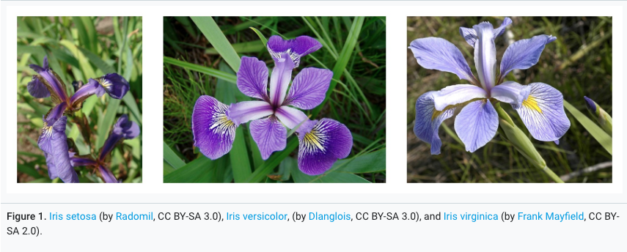
Iris Species Classification
Features
sepal_length
sepal_width
petal_length
petal_width
Species
Iris setosa
Iris versicolor
Iris virginica
https://archive.ics.uci.edu/ml/datasets/iris

Slide 17
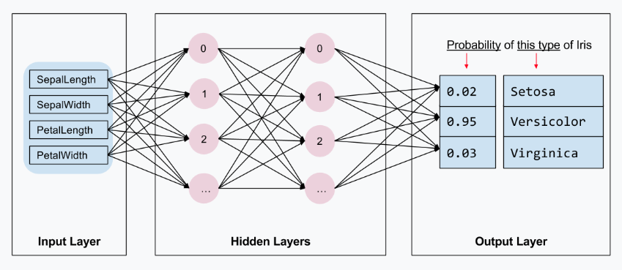
https://www.tensorflow.org/tutorials/eager/custom_training_walkthrough

Slide 18
How to build a TensorFlow model/TensorFlowLite model for mobile.
(demo)

Slide 19

Tensorflow Graph
freeze
Tensorflow Model
convert
TensorflowLite Model

Slide 20
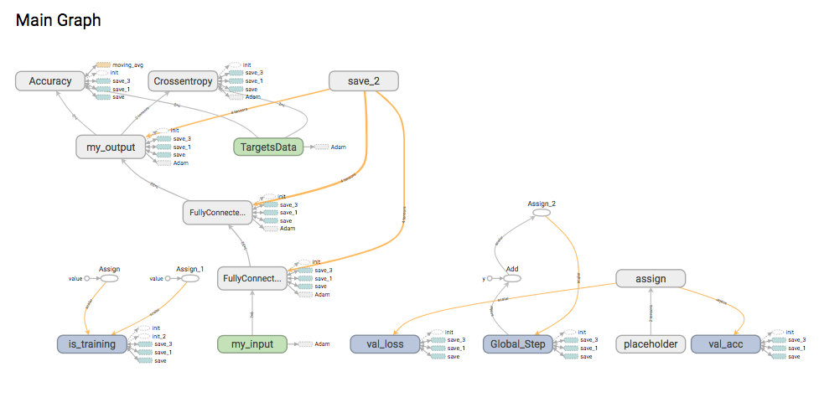

Slide 21
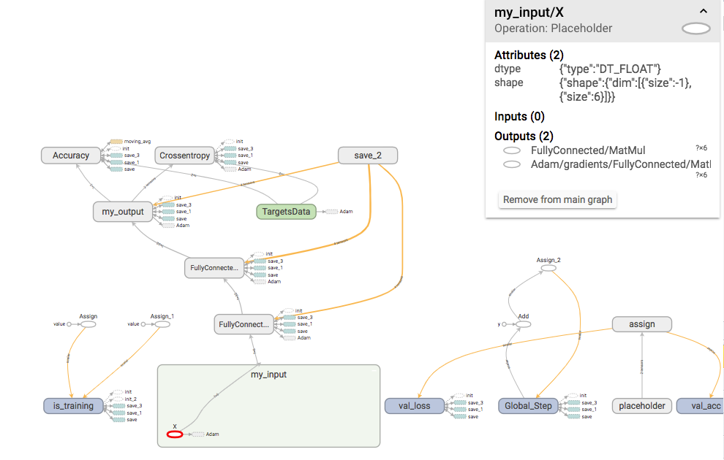

Slide 22
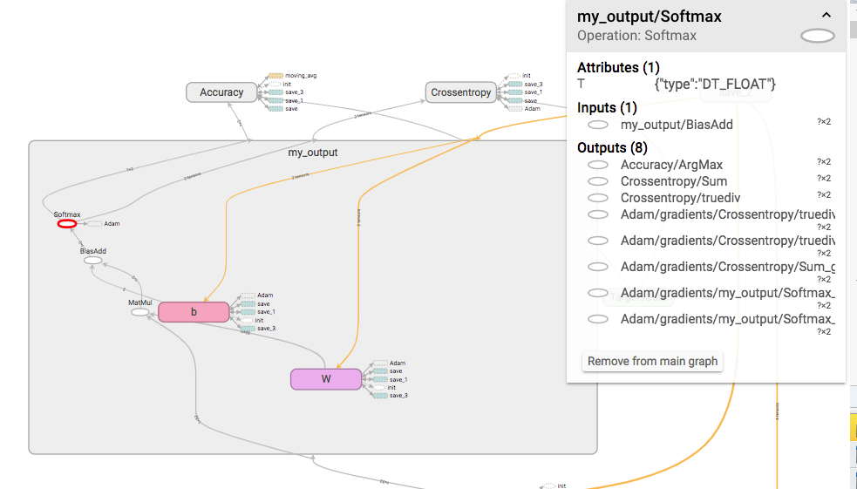

Slide 23
How to build Android apps with models. (demo)

Slide 24
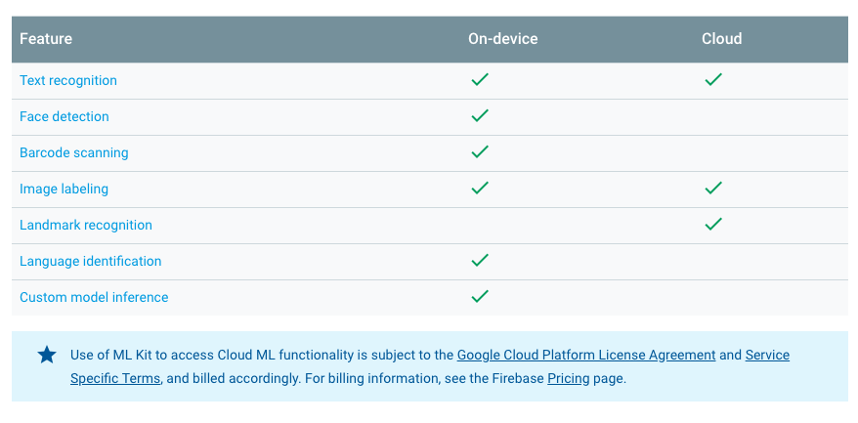
ML Kit for Firebase
https://firebase.google.com/docs/ml-kit/

Slide 25
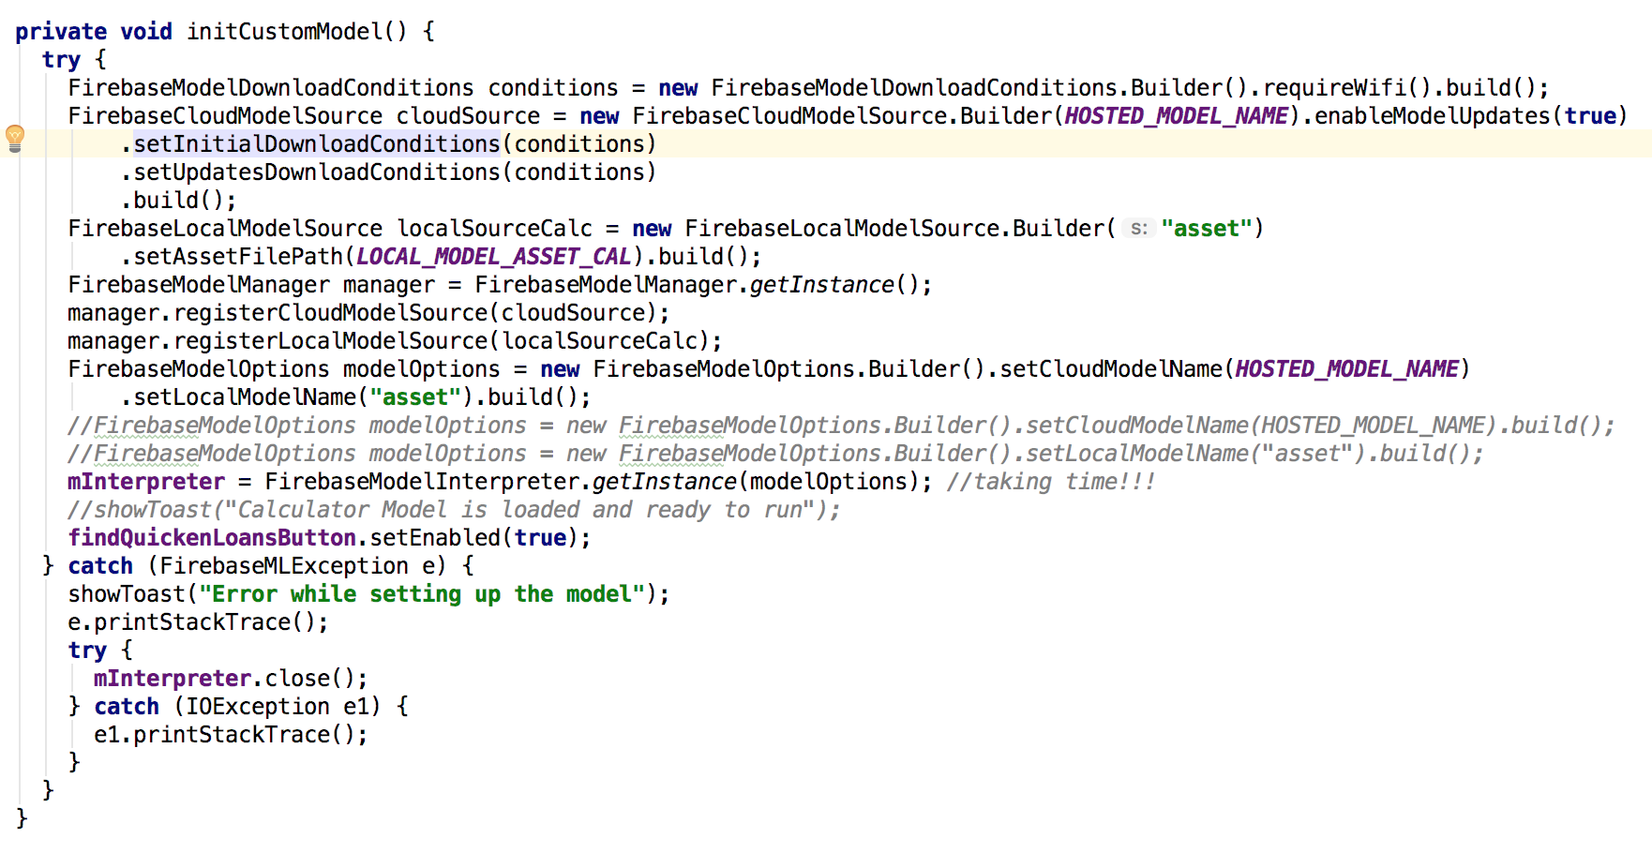

Slide 26
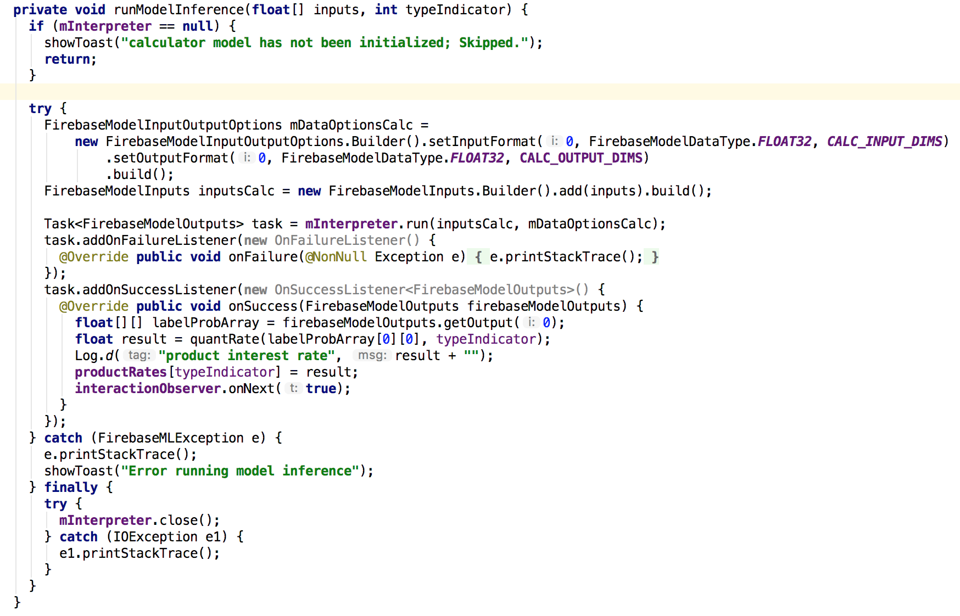

Slide 27
Thank You.
Happy Learning!
Special Thanks to Don Ward
jason.mai2010@gmail.com
https://github.com/jmai6/windsor_devfest_2019

