Slide 1
HELP NGO Cluster Analysis to provide insight on backward countries need Aids
The data set being analyzed following two different methodologies
K-Means Clustering
This methodology to perform optimal grouping based is based on to find minimum distance between the center aka centroids of a given cluster
Here, we need to decide what is our optimal K (no of cluster) to start with the algorithm
First the cluster centers are pre-decided. Then all the points are assigned to their nearest cluster center and then the center is recalculated as the mean of all the points which fall in that cluster. Then the clustering is repeated with the new centers and the centers are updated according to the new cluster points.
Hierarchical Clustering
This methodology calculates the NxN distance (similarity) matrix, which calculates the distance of each data point from the other
Each item is first assigned to its own cluster, i.e. N clusters are formed
The clusters which are closest to each other are merged to form a single cluster

Slide 2
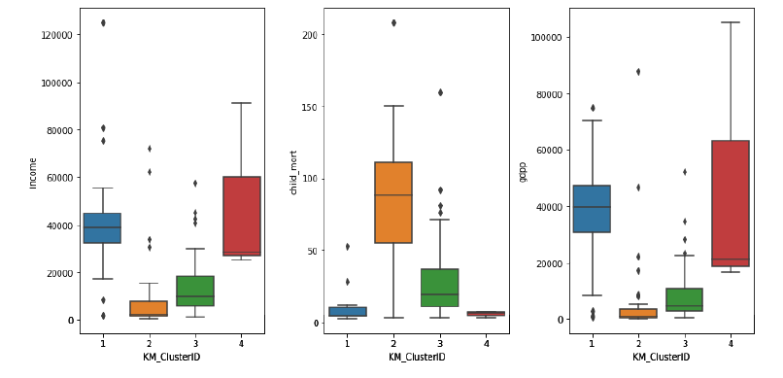
HELP NGO Cluster Analysis to provide insight on backward countries need Aids
﻿ Countries participated in Cluster-1 has very balanced income and gdpp mean nearly 40K with very very low child mortality rate
Countries participated in Cluster-2 has very high child mortality rate with low income ranges below 20K and low gdpp even less than 5K mean
Countries participated in Cluster-3 has decent income but compared to income the per capita gdp is low. Where as chil-mortality is high
Countries participated in Cluster-4 has very good income and gdpp mean arond roughly 30K with very very low kind of negligible child mortality rate. These country certainly not required any sort of aid or financial support

