Slide 1
Predicting Heart Disease with Personal Health Indicators
By: James Makanas

Slide 2
Background Information
2020 CDC Health Status Survey of 401,958 adults for the Behavioral Risk Factor Surveillance System (BRFSS)
Originally had 279 columns
Dataset trimmed to 391,795 rows with 18 columns potentially related to heart disease

Slide 3
Data Description
Dependent variable: Reported having coronary heart disease or myocardial infarction
Binary
Categorical
Independent variables
BMI (continuous)
Smoking (categorical)
Alcohol Drinking (categorical)
Stroke (categorical)
Physical Health (continuous)
Mental Health (continuous)
Difficulty Walking (categorical)
Sex (categorical)
Age Category (categorical)
Diabetic (categorical)
Physical Activity (categorical)
General Health (categorical)
Sleep Time (continuous)
Asthma (categorical)
Kidney Disease (categorical)
Skin Cancer (categorical)

Slide 4
Primary Objectives
Utilize the relevant health status indicators to create a binary classification model that predicts heart disease
Go through the necessary preprocessing steps to prepare the data and then the model selection, tuning, and validation process

Slide 5
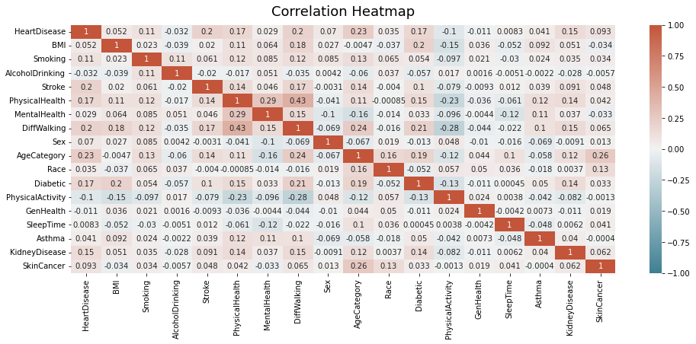
Methodology: Data Preprocessing
No missing values
No near-zero variance predictors out of numerical variables
No collinearity
Highest correlation coefficient: .43

Slide 6
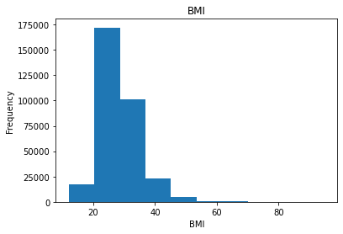
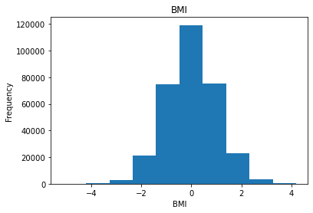
Methodology: Transforming Skewed Numerical Variables
BMI 1.332431 PhysicalHealth 2.603973 MentalHealth 2.331112 SleepTime 0.679035
Before Yeo-Johnson
Variable Skewness Coefficient
BMI: 1.33
PhysicalHealth: 2.60
MentalHealth: 2.33
SleepTime: 0.68
After Yeo-Johnson
Variable Skewness Coefficient
BMI: -0.01
PhysicalHealth: 1.00
MentalHealth: 0.72
SleepTime: 0.68
Skewed right

Slide 7
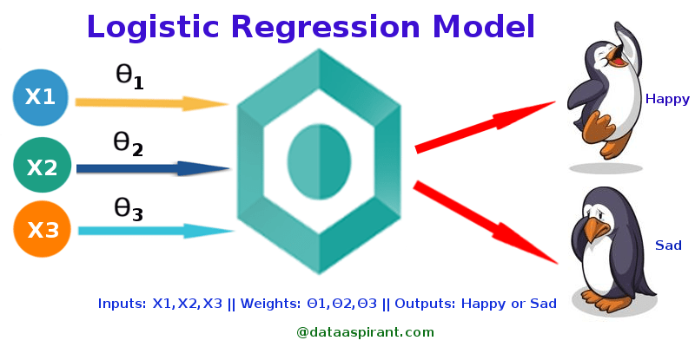
Methodology: Model Selection
Model Type Selected: Logistic Regression
Good for binary classification
1: Heart disease present
0: No heart disease present
Estimates the relationship between the binary dependent variable and the independent features selected
(Source: http://dataaspirant.com/2017/03/02/how-logistic-regression-model-works/)

Slide 8
Methodology: Model Training and Validation
Total Data: 319,795
Data Split
70% of the data will be used within model development.
30% of the data will be used to measure model performance after the model was developed.
Data split allows for a large sample for both training and testing. This also allows for additional model validation prior to evaluating model performance on test data.
Training Split:
223,856
Test Split:
95,939
Used to develop the model
Used to measure model performance

Slide 9
Methodology: Model Training and Validation
Total Data: 319,795
Model Validation
Prior to testing, the model was validated with 10-fold cross validation on a portion of the training split not used to develop the model.
Accuracy: 91.58%
Training Split:
223,856
Test Split:
95,939
10-Fold Cross Validation

Slide 10
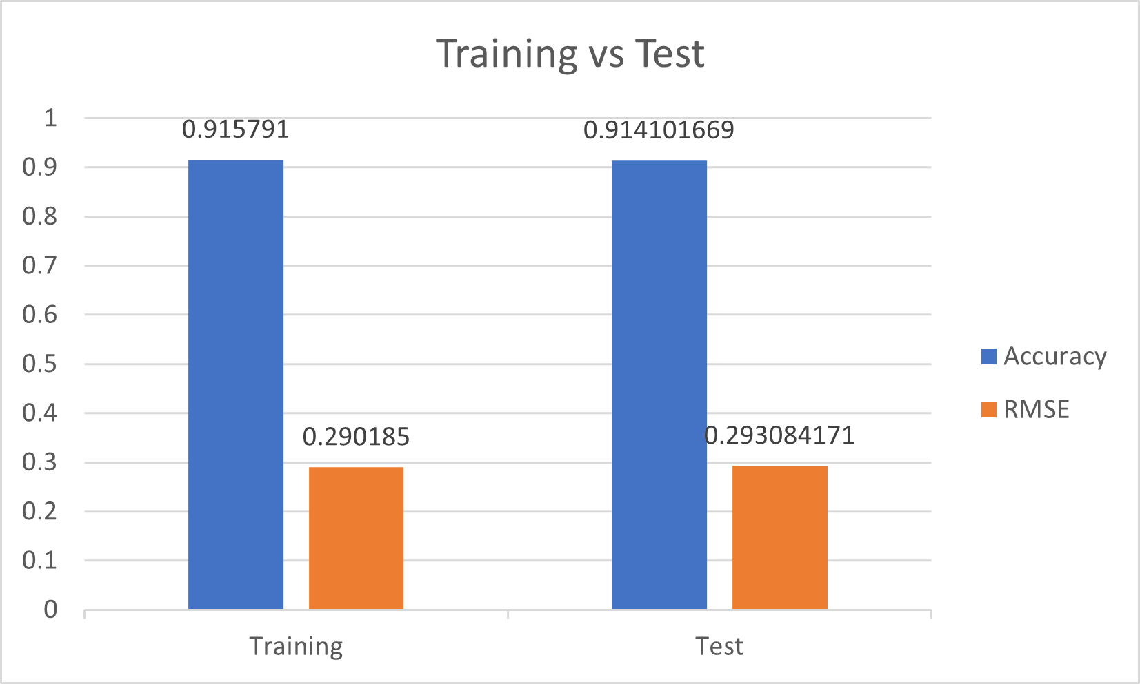
Results: Model Performance
Model Validation
After validating the model with a portion of the training data not used in developing the model, the model was then evaluated on the test split data.
Training Model Validation
Accuracy: 91.58%
Root Mean Squared Error: .2901
Test Model Performance
Accuracy: 91.41%
RMSE: .2931
Strong performance in predicting different samples of the data shows that the model will perform well on brand new data

Slide 11
Potential Uses
With this logistic regression model, we can potentially predict the presence of coronary heart disease or myocardial infarction at a large scale given that the people provide their health status indicators related to heart disease
Health organizations
At home use

Slide 12
References
https://www.kaggle.com/datasets/kamilpytlak/personal-key-indicators-of-heart-disease
https://dataaspirant.com/how-logistic-regression-model-works/

