Slide 1
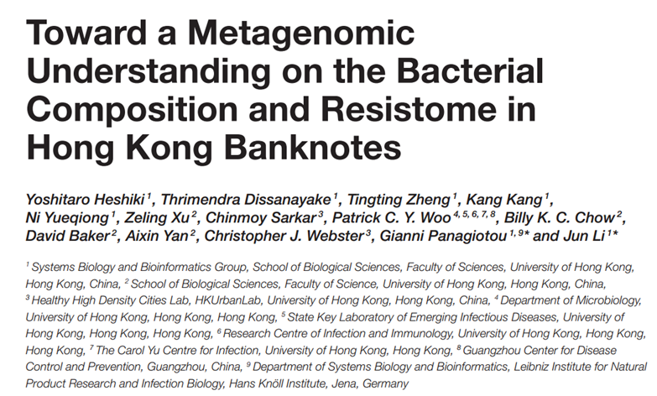

Team E. cooli’s Analysis of
Andrew Weise
Conard Lee
Joel Maki
Justin Anast

Slide 2
Background of Biological Question
Bacteria are becoming increasingly resistant to commonly prescribed antibiotics at an alarming rate.
Can be due to overuse of antibiotics on food production animals, unnecessary prescription of antibiotics by doctors, etc.
However, the rate of antibiotic discovery has also slowed down drastically.
Search for new antibiotics is not profitable, so the research has fallen out of favor with large pharmaceutical companies.
Antibiotic resistant strains can cause ghastly illnesses, which can be difficult or impossible to treat (MRSA, etc.) with standard antibiotics.
Antibiotic cocktails or toxic alternatives may be used for treatments.
As such, understanding how antibiotic-resistant strains travel through a population is of paramount importance.

Slide 3
Background cont.
Cities, as high population density areas, are at high risk for disease outbreaks.
Because the city of Hong Kong has a hot-humid climate and a high mobility of people, it particularly bears a high risk of the spread of infectious disease.
Due to the frequent circulation and casual handling of physical currency, it is a likely source of many kinds of bacteria, both pathogenic and commensal.
Thus, the authors decided to perform microbial community analyses on Hong Kong banknotes, with a focus on banknotes recovered from hospitals and metro stations.

Slide 4

Obtain sequence files (fastq)
Quality Trimming
d
Taxonomy profiling
Distill relative abundance
Mapping reads to nr database
SRA Toolkit
Not explained
DIAMOND
MEGAN5
“In-house script”
Calculate Shannon diversity, generation of heatmaps and rarefaction curve
Split files into F and R sequences
Inspect quality and trim
Assembly of genomes, assignment of taxonomy, output of relative abundance, generation of heatmaps.
SRA toolkit
FastQC and BBMerge
VEGAN R Package
MetaPhlAn
Note: Because the original dataset was made up of 15 sequencing files that sum to a total of approximately 96 GB of files, we decided to run a partial analysis as a proof of concept, rather than try to recreate the analysis exactly, due to storage constraints.

Slide 5
MetaPhlAn
Do we still want to do this part?

Slide 6
99 Problems and a Script Ain’t One (It was all of them)
DIAMOND: We were originally going to use DIAMOND to map our shotgun sequenced reads, but decided not to for two reasons:
1- DIAMOND’s github page said it was used to align protein and translated DNA, but we have DNA sequences.
2- It required us to download the NCBI nt database, which would have been extremely time consuming with our limited internet speeds and computing power.
MetaPhlAn: MetaPhlAn needed an older version of Python, so we tried to learn virtual environments, but we gave up and simply uninstalled Python3 in favor of 2.7…
Dendrogram on heatmap figure was “backwards”
VEGAN: Documentation was difficult to navigate.
Difficult to find out that we needed to change NA values to 0 in order to have our abundance table recognized.

Slide 7
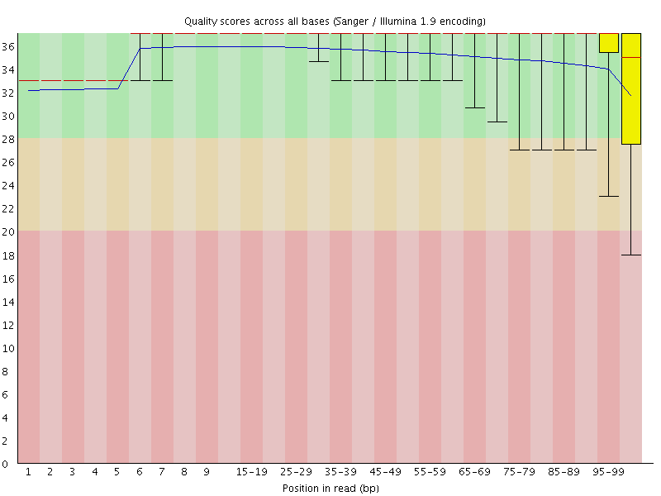
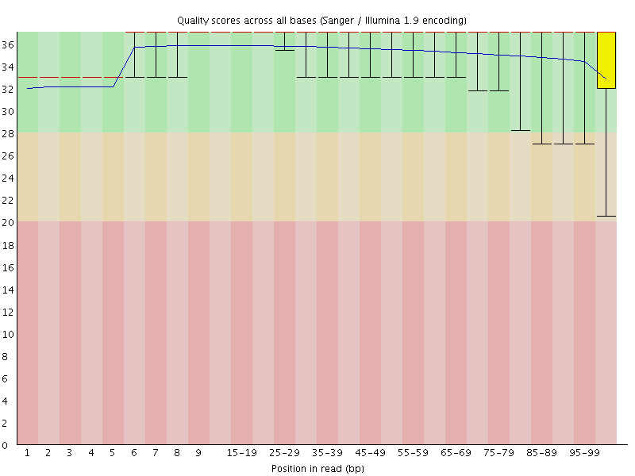
Pre-trimmed Post-trimmed

Slide 9
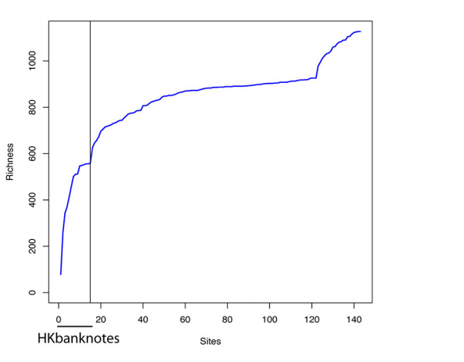
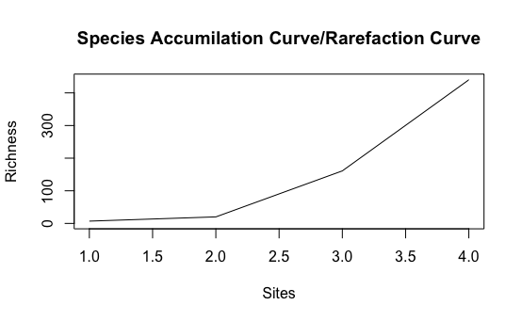
Hospital 11 (Banknote)
Hospital 6 (Banknote)
Metro Station 1
Environmental Samples (Metro air)

Slide 10
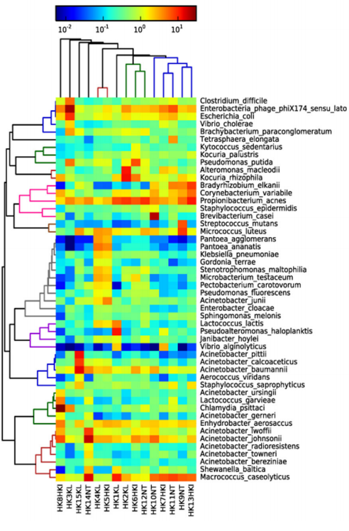
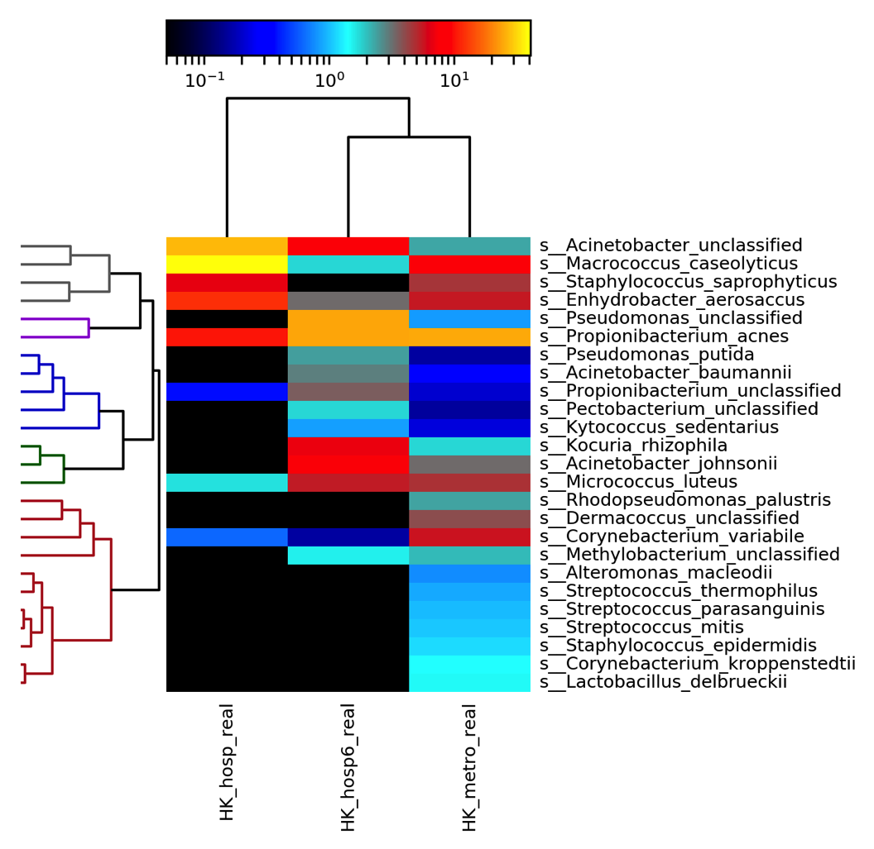

Slide 11
Thank you,
Questions?

