Slide 1
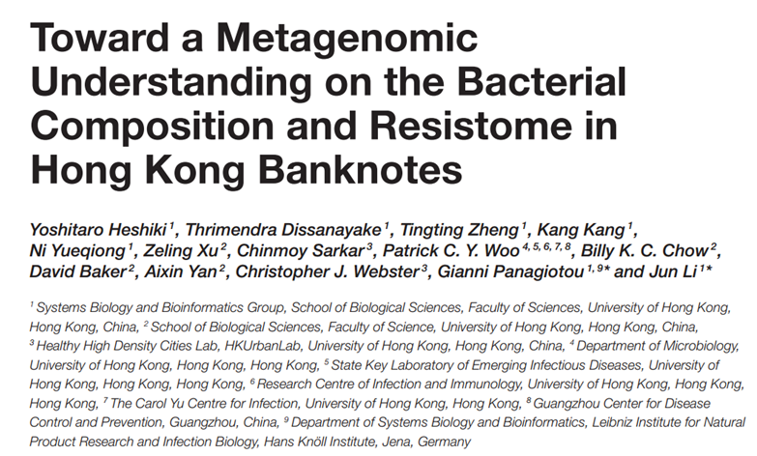

Team E. cooli’s Analysis of
Andrew Weise
Conard Lee
Joel Maki
Justin Anast

Slide 2
Background of Biological Question
Many pathogenic bacteria are becoming resistant to clinical antibiotics, while the rate of antibiotic discovery has slowed down drastically.
As such, understanding how antibiotic-resistant strains travel through a population is of paramount importance.
Due to the frequent circulation and casual handling of physical currency, it is a likely source of many kinds of bacteria, both pathogenic and commensal.
Because the city of Hong Kong is at high-risk for the spread of infectious disease, this paper investigates the microbial community of banknotes in Hong Kong hospitals and metro stations.

Slide 3

Obtain sequence files (fastq)
Quality Trimming
d
Taxonomy profiling
Distill relative abundance
Mapping reads to nr database
SRA Toolkit
Not explained
DIAMOND
MEGAN5
“In-house script”
Calculate Shannon diversity, generation of heatmaps and rarefaction curve
Split files into F and R sequences
Inspect quality and trim
Assembly of genomes, assignment of taxonomy, output of relative abundance, generation of heatmaps.
SRA toolkit
FastQC and BBMerge
VEGAN R Package
MetaPhlAn
Note: Because the original dataset was made up of 15 sequencing files that sum to a total of approximately 96 GB of files, we decided to run a partial analysis as a proof of concept, rather than try to recreate the analysis exactly, due to storage constraints.

Slide 4
99 Problems and a Script Ain’t One (It was all of them)
DIAMOND: We were originally going to use DIAMOND to map our shotgun sequenced reads, but decided not to for two reasons:
1- DIAMOND’s github page said it was used to align protein and translated DNA, but we have DNA sequences.
2- It required us to download the NCBI nt database, which would have been extremely time consuming with our limited internet speeds and computing power.
MetaPhlAn: MetaPhlAn needed an older version of Python, so we tried to learn virtual environments, but we gave up and simply uninstalled Python3 in favor of 2.7…
VEGAN: Documentation was difficult to navigate.
Difficult to find out that we needed to change NA values to 0 in order to have our abundance table recognized.

Slide 5
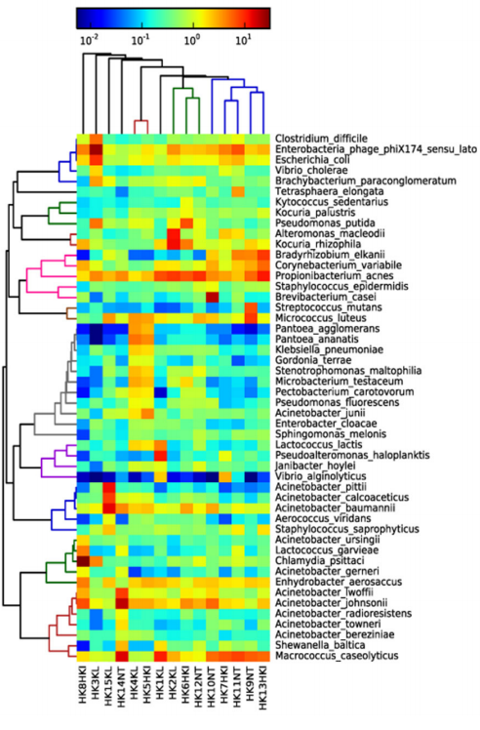
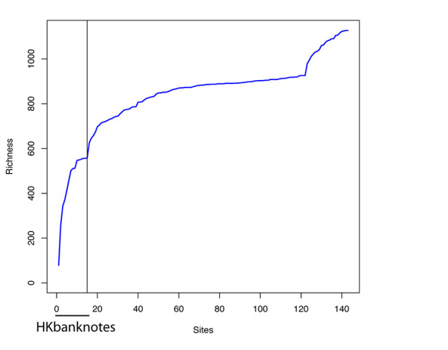

Slide 6
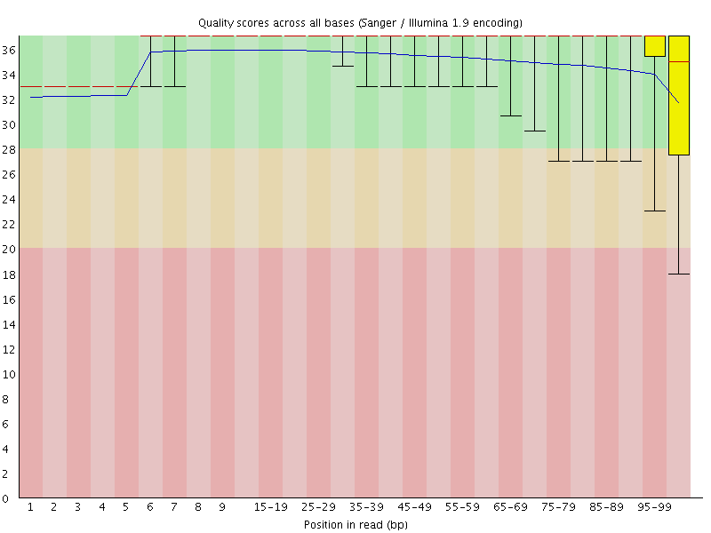
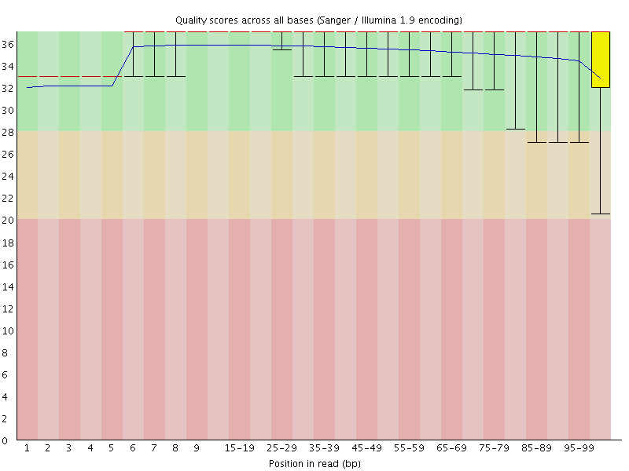
Pre-trimmed Post-trimmed

Slide 7
Thank you,
Questions?

