Slide 1
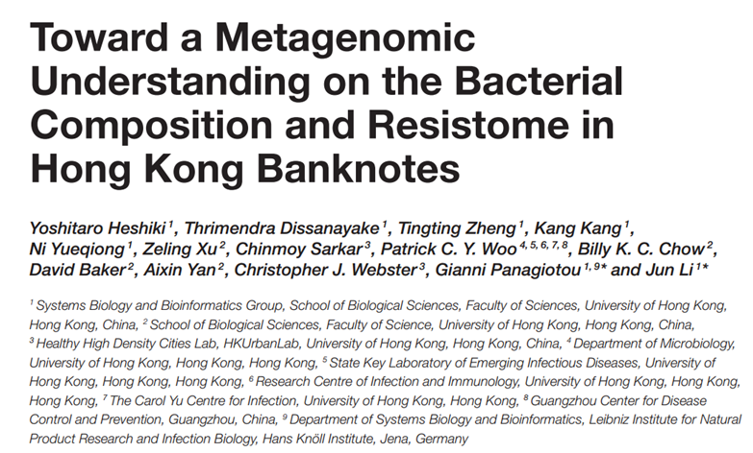

Team E. cooli’s Analysis of
Andrew Weise
Conard Lee
Joel Maki
Justin Anast

Slide 2
What the paper did…

Slide 3
What the paper did…
Collected samples from Hong Kong bank notes
Hospitals and metro stations
Shotgun sequencing using Illumina HiSeq
Reads were processed with quality control step
No indication how
Reference given… Li X. et al. 2017 method was never discussed

Slide 4
What the paper did…
High quality reads mapped to NCBI data based using DIAMOND with default settings
Aligns organisms in sample to known
DID NOT DO, with DIAMOND you have to download entire NCBI genome database
LCA algorithm was implemented with LCA mapper of MEGAN 5 for taxonomy profiling

Slide 5
What the paper did…
Reads mapped to eukaryotes were removed
We did not do this
Relative abdundance for species was distilled was distilled from LCA results with
“IN HOUSE SCRIPT”
– which they also did not provide
“I would ding them on that” -Tracy Heath

Slide 6
What the paper did…
High

Slide 7
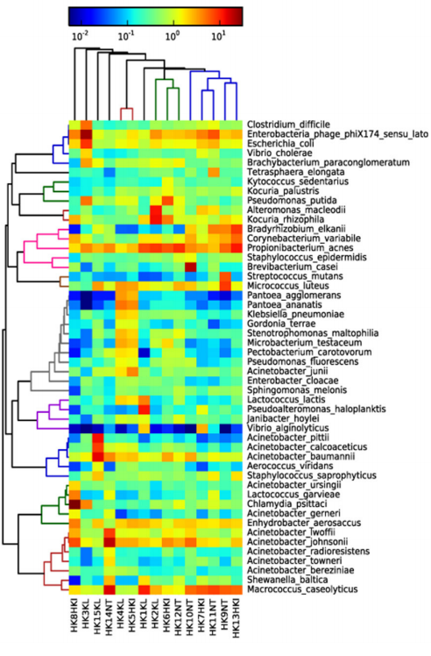
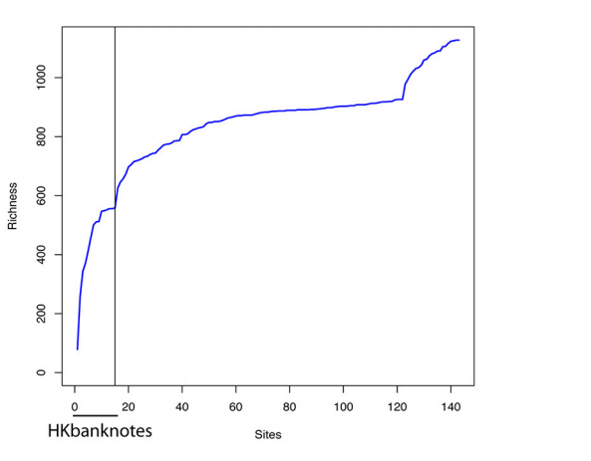

Slide 8
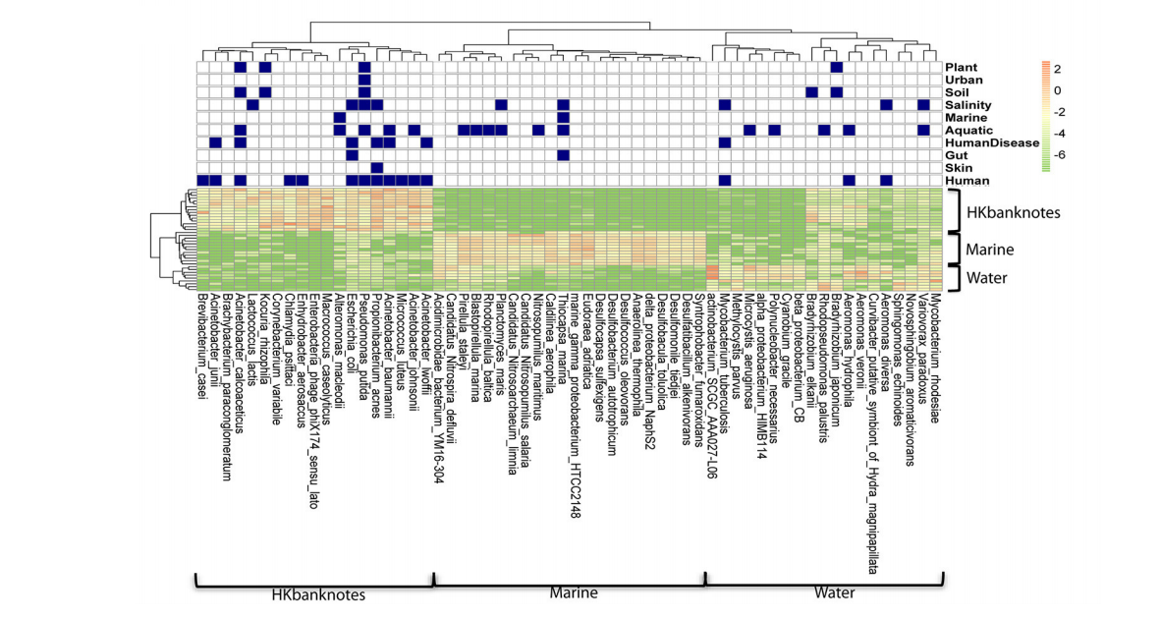

Slide 9
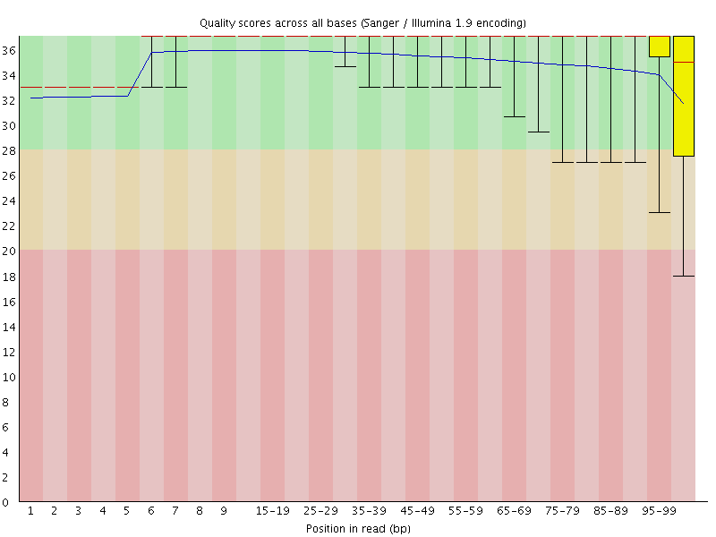
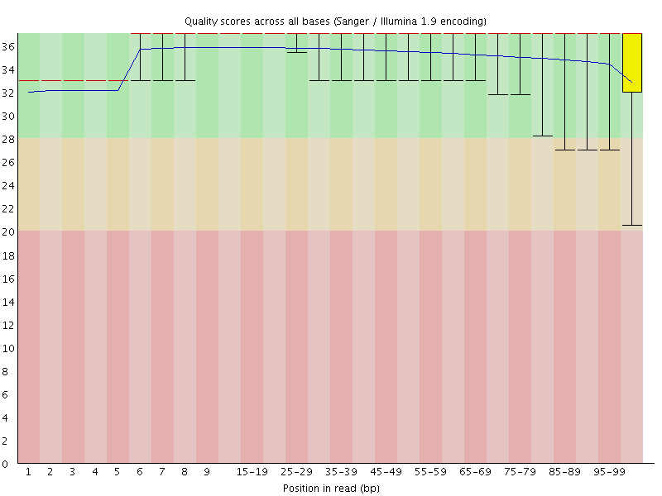
Pre-trimmed Post-trimmed

Slide 12
Thank you,
Questions?

