Slide 1
exTreg/Treg Pseudotime Binning, DE, and Bulk Transcriptome

Slide 2
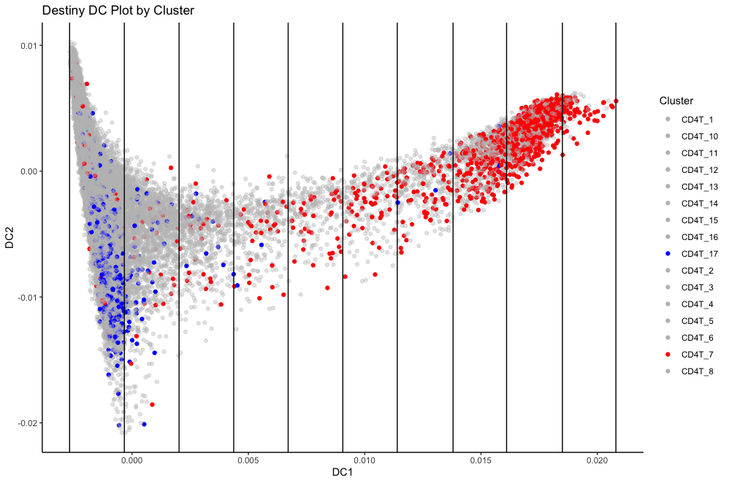
Bin 1 2 3 4 5 6 7 8 9 10
Plot was split into 10 bins, based on the DC1 level. Cluster 7 (exTregs) primarily in bins 8,9,10, while Cluster 17 (Tregs) is mostly in bin 1

Slide 3
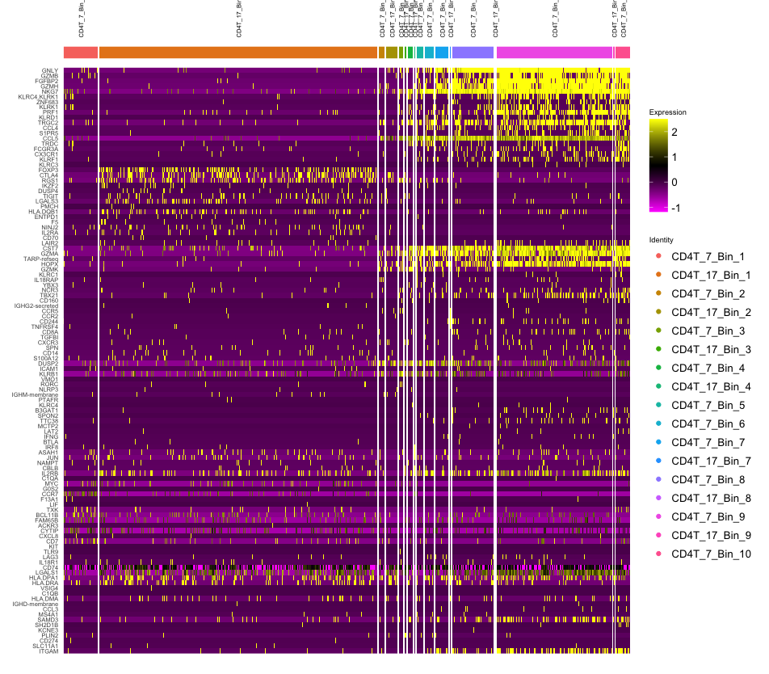
Gene DE for all bins in cluster 7 and 17 (log2fc)

Slide 4
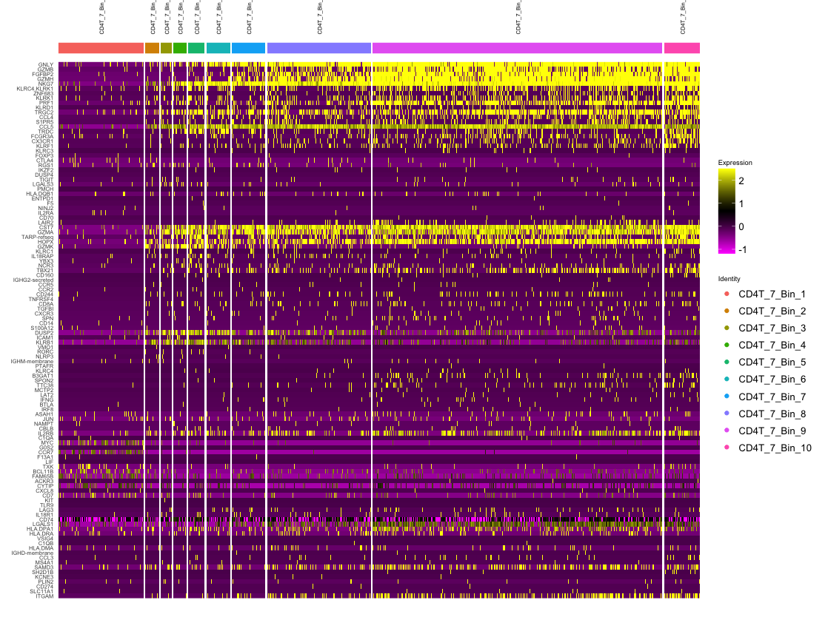
Gene DE for cluster 7

Slide 5
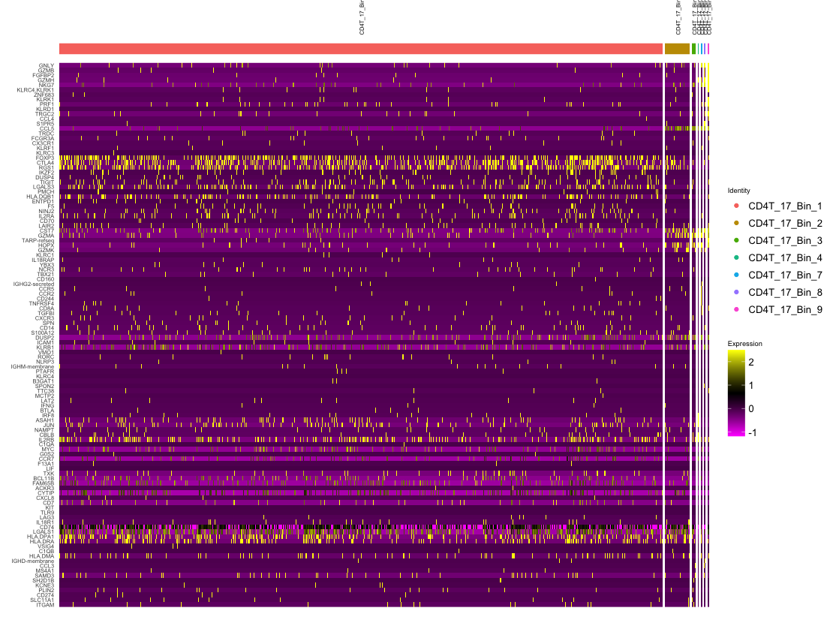
Gene DE for Cluster 17
Next slide shows same results without Bin 1

Slide 6
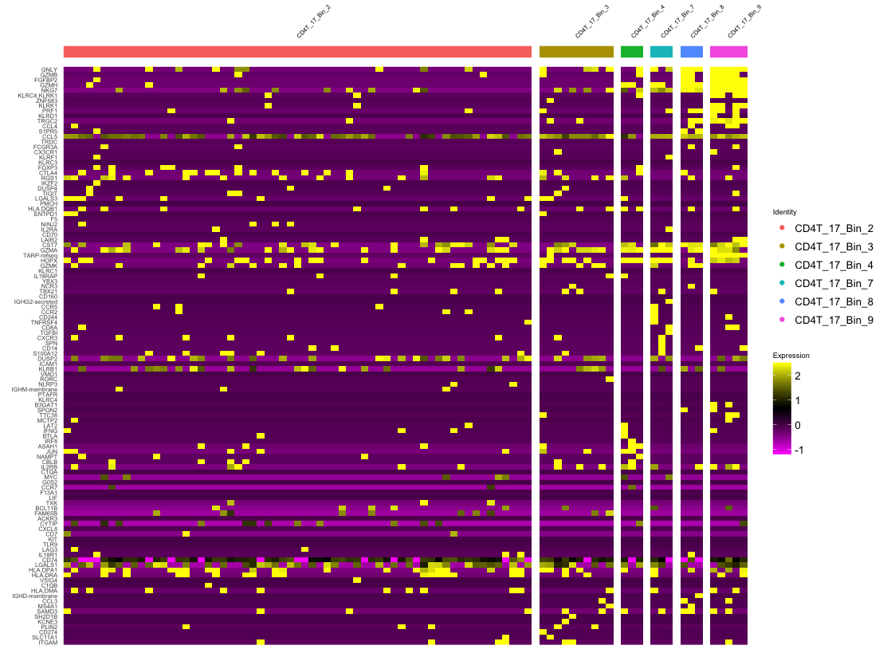
Gene DE for Cluster 17 (minus Bin 1)

Slide 7
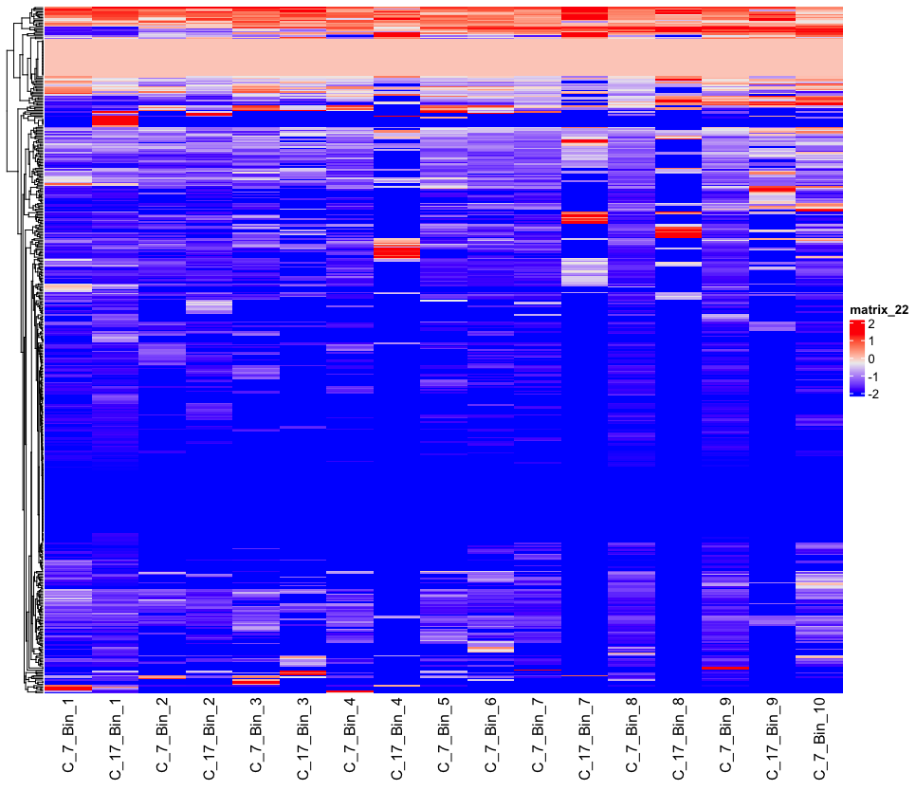
Bulk Transcriptome for each bin (all genes)

Slide 8
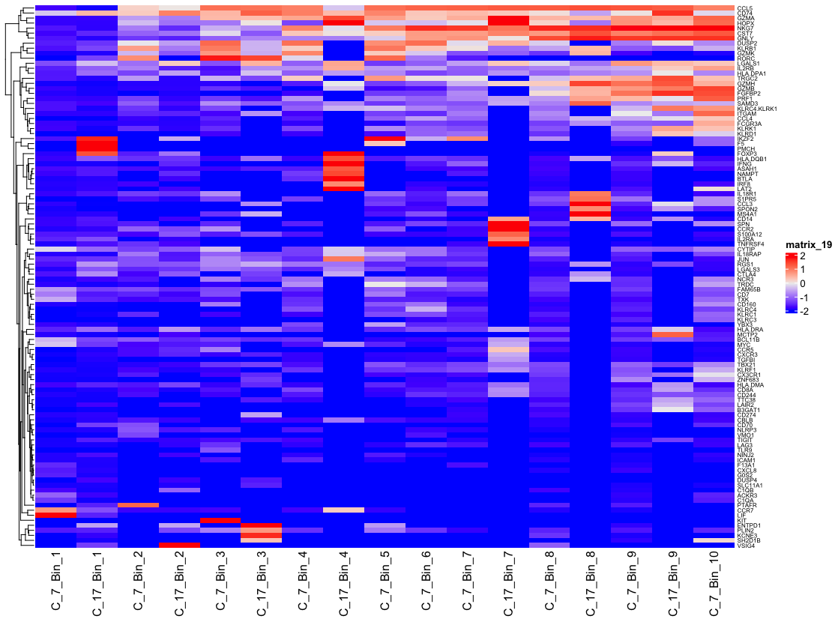
Bulk Transcriptome for each bin (top 15 genes for each bin/cluster pair)

Slide 9
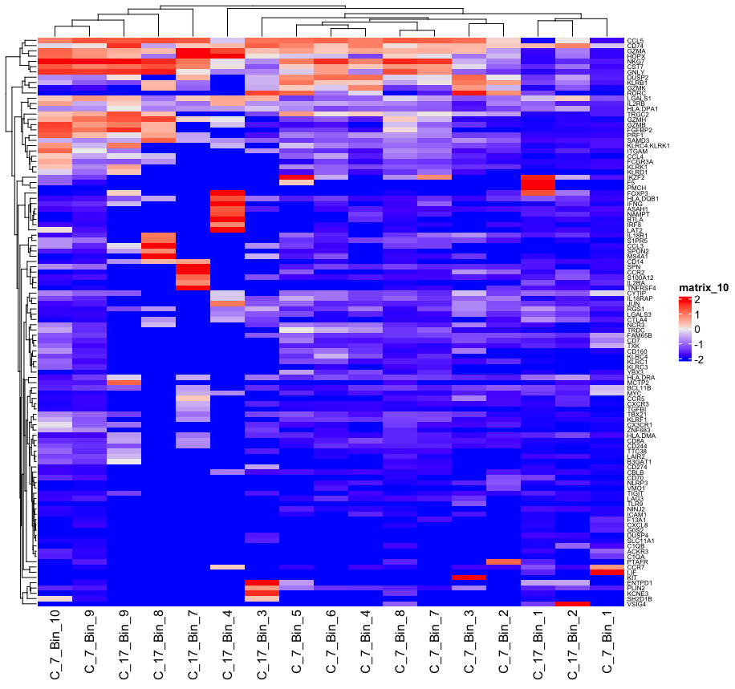
Bulk Transcriptome (Bins clustered by heatmap algorithm)

Slide 10
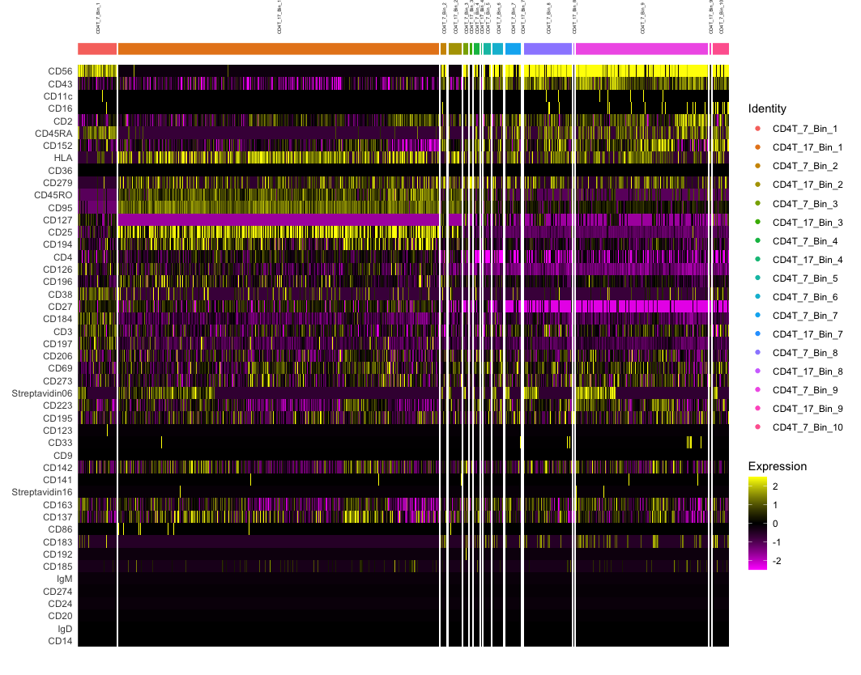
Marker DE for all bins in cluster 7 and 17 (log2fc)

Slide 11
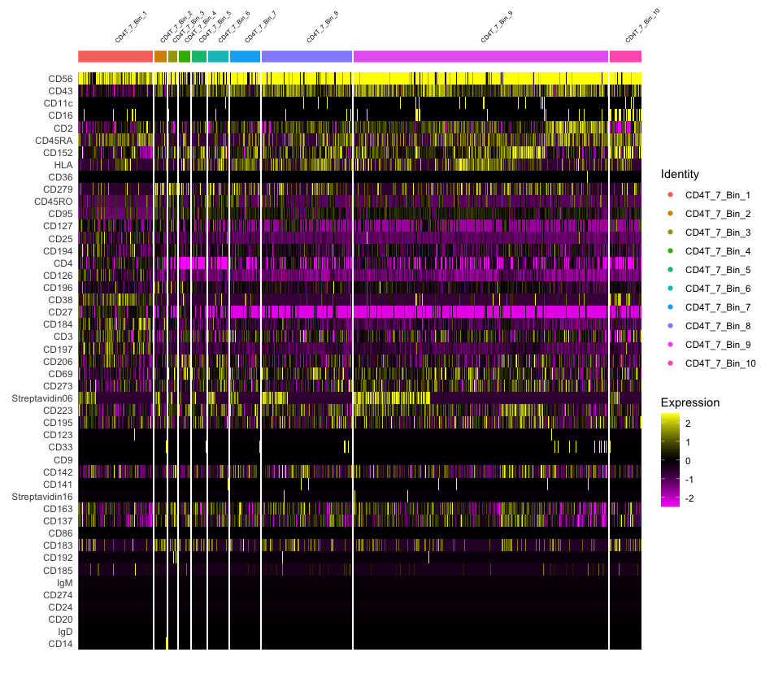
Marker DE for all Cluster 7 (exTreg) bins

Slide 12
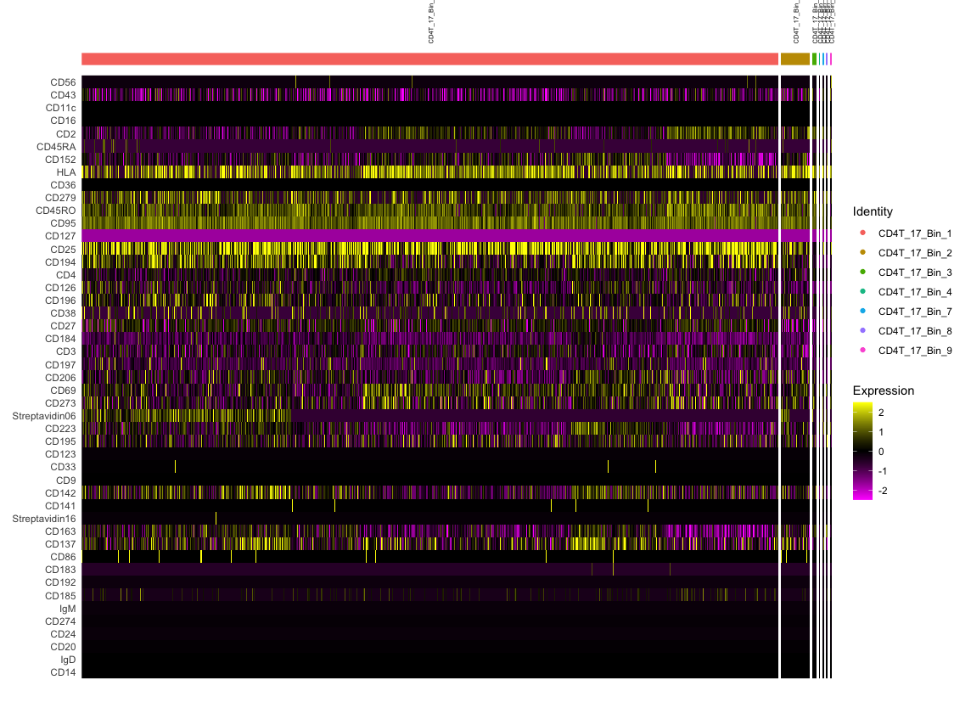
Marker DE for all cluster 17 bins (Treg) bins
Next slide shows same results without Bin 1

Slide 13
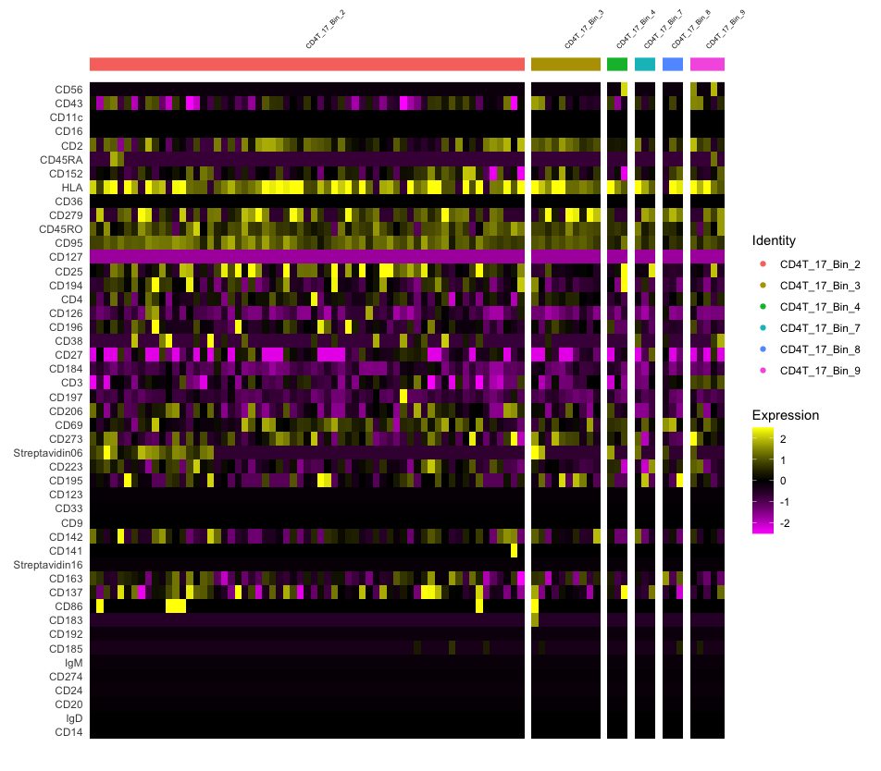
Marker DE for all cluster 17 bins except bin 1

Slide 14
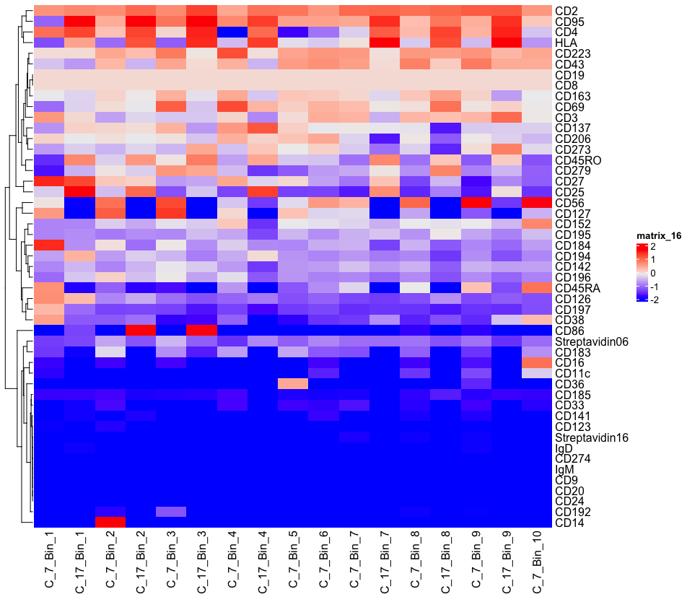
Bulk Marker Expression for Cluster 7 and 17, separated by bin, Markers clustered

Slide 15
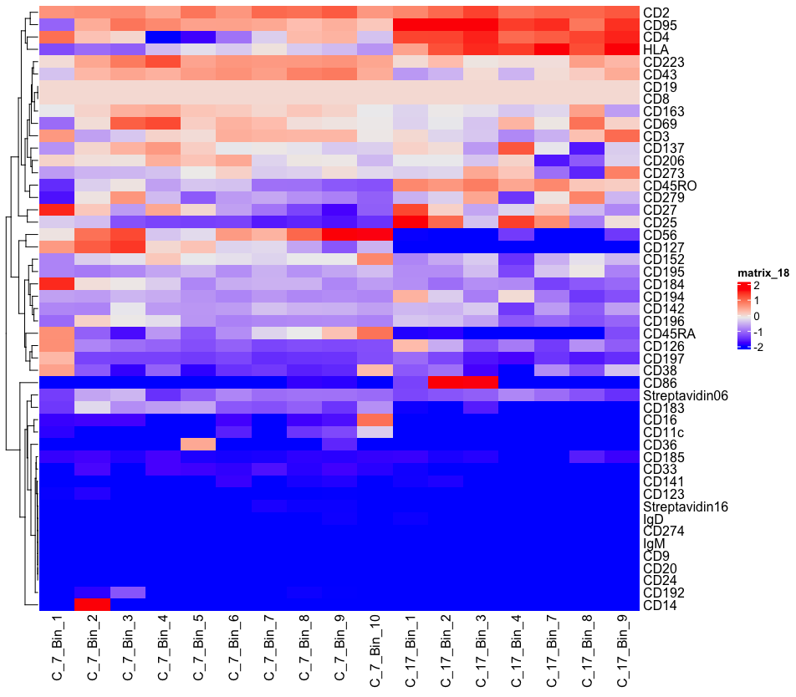
Bulk Marker Expression for Cluster 7 and 17, separated by cluster, Markers clustered

Slide 16
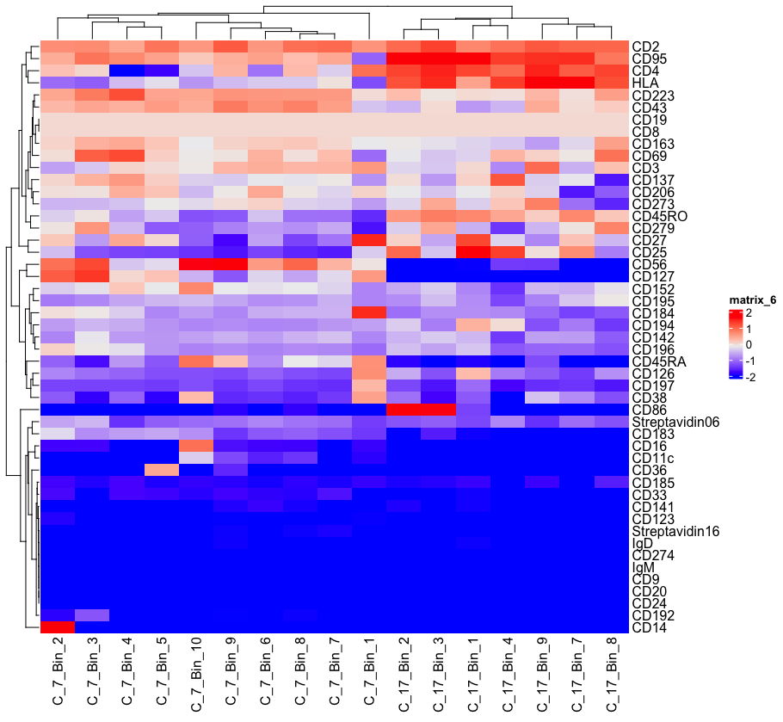
Bulk Marker Expression by bin for Cluster 7 and 17 (Clustered by Gene Expression and Bin/Cluster Pair)

Slide 17
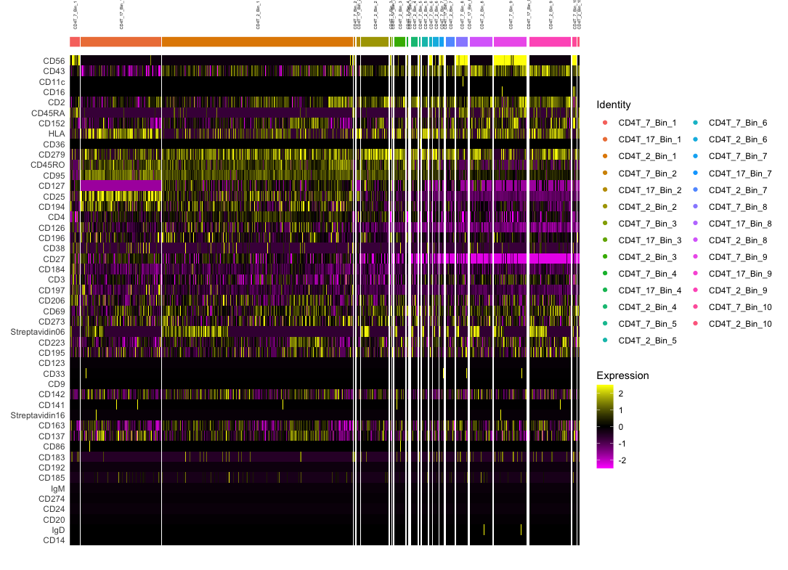
Cluster 2, 7, and 17 Marker Expression

Slide 18
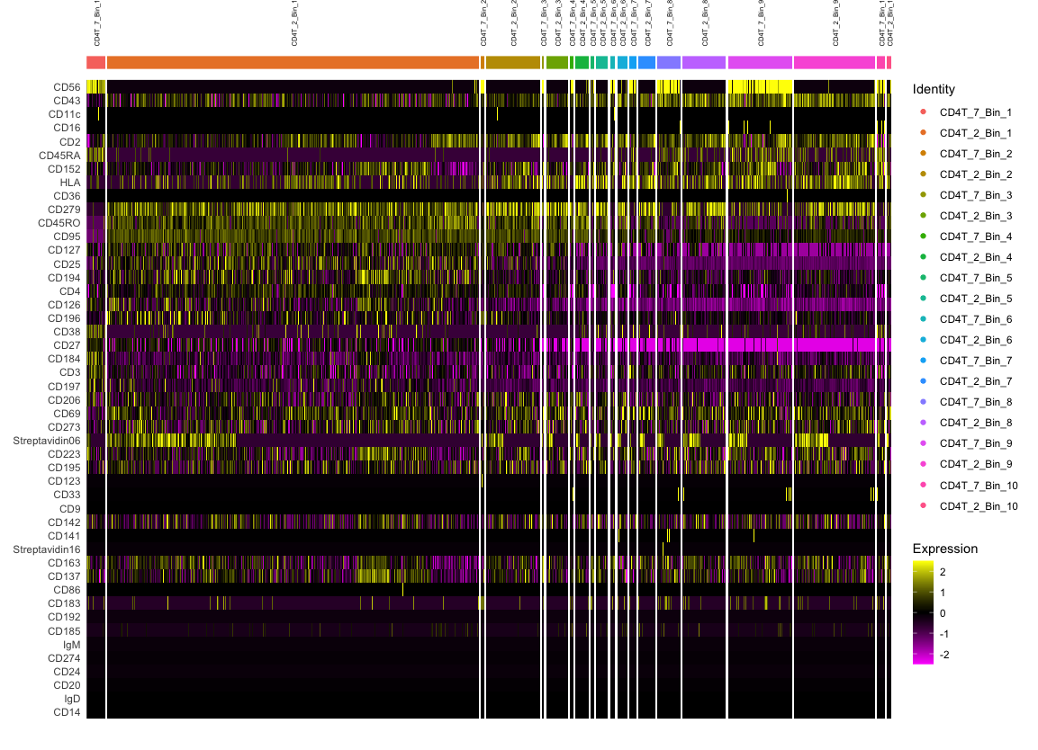
Cluster 2 and 7 Marker Expression

Slide 19
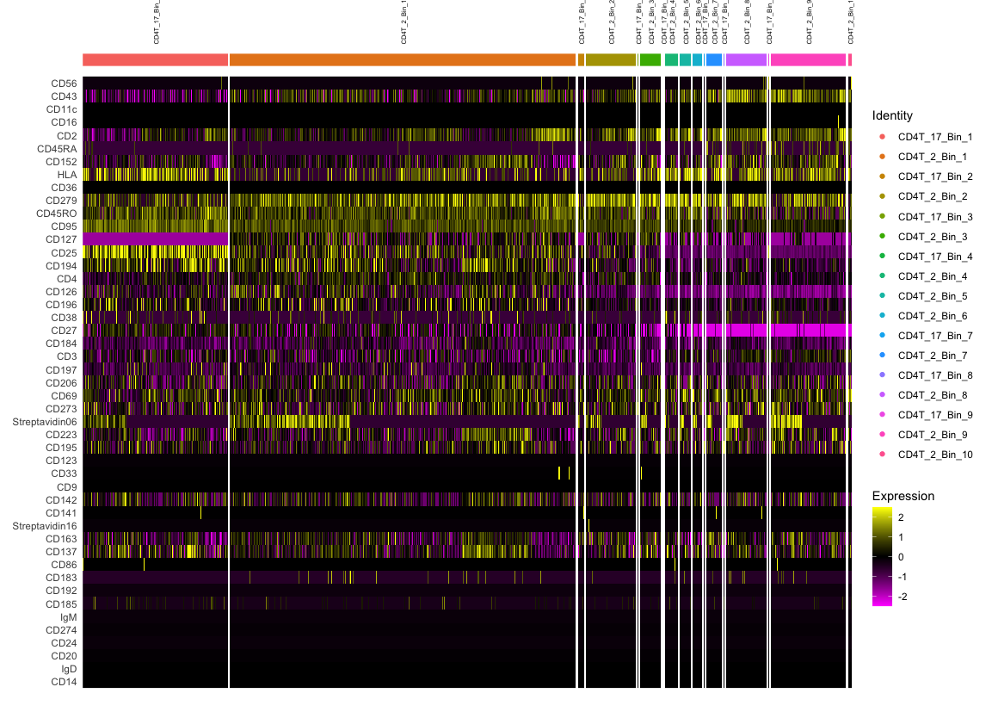
Cluster 2 and 17 Marker Expression

Slide 20
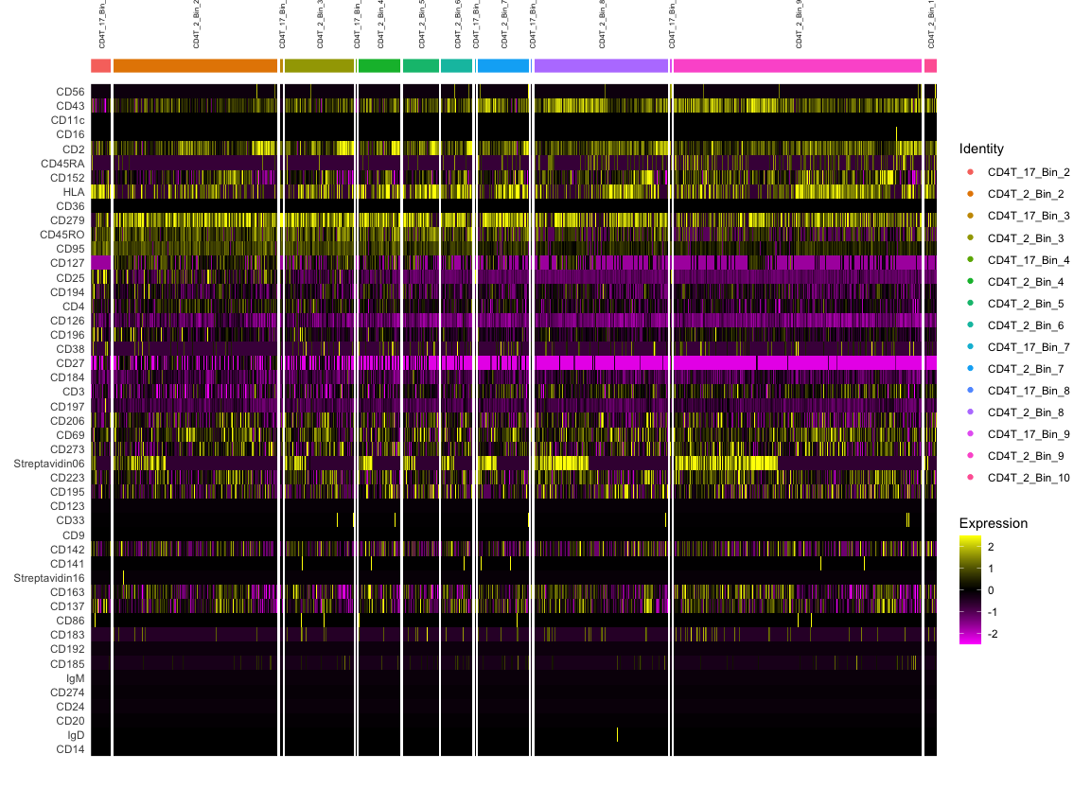
Cluster 2 and 17 Marker Expression
(without Bin 1)

Slide 21
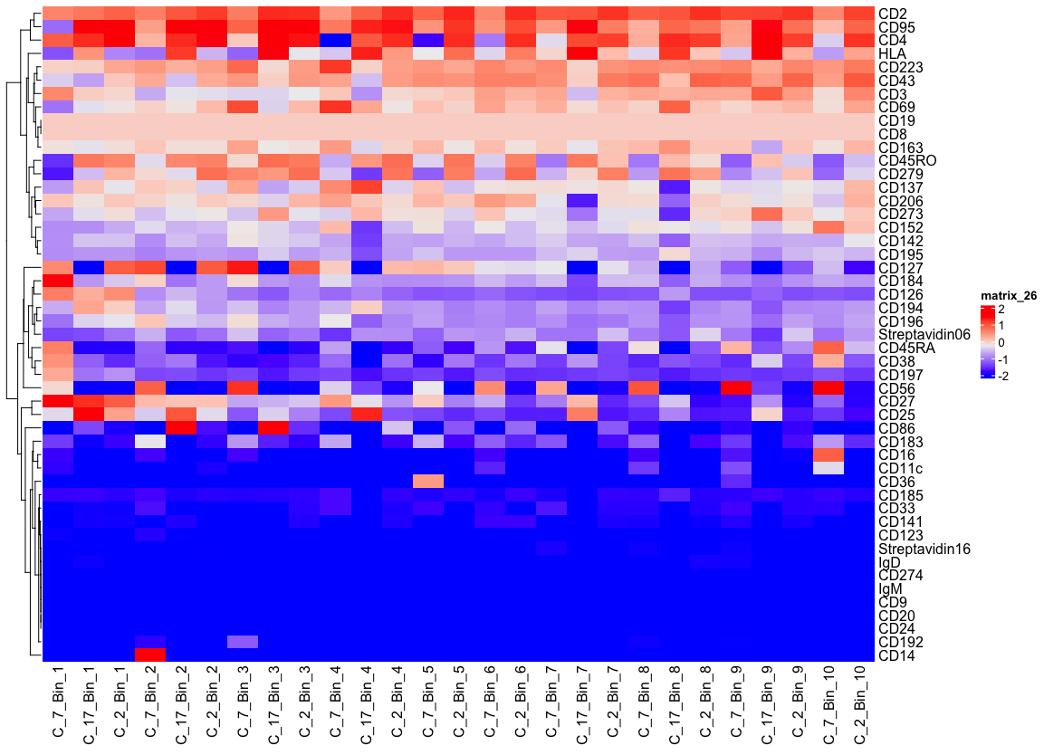
Cluster 2, 7, and 17 Bulk Marker Expression by bin

Slide 22
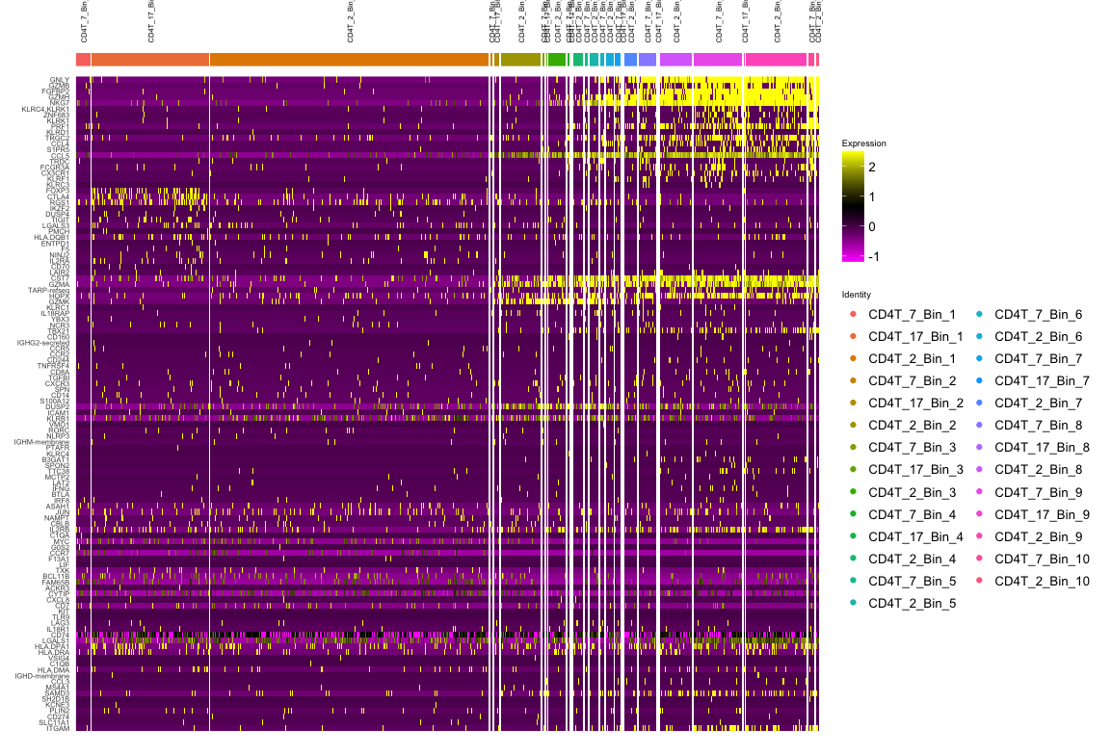
Cluster 2, 7, and 17 Transcriptome Expression

Slide 23
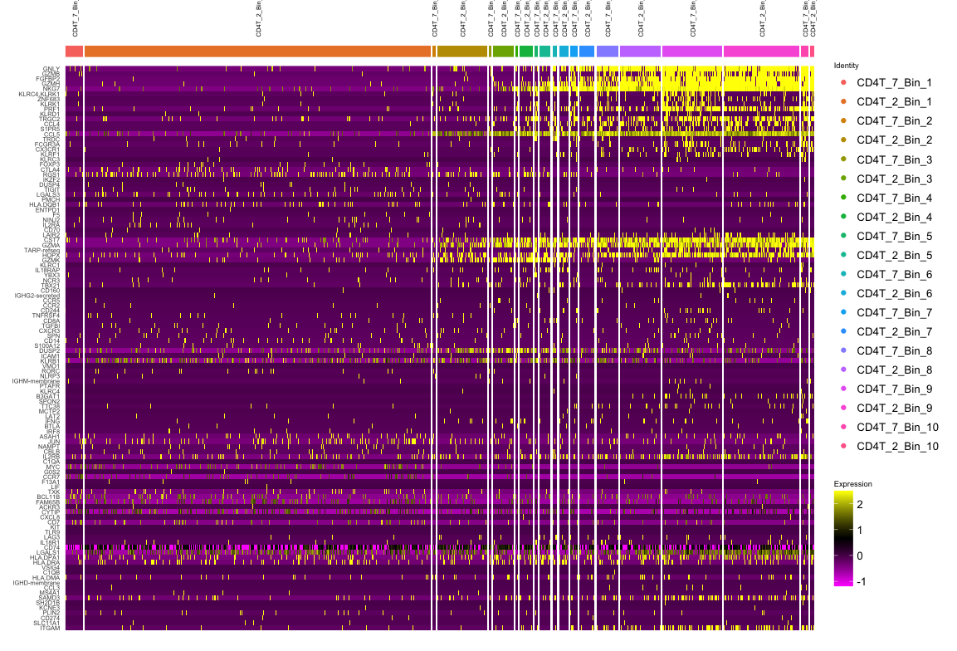
Cluster 2 and 7 Transcriptome Expression

Slide 24
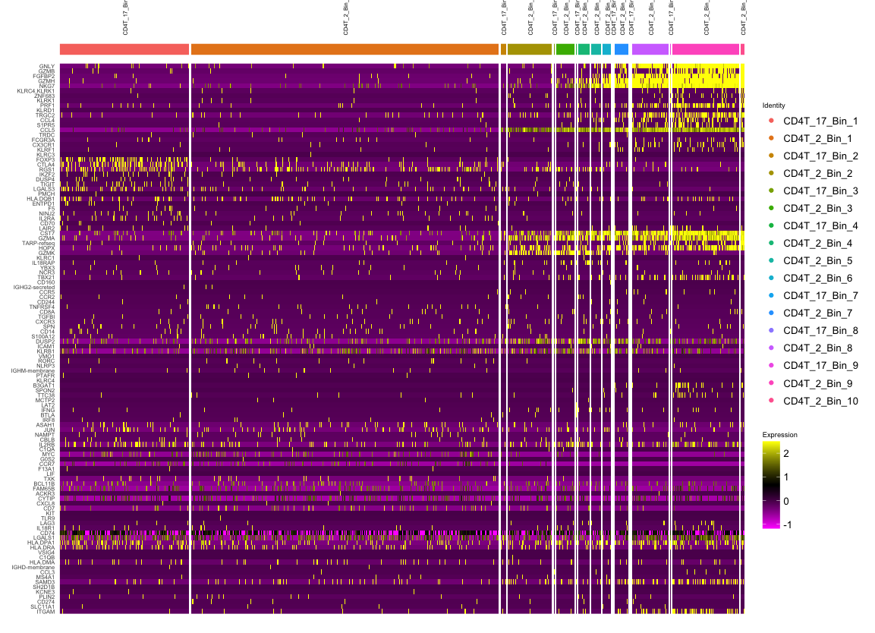
Cluster 2 and 17 Transcriptome Expression

Slide 25
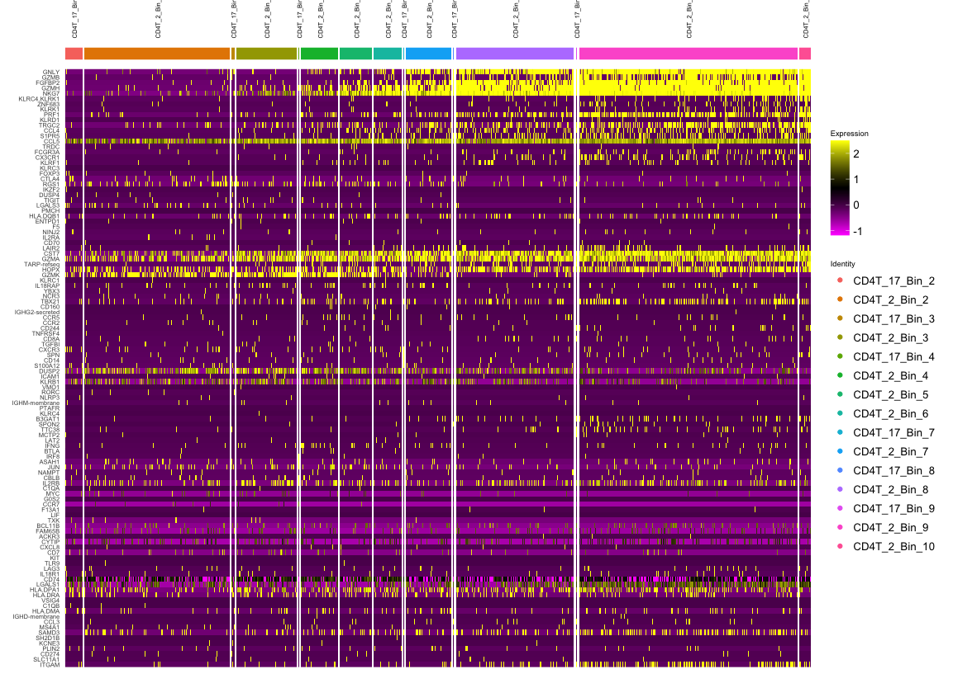
Cluster 2 and 17 Transcriptome Expression (Without Bin 1)

Slide 26
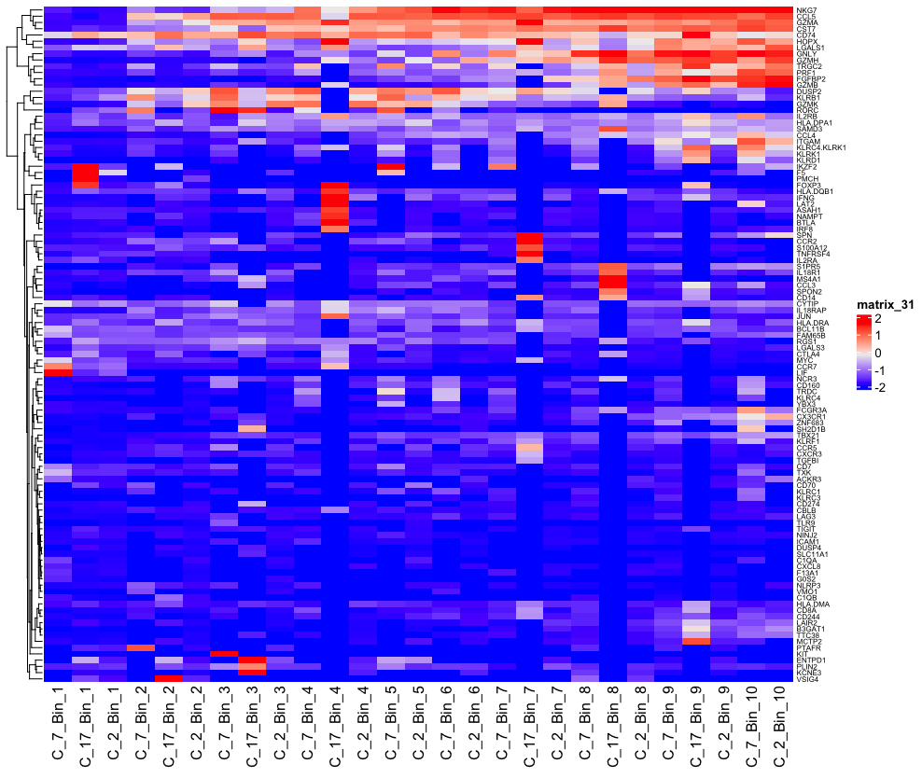
Bulk Transcriptome Expression

