Slide 1
Aspect Oriented Programming
Jakub Malczak
Łódzka Grupa Profesjonalistów IT & .NET

Slide 2
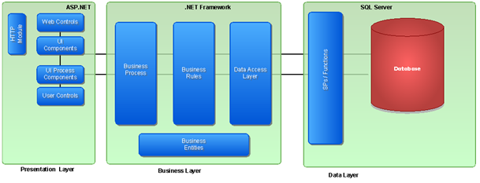
Overview
Break down problem logic into concerns
What is concern

Slide 3
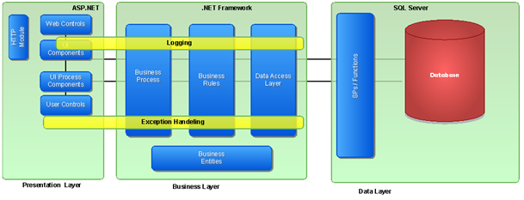
Overview
Crosscutting concerns
Implementing crosscutting concerns

Slide 4
Problems
Tangled and scattered code
High coupling with classes implementing concern
Separation of concerns is incorrect

Slide 5
History
Metaobject protocol
Introspection
Intercession
Common Lisp Object System
Moose for Perl

Slide 6
History
Subject oriented programming
AOP introduced by Gregor Kiczales at Xerox
AspectJ

Slide 7
Basic Concepts of AOP
Crosscutting concerns expressed in modules called aspects
Joint points and pointcuts
Advices

Slide 8
Basic Concepts of AOP
Compile time weaving
Source level weaving
Writting own compiler
Modification of MSIL code

Slide 9
Basic Concepts of AOP
Run time weaving
Proxies
Load time static weaving – define pointcuts using compile time weaving and add advices at run time
Dynamic proxies - System.Reflection.Emit

Slide 10
Usage Scenario
Logging
Exception handling
Authorization
Transaction handling

Slide 11
Available frameworks for .NET
Postsharp
Microsoft Enterprise Library Policy Injection Block
Spring.Net
Castle Dynamic Proxy

Slide 12
Postsharp overview
Compile time weaving
Supports .NET Framework 2.0 – 4.0
Mono
Azure

Slide 13
Postsharp aspects
OnMethodBoundaryAspect
OnEntry
OnSuccess
OnException
OnExit

Slide 14
Postsharp aspects
MethodInterceptionAspect
OnInvoke
LocationInterceptionAspect
OnGetValue
OnSetValue

Slide 15
Postsharp aspects
EventInterceptionAspect
OnAddHandler
OnRemoveHandler
OnInvokeHandler

Slide 16
Applying Postsharp aspects
Custom attributes
Multicast attributes
Programmaticaly

Slide 17
Sources
http://www.codeproject.com/Articles/50202/Aspect-Oriented-Programming-101
http://www.sharpcrafters.com/postsharp/documentation

Slide 18
Thank You

Slide 19
AOP in .NET
http://www.alenz.org/mirror/khason/why-microsoft-can-blow-off-with-c.html

