Slide 1

HP Meetings Windows Azure Basics
Jakub Malczak

Slide 2
Utility Computing
Idea
Time sharing systems
Mainframe computing
Grid computing

Slide 3
What Is The Cloud?
A set of connected servers
On which developers can:
Install and run services
Store and retrieve data

Slide 4
Characteristics Of Cloud Computing
Infinite resources
Scale on demand
Pay per use
High availability
Geographical location of DC - CDN

Slide 5
Cloud Services
IaaS
PaaS
SaaS

Slide 6
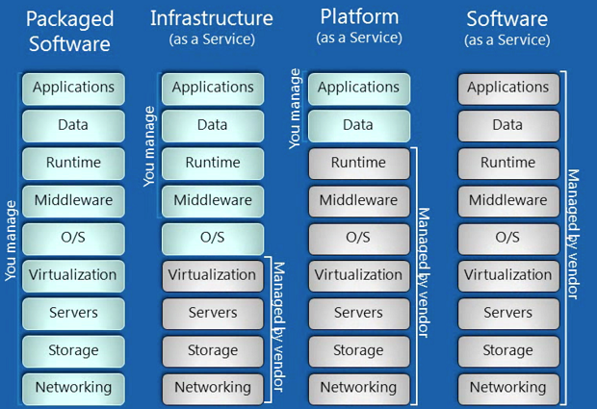
Cloud Services

Slide 7
Is Azure The Only One?
Amazon Web Services EC2 / S3
Verizon
IBM
SalesForce
Azure
http://searchcloudcomputing.techtarget.com/feature/Microsoft-2011-top-cloud-computing-provider#slideshow

Slide 8











Windows Azure Platform
Azure™ Services Platform

Slide 9
What Azure AppFabric?
Service Bus
Access Control Services

Slide 10
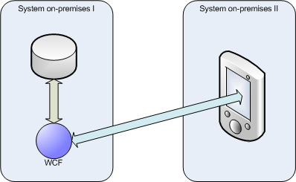
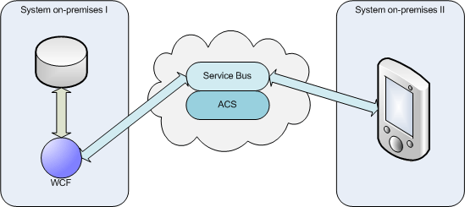
Service Bus and ACS

Slide 11
SQL Azure
SQL Server hosted in the Cloud
Highly scallable, available and load balanced
Created to provide relational storage
Very expensive

Slide 12
What Is Windows Azure?
It is an operating system for the cloud
It is designed for utility computing
It has four primary features:
Service management
Compute
Storage
Developer experience

Slide 13
What's Missing In The Cloud?
….
……
Service 1
Service 2
Service 3
Service N

Slide 14
What Is Windows Azure?
It is an operating system for the cloud
It is designed for utility computing
It has four primary features:
Service management
Compute
Storage
Developer experience

Slide 15
Service Management
Available from developer portal
Available from WA SDK tools
Available from User Code by using REST API

Slide 16
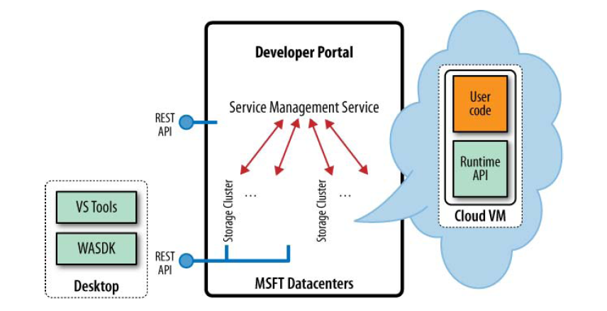
Service Management

Slide 17
Compute
Service model - cspkgx
Roles and endpoints
Configuration options

Slide 18
Roles
Web role
Worker role
CGI web role
WCF service role

Slide 19
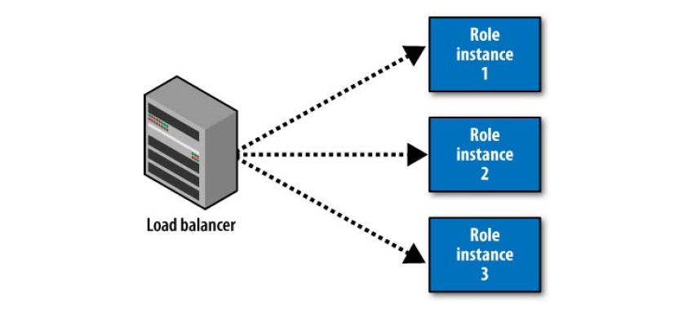
Role Instances

Slide 20
Role sizes
Extra small – One core / 768 MB RAM
Small – One core / 1.75 GB RAM
Medium – Two cores / 3.5 GB RAM
Large – Four cores / 7 GB RAM
Extra large – Eight cores / 14 GB RAM

Slide 21
Putting It All Together
Example:
n
m
Web Role
Worker Role
LB
Cloud Storage (blob, table, queue)

Slide 22
Not Only .NET Code
Running applications written in other languages
FastCGI
Using worker roles to run other binnaries

Slide 23
Azure Storage Characteristics
Distribution
Scallability
Replication
REST APIs

Slide 24
Azure Storage
BLOBs
Queues
Azure Tables

Slide 25
Azure Storage BLOBs
Containers
Named files
Metadata
Windows Azure XDrive

Slide 26
Azure Storage Queues
Used to communicate between different parts of application
Unlimited number of messages
Guarantee of delivery (Visibility Timeout)
Message size limited to 8KB

Slide 27
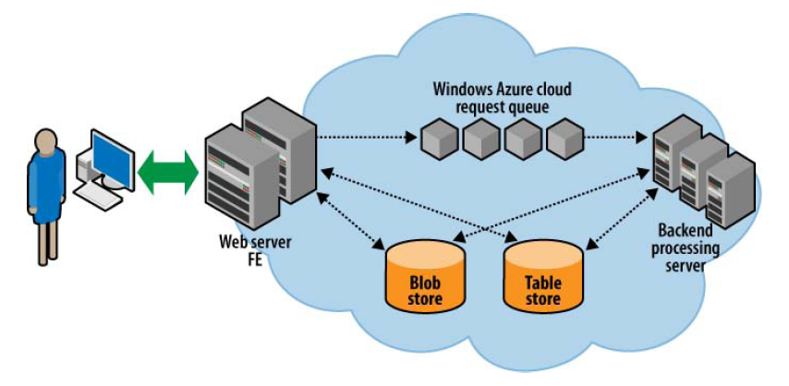
Azure Storage Queues

Slide 28
Azure Storage Tables
NoSQL
Enable to store massive amout of structured data
Entities
Properties
No fixed schema

Slide 29
Azure Storage Tables
Partition Keys
Row Keys
WCF Data Services
Entity group transactions

Slide 30
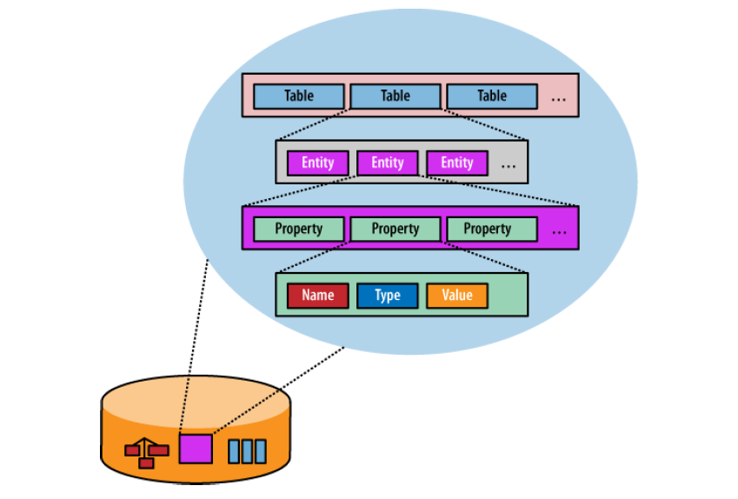
Azure Storage Tables

Slide 31
How To Register
Go to windows.azure.com
Windows Live account
Yes you really have to give them your credit card details even for trial service
Free trial for 90 days

Slide 32
Licensing
Pay as you go
Subscription offers
Special offers for MSDN members / BizSpark members

Slide 33
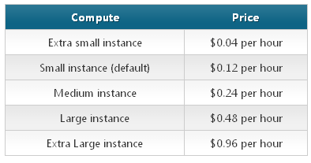
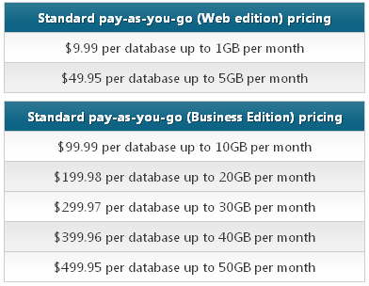
How much does it cost?

Slide 34
Microsoft Data Centers
http://www.youtube.com/watch?v=mLZUhPitCK4&feature=related

Slide 35

Questions

Slide 36
Thank You

