Slide 1
Netflix
Have we changed what we watch?
What do the last seven years show us?

Slide 2
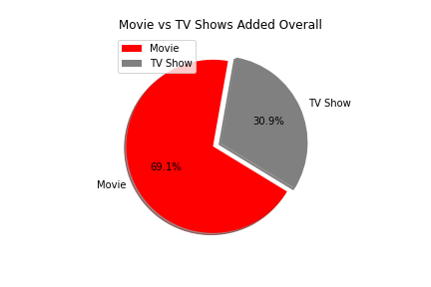
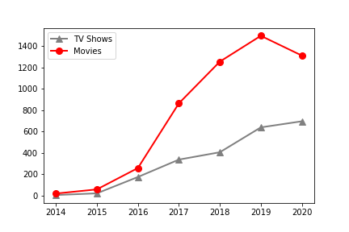
From the movie spot to show time?
From 2016 to 2018, shows have been added in mass
In 2017, there was a massive expansion of media
Between 2017 to 2019 there was a massive spike in movies added
Even though movies are being added 3 to1 compared to shows, shows have been on a steady incline
The overall line graph shows that even though movies outnumber shows, shows continue to grow on the platform
As shows have been steadily been increased there was a dip in movies being added to Netflix between 2019 and 2020
Notes:
Overall Movies 5377 and TV Shows 2410
2016 to 2017 saw media go from 258/174 to 864/337
2018/2019 saw thousands of movies added

Slide 3
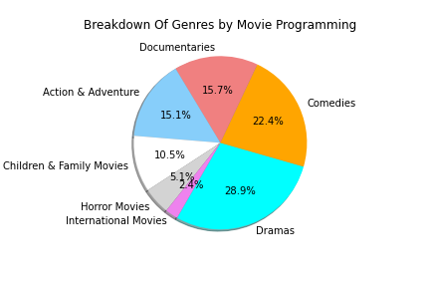
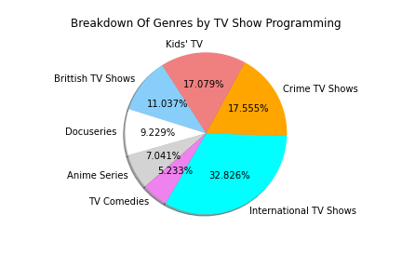
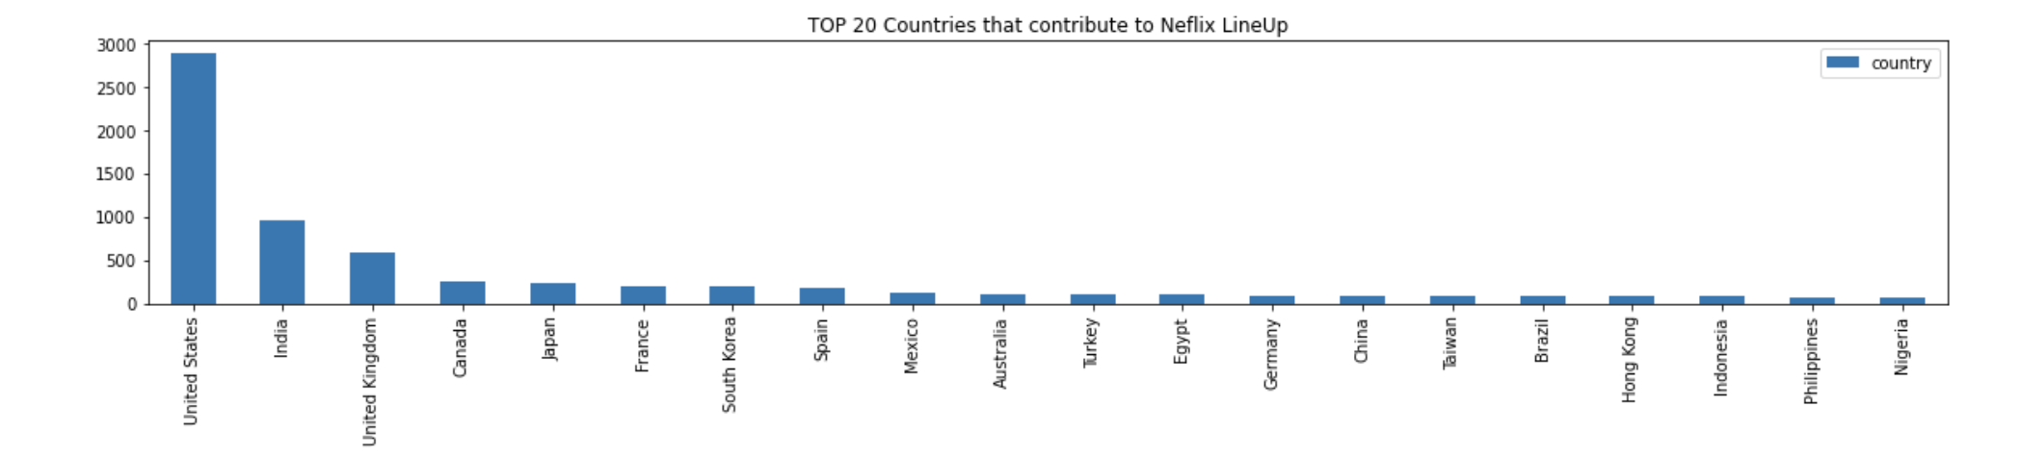
What types of shows/movies ARE they adding?
We began the Netflix dataset with a Total of 89 Contributing Countries
Top 4 countries are USA, India, United Kingdom, and Canada
The top 15 genres seem to be repeated between Movies & TV shows
Once we separate TV Shows and Movies we see more differences
TV Shows show more international flavor adding variety
Movies are dominated by Dramas, Comedies, and Documentaries
TV Shows top genres are International Shows, Crime Shows, and Kids’ TV

Slide 4
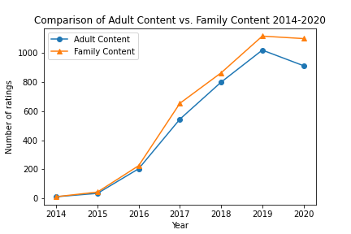
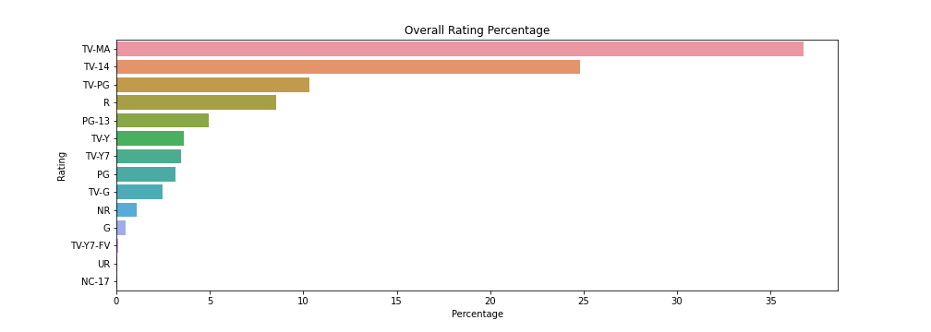
Are we getting more edgy content?
Overall, we have seen that mature content has dominated the programming
In 2016 to 2018 to 2020 we have seen more and more TV-MA shows and movies being added to Netflix over the years
Once we group all the rating and sort them by “family friendly” and “mature” we notice something different
Even though separated we see TV-MA dominating, we see that over the years there have been more family friendly content on Netflix
Even more recently between 2019 and 2020 we see a decline in mature content while family friendly content stays at the same pace

Slide 5
Netflix Even though we had an idea of what the data showed us, when we dug deeper we revealed another story.
Notes:
We started with one idea but after a little more digging we found more interesting data
Limiters were not having a data set or API directly from Netflix
This shows only the Netflix platform but is it the same on others
The data keeps shows/movies that were added but does not remove them when Netflix does… would numbers change?
https://www.kaggle.com/shivamb/netflix-shows

