Slide 1



Fundamentals of Adaptive Beamforming
Ioannis Mallioras
PhD candidate
Maggioli SpA, Aristotle University of Thessaloniki
2024

Slide 2
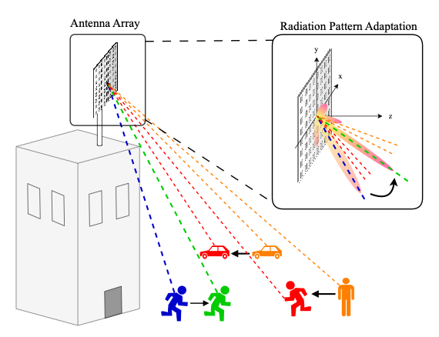
What is Adaptive Beamforming?
Definition
Technique that dynamically adjusts the radiation pattern of an array to improve the signal-to-noise (SNR) ratio of received signals.
Why it is useful:
Improved Signal Quality
Enhanced Throughput and Network Capacity
Energy Efficiency

Slide 3
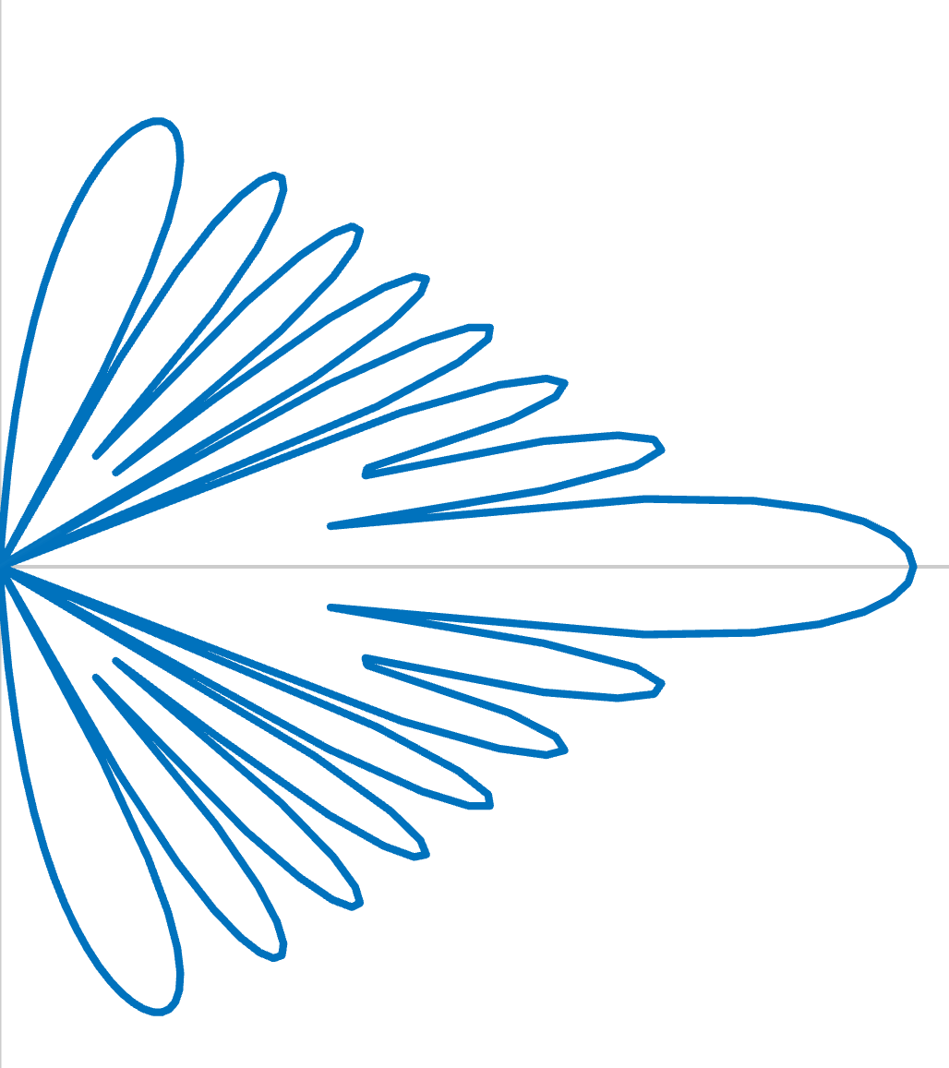
How is beamforming achieved?
Radiation Pattern
Phased Antenna Array: Directive antenna comprised of multiple radiating elements in various configurations (e.g. linear, planar).
Radiation Pattern: a graphical representation of the distribution of radiated energy from an antenna.
The direction of the main lobe and the overall shape of the pattern can be controlled by:
The amplitudes and phases of the feeding current applied to each element.
Sidelobes
Uniform Linear Array (ULA)
Main Lobe
Nulls

Slide 4
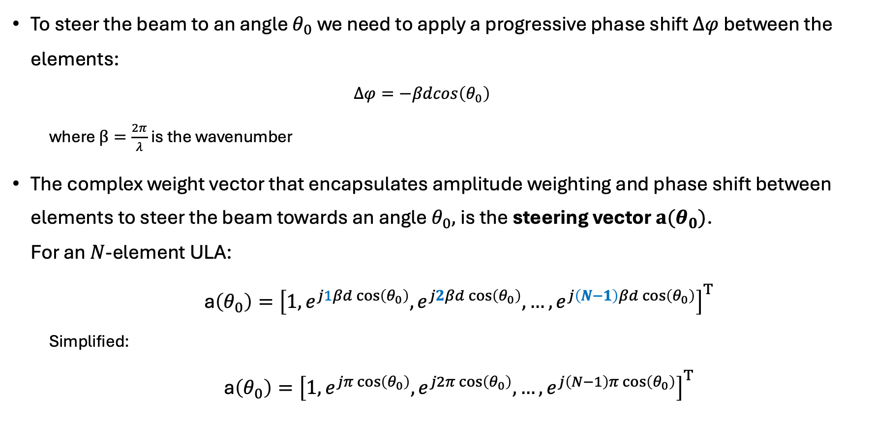
Beam-steering using phase shift
To steer the beam to an angle $θ_{0}$we need to apply a progressive phase shift $Δφ$ between the elements:
$$Δφ=−βdcos\left(θ_{0}\right)$$
where $β=\frac{2π}{λ}$ is the wavenumber
The complex weight vector that encapsulates amplitude weighting and phase shift between elements to steer the beam towards an angle $θ_{0},$is the steering vector $a(θ_{0})$. For an $N$-element ULA:
a$\left(θ_{0}\right)={\left[1, e^{j1βd\cos\left(θ_{0}\right)}, e^{j2βd\cos\left(θ_{0}\right)},…,e^{j\left(N−1\right)βd\cos\left(θ_{0}\right)}\right]}^{Τ}$
Simplified:
a$\left(θ_{0}\right)={\left[1, e^{jπ\cos\left(θ_{0}\right)}, e^{j2π\cos\left(θ_{0}\right)},…,e^{j\left(N−1\right)π\cos\left(θ_{0}\right)}\right]}^{Τ}$

Slide 5
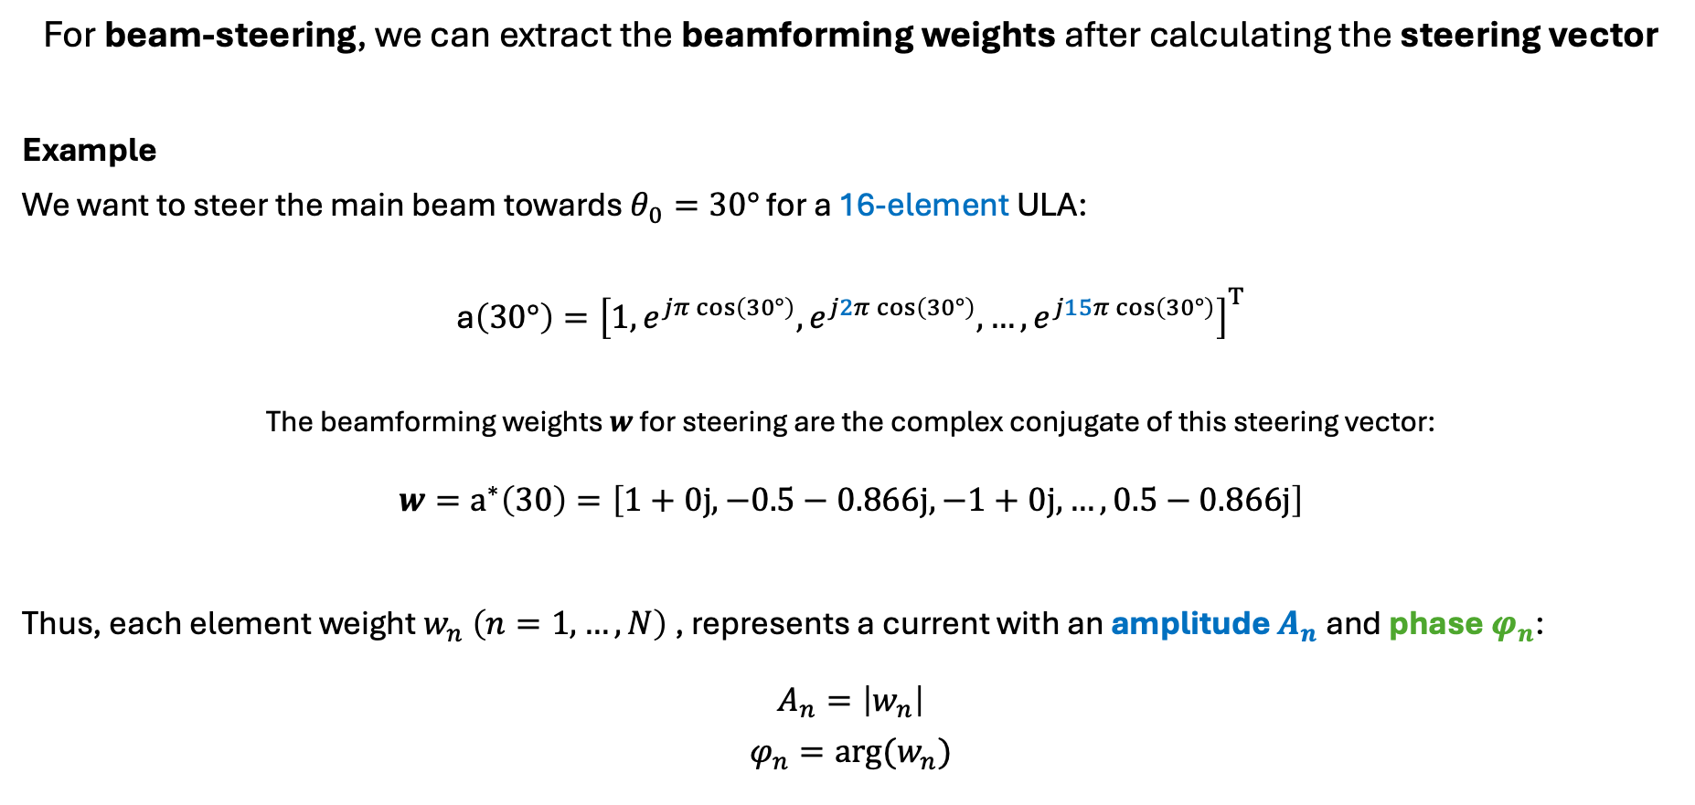
Beam-steering example
For beam-steering, we can extract the beamforming weights after calculating the steering vector
Example
We want to steer the main beam towards $θ_{0}=30°$ for a 16-element ULA:
a$\left(30°\right)={\left[1, e^{jπ\cos\left(30°\right)}, e^{j2π\cos\left(30°\right)},…,e^{j15π\cos\left(30°\right)}\right]}^{Τ}$
The beamforming weights $w$ for steering are the complex conjugate of this steering vector:
$${w=\text{a}}^{∗}\left(30\right)=\left[1+0j, −0.5−0.866j,−1+0j, …,0.5−0.866j​\right]$$
Thus, each element weight $w_{n} \left(n=1,…,N\right)$, represents a current with an amplitude $A_{n}$and phase$φ_{n}$:
$$A_{n}=\left|w_{n}\right|$$
$$φ_{n}=arg⁡(w_{n})$$

Slide 6
Zero-Forcing (or Null-steering) Adaptive Beamforming
Zero forcing beamforming: Technique where radiation pattern is adjusted to place nulls (points of minimum radiation) in the direction of unwanted signals.
More complex algorithms are used for null-steering (next lesson)
Benefits:
Interference Rejection
Improved Signal Quality
Enhanced Security
Improved Signal-to-Interference ratio (SIR)

Slide 7

Adaptive Beamforming in 6G
Increased data rates and capacity
Improved coverage and connectivity
Enhanced interference management
Energy efficiency
Support for advanced applications
Scalability and flexibility

Slide 8
Current obstacles and AI integration
Obstacles of conventional ABF techniques
Computational complexity (MVDR, LMS)
Slow convergence (RLS)
Scalability
AI contribution
Computational efficiency
Predictive capabilities
Dynamic adaptation
Self-improvement

