Slide 1



Α Conventional Adaptive Beamforming Technique
Ioannis Mallioras
PhD candidate
Maggioli SpA, Aristotle University of Thessaloniki 2024

Slide 2


Adaptive Beamforming process
In our implementation, we use the DoAs of incoming signals.
A DoA estimation algorithm is responsible to extract the angles $θ_{m}.$
The null-steering beamformer (NSB) algorithm will be used to produce the weights
The new radiation pattern will form nulls towards the direction of interference and the main lobe towards the desired user
Each element input $x_{n}$ is processed and information about the signals $s_{m}$ is extracted.
This information can be the covariance matrix, channel state information or the directions of arrival (DoAs) of incoming signals.
A beamforming algorithm is used (LMS, RLS, MVDR, NSB) to calculate the beamforming weights based on this information.

Slide 3
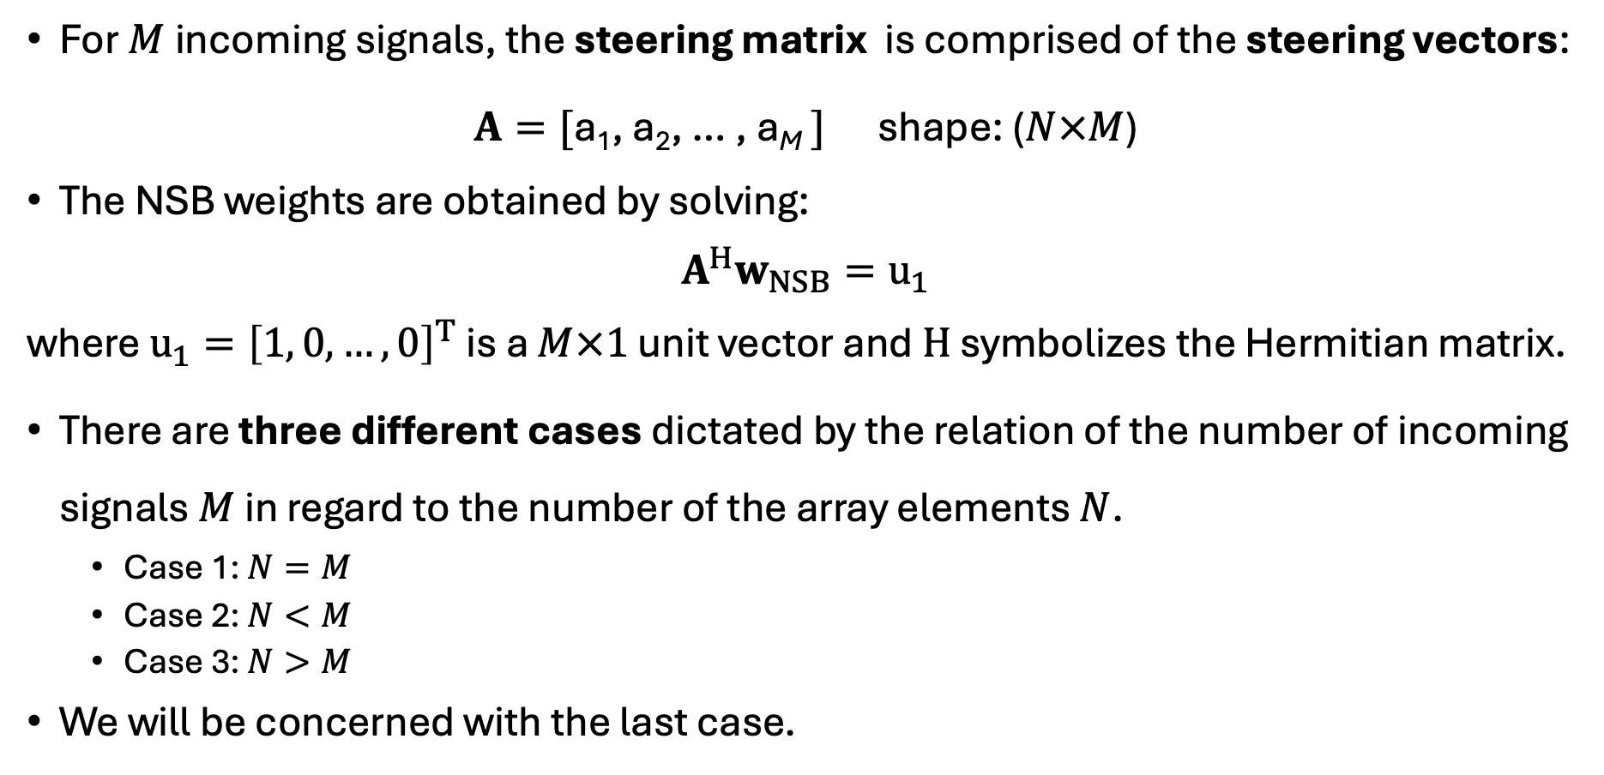
The NSB algorithm
For $M$incoming signals, the steering matrix is comprised of the steering vectors:
$A=[$a₁, a₂, … , a_{M} $]$ shape: ($N×M$)
The NSB weights are obtained by solving:
$$A^{H}w_{NSB}=u_{1}$$
where $u_{1}={\left[1, 0, …, 0\right]}^{T}$ is a $M×1$ unit vector and $H$ symbolizes the Hermitian matrix.
There are three different cases dictated by the relation of the number of incoming signals $M$ in regard to the number of the array elements $N$.
Case 1: $N=M$
Case 2: $N<M$
Case 3: $N>M$
We will be concerned with the last case.

Slide 4
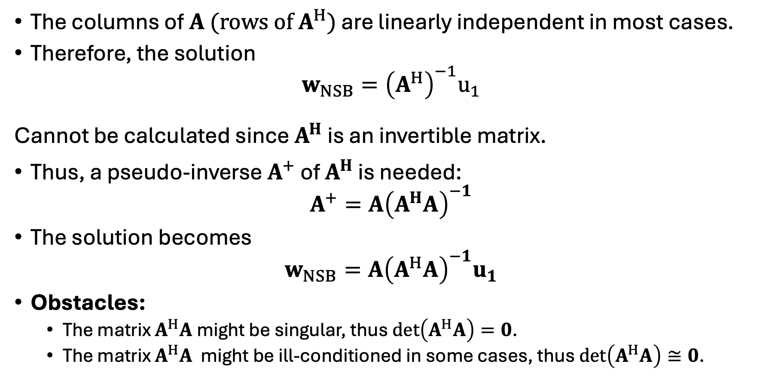

The NSB algorithm (case$N>M$)
The columns of $A (rows of A^{H})$ are linearly independent in most cases.
Therefore, the solution
$$w_{NSB}={\left(A^{H}\right)}^{−1}u_{1}$$
Cannot be calculated since $A^{H}$ is an invertible matrix.
Thus, a pseudo-inverse $A^{+}$ of $A^{H}$ is needed:
$$A^{+}=A{\left(A^{H}A\right)}^{−1}$$
The solution becomes
$$w_{NSB}=A{\left(A^{H}A\right)}^{−1}u_{1}$$
Obstacles:
The matrix $A^{H}A$ might be singular, thus $det\left(A^{H}A\right)=0$.
The matrix $A^{H}A$ might be ill-conditioned in some cases, thus $det\left(A^{H}A\right)≅0$.

Slide 5
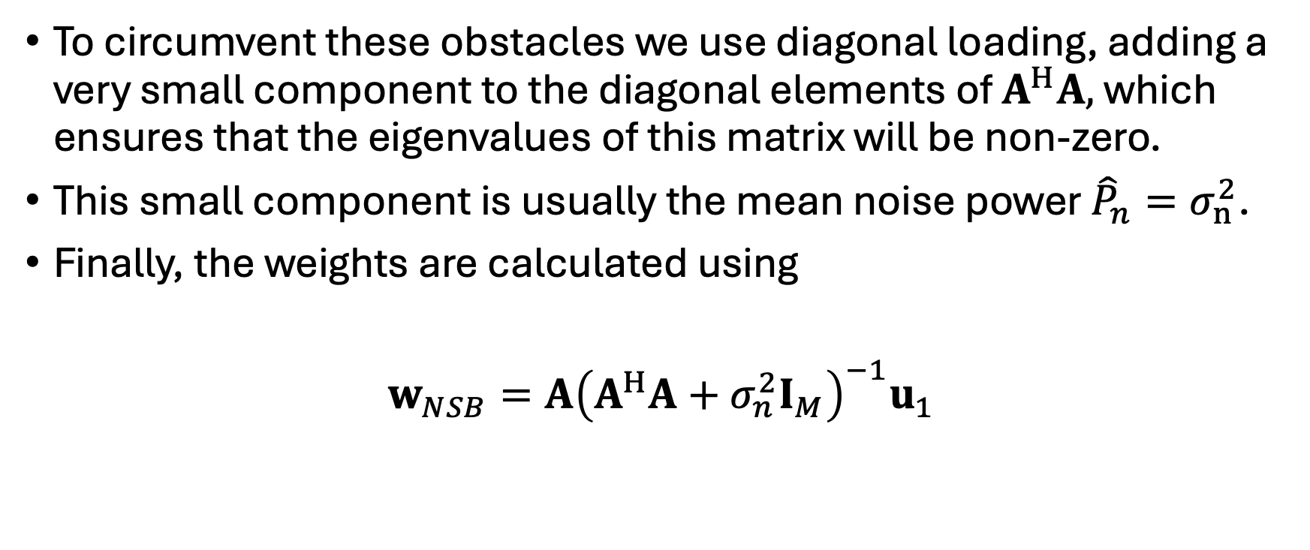
The NSB algorithm
To circumvent these obstacles we use diagonal loading, adding a very small component to the diagonal elements of $A^{H}A,$ which ensures that the eigenvalues of this matrix will be non-zero.
This small component is usually the mean noise power ${\hat{P}}_{n}=σ_{n}^{2}$.
Finally, the weights are calculated using
$w_{NSB}=A{\left(A^{H}A+σ_{n}^{2}I_{M}\right)}^{−1}u_{1}$

Slide 6
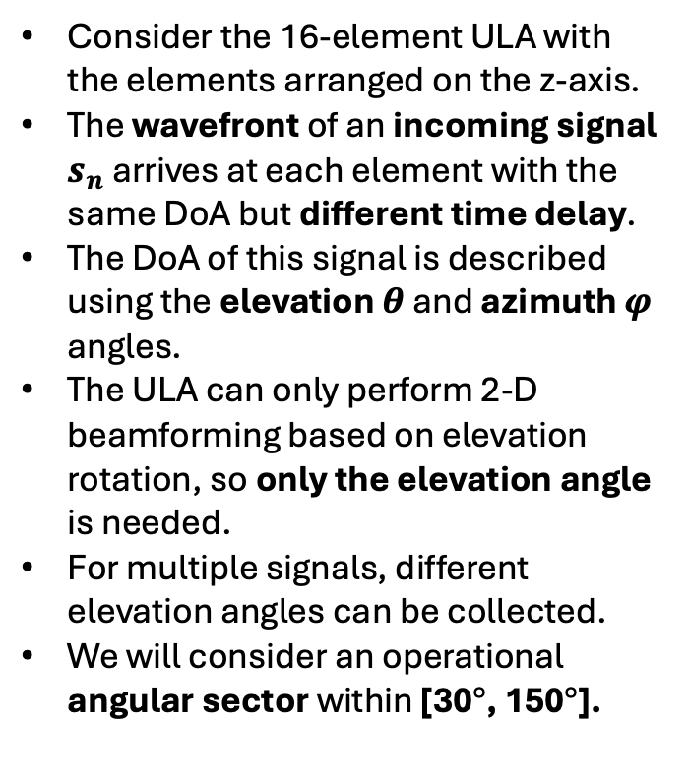
Regarding the direction of arrival (DoA)
30°
Consider the 16-element ULA with the elements arranged on the z-axis.
The wavefront of an incoming signal $s_{n}$ arrives at each element with the same DoA but different time delay.
The DoA of this signal is described using the elevation $θ$ and azimuth $φ$ angles.
The ULA can only perform 2-D beamforming based on elevation rotation, so only the elevation angle is needed.
For multiple signals, different elevation angles can be collected.
We will consider an operational angular sector within [30$°$, 150$°$].
150°

