Slide 1

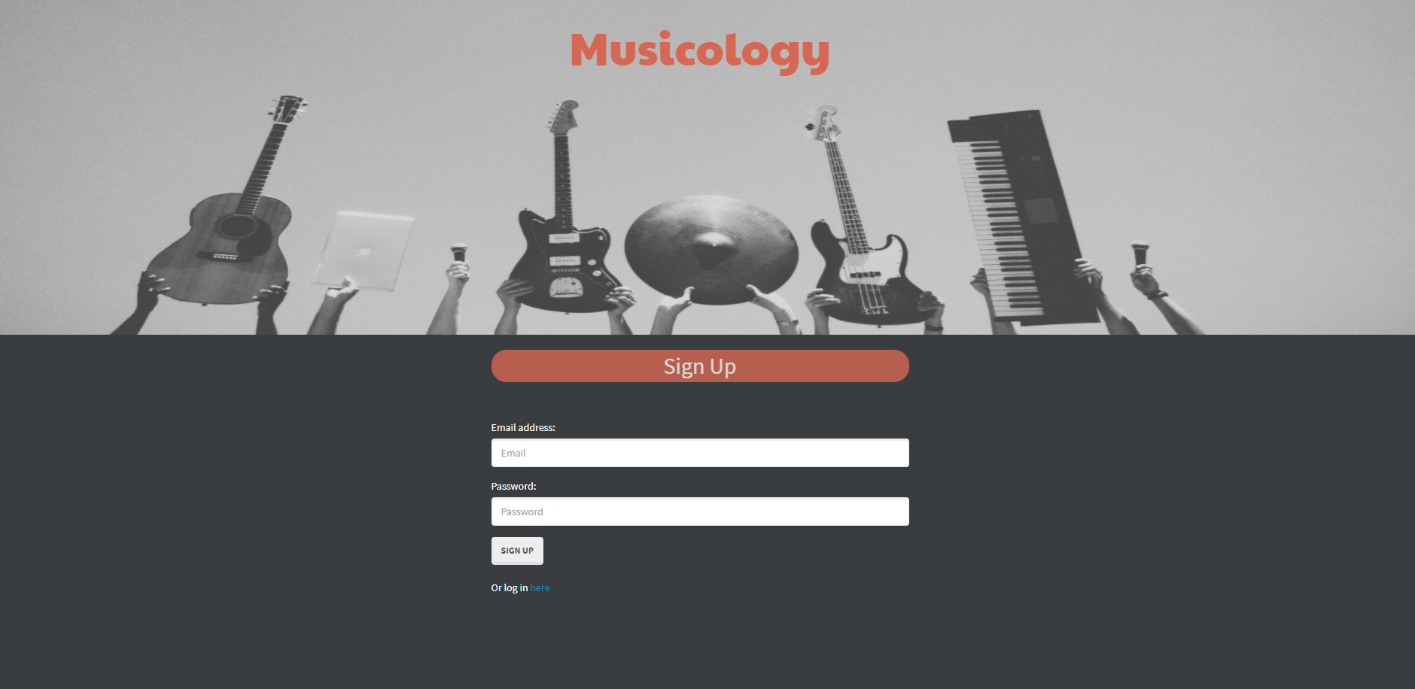
Musicology sign up page takes you to your log in

Slide 2
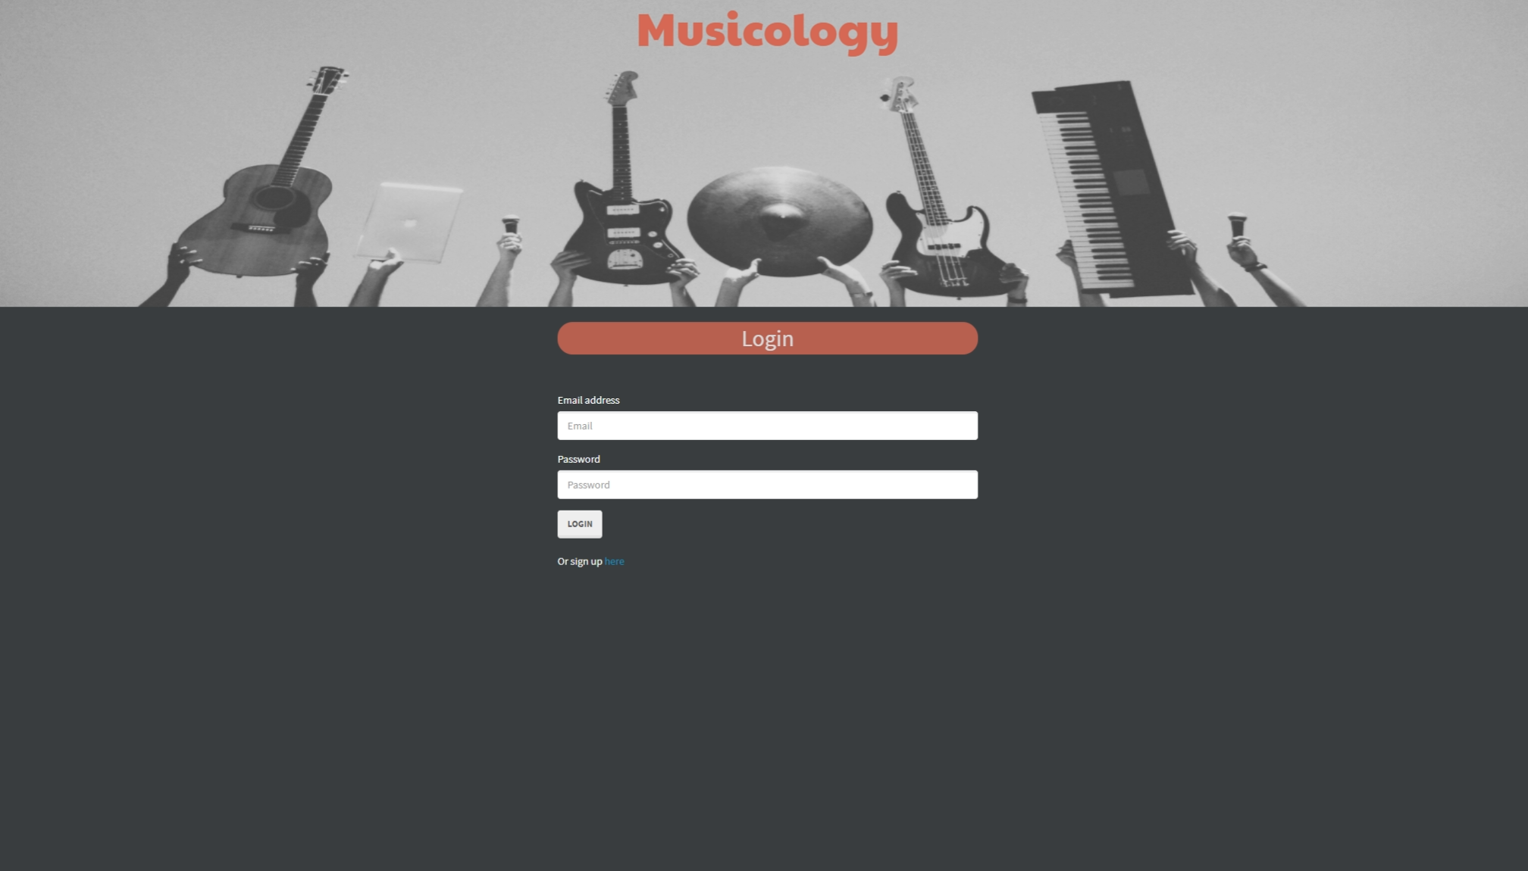
Musicology log in page takes you to your Saved member page

Slide 3
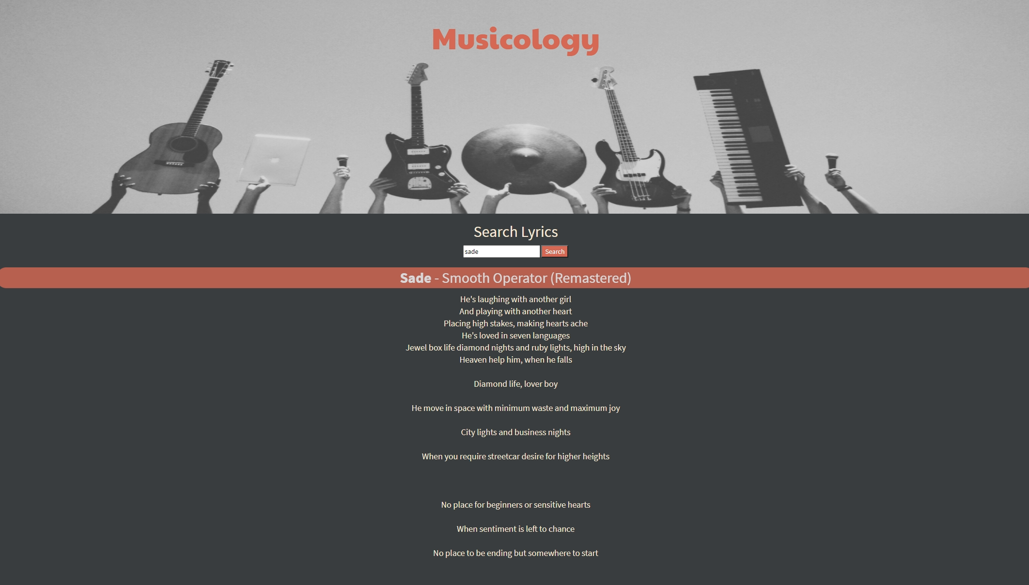
member page

Slide 4
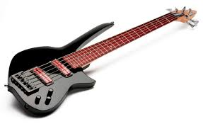

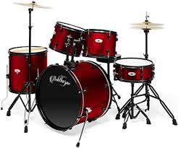
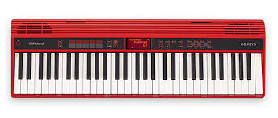
Installation
Npm I
Express
Express_handlebars
Inquirer
Mysql2
Sequelize

Slide 5
Usage
Anyone wanting their music playlist and information in one app

Slide 6
Contribution
Josh Malone: Front end, Back end, API, Readme
Jammie Hardy: Front end, Back end, API, PowerPoint
Adam Juwig: Concept Idea
Big thanks to the:
Discord family and fairy godmother

Slide 7
Future Development
Add more history details of songs or albums
When clicked play songs and or album of choice
Automate lyrics playing across screen

Slide 8
Demo
Josh malone

