Slide 1
Comprehensive Adult Wellness

Slide 2
Comprehensive Adult Wellness Provider Performance
Measure | Providers | Measure Met | 95% Confidence Interval | Standard Deviation
Breast Cancer Screening | 159 | 59.4% | (56.8% - 61.9%) | 16.2%
Colorectal Cancer Screening | 167 | 44.5% | (41.5% - 47.4%) | 19.5%
Depression Screening | 178 | 48.4% | (45.1% - 51.6%) | 22.1%
Diabetes Screening | 172 | 83.9% | (82.4% - 85.5%) | 10.5%

Slide 3
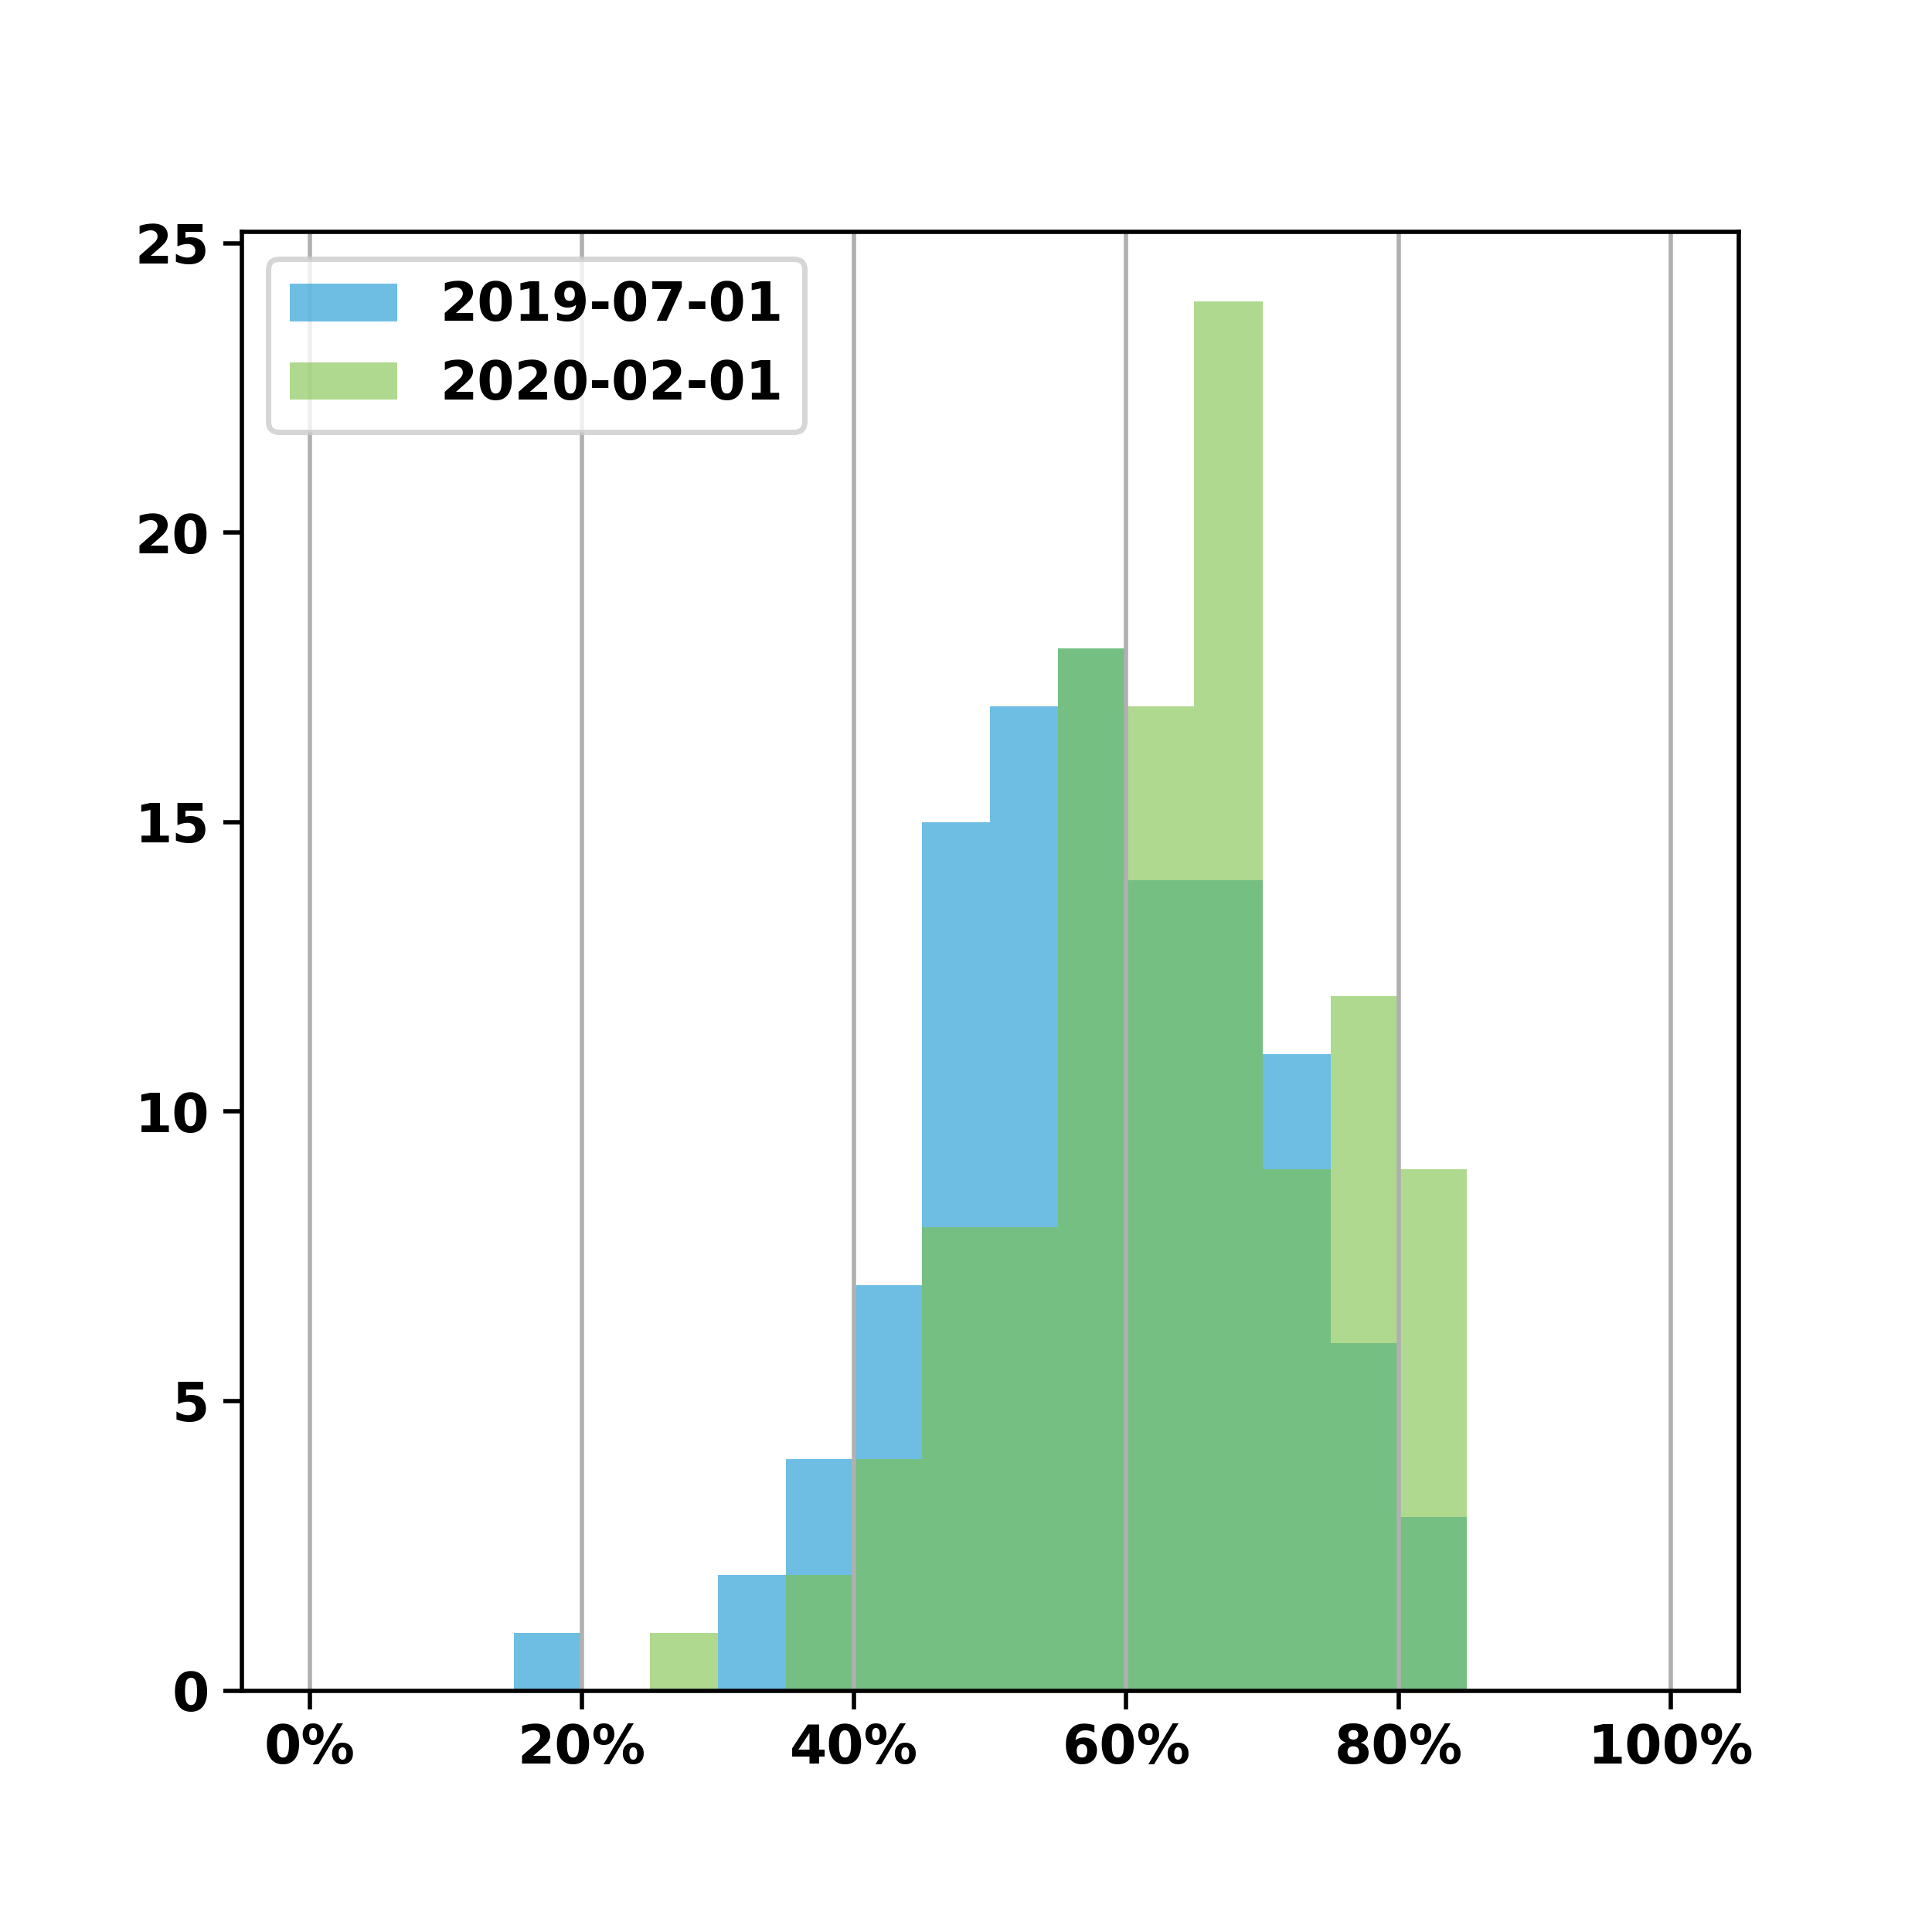
Comprehensive Adult Wellness Breast Cancer Screening
There was a significant increase of 5.4% MM across 112 providers while standard deviation decreased 0.6%
 | July 2019 | February 2020
Mean Met % | 58.0% | 63.4%
Standard Dev. | 12.0% | 11.3%
95% CI | (55.8% - 60.2%) | (61.3% - 65.4%)
t-stat: -6.4342 | df: 111 | p-value: <0.05

Slide 4
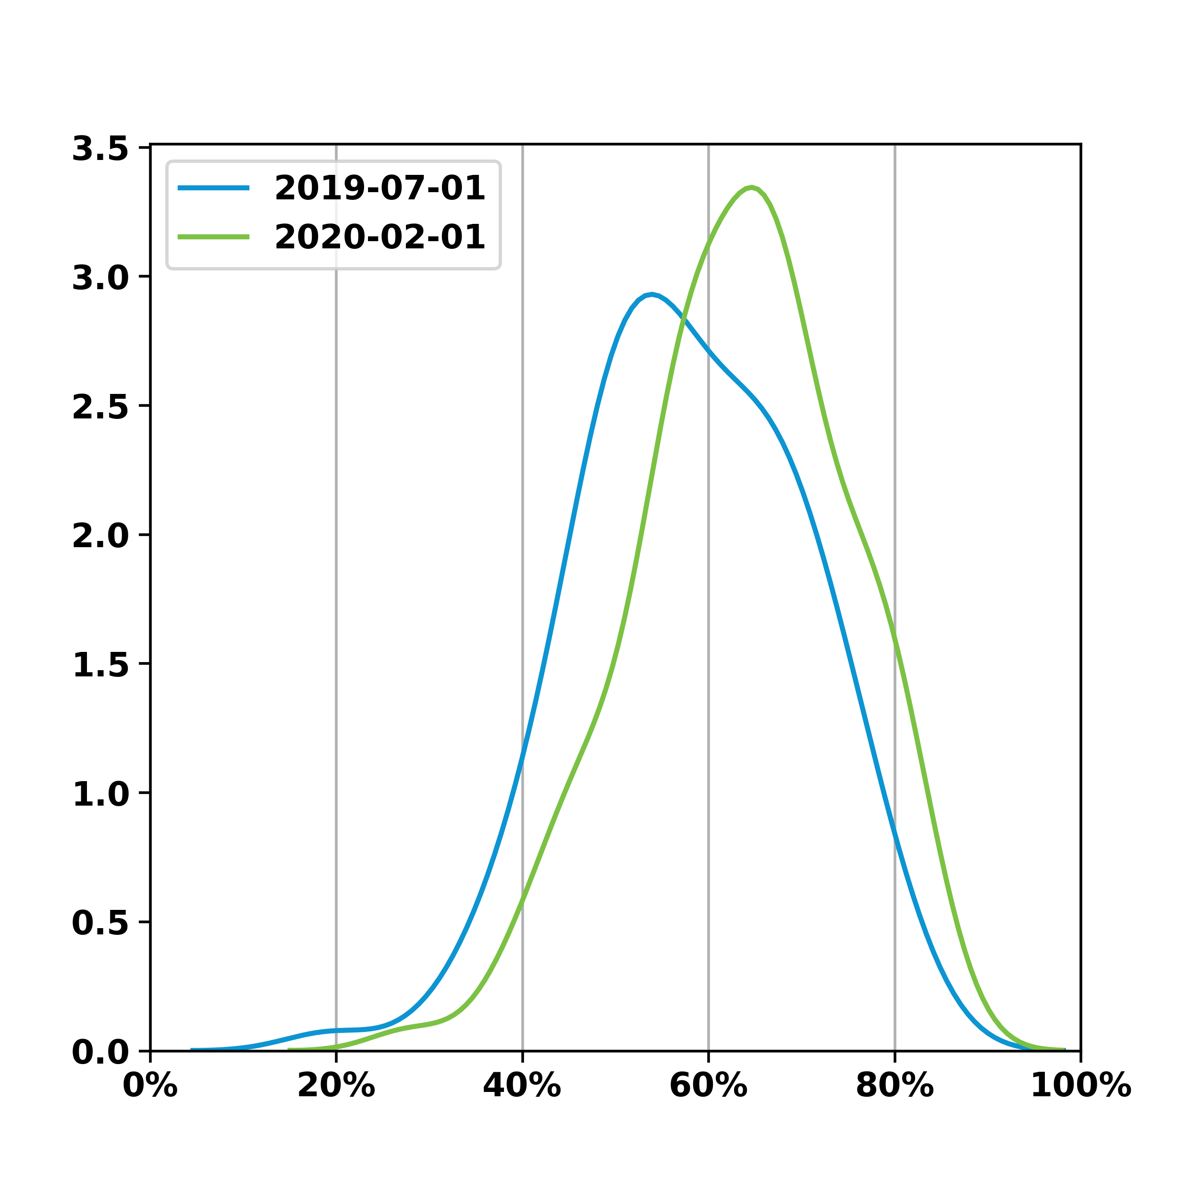
Comprehensive Adult Wellness Breast Cancer Screening
There was a significant increase of 5.4% MM across 112 providers while standard deviation decreased 0.6%
 | July 2019 | February 2020
Mean Met % | 58.0% | 63.4%
Standard Dev. | 12.0% | 11.3%
95% CI | (55.8% - 60.2%) | (61.3% - 65.4%)
t-stat: -6.4342 | df: 111 | p-value: <0.05

Slide 5
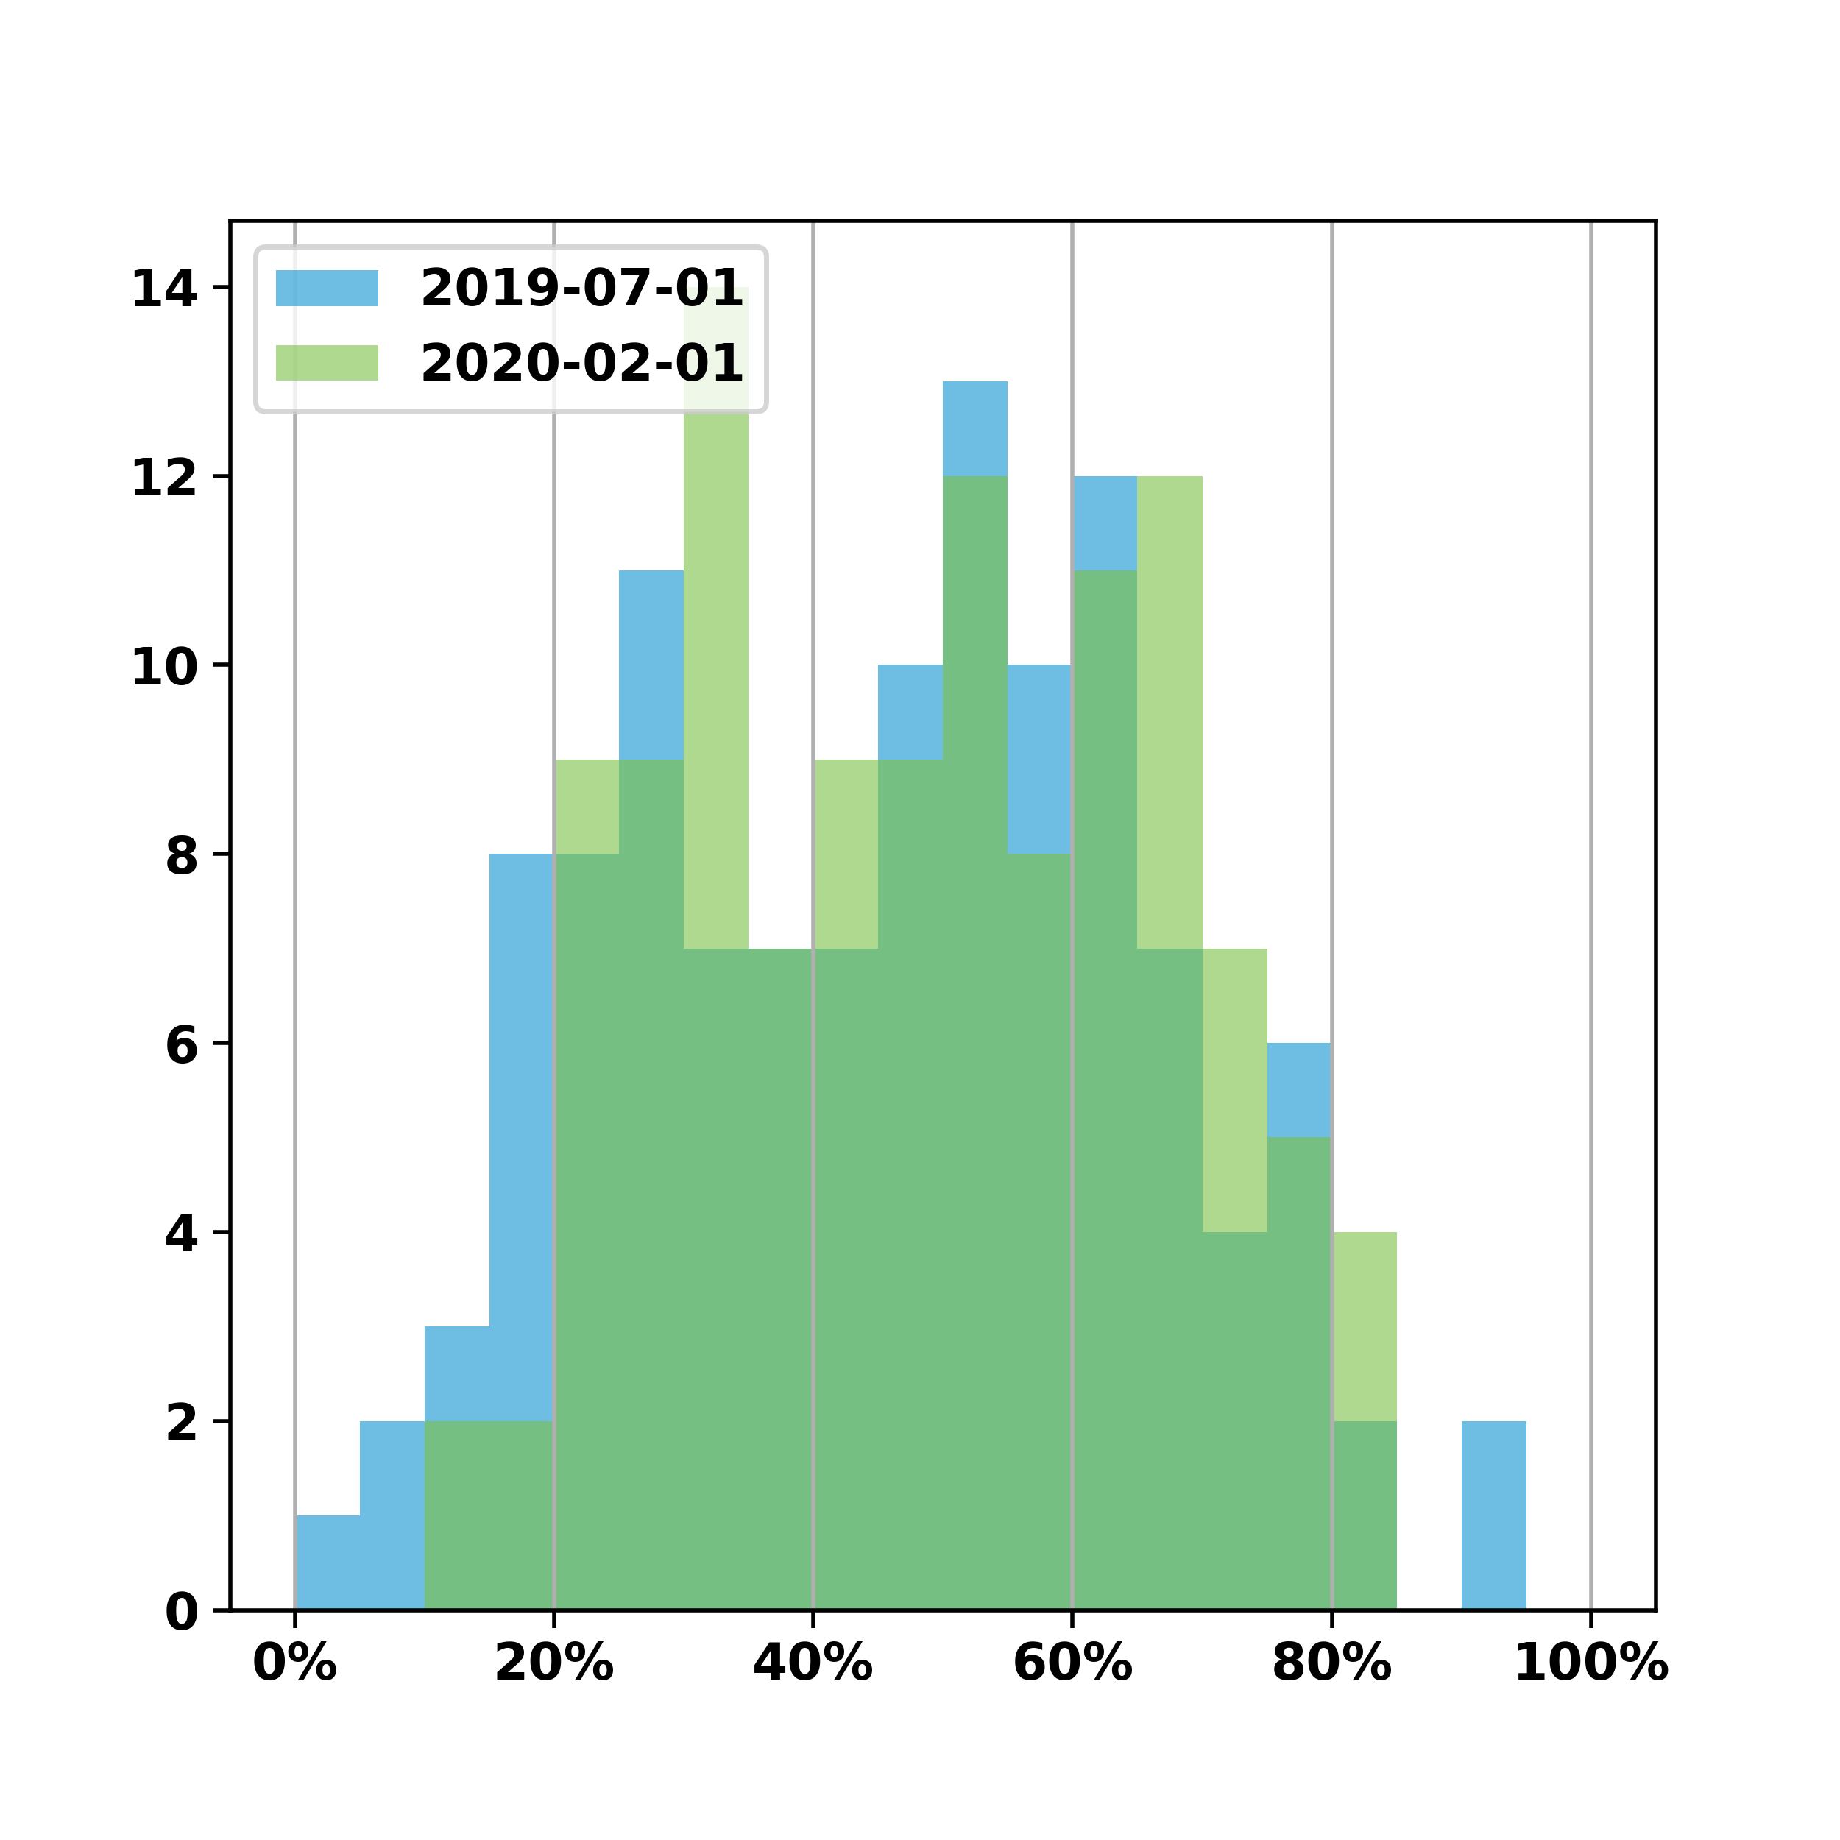
Comprehensive Adult Wellness Colorectal Cancer Screening
There was a significant increase of 2.2% MM across 120 providers while standard deviation decreased 2.1%
 | July 2019 | February 2020
Mean Met % | 46.4% | 48.6%
Standard Dev. | 20.2% | 18.0%
95% CI | (42.8% - 50.0%) | (45.4% - 51.8%)
t-stat: -3.3824 | df: 119 | p-value: <0.05

Slide 6
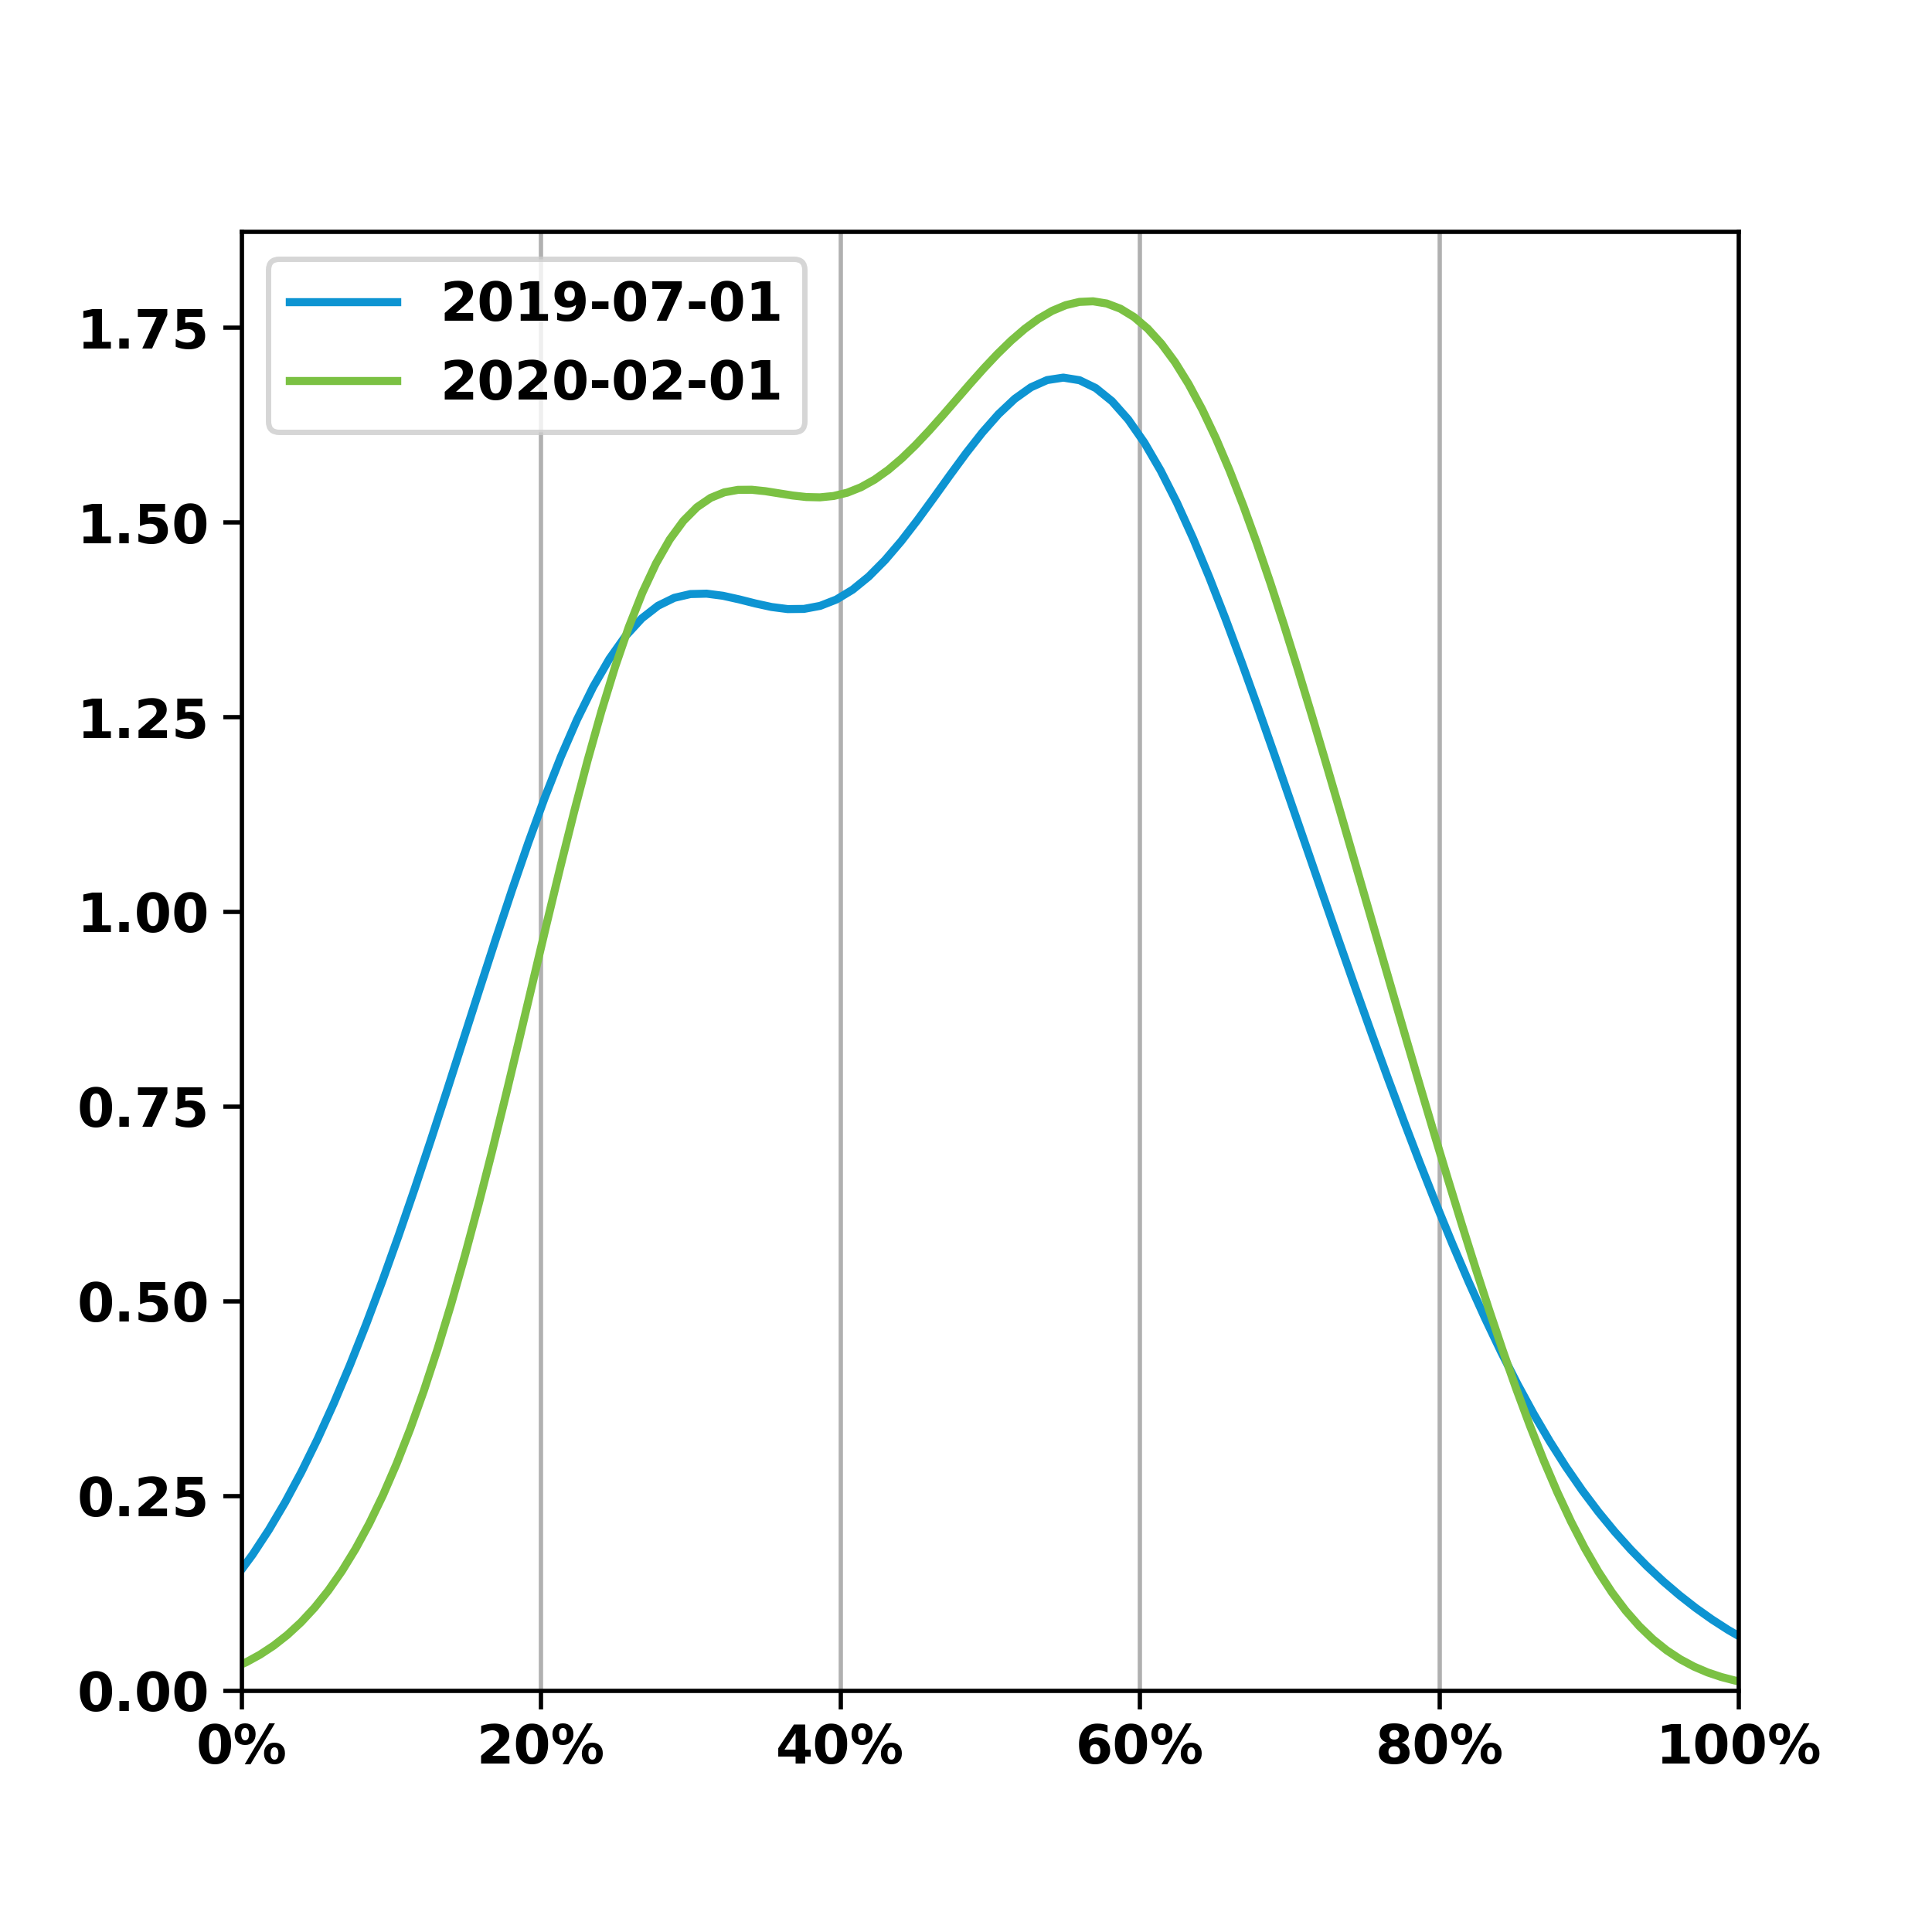
Comprehensive Adult Wellness Colorectal Cancer Screening
There was a significant increase of 2.2% MM across 120 providers while standard deviation decreased 2.1%
 | July 2019 | February 2020
Mean Met % | 46.4% | 48.6%
Standard Dev. | 20.2% | 18.0%
95% CI | (42.8% - 50.0%) | (45.4% - 51.8%)
t-stat: -3.3824 | df: 119 | p-value: <0.05

Slide 7
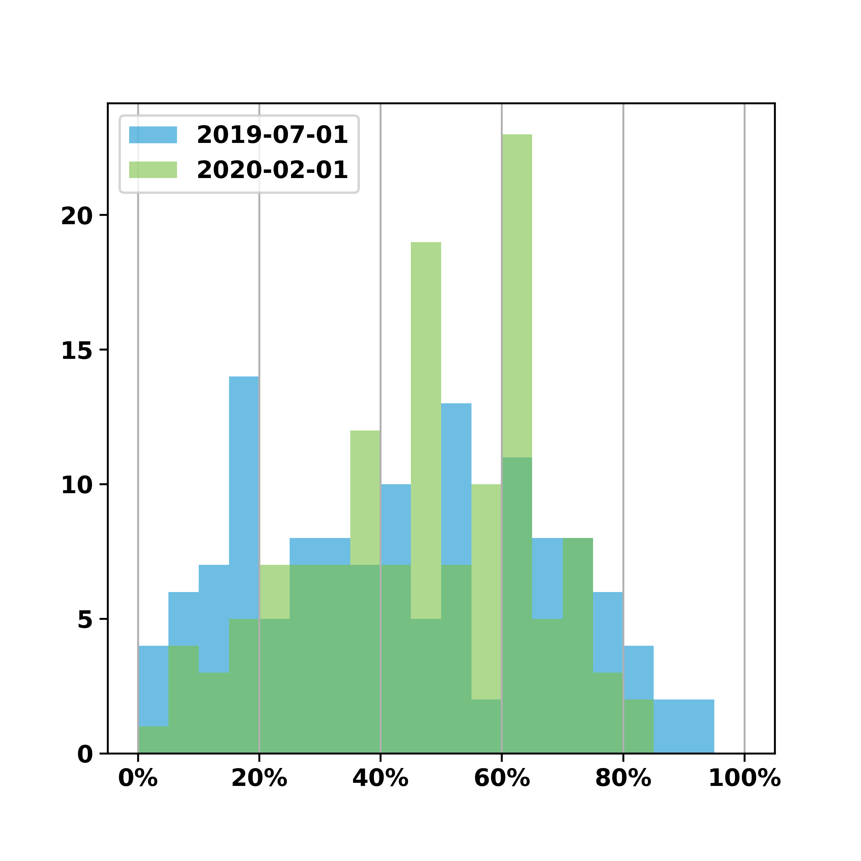
Comprehensive Adult Wellness Depression Screening
There was an increase of 3.0% MM across 130 providers while standard deviation decreased 5.5%
 | July 2019 | February 2020
Mean Met % | 43.8% | 46.7%
Standard Dev. | 24.2% | 18.7%
95% CI | (39.6% - 47.9%) | (43.5% - 50.0%)
t-stat: -1.9374 | df: 129 | p-value: 0.05*
*not statistically significant

Slide 8
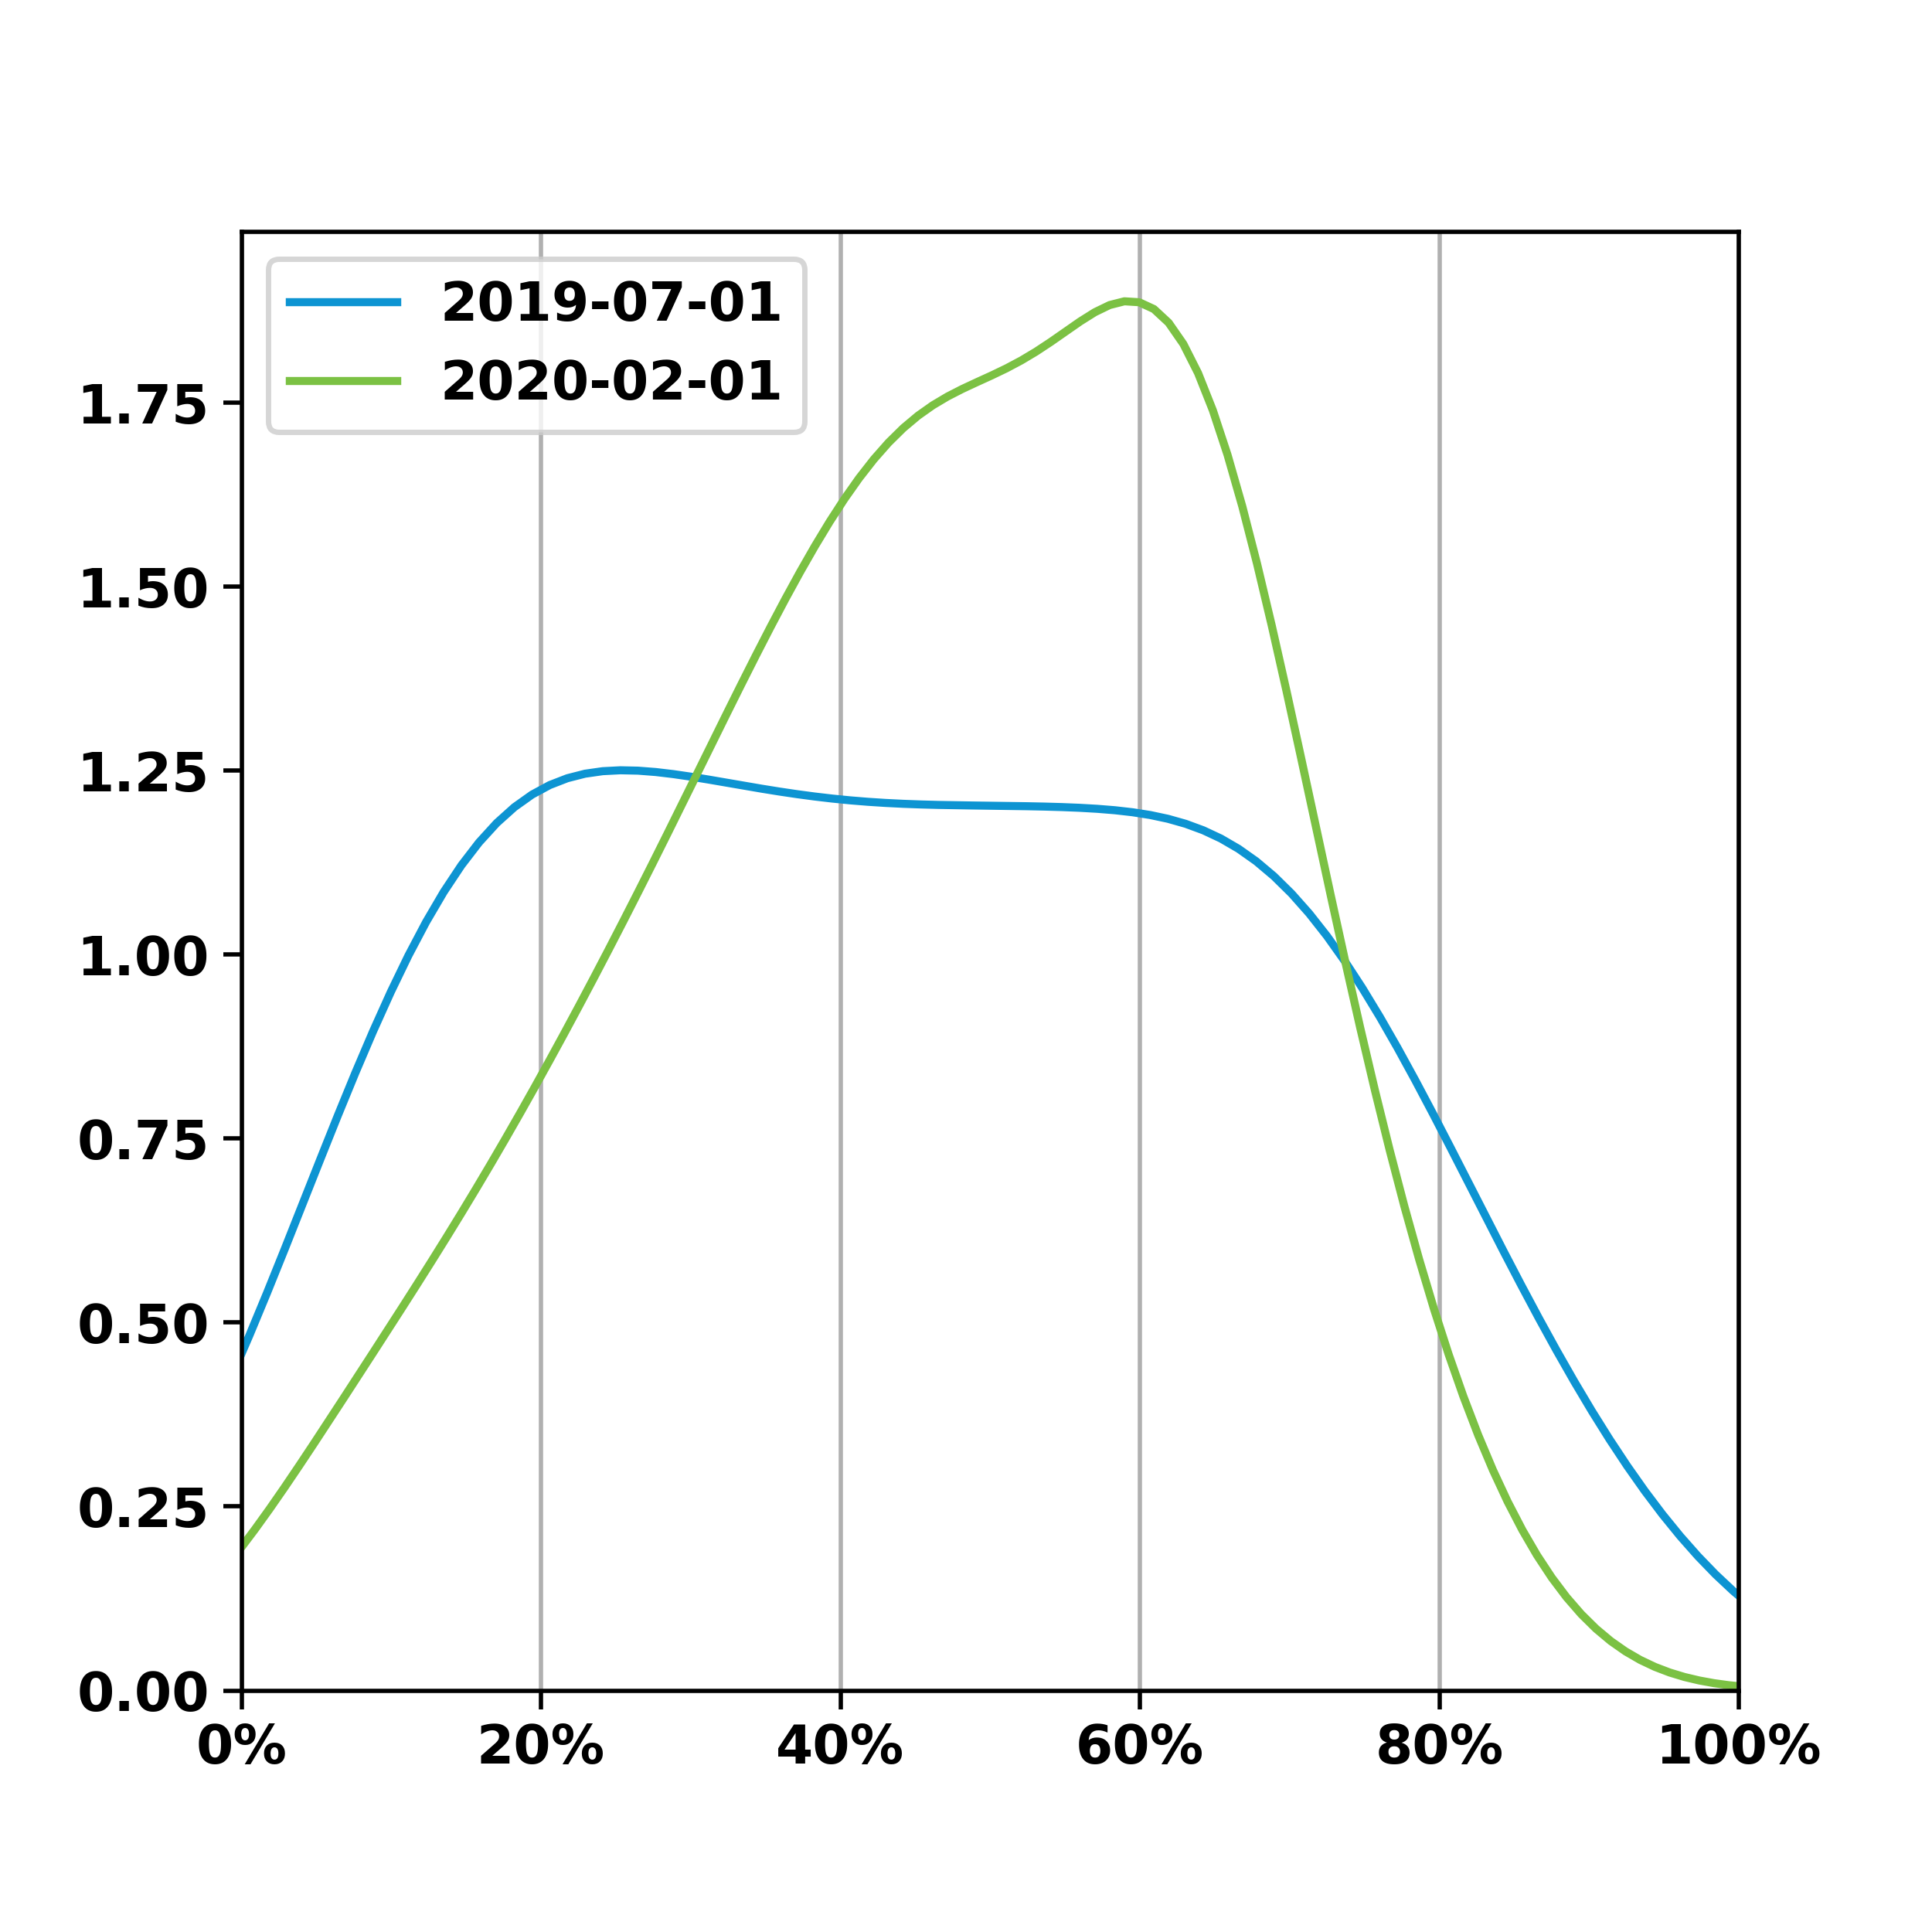
Comprehensive Adult Wellness Depression Screening
There was an increase of 3.0% MM across 130 providers while standard deviation decreased 5.5%
 | July 2019 | February 2020
Mean Met % | 43.8% | 46.7%
Standard Dev. | 24.2% | 18.7%
95% CI | (39.6% - 47.9%) | (43.5% - 50.0%)
t-stat: -1.9374 | df: 129 | p-value: 0.05*
*not statistically significant

Slide 9
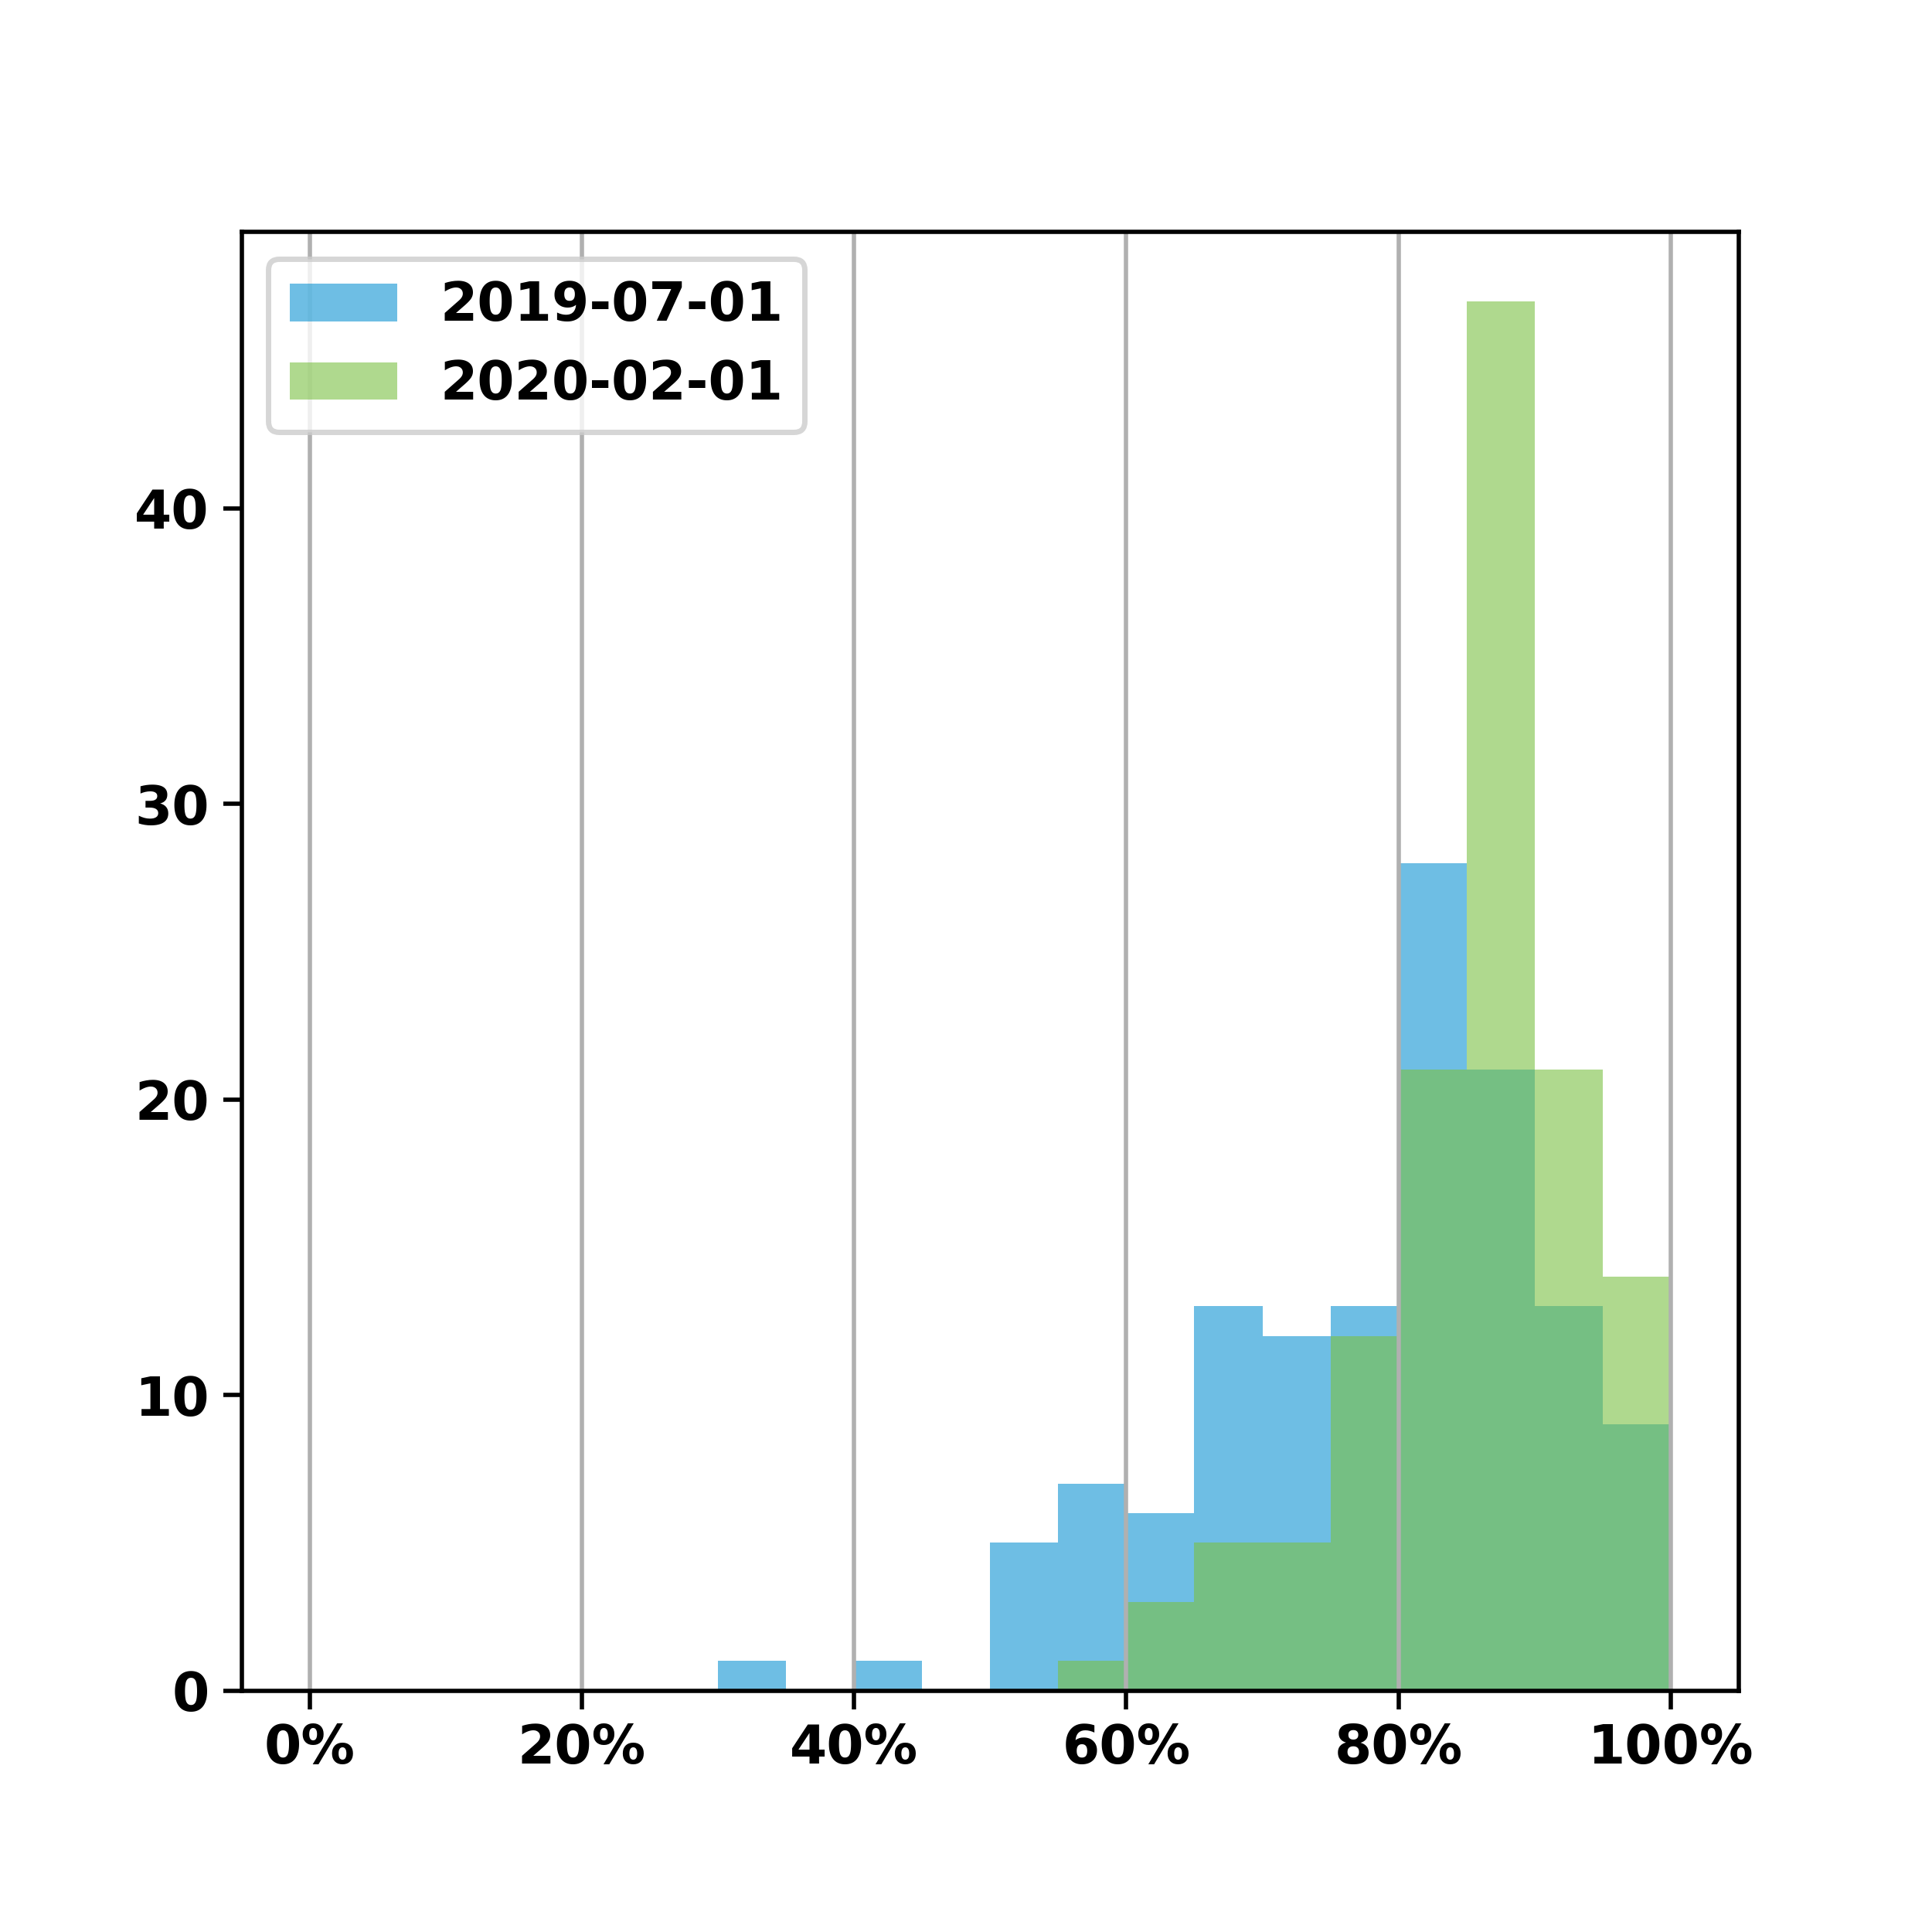
Comprehensive Adult Wellness Diabetes Screening
There was a significant increase of 7.1% MM across 129 providers while standard deviation decreased 4.6%
 | July 2019 | February 2020
Mean Met % | 78.2% | 85.3%
Standard Dev. | 12.9% | 8.3%
95% CI | (76.0% - 80.5%) | (83.9% - 86.8%)
t-stat: -10.8639 | df: 128 | p-value: <0.05

Slide 10
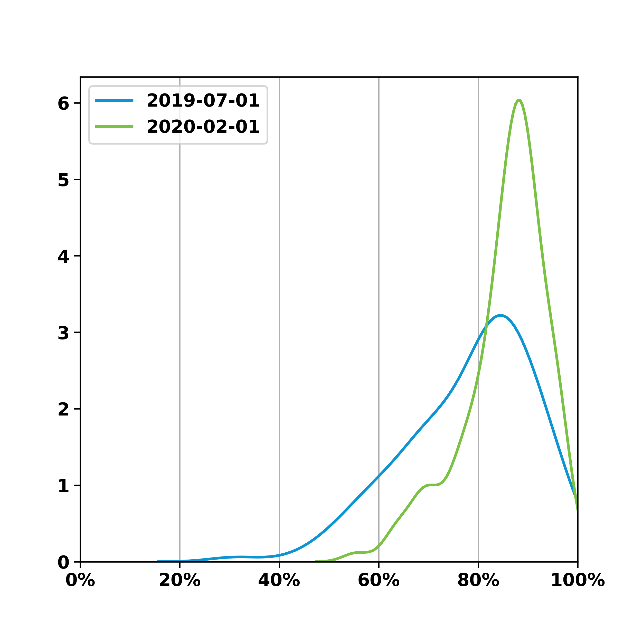
Comprehensive Adult Wellness Diabetes Screening
There was a significant increase of 7.1% MM across 129 providers while standard deviation decreased 4.6%
 | July 2019 | February 2020
Mean Met % | 78.2% | 85.3%
Standard Dev. | 12.9% | 8.3%
95% CI | (76.0% - 80.5%) | (83.9% - 86.8%)
t-stat: -10.8639 | df: 128 | p-value: <0.05

Slide 11
Diabetes Mellitus

Slide 12
Diabetes Mellitus Provider Performance
Measure | Providers | Measure Met | 95% Confidence Interval | Standard Deviation
Hba1c Less Than 8 | 147 | 56.5% | (54.2% - 58.8%) | 14.1%

Slide 13
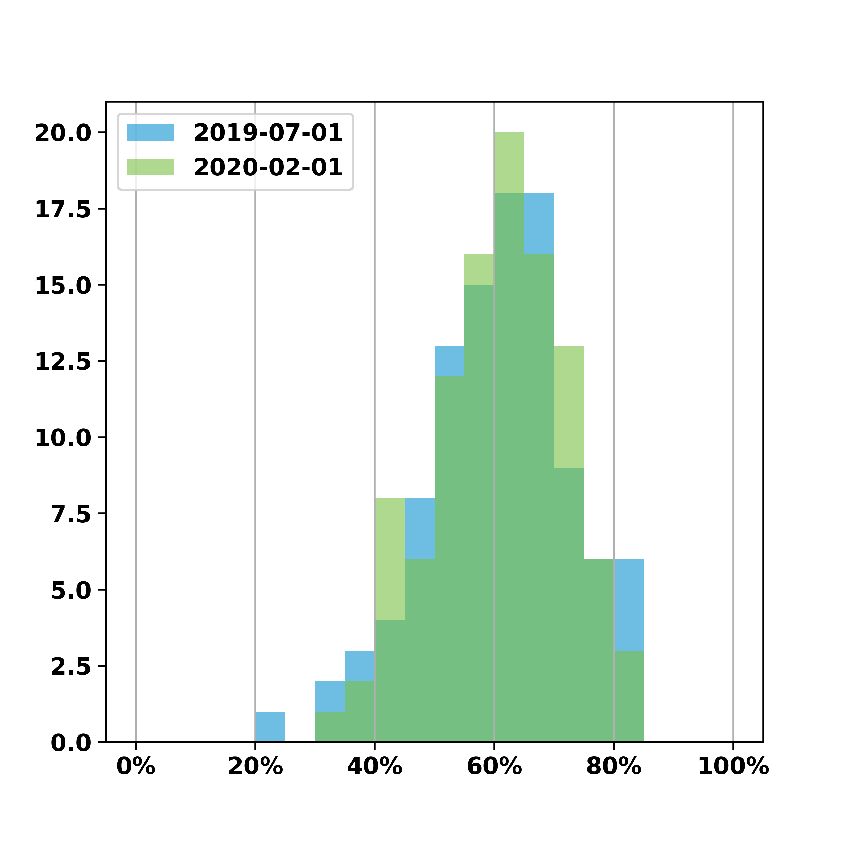
Diabetes Mellitus Hba1c Less Than 8
There was a decrease of 0.3% MM across 103 providers while standard deviation decreased 0.9%
 | July 2019 | February 2020
Mean Met % | 60.7% | 60.3%
Standard Dev. | 12.0% | 11.1%
95% CI | (58.4% - 63.0%) | (58.2% - 62.5%)
t-stat: 0.4513 | df: 102 | p-value: 0.65*
*not statistically significant

Slide 14
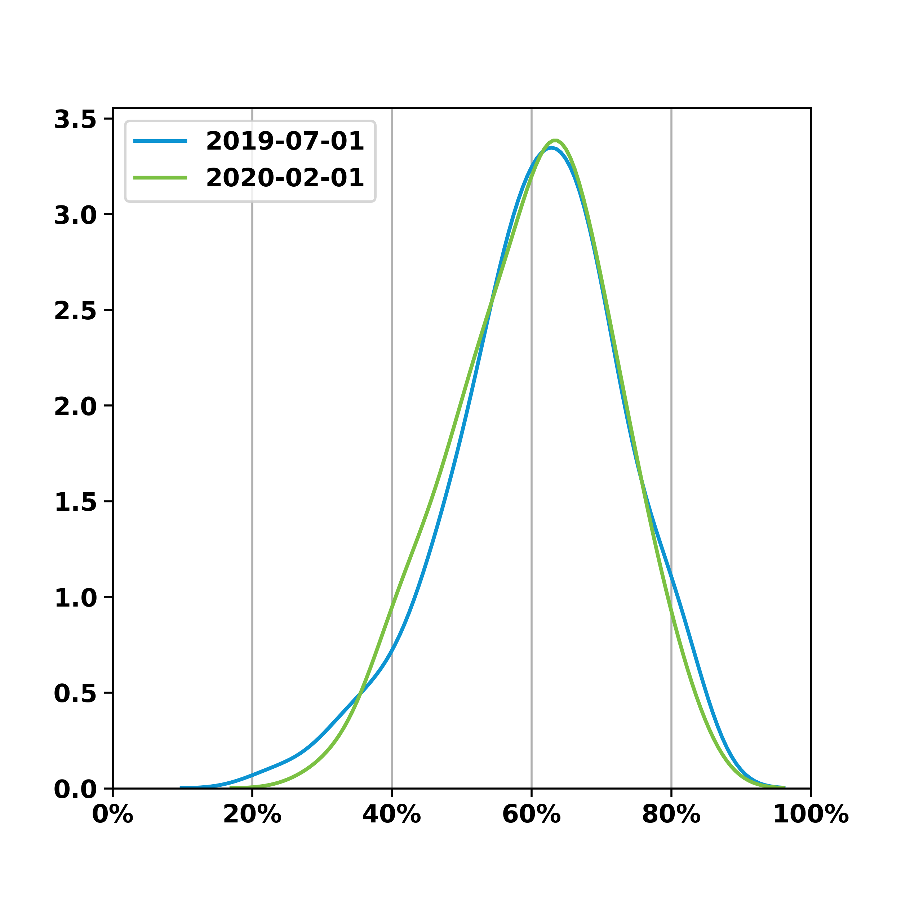
Diabetes Mellitus Hba1c Less Than 8
There was a decrease of 0.3% MM across 103 providers while standard deviation decreased 0.9%
 | July 2019 | February 2020
Mean Met % | 60.7% | 60.3%
Standard Dev. | 12.0% | 11.1%
95% CI | (58.4% - 63.0%) | (58.2% - 62.5%)
t-stat: 0.4513 | df: 102 | p-value: 0.65*
*not statistically significant

Slide 15
Hypertension

Slide 16
Hypertension Provider Performance
Measure | Providers | Measure Met | 95% Confidence Interval | Standard Deviation
Bp Less Than 140 90 | 166 | 60.5% | (58.9% - 62.0%) | 10.3%

Slide 17
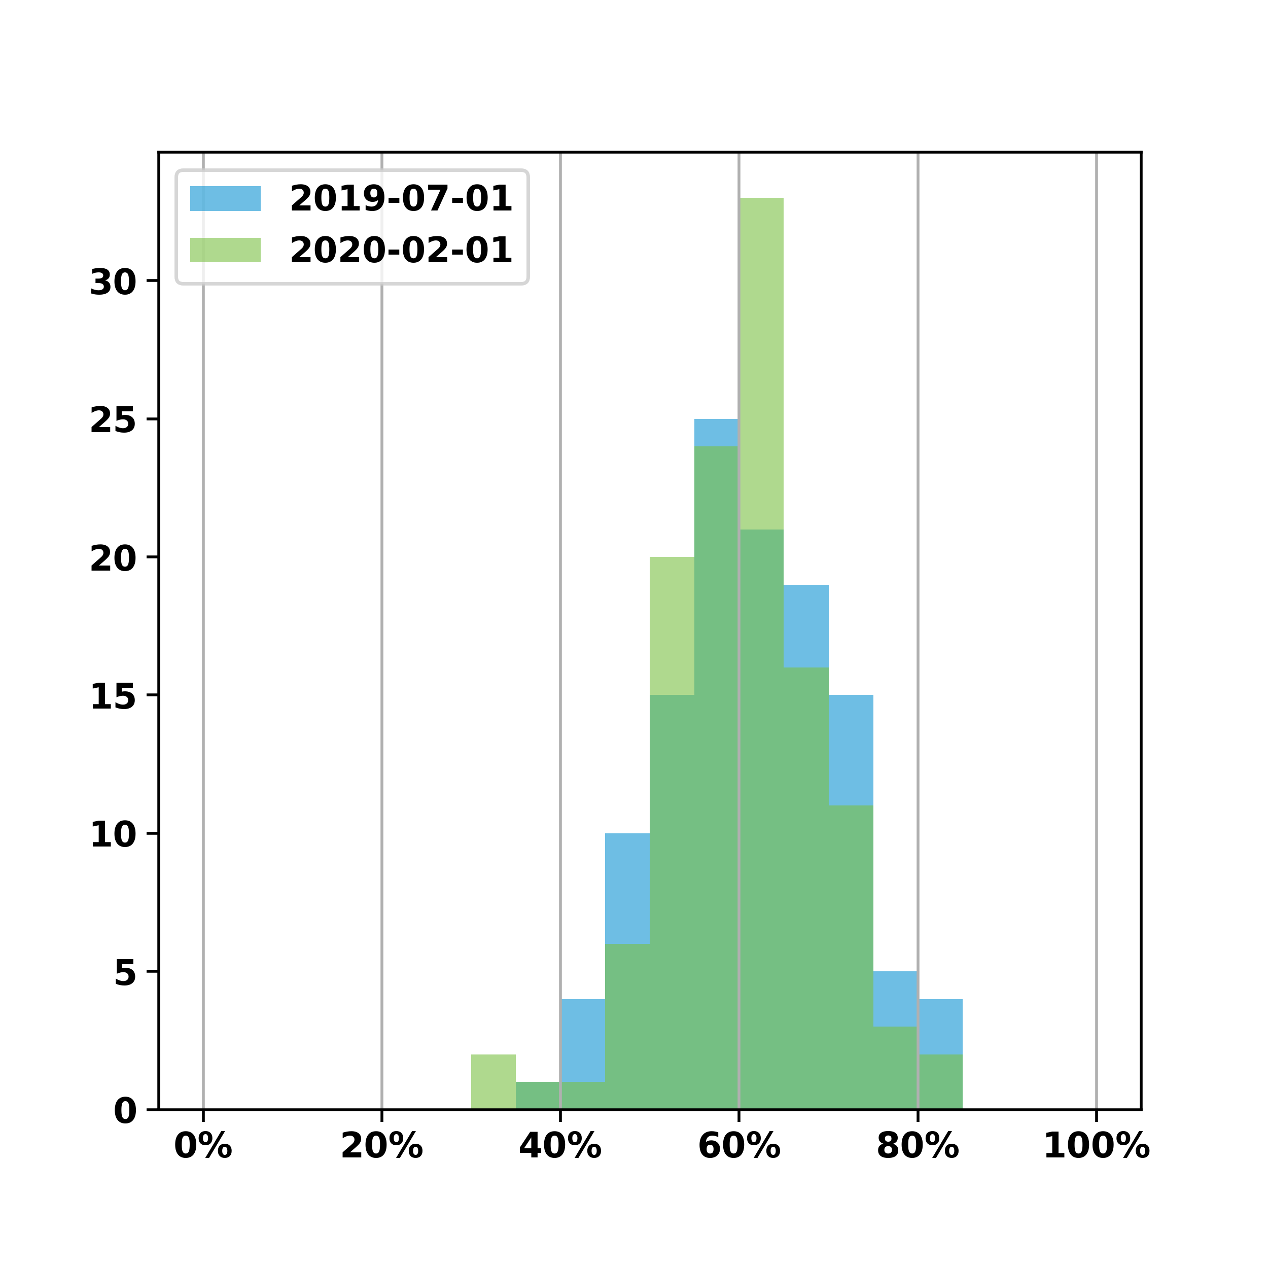
Hypertension Bp Less Than 140 90
There was a decrease of 1.0% MM across 119 providers while standard deviation decreased 0.4%
 | July 2019 | February 2020
Mean Met % | 61.3% | 60.4%
Standard Dev. | 9.2% | 8.8%
95% CI | (59.7% - 63.0%) | (58.8% - 62.0%)
t-stat: 1.2874 | df: 118 | p-value: 0.2*
*not statistically significant

Slide 18
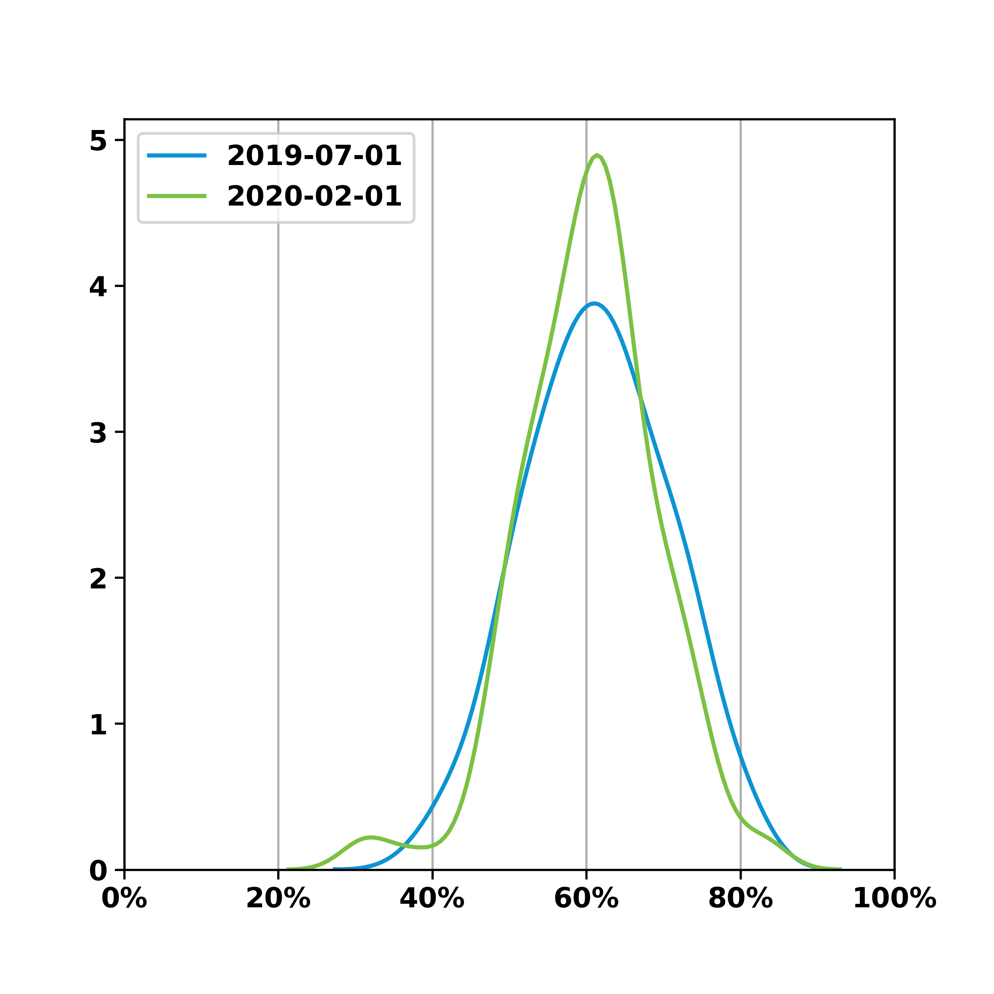
Hypertension Bp Less Than 140 90
There was a decrease of 1.0% MM across 119 providers while standard deviation decreased 0.4%
 | July 2019 | February 2020
Mean Met % | 61.3% | 60.4%
Standard Dev. | 9.2% | 8.8%
95% CI | (59.7% - 63.0%) | (58.8% - 62.0%)
t-stat: 1.2874 | df: 118 | p-value: 0.2*
*not statistically significant

