Slide 1

Movie Recommendation System
John Maloney
January 2025
UMGC Capstone Final Project

Slide 2
Introduction
The Problem:
In the modern digital entertainment world, users have access to vast catalogs of movies on streaming platforms. However, discovering new content can be overwhelming. A recommendation system aims to solve this issue by providing personalized suggestions based on user preferences. By analyzing user interactions (e.g., ratings) and demographic information, the system can recommend movies that users are likely to enjoy, increasing user engagement and satisfaction.

Slide 3
Model Results
MAP
57.3%
NDCG
100%
P
88.9%
R
57.3%
Mean Average Precision
Normalized Discounted Cumulative Gain
Precision@K
Recall@K
Pro: High precision indicates that the top-k movies are accurate and relevant recommendations most of the time.
Con: The low recall metric shows that the model is only retrieving about 57% of the relevant items from the entire pool of possible recommendations.

Slide 4
Data Preparation
Dataset: MovieLens 1M (1M ratings from 6,000 users on 4,000 movies).
Files used:
ratings.dat: User IDs, movie IDs, ratings, timestamps.
movies.dat: Movie IDs, titles, genres.
Preprocessing steps:
Convert timestamps to human-readable dates.
Normalize columns (userId, movieId, rating).
Handle missing and inconsistent values.

Slide 5
Files Used in the Project
data_processing.py: Loads and preprocesses data.
main.py: Runs the recommendation system, collects user input, and displays results.
model.py: Defines the NCF model architecture and loads weights.
train.py: Manages training, splits data, and saves accuracy graphs.

Slide 6
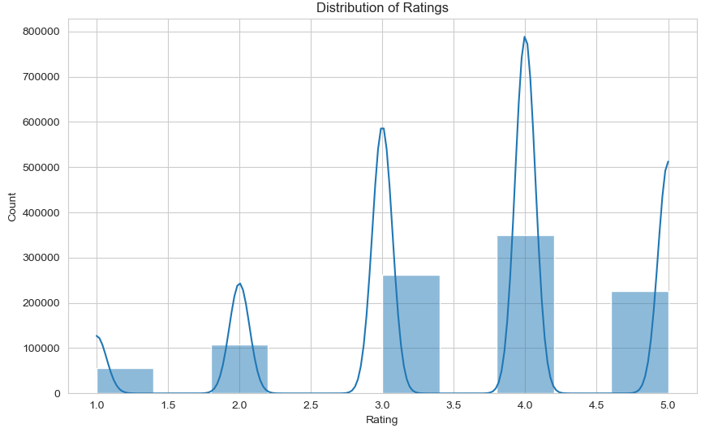
Exploratory Data Analysis (EDA)
Goal: Understand dataset trends and patterns.
Key Insights:
Distribution of Ratings: Most ratings fall between 3 and 4 stars.
User Behavior: Some users rate significantly more movies than others.
Popular Movies: Certain movies receive more ratings, reflecting popularity.

Slide 7
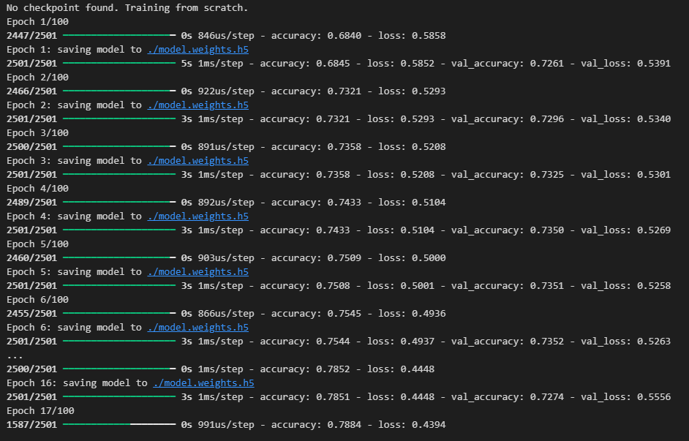
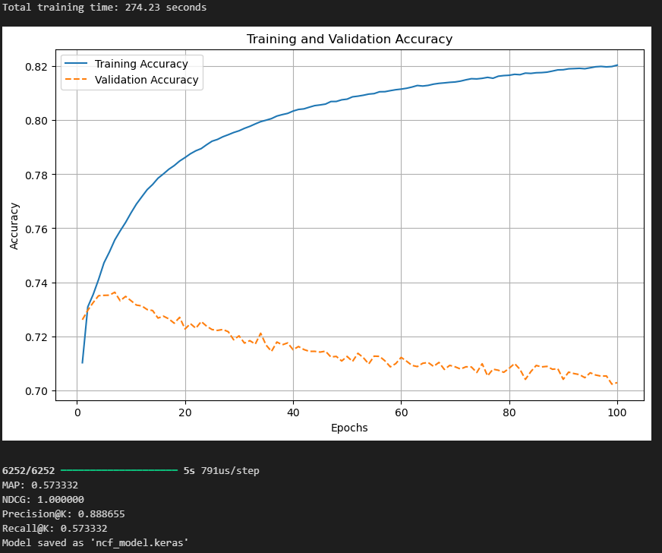
Model Development
Core Model: Neural Collaborative Filtering (NCF).
Initial training: 100 Epochs
Training from scratch or resume from .ckpt file
Elapsed time, Accuracy, Loss are tracked live during training
Training graphs are saved after each session to provide clear visualization of overfitting trends

Slide 8
Challenges and Solutions
Challenge 1: Inconsistent user behavior (e.g., conflicting ratings).
Solution: Apply a filtering mechanism to reduce noise.
Challenge 2: Data imbalance (popular movies dominate).
Solution: Use downsampling to balance the dataset.
Challenge 3: Long training time on Colab.
Solution: Optimize data loading and save intermediate results.

Slide 9
Conclusion/Future Improvements
This project showcased the development of a movie recommendation system using Neural Collaborative Filtering. By leveraging deep learning techniques, I was able to build a model that goes beyond traditional matrix factorization methods, offering more personalized and accurate recommendations.
Future improvements could include:
Incorporating User Demographics: Adding user demographic data could further improve the personalization of recommendations.
Fine-Tuning Hyperparameters: Experimenting with different model configurations to optimize performance.
Scaling to Larger Datasets: Applying the model to larger datasets to test its scalability.
Overall, this project provided valuable insights into the challenges and solutions involved in building a recommendation system using machine learning.

