Slide 1
Elasticsearch
You Know, for Search

Slide 2
What is Elasticsearch?
a highly scalable open-source full-text search and analytics engine
stores, searches, and analyzes big volumes of data quickly and in near real time
underlying engine/technology that powers applications that have complex search features and requirements

Slide 3
Elasticsearch - NoSQL Database?
Elasticsearch is commonly used in addition to another database (so it is not used a primary database)
The primary database system should provide strong focus on constraints, correctness and robustness, and on being readily and transactionally updatable
The records from master databse are then asynchronously pushed to Elasticsearch
Strong focus is put on keeping things in sync
There's no silver bullet - no one solution to rule all demands

Slide 4
Basic terms: Cluster and Node
A cluster is a collection of servers (nodes)
It can consist of one or more nodes
Cluster is responsible for keeping the entire data and provides indexing, storage and search capabilities
Node is a single server that participates in operations performed on cluster
Starting a node you can define which cluster it should join. With proper configuration it will be automatically discovered.
By default:
{ "name": "KEM2Lnm",
"cluster_name": "elasticsearch",
"cluster_uuid": "7JLViti1RbKmYYwZWyo1JQ", …
}

Slide 5
Basic terms: Index
A collection of related documents
Index is identified by its name
Different strategies for distributing data on indices
Assuming we have three docuemnt types - product, client and order:
It is common to create separate indices for each of them
But we can also place them all in one index

Slide 6
Index – think about strategy
Catalog-based data
>curl -XPUT http://localhost:9200/catalog_v1
>curl -XPUT http://localhost:9200/catalog_v1/_alias/catalog
>curl -XPUT http://localhost:9200/catalog_v2
>curl -X POST http://127.0.0.1:9200/_aliases \
-d '{
"actions": [
{ "remove": { "index": "catalog_v1", "alias": "catalog" }},
{ "add": { "index": "catalog_v2", "alias": "catalog" }}
]
}'
>curl -X DELETE http://127.0.0.1:9200/catalog_v1

Slide 7
Index – think about strategy
Index per client
>curl -XPUT http://localhost:9200/catalog_Earp
>curl -XPUT http://localhost:9200/catalog_Empirica
Shared index + routing
curl -X PUT http://127.0.0.1:9200/catalog \
-d '{
"mappings": {
"order": {
"properties": {
"catalog_id": {
"type": "string", "index": "not_analyzed" }…}'

Slide 8
Index – think about strategy
Time-based index
>curl -XPUT http://localhost:9200/logs_20170620
>curl -XPUT http://localhost:9200/logs_20170620/_alias/logs
// insert logs >curl –XPUT http://localhost:9200/logs/log/123456 ...
>curl -XPUT http://localhost:9200/logs_20170621
>curl -X POST http://127.0.0.1:9200/_aliases \
-d '{
"actions": [
{ "remove": { "index": "logs_20170620", "alias": "logs" }},
{ "add": { "index": "logs_20170621", "alias": "logs" }}
]
}'
>curl -XPOST http://localhost:9200/logs_20170620/_close

Slide 9
Basic terms: Shard
Index can be subdivided into smaller pieces called „shards”
The number of shards is defined on index creation time
Single shard acts in a similar way like index
Shard can be hosted on any node of the cluster
The mechanism of distributing documents across shards and preforming search queries on multiple shards is managed internally by Elasticsearch
Single shard cannot be split on different nodes (but single node can have multiple shards)
Useful for:
large amounts of data in order to horizontally scale the data volume
Distributing and parallelizing search operations for better performance

Slide 10
Basic terms: Replica shard
Copy of index’s shard
Failover mechanism (when node goes off, shard gets corrupted etc.)
Replica is never allocated on the same node as its primary shard
When primary shard goes down, its replica starts to act as the original shard
Number of replicas can be defined at index creation time and later changed dynamically
Posibility to dynamically adjust numer of replicas can be very usefull when topic of scaling comes into play
By default Elasticsearch creates 5 shards per index and one replica for each primary shard (that gives total of 10 shards per index)

Slide 11
Basic terms: Type and Document
Type
Logical part of index
Set of fields that have common name, type, analyzer, tokenizer etc.
It is not obligatory to define a contract for a type
Document
Basic unit of information
Is expressed in JSON format
A document, while indexing, must be assigned to a type that resides in one of the indices

Slide 12
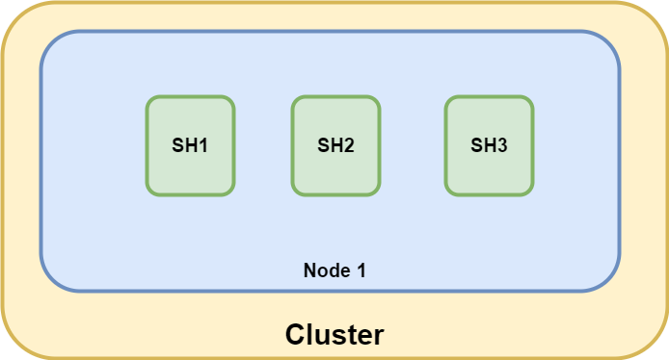
Single node with three shards

Slide 13
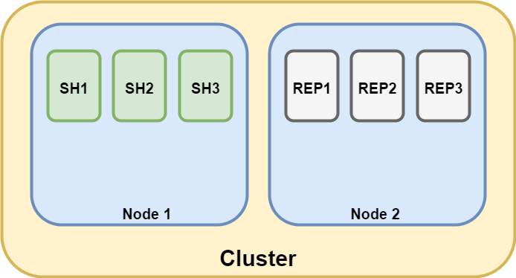
Two nodes with three shards and replicas

Slide 14
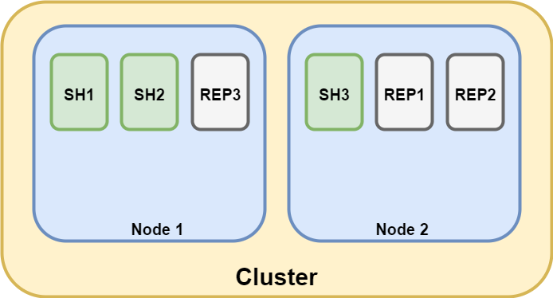
Two nodes with three shards and replicas

Slide 15
Document oriented database
Before saving, documents must be denormalized
Denormalization:
increases retrieval performance (no query joining is necessary)
uses more space (infomation must be stored several times)
makes keeping things consistent and up-to-date more difficult (any change must be applied to all instances)
Denormalized documents are great for write-once-read-many-workloads strategy
After preparing data for searching, it needs to be indexed

Slide 16
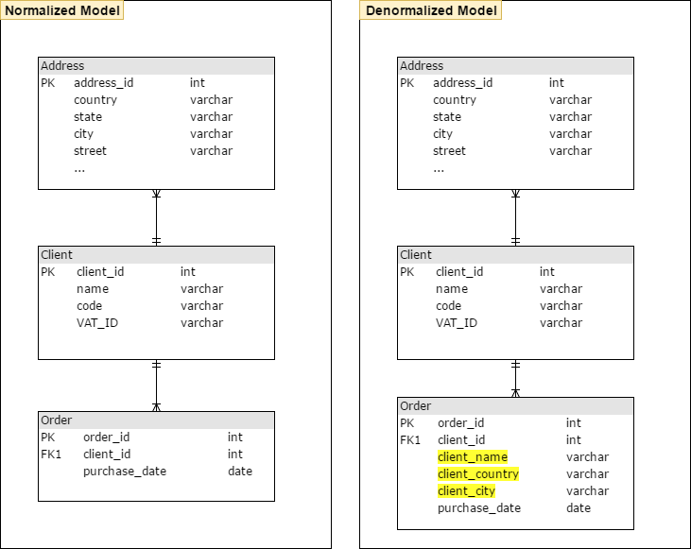

Slide 17
Elasticsearch - indexing data
POST http://127.0.0.1:9200/crm-invoicing/order
{
"order_id": "34",
"cient_id": "1",
"name": "EARP",
"code": "WR-EARP",
"country": "Poland",
"city": "Warszawa",
"date": "2017-06-21"
},
{
"order_id": "35",
"cient_id": "2",
"name": "Empirica",
"code": "WR-EMP",
"country": "Poland",
"city": "Wroclaw",
"date": "2017-06-16"
}

Slide 18
Working with Elasticsearch
GET http://127.0.0.1:9200/crm-invoicing/order/_search?q=name=EARP
POST http://127.0.0.1:9200/crm-invoicing/order/_search
{
"query": {
"bool": {
"must": [
{ "match": { "name": "Empirica" } }
]
}
}
}

Slide 19
Elasticsearch response
{
"took": 2,
"timed_out": false,
"_shards": {
"total": 5,
"successful": 5,
"failed": 0
},
"hits": {
"total": 1,
"max_score": 0.30685282,
"hits": [
{
"_index": "crm-invoicing",
"_type": "order",
"_id": "AVyxIXacMnetrernk8np",
"_score": 0.30685282,
"_source": {
"order_id": "35",
"cient_id": "2",
"name": "Empirica",
"code": "WR-EMP",
"country": "Poland",
"city": "Wrolaw",
"date": "2017-06-16"
} } ] }
}

Slide 20
Dziękuję ☺

