Slide 1
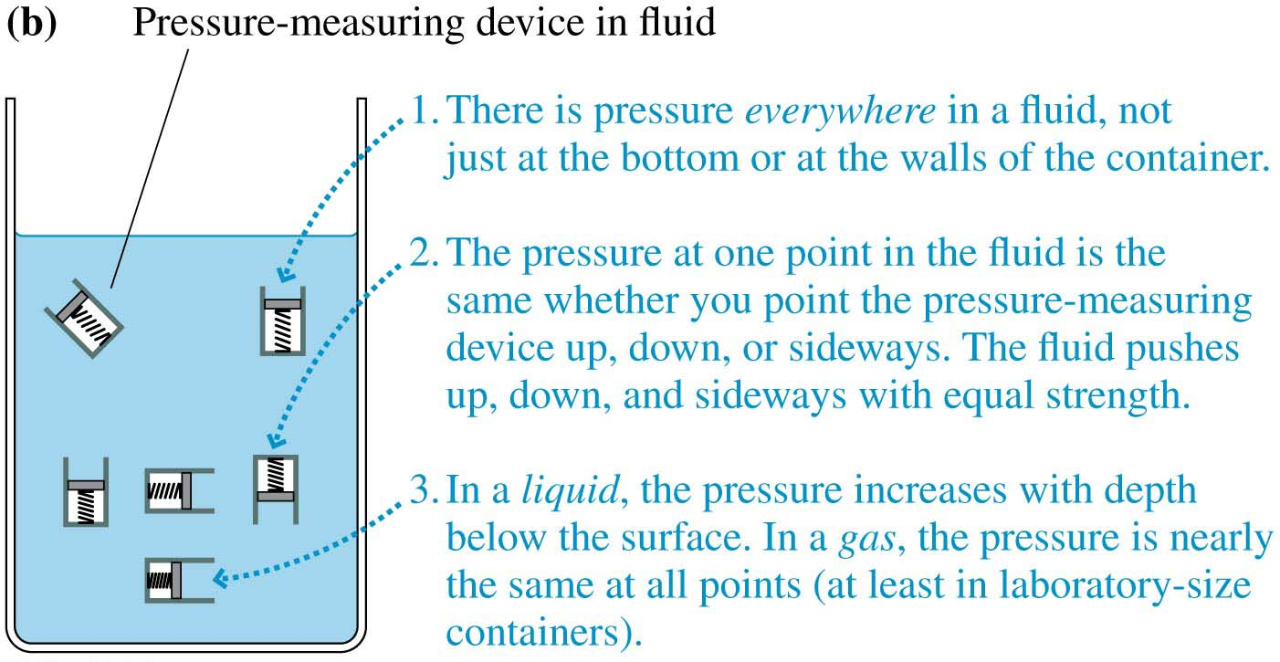
Figure 14.4b
© 2017 Pearson Education, Inc.

Slide 2
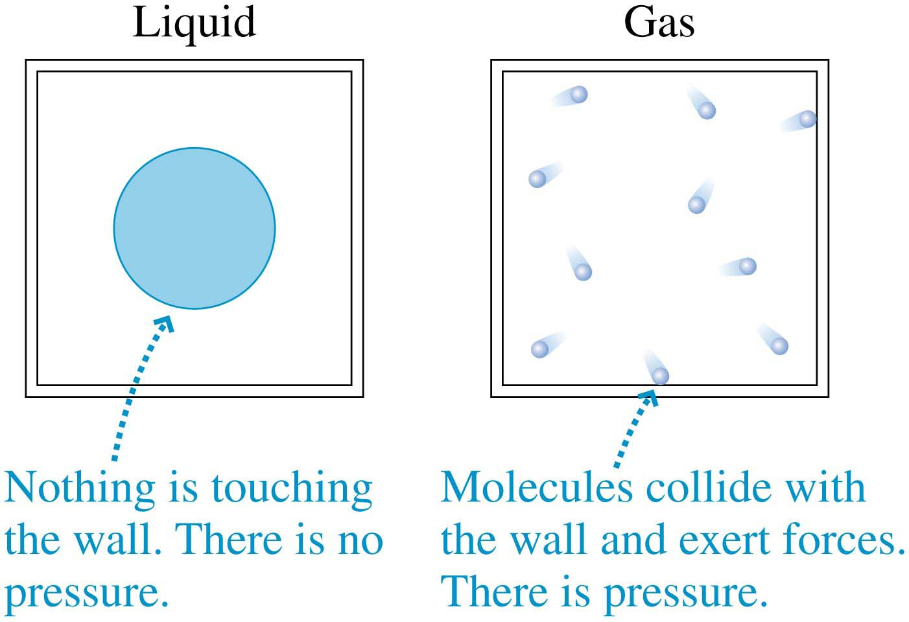
Figure 14.5
© 2017 Pearson Education, Inc.

Slide 3
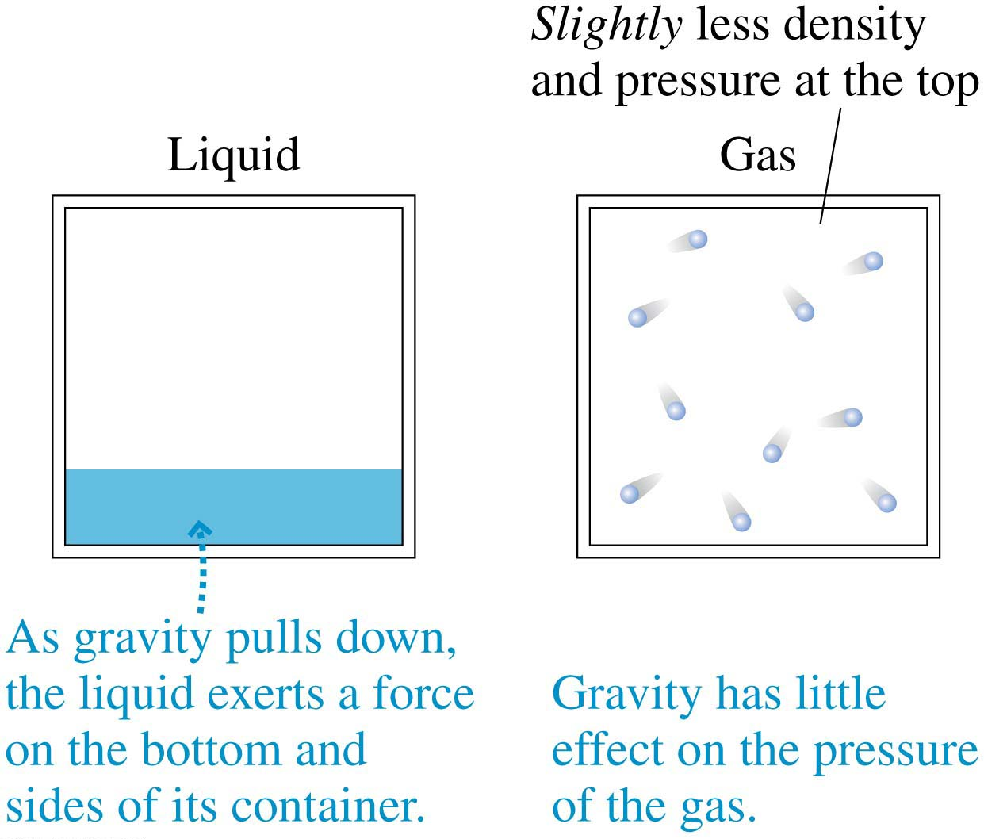
Figure 14.6
© 2017 Pearson Education, Inc.

Slide 4
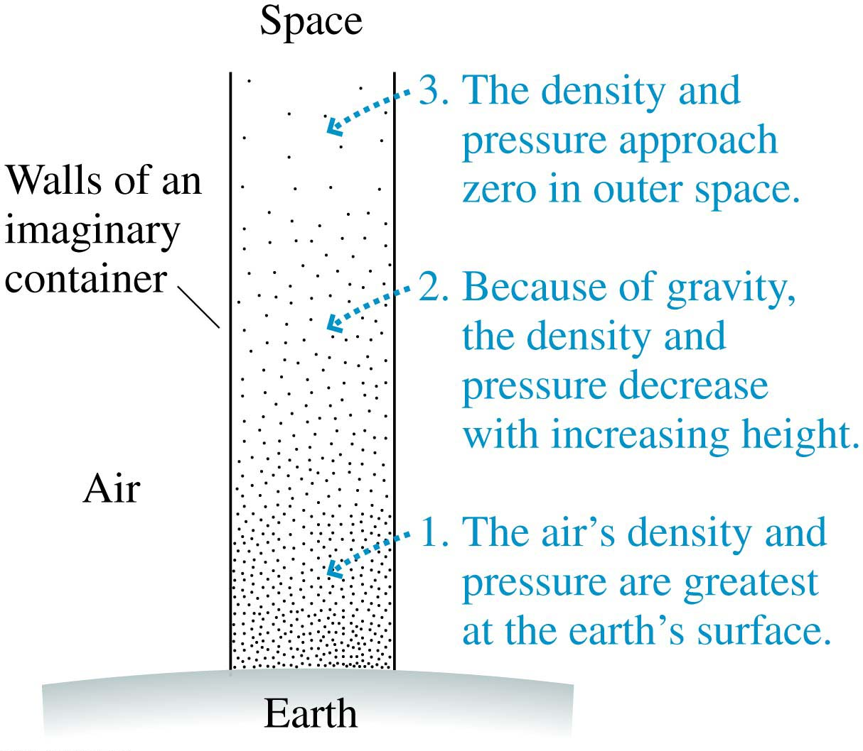
Figure 14.7
© 2017 Pearson Education, Inc.

