Slide 1
Rubik’s Cube Manipulator
Jules Manalang

Slide 2
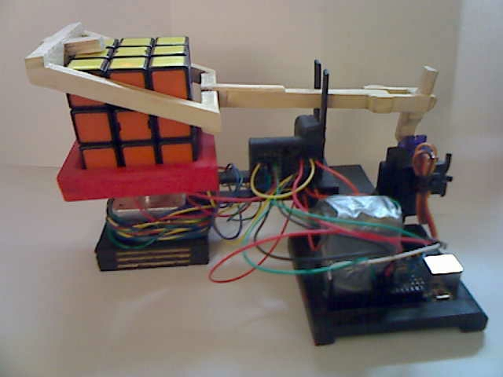
Objectives
The Rubik’s Cube Manipulator turns the faces of the cube as directed by the user through the use of the Serial Monitor built into the Arduino IDE.

Slide 3
Purpose
I am a Competitive Rubik’s Cuber – Averages around 10 Seconds
During practice, a cuber scrambles and solves the cube. Extra Work-> Extra Tired-> Less Practice
Some cubers do over 1000 solves a day
An average solve takes over 50 moves to solve
An average scramble is 20 moves
That’s around 70,000 turns
With a cube manipulator that takes in a string input, no wasted effort.
Simply type the desired moves (text form) into the Cube Manipulator and it does for you
It doesn’t only scramble the cube, but takes in any valid input
This means it can solve the cube as well if you give it the solution.

Slide 4
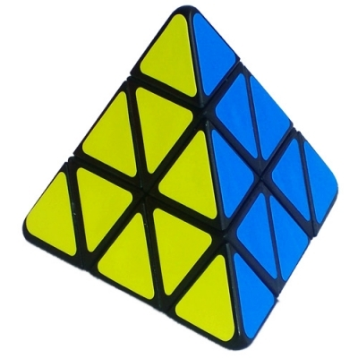
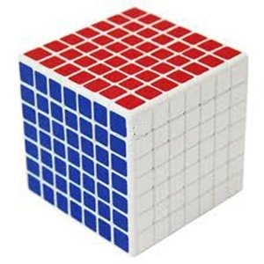
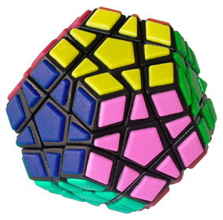
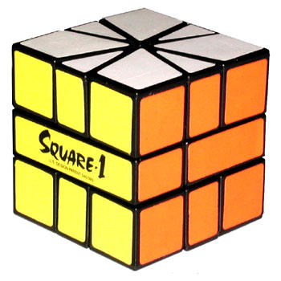
Real life application and Expansion
The Cube Manipulator could help at Rubik’s Cube competitions.
Replace Human Scramblers with robots – No Human Error
Improved Design – Faster than Human Scramblers
Adapt to Different Types of Puzzles

Slide 5
Realtime and Embedded
The Arduino is an embedded system containing everything in one package. (Processor, Memory, outputs and inputs)
It is realtime as it takes in data from the user and processes this information as it is entered.

Slide 6
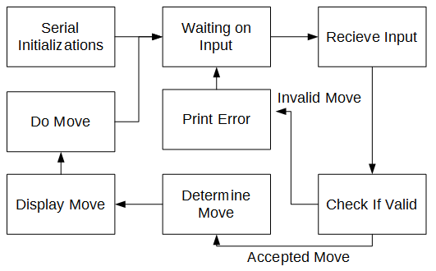
How does it work? - Software

Slide 7
How does it work? - Software (Extra Details)
Uses Standard Cubing Notations –
U F R L B D U’ F’ R’ L’ B’ D’ U2 F2 R2 L2 B2 D2 x y z x’ y’ z’ x2 y2 z2
U, U’, U2 => Top Side Quarter Clockwise, Quarter Counter-clockwise, Half turn.
F – Front, R – Right, L – Left, B – Back, D – Bottom
Cube rotations along the axis x y z.
Motor controls are managed by libraries built into the Arduino IDE
Servo.h
Stepper.h
Inputs are handled through Serial Communications with the Serial.readString() and is parsed.
Parsed inputs determined the proper motor movements

Slide 8
How does it work? - Hardware
Bi-Polar Stepper Motor – Handles the actual turning of the cube
Uses the L293D IC motor controller
Powered from two 9V batteries
Servo – Controls the arm
The Arm handles – Tilting and holding the cube
Connected Directly into the Arduino
Arduino – Handles the Input from the user
Powered by Computer
The cube is manipulated using a series of Tilting and Twisting

Slide 9
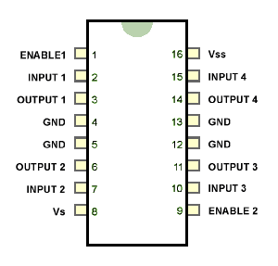
How does it work? - L293D
Motor Controller L293D – Dual H-Bridge Motor controller that handles the movement of the motor from the Arduino Input. Pins are attached accordingly to the motor and the Arduino (Pins 8,9,10,11)

Slide 10
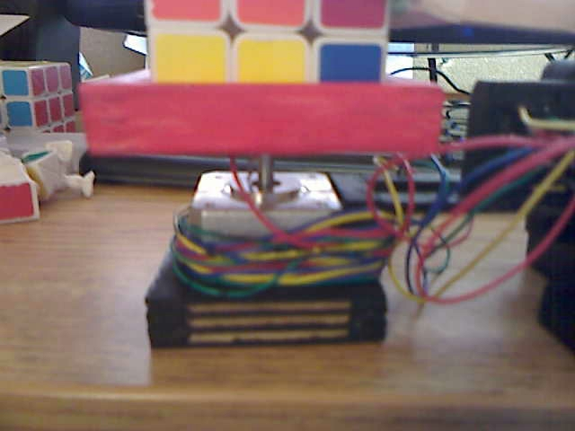
How does it work? - Turning The Cube.
12 V Stepper Motor is attached to the base and the cube tray. When the arm is down, the Cube Manipulator turns the bottom face. When the arm is up, the cube can rotate along the Y (vertical axis)

Slide 11
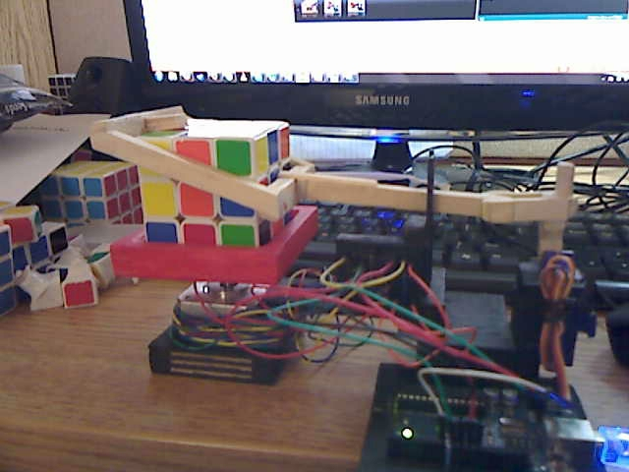
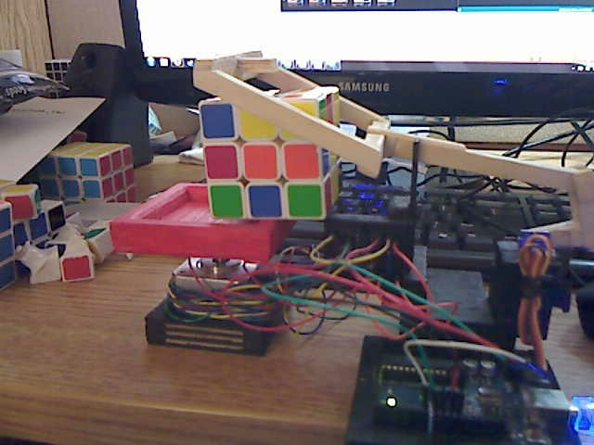
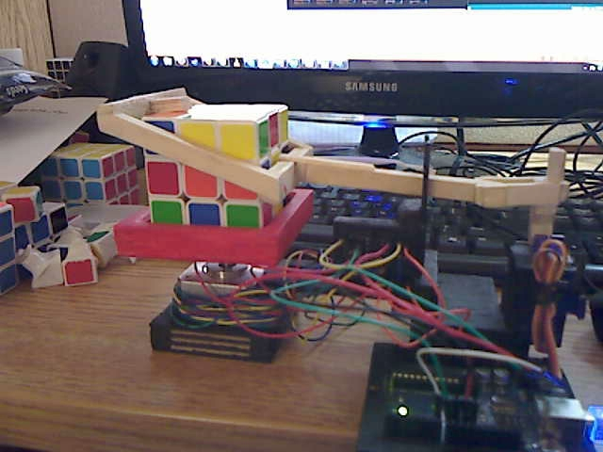
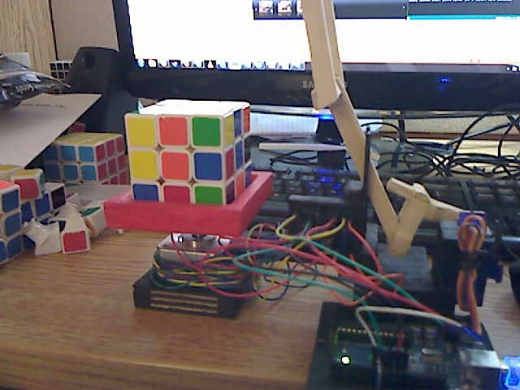
How does it work? - Tilting the cube
The Arm is also used to tilt the cube on a different axis. This is by a pulling and pushing motion by the arm to tilt the cube on the x-axis.

Slide 12
Turning Pseudo Code
If the user, were to put in a U2 move to move the top face twice. The Manipulator needs to tilt the cube so the top face on the turning tray. The following functions were implemented. CW(); // clockwise turn CCW(); // counter clockwise turn DT(); // half turn // these function also have a corresponding overdrive function that adds extra steps to make up for the resistance from the cube. tilt(); // tilt the cube forward or following cube notation doing x’ hold(); // make the arm hold the cube up(); // raise the arm so it is not holding the cube. Using these functions an U2 move would be tilt(); tilt(); //top is on the turning tray hold(); oDT(); //top has been turned twice tilt(); tilt(); //top is returned to the top up();

Slide 13
Final Words and Thanks
Future of The Cube Manipulator
Gear the stepper motor so it doesn’t have difficulties turning
Attach a camera and implement auto-solving to the Arduino so it takes in color data and generates a solution that it will do itself
Implement Auto scrambling of the cube using a random move generator
Thanks to CSE321 for finally giving me an excuse to make a Cube Manipulator, a project that I’ve been wanting to do since I started cubing.
To Jaap’s Puzzle Page for the puzzle images used in this presentation
To David Gilday for the MindCuber, the Lego NTX cube solver that the Cube Manipulator is based on.

