Slide 1
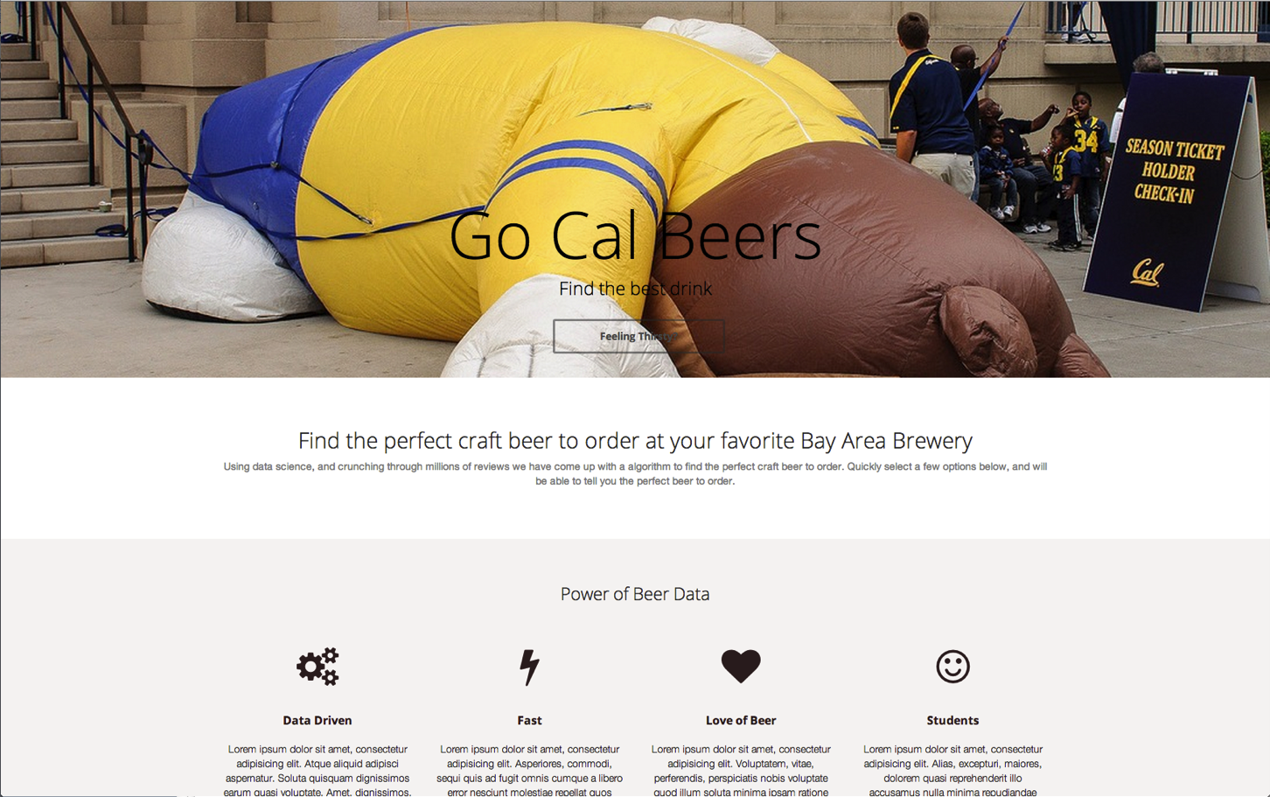
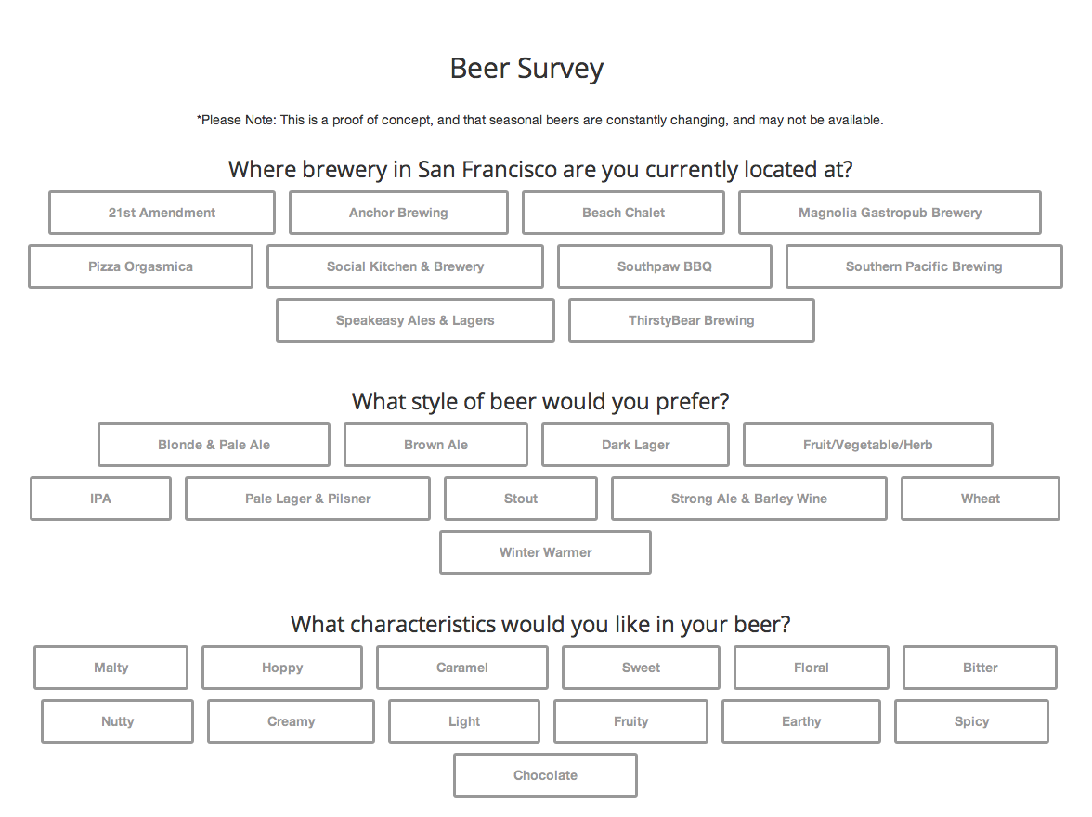
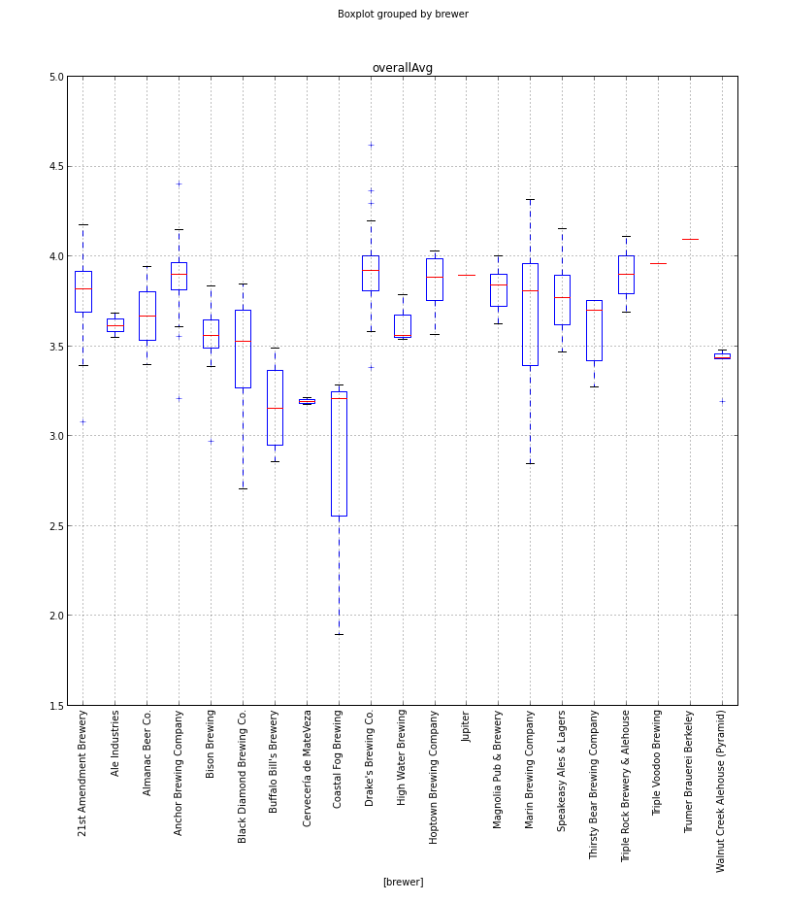
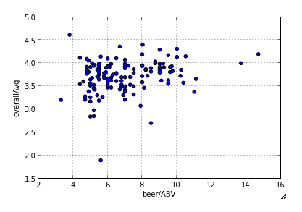
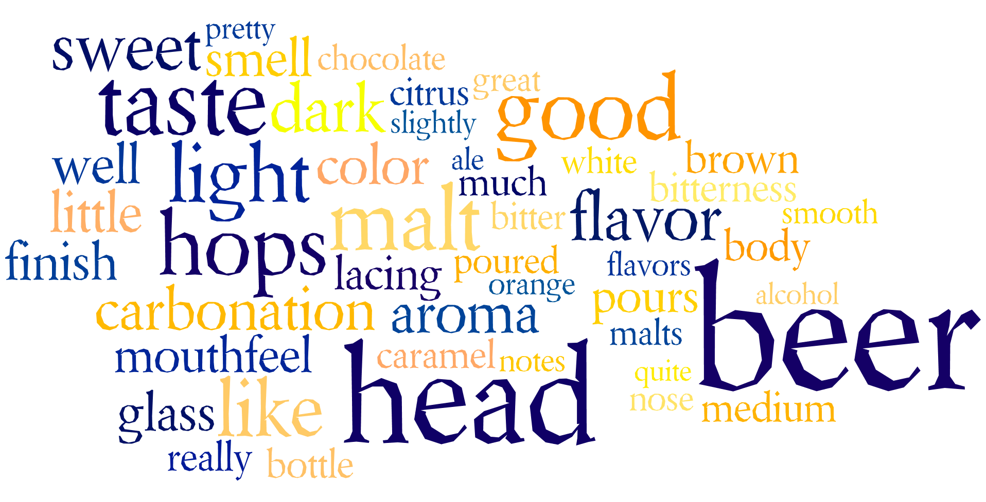
Why Big Beer Data?
Amidst a declining nationwide beer market, the craft brewing industry has flourished, growing 18% in 2013 alone.
Our recommendation system aims to expedite this process by suggesting beers tailored to a user’s flavor preferences and that brewery’s specific menu offerings
Application
Go beers allows you to find the perfect craft beer based on your preferences at SF breweries using a simple survey to find out what you enjoy in a beer.
Repsonive design to work on any device.
Challenges & Lessons
Our large dataset is a 1.2GB text file that kept crashing our VM’s.
Our dataset is outdated which casued problems, since new beers are constanally being released, and old ones are discontinued.
While we all consider ourselves to be decently familiar with broad beer style categories, we soon realized that the level of detail present in Beer Advocate’s classifications were far beyond our understanding. Thus, we had to conduct extensive online research about beer styles so that we could accurately reclassify them into broader, more approachable categories.
Competetiors & Tools
Craftbeers.com offers a similar app, but wasn’t tailored to a users location
We used OpenRefine, Pandas, and Python to clean and anaylize our data.
Data Graphs
Distrubtion of beer
scores for each brewery.
ABV vs overall average score. Which shows that beers with lower ABV have a greater range.
Beer Advocate Data Sets
A 1.5GB text file with over 1.5 million reviews from Jan 1998 until Nov 2011.
Data found through Stanford SNAP
Schema for the dataset [beer name, beer id, brewer id, ABV, beer style, apperence score, aroma score, palate score, taste score, profile name, and review text]
Second dataset was manually collected from beer advocate to find all 39 Bay Area brewers.
Open Issues & Extensions
With our data being outdated we have no way of knowing if our beers are current without checking the brewers website.
We would love to create a API that would allow breweries to instantly update our app with any changes to their menus.
We would like to extend our app, such as the integration of map and location services to further streamline the recommendation system, and expand to other markets.
Also we would like to use machine learning techniques to refine our results based on a user’s prior selections and avoid recommending beers that the user has tried and disliked.
Data Cleaning & Integration
Created our own script to parse the data text file into a proper CSV file.
Deloveped a parser to handle the large text file, and to help us better analyze the data.
Our parser helped us clean the data, and discover punctuation in string values of the data that interfered with iPython.
OpenRefine help us better understand our data.
50 most frequently used words in beer reviews from Bay Area brewers

