Slide 1
Guidance Client
Guidance Service
Synchronous, Direct Guidance Request
Guidance Client
Guidance Service
Synchronous, Direct Guidance Conversation

Slide 2
EHR Radiology Workflow
Guideline Appropriate Ordering Service
Clinician is placing an order for a diagnostic imaging study
EHR gathers the appropriate information and issues an assessment request to the Guideline Appropriate Ordering Service
The service determines the appropriateness of the order and returns the assessment score and relevant guideline
EHR presents the assessment to the ordering clinician

Slide 3
Guidance Client
Guidance Service
Clinician is placing an order for a diagnostic imaging study
EHR gathers the appropriate information and issues an assessment request to the Guideline Appropriate Ordering Service
The service determines the appropriateness of the order and returns the assessment score and relevant guideline
EHR presents the assessment to the ordering clinician
If the service indicates that more information is needed to obtain a more accurate assessment, the clinician is prompted to provide the information, and the request is repeated

Slide 4
EHR
Event Publish/Subscribe Service
Guidance Service
Asynchronous, Indirect Guidance using Event Publish/Subscribe Service

Slide 5
Content Producers
EHR and Content Vendors
Hospitals and Institutions
Medical Societies and Associations
Quality Reporting Agencies
Shareable Knowledge Artifacts
EHR with Internal CDS Engine
CDS Service
Health Dataset w/ Analytics Engine
Quality Reporting Service
Content Consumers

Slide 6
Measure
Population Group
Populations
Initial Pop.
Denominator
Denominator Exclusions
Numerator
Stratifiers
Age Range
Gender
Supplemental Data
Gender
Deceased

Slide 7
Measure
MeasureReport - Summary
Population Group
Population Group
Populations
Populations
IP
DEN
500
250
Stratifiers
Stratifiers
Age
Gend
250
250
250
250
Supplemental Data
Supplemental Data
Gend
Dec
250
0
250
500

Slide 8
Sharing via Services
Authoring
Publishing
Evaluation
Guideline Development
Decision Support Services
Terminology Service(s) (e.g. VSAC)
Measure Developers
Measure Evaluation Services
Decision Support Authors
Knowledge Repository(s)
(e.g. CDS Connect)
EHRs
Quality Improvement Agencies
SMART Apps
Professional Societies
Backend Services Applications
...
...

Slide 9
Measure
MeasureReport - Individual
Population Group
Population Group
Populations
Populations
IP
DEN
1
1
Stratifiers
Stratifiers
Age
Gend
1
1
0
0
Supplemental Data
Supplemental Data
Gend
Dec
1
0
0
1
Resources

Slide 10


Service Integration
Clinical Reasoning Implementation
CDS Hooks Request with Patient Data
CQL Libraries
PlanDefinition
EHR
order-select
$apply operation
CDS Hooks API
CarePlan with RequestGroup
CDS Hooks Response

Slide 11


CQL Ingestion Integration
Clinical Reasoning-enabled EMR/CDR
PlanDefinition
Clinical Application
Import/Ingest
CDR
Clinical Reasoning Engine
CQL Libraries
GET Observation/?code=123
POST MedicationRequest
GET PlanDefinition/123/$apply

Slide 12
MeasureReport – Patient-Listing
Population Group
Populations
500
250
IPOP
DEN
NUM
...
Stratifiers
...
250
250
Male
Female
250
250
Supplemental Data
250
0
250
500
MeasureReport - Individual
MeasureReport - Individual
Population Group
Population Group
Populations
Populations
1
1
1
1
...
Stratifiers
Stratifiers
1
0
1
0
1
0
1
0
Supplemental Data
Supplemental Data
1
0
0
1
1
0
0
1
Resources
Resources

Slide 13
Knowledge Artifact
Components
Metadata
Logic
Structure

Slide 14
Metadata
Parameters
Data
Actions
Triggers
Logic
Library
DS Rule
Doc Template
Order Set
Measure
Metadata
Metadata
Metadata
Metadata
Metadata
Parameters
Triggers
Logic
Logic
Logic
Data
Logic
Actions
Logic
Actions
DSS Module
Metadata
Parameters
Data
Triggers
Actions

Slide 15
Metadata
Parameters
Data
Actions
Triggers
Logic

Slide 16
PlanDefinition
RequestOrchestration
action (group)
action (group)
action (item)
ActivityDefinition
action (item)
ServiceRequest
definition
resource
action (item)
ActivityDefinition
action (item)
MedicationRequest
definition
resource

Slide 17
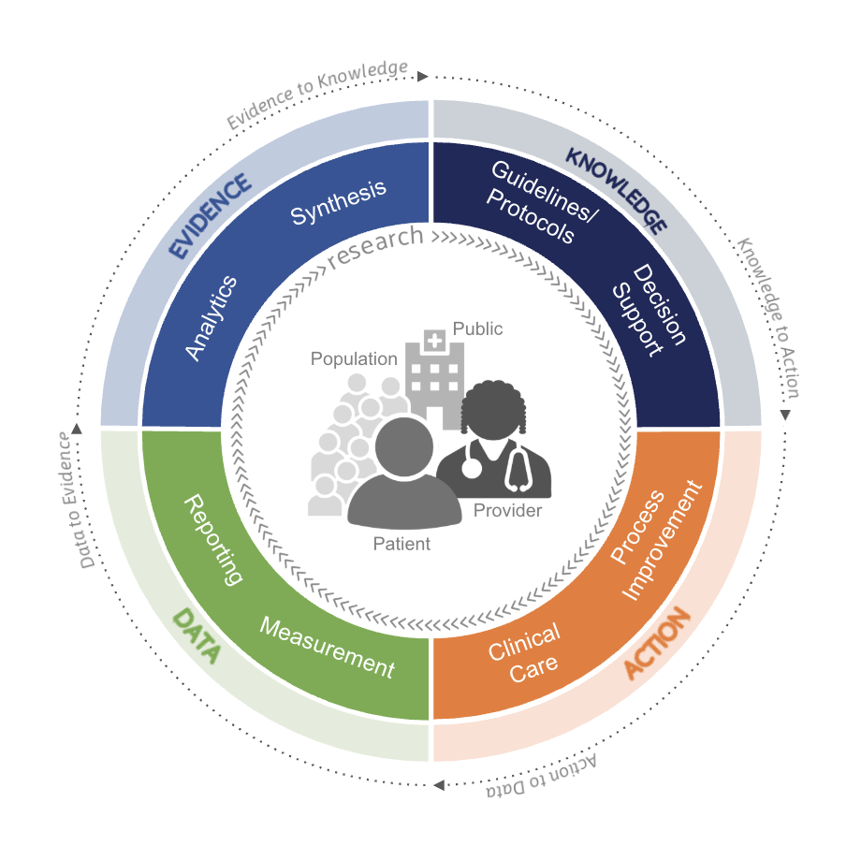
Image - 11/6
Notes:
Circle text generator:
https://inkpx.com/templates/qr4/text-in-circle
(copy/paste - don’t download)
(font for Action-to-Data) . . . use default for others
… use “fill” or “stroke” only, not both to keep edges cleaner. . . play with bold font to get desired width
…. Use font “size” to lock dimensions
…edit color hex code to match
Use different paths to get text to flip to bottom half of circle

Slide 18
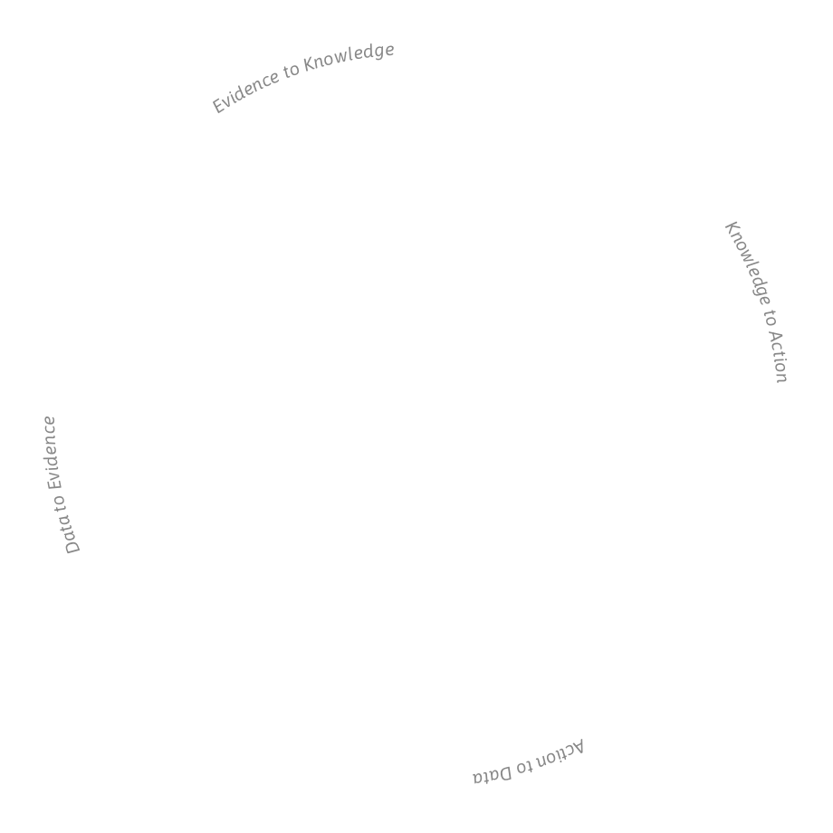






Synthesis
Guidelines/ Protocols
Analytics
Decision
Support
Public
Population
Provider
Process Improvement
Reporting
Patient
Measurement
Clinical
Care
Editable - 11/6
Notes:
Circle text generator:
https://inkpx.com/templates/qr4/text-in-circle
(copy/paste - don’t download)
(font for Action-to-Data) . . . use default for others
… use “fill” or “stroke” only, not both to keep edges cleaner. . . play with bold font to get desired width
…. Use font “size” to lock dimensions
…edit color hex code to match
Use different paths to get text to flip to bottom half of circle

