Slide 1
Hand Gesture Recognition System
By
Jeevitha meyyappan

Slide 2
Synopsis..
Hand Gesture Recognition - The goal of this application is to detect the Hand Gesture via the Web cam, and then making the recognition with the pattern.
This application works in a scenario when a camera is placed and when someone makes an hand gesture, the application interprets the gesture and further displays that in the screen.
The classes used in this are based on the OpenCV Library - CV2.
In this 6 different gestures of Right and Left hands are detected –
No Hand
One Finger shown
Two Finger shown
Three Finger shown
Four Finger shown
Five Finger shown

Slide 3
Attempts Taken
Tried to implement Guesture Recognition with the below Libraries,
AForge.Net - C# - No Clarity in the end Histogram part for recognizing the Guesture - Failure
Emgu CV - C# - Struck with the Skin color extraction of the hand - Failure
CV2 - Python - I was able to implement the entire functionality, though faced a few difficulties in the beginning. - Success

Slide 4
Algorithm
The Live video is captured with the Webcam.
A rectangular area is defined for the video and the region parameter is declared where the hand is placed
A Grey image of the hand is generated and a guassian blur is applied. Further a threshold of this image is made to remove the extra noises.
Extract contour of the max area which is of the hand.
Make a bounding rectangle of the contour and a convex hull around the hand. By deducing the area of these we will have the area of the rectangle around the hand and area of the convex hull.
The gap between the fingers are counted here and they are determined by figuring out the angle between each fingers.
And accordingly the count of fingers is displayed in the screen.

Slide 5
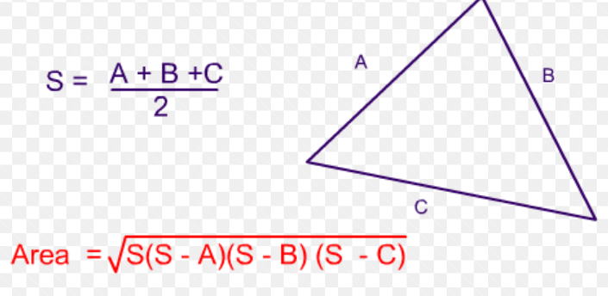
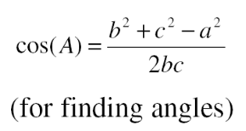
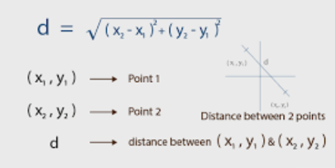
Formulas used
Angle Formula
Distance Formula
Area Formula
To find the angle between the fingers(To segregate the fingers).
To Calculate the length of the inner sides of both the fingers and the distance between the finger tips.
To Calculate the area of the hand.

Slide 6
Find the angle between the fingers to segregate the fingers and inturn count them.

Slide 7
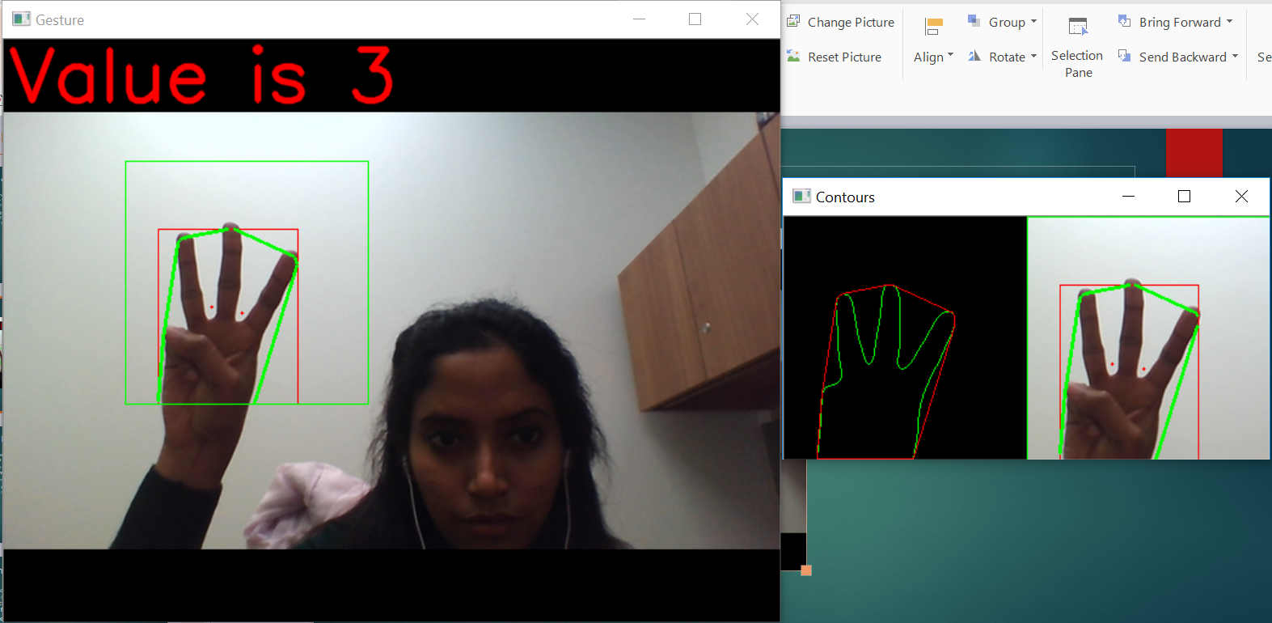
Demo 1

Slide 8
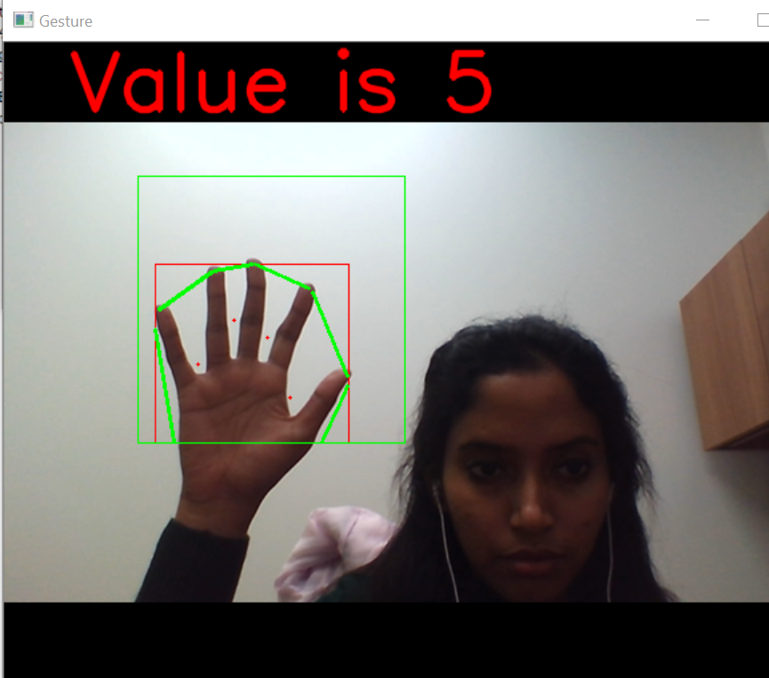
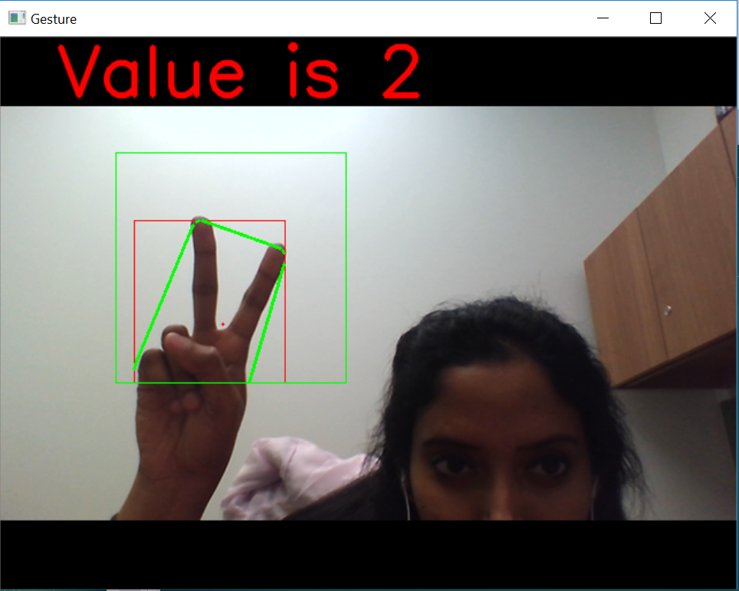
Demo 2

Slide 9
Contour Images

Slide 10
Future works
This can be further extended to Sign Language recognition by calculating the position of fingers for each alphabets.
For more accuracy Haar cascade classifiers or Test and Train datasets can be used.

Slide 11
References
Reference taken from - https://opencv-python-tutroals.readthedocs.io/en/latest/py_tutorials/py_gui/py_image_display/py_image_display.html
Python Library used - CV2, Numpy, Math

Slide 12
Thank You..

