Slide 1
Data Mining
(Lecture 2)
Jaya Krishna M

Slide 2
Text
39-44, 83-99 (DM Concepts, Han)
1-13 (DM with Python, Layton)
Helpful Videos
Importance of Domain Knowledge https://www.youtube.com/watch?v=y1bDZXVqZy8 (3mins)
Basics of Data Mining https://www.youtube.com/watch?v=u2oSiVOQRmg (10mins)
Data Mining Fundamentals https://www.youtube.com/watch?v=GLAK3dF7dfg (8mins)
Introduction to Data Mining: Basic Vocabulary https://www.youtube.com/playlist?list=PL8eNk_zTBST-gN6Y5E-5FZdARXjglYpyT (start of series) https://www.youtube.com/watch?v=f7NfO16l04U (4mins)
Introduction to Data Mining: Data Types https://www.youtube.com/watch?v=dyYKQpFJOZQ (4mins)
Introduction to Data Mining: Data Attributes (Part 1) https://www.youtube.com/watch?v=hu7iGGnzq3Y (5mins)
Introduction to Data Mining: Data Attributes (Part 2) https://www.youtube.com/watch?v=xrFtN_UJhYc (4mins)
Data Preprocessing (very good in-depth introduction) https://www.youtube.com/watch?v=2e4fgSgn64Q (76mins)
Cleaning Data with Python (very beginner level) https://www.youtube.com/watch?v=ZOX18HfLHGQ (5mins)
Using Python and Pandas (very beginner level) https://www.youtube.com/watch?v=XDAnFZqJDvI (5mins)

Slide 3
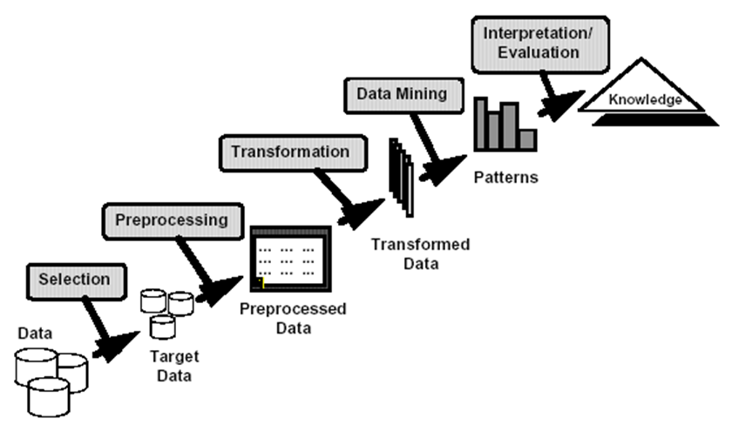
Knowledge Discovery

Slide 4
Why Data Preprocessing?
Data in the real world is dirty
incomplete: lacking attribute values, lacking certain attributes of interest, or containing only aggregate data
noisy: containing errors or outliers
inconsistent: containing discrepancies in codes or names
No quality data, no quality mining results!
Quality decisions must be based on quality data
Data warehouse needs consistent integration of quality data

Slide 5
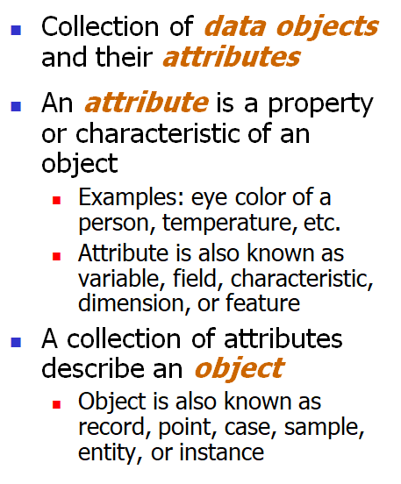
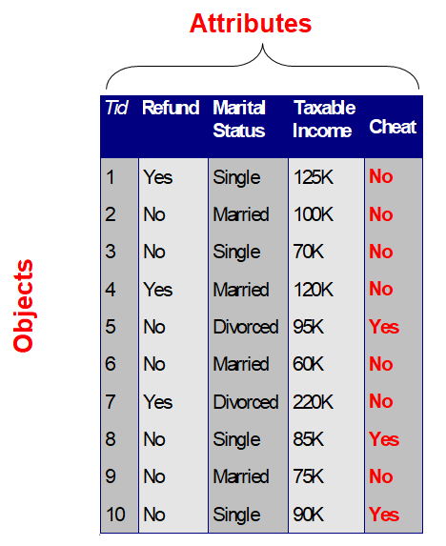
What is Data?

Slide 6
A More Complete View of Data
Data may have parts
The different parts of the data may have relationships
More generally, data may have structure
Data can be incomplete

Slide 7
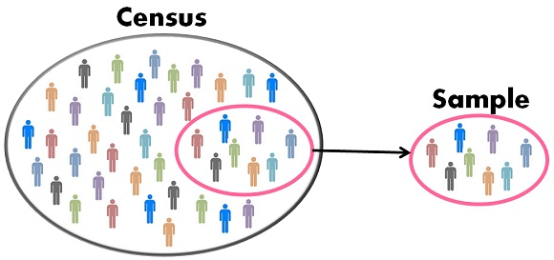
Data Selection: Population vs sample

Slide 8
Data Mining Step I : - Sampling
Sampling is the main technique employed for data selection
It is often used for both the preliminary investigation of the data and the final data analysis.
Statisticians sample because obtaining the entire set of data of interest is too expensive or time consuming.
Example: What is the average height of a person in Ioannina?
We cannot measure the height of everybody
Sampling is used in data mining because processing the entire set of data of interest is too expensive or time consuming.
Example: We have 1M documents. What fraction has at least 100 words in common?
Computing number of common words for all pairs requires 10¹² comparisons
Example: What fraction of tweets in a year contain the word “Greece”?
300M tweets per day, if 100 characters on average, 86.5TB to store all tweets

Slide 9
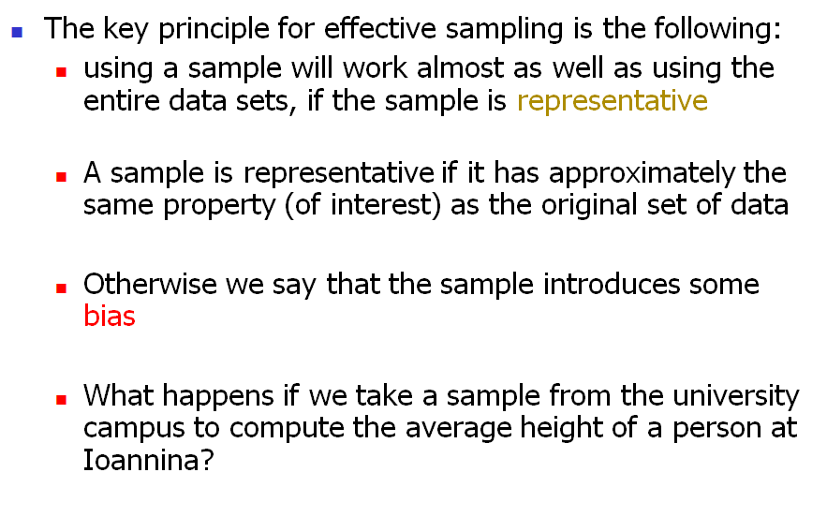
Sampling …..

Slide 10
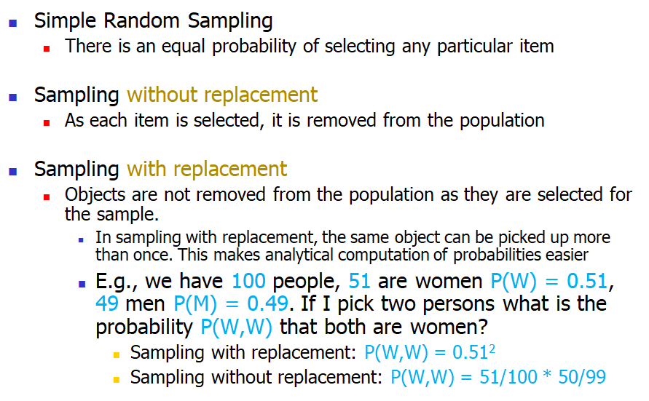
Types of Sampling

Slide 11
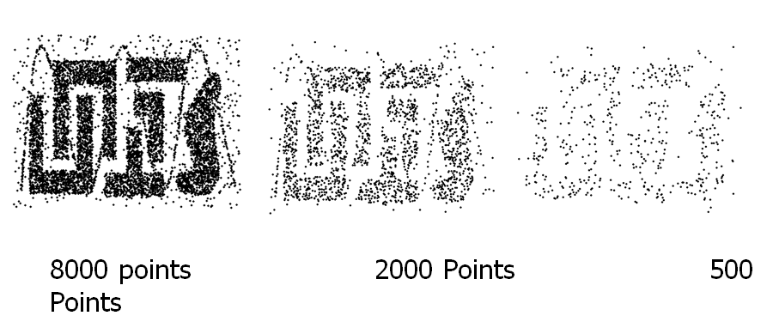
Sample Size

Slide 12
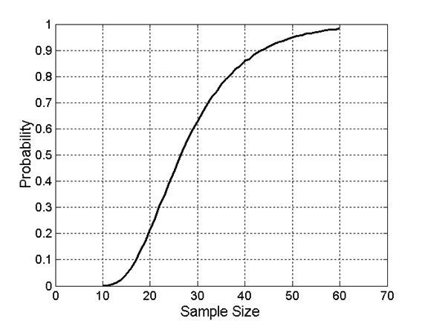
Sample Size vs Probability of Confidence

Slide 13
Data Mining Part II : Exploratory Analysis of Data
Summary statistics: numbers that summarize properties of the data
properties include frequency, location and spread
Most summary statistics can be calculated in a single pass through the data

Slide 14
Frequency and Mode
The frequency of an attribute value is the percentage of time the value occurs in the
data set
Eg: For example, given the attribute ‘gender’ and a representative population of people, the gender ‘female’ occurs about 50% of the time.
The mode of a an attribute is the most frequent attribute value
The notions of frequency and mode are typically used with categorical data

Slide 15
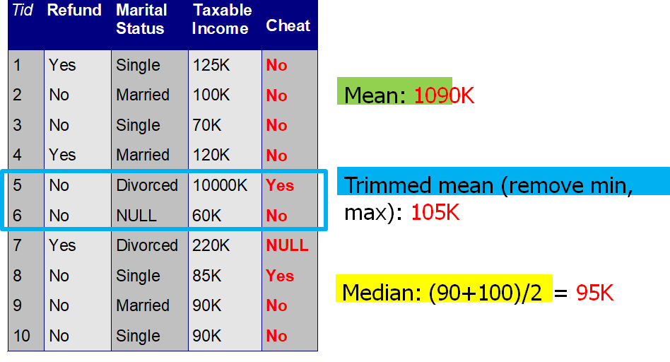
Example (Avg Measures)

Slide 16
Measures of Spread : Range and Variance
Range is the difference between the max and min
The variance or standard deviation is the most common measure of the spread of a set of points.

Slide 17
Data Mining Step III: Data Preprocessing (Measuring Data Quality)
Poor data quality negatively affects many data processing efforts
“The most important point is that poor data quality is an unfolding disaster.
Poor data quality costs the typical company at least ten percent (10%) of revenue; twenty percent (20%) is probably a better estimate.”
Data mining example: a classification model for detecting people who are loan risks is built using poor data
Some credit-worthy candidates are denied loans
More loans are given to individuals that default

Slide 18
Why Is Data Often Incomplete?
Attributes of interest are not available (e.g., customer information for sales transaction data)
Data were not considered important at the time of transactions, so they were not recorded!
Data not recorder because of misunderstanding or malfunctions
Data may have been recorded and later deleted!
Missing/unknown values for some data

Slide 19
Data Cleaning Basics
Data cleaning tasks
Fill in missing values
Identify outliers and smooth out noisy data
Correct inconsistent data

Slide 20
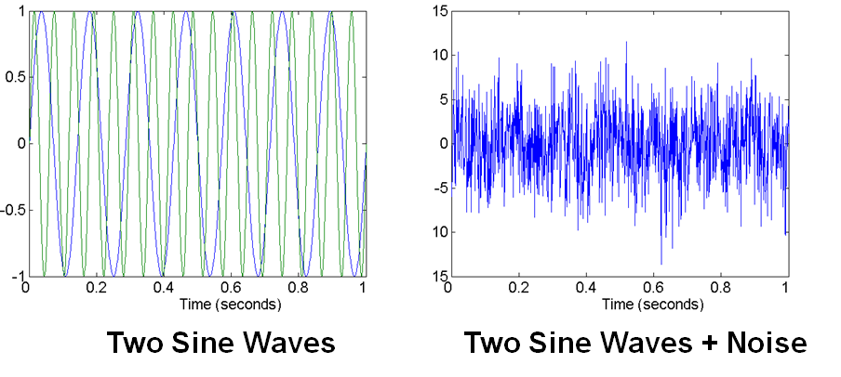
Data Preprocessing - Noise in data
For objects, noise is an extraneous object
For attributes, noise refers to modification of original values
Examples: distortion of a person’s voice when talking on a poor phone and “snow” on television screen

Slide 21
Data Preprocessing - Finding Outliers
Outliers are data objects with characteristics that are considerably different than most of the other data objects in the data set
Case 1: Outliers are noise that interferes with data analysis
Case 2: Outliers are the goal of our analysis
Eg: Credit card fraud,Intrusion detection

Slide 22
Data Preprocessing - Finding Missing Values
Reasons for missing values
Information is not collected(e.g., people decline to give their age and weight)
Attributes may not be applicable to all cases(e.g., annual income is not applicable to children)
Handling missing values
Eliminate data objects or variables
Estimate missing values
Example: time series of temperature
Example: census results
Ignore the missing value during analysis

Slide 23
Data Preprocessing - Filling Missing Values
Missing completely at random (MCAR)
Missingness of a value is independent of attributes
Fill in values based on the attribute
Analysis may be unbiased overall
Missing at Random (MAR)
Missingness is related to other variables
Fill in values based other values
Almost always produces a bias in the analysis
Missing Not at Random (MNAR)
Missingness is related to unobserved measurements
Informative or non-ignorable missingness
Not possible to know the situation from the data

Slide 24
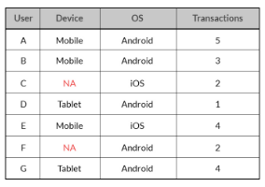
Data Preprocessing - Filling Missing Values (Example)

Slide 25
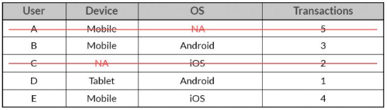
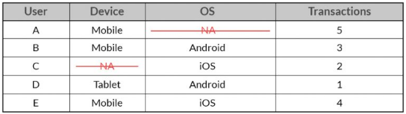
Data Preprocessing - Filling Missing Values (Example)
Deletion :
Pairwise Deletion :

Slide 26
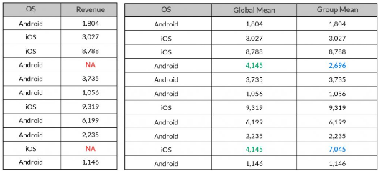
Data Preprocessing - Filling Missing Values (Example)
Popular Averaging Techniques:

Slide 27
Data Mining Step 4 : Handling Duplicate Data
Data set may include data objects that are duplicates, or almost duplicates of one another
Major issue when merging data from heterogeneous sources
Examples: Same person with multiple email addresses
Data cleaning
Process of dealing with duplicate data issues

Slide 28
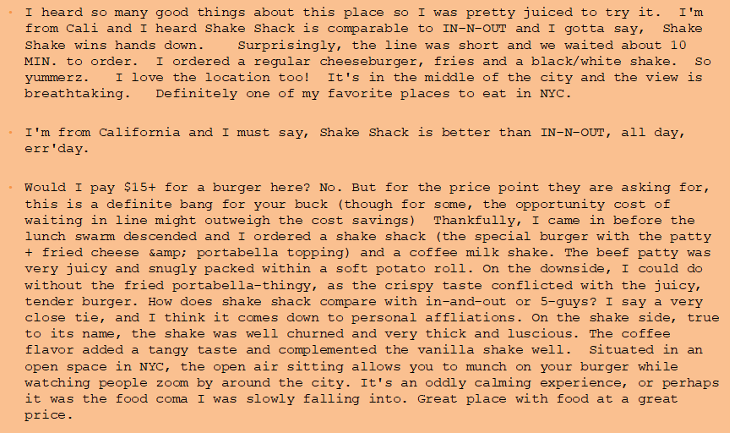
Mining Data Example

Slide 29
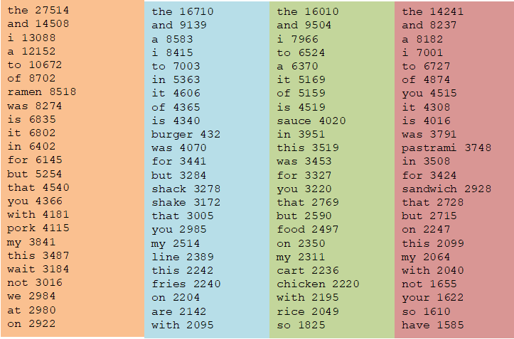
First Step
Do simple processing to “normalize” the data (remove punctuation, make into lower case, clear white spaces, other?)
Break into words, keep the most popular words

Slide 30

First Step
Do simple processing to “normalize” the data (remove punctuation, make into lower case, clear white spaces, other?)
Break into words, keep the most popular words

Slide 31
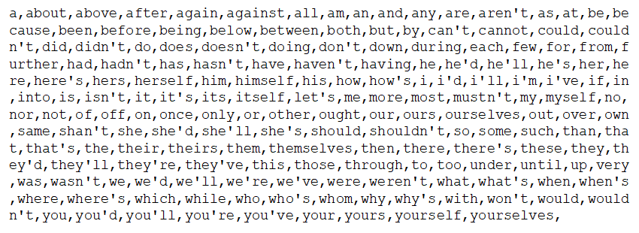
Remove Stop Words
•Remove stop words (Stop-word lists can be found online.)

Slide 32
TF-IDF
•The words that are best for describing a document are the ones that are important for the document, but also unique to the document.
• TF(w,d): term frequency of word w in document d
Number of times that the word appears in the document
Natural measure of importance of the word for the document
IDF(w): inverse document frequency
•Natural measure of the uniqueness of the word w
•TF-IDF(w,d) = TF(w,d) ´*IDF(w)

Slide 33
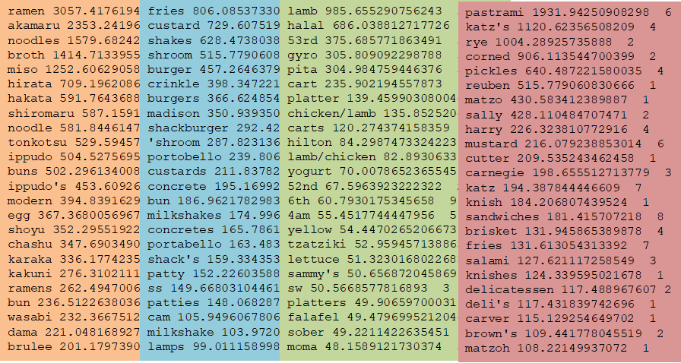
Final Result

Slide 34
Next Class
Supervised and Unsupervised Learning
Linear Regression

