Slide 1


Here's your outline to get started
Key facts about your topic
Airbnb, Inc. is an online marketplace for arranging or offering lodging, primarily homestays, or tourism experiences. The company does not own any of the real estate listings, nor does it host events; it acts as a broker, receiving commissions from each booking. The company is based in San Francisco, California, United States.
Founded: 2008
Revenue: $2.60 Billion USD (2017)
Headquarters: San Francisco, CA
CEO: Brian Chesky
Founders: Brian Chesky, Joe Gebbia, Nathan Blecharczyk
See more: Open the Notes below for more information.
Notes:
QuickStarter has created an outline to help you get started on your presentation. Some slides include information here in the notes to provide additional topics for you to research.

Slide 2

Related topics to research
Amazon
Online marketplace
Peter Thiel
Jack Dorsey
Guy Oseary
Shervin Pishevar
Keith Rabois
Belinda Johnson
Kevin Hartz
Use Smart Lookup to learn more
1
Highlight one of the related topics
Right-click on the topic
Choose "Smart Lookup"
2
3

Slide 3

Airbnb
By: Atilla Toy, Vicky Patiño, Jordan Lucas & Brenda Minto

Slide 4
Contents
Store CSV into DataFrame
Data Exploration
Data Clean-Up Process
Database Process
Queries
Notes:
Consider talking about:
Funding
Acquisitions

Slide 5

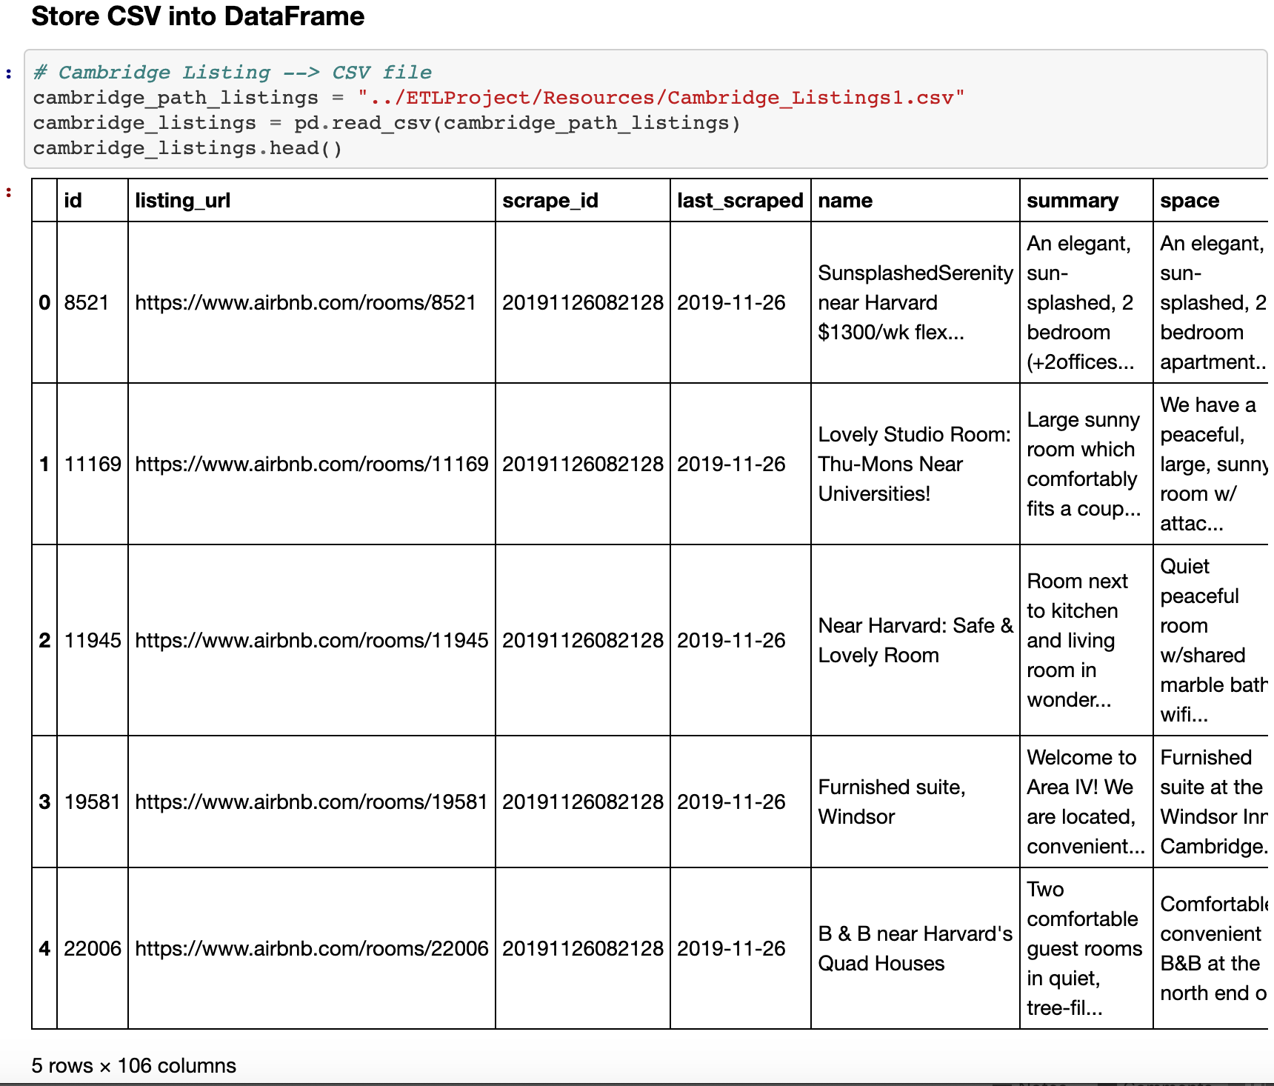
Store CSV into DataFrame (Cambridge Listings)

Slide 6

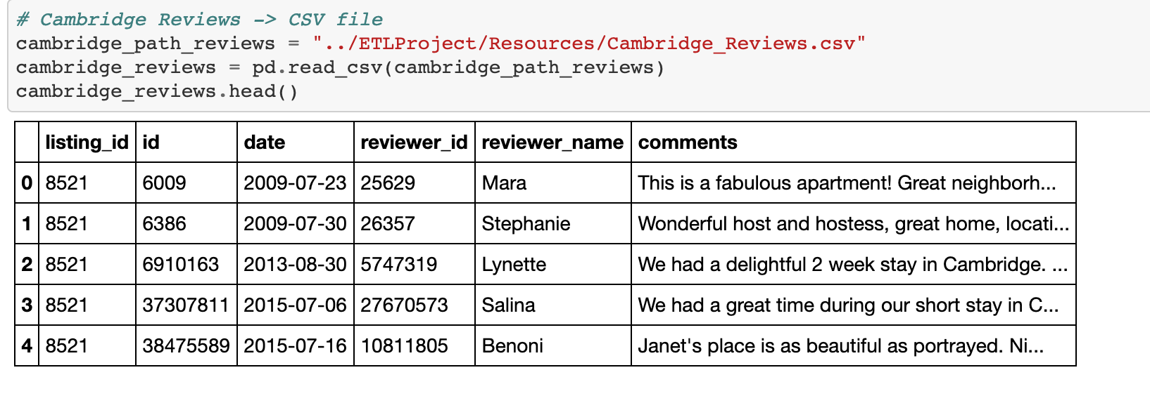
Store CSV into DataFrame (Cambridge Reviews)

Slide 7
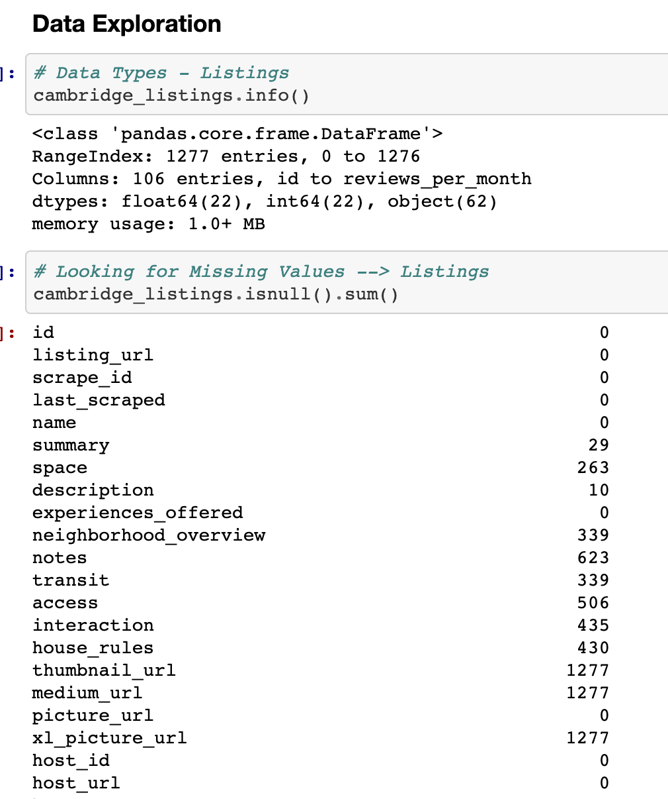
Data Exploration

Slide 8
Data Clean-up Process
Notes:
Consider talking about:
Cancellations
Deposits

Slide 9
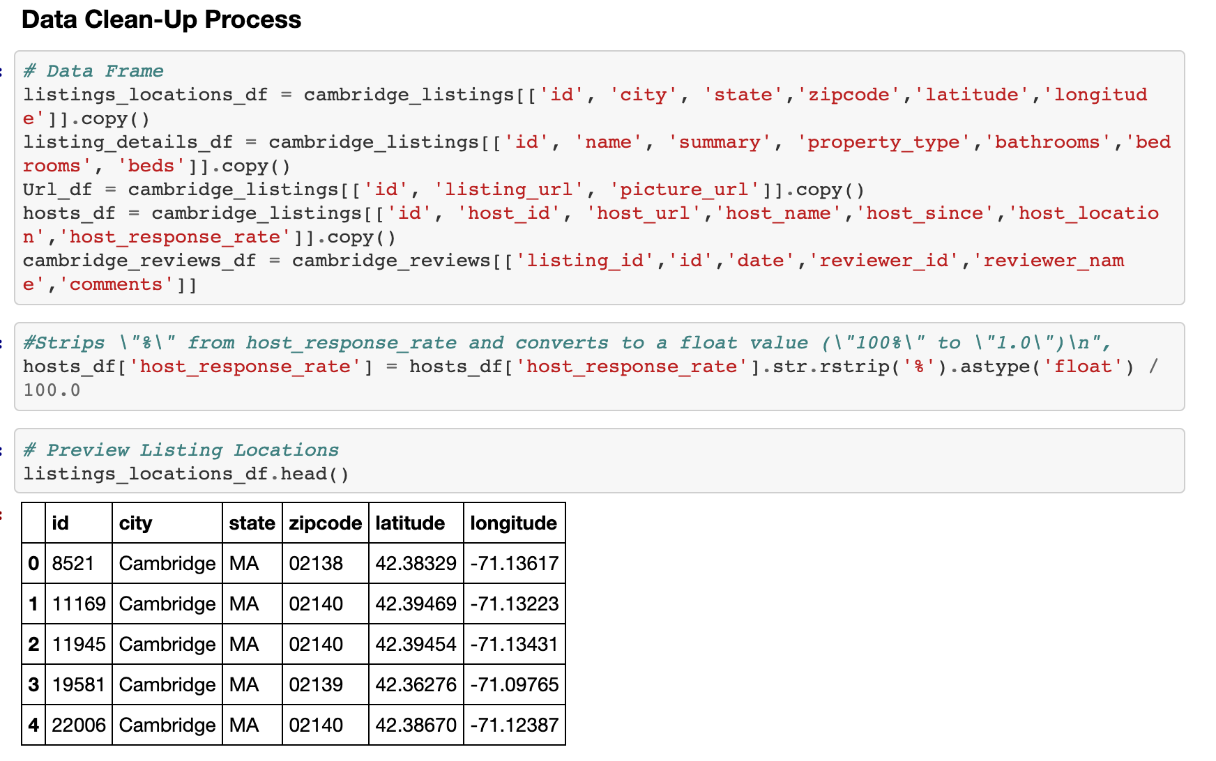

Slide 10
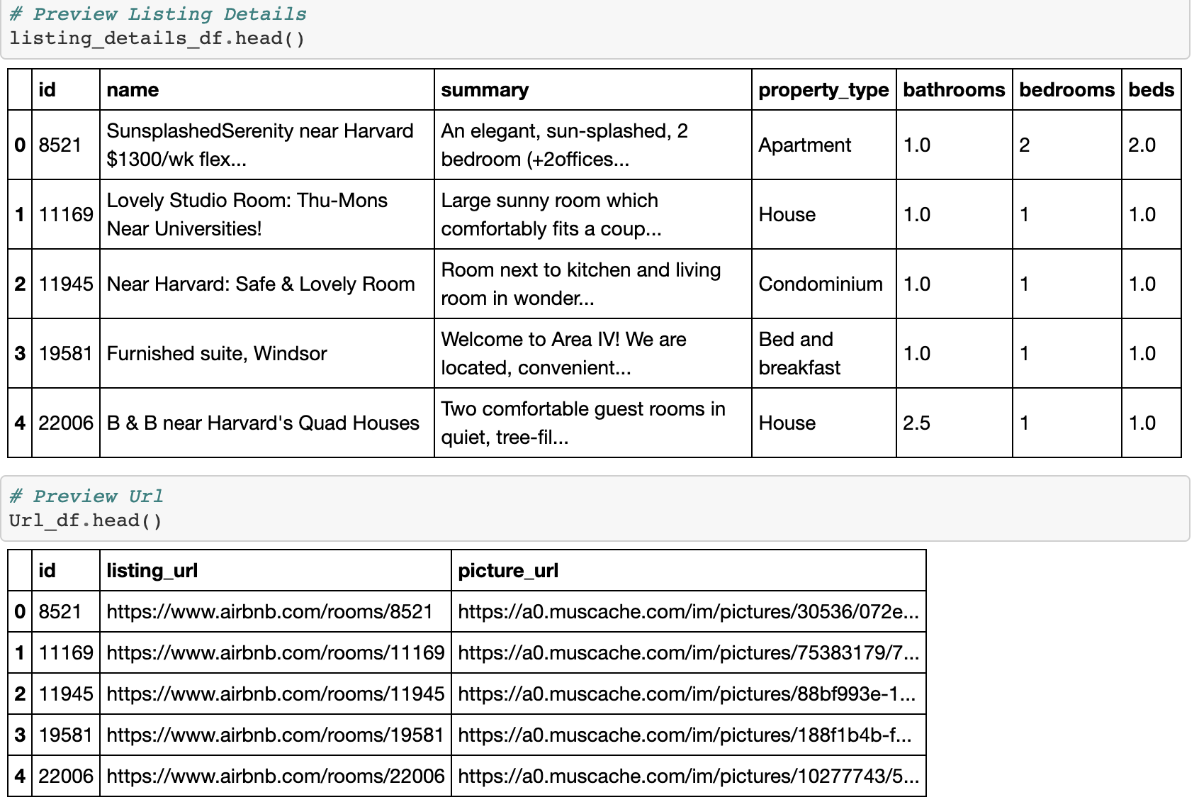
Notes:
Consider talking about:
Europe
United States
Japan

Slide 11
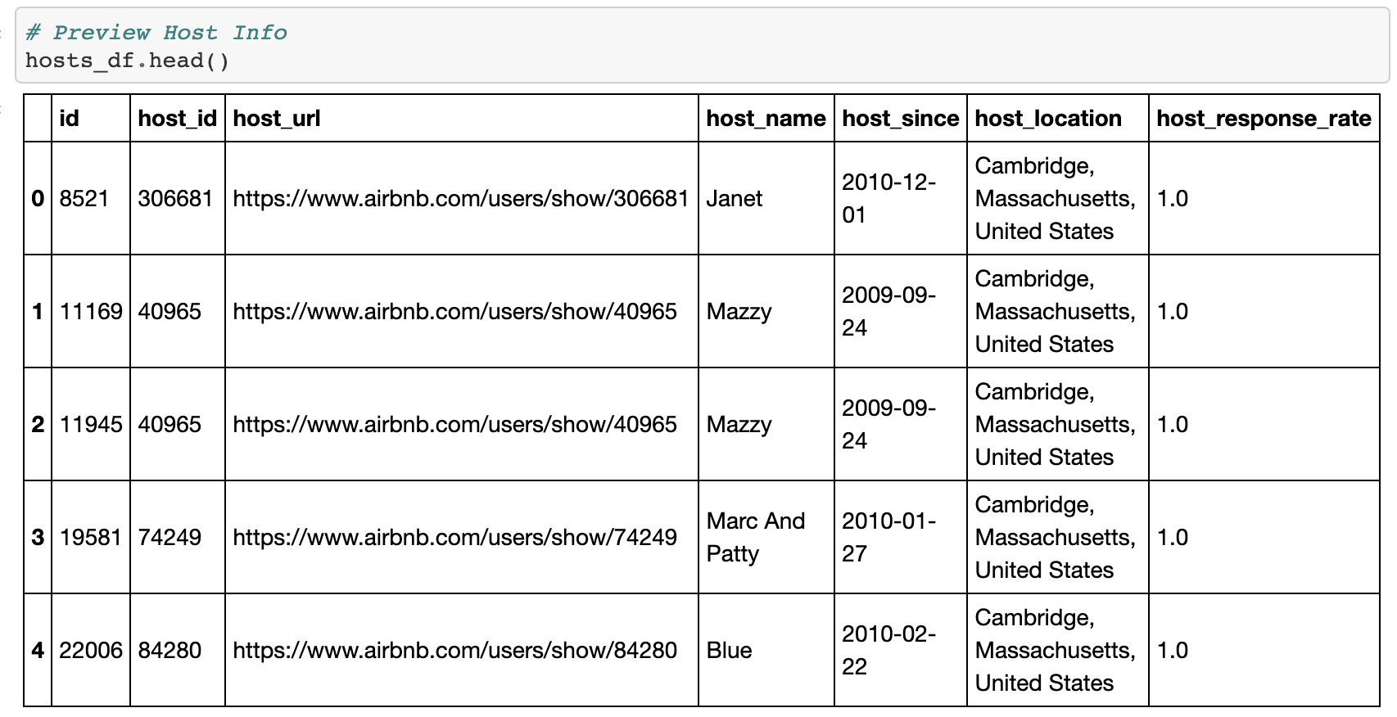
Notes:
Consider talking about:
Fair housing implications and discrimination
Housing affordability
Negative guest experiences
Bait-and-switch scams
Delisting of West Bank settlements
Lawsuits

Slide 12
Database Creation
Notes:
Consider talking about:
Cancellations
Deposits

Slide 13
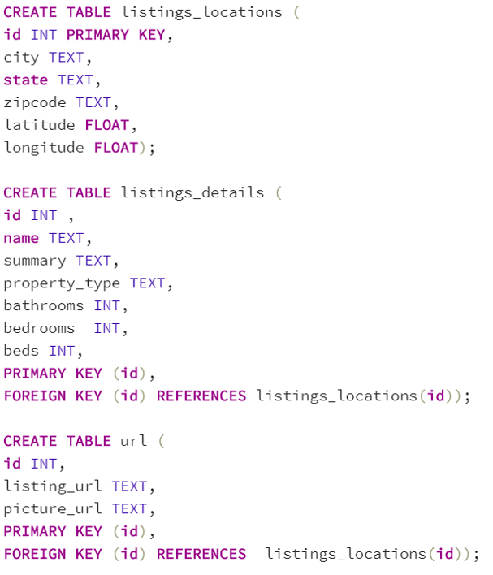
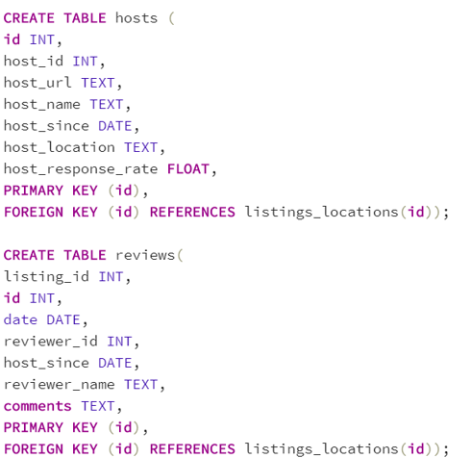
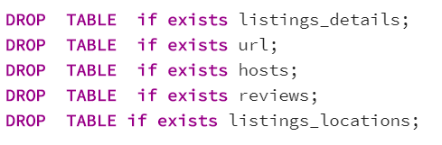

Slide 14
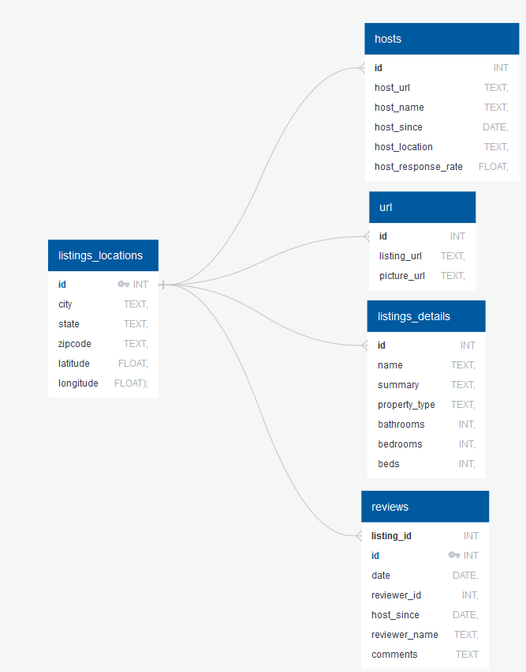

ERD

Slide 15
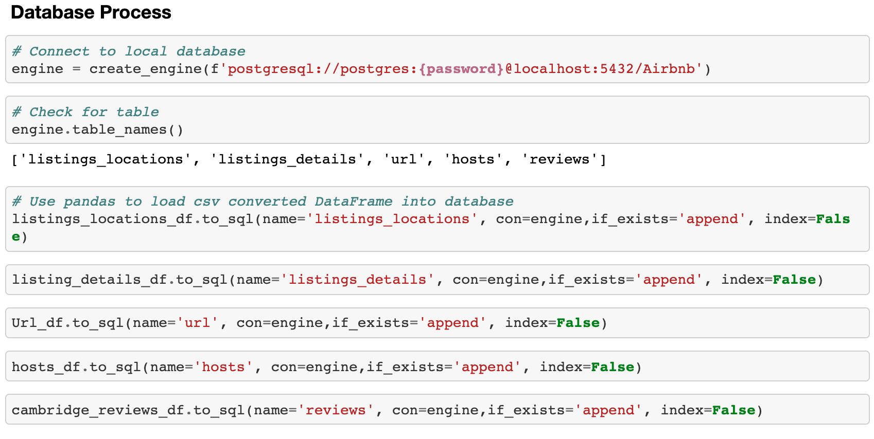
Connection Process

Slide 16

Queries

Slide 17
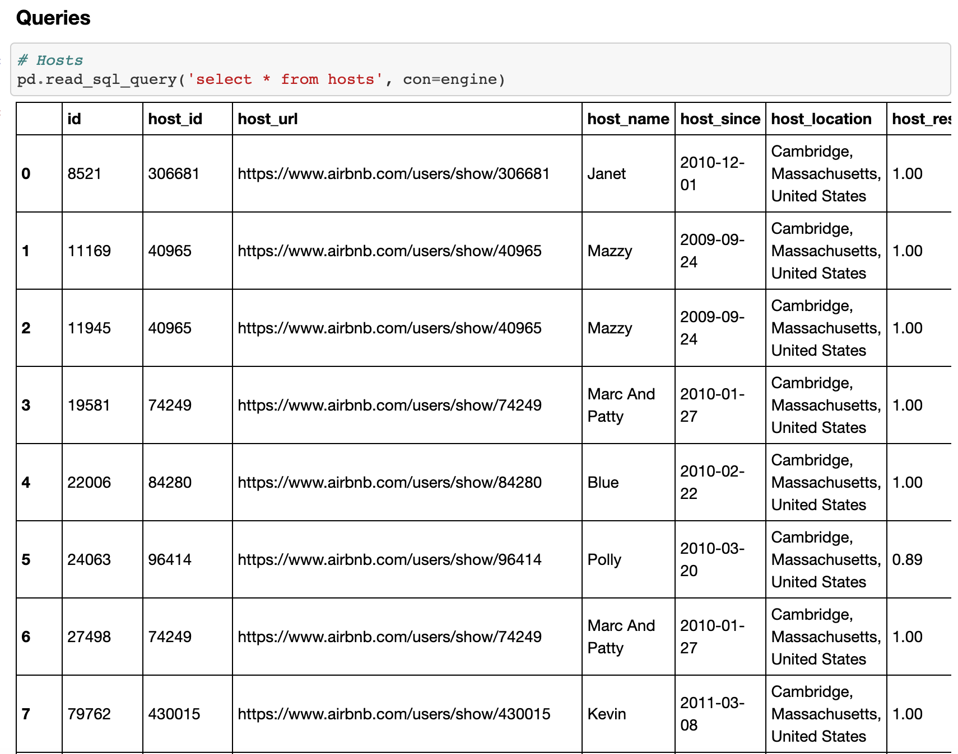
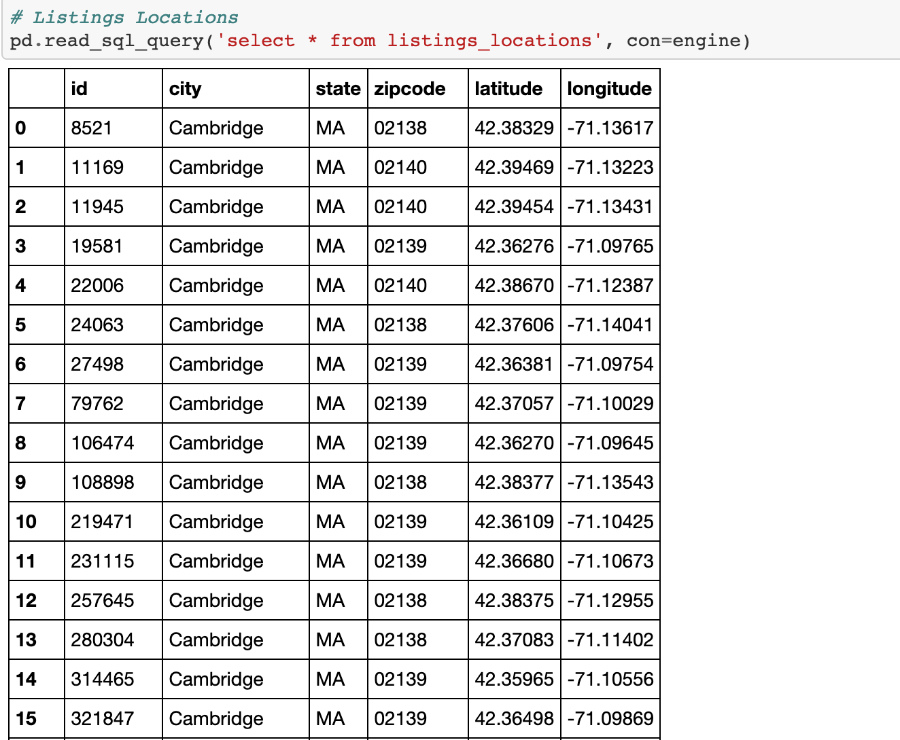
1277 rows × 6 columns

Slide 18
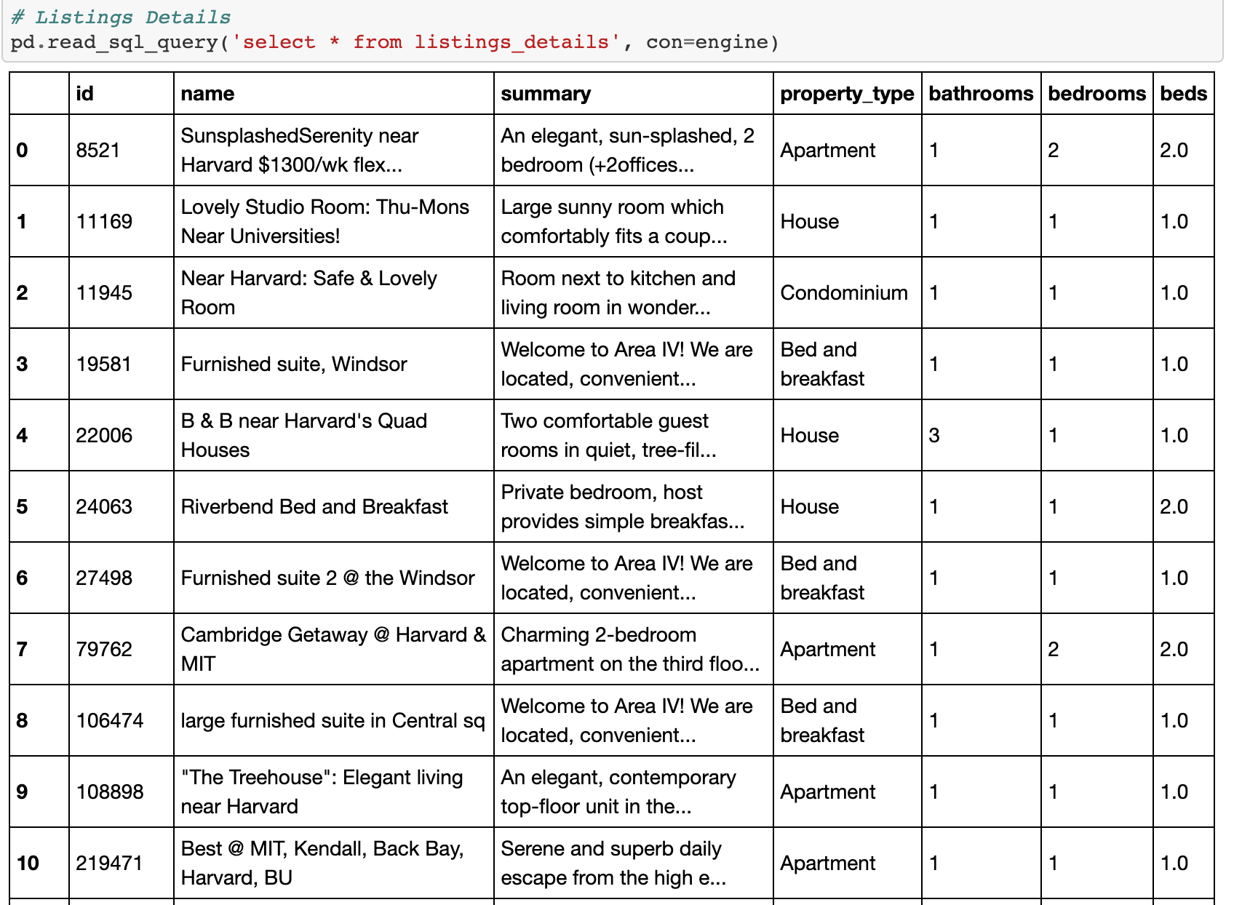
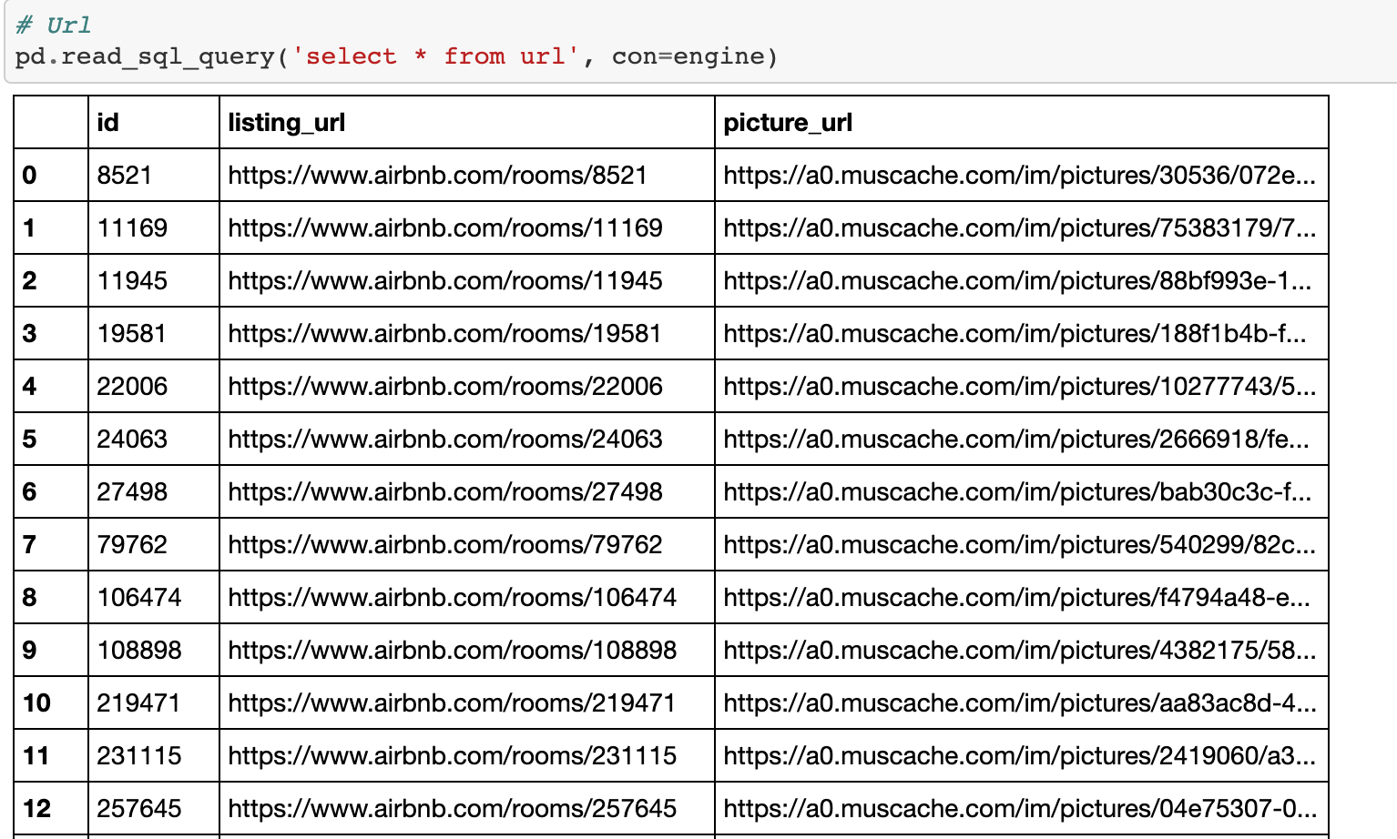

Slide 19
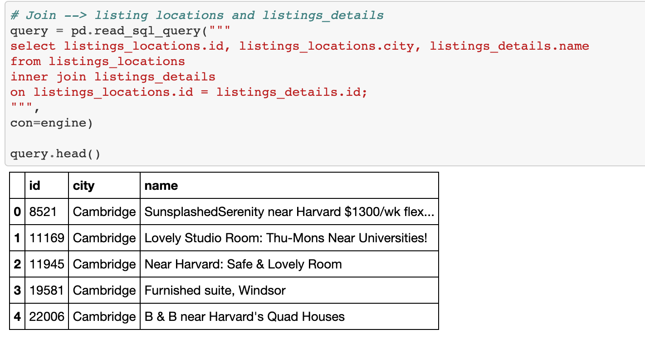
Join Queries

