Slide 1
Predicting probability of Hailstorms Using Time Series Forecasting
Jessica Manko
GEOG5990 Final Project
Spring 2020

Slide 2

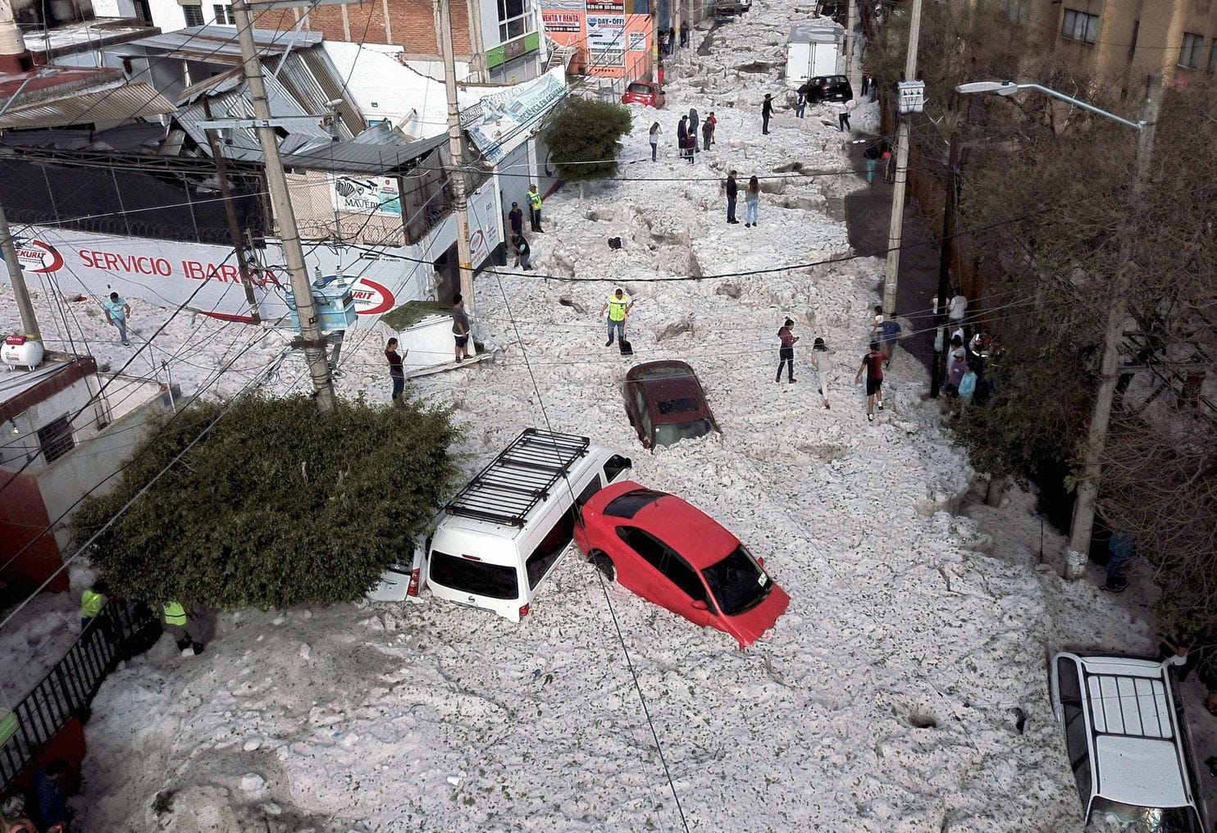
Introduction
Severe weather is a meteorological phenomena with the potential to cause serious damage.
Hail is a form of precipitation consisting of solid ice that forms inside thunderstorm updrafts and can cause billions of dollars of damage to structures, crops and livestock.
It is useful to accurately forecast when these events will occur.
The goal of this project is to run a time series prediction on the probability of hail events occurring using the Prophet and ARIMA models.

Slide 3

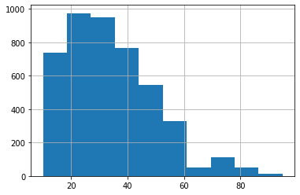
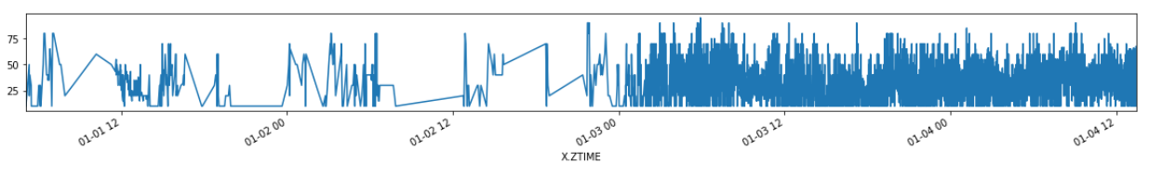
Data Preprocessing
The dataset is a product of NOAA from the Severe Weather Data Inventory representing detections of hail storm cells in the United States based on NEXRAD radar data during 2015.
10 rows: time, latitude, longitude, azimuth, range, wsr_id, cell_id, probability of hail, probability of severe hail, and maximum size of hail.
1,048,576 values; subset the first 20,000; clean up data by removing duplicates and null values.
Create a datetime index to run the time series prediction.
Subset the data frame to the columns needed to run analysis.
Trim sparse data away and focus on events after 01-03-2015.

Slide 4
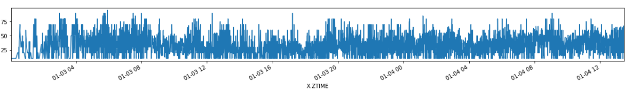
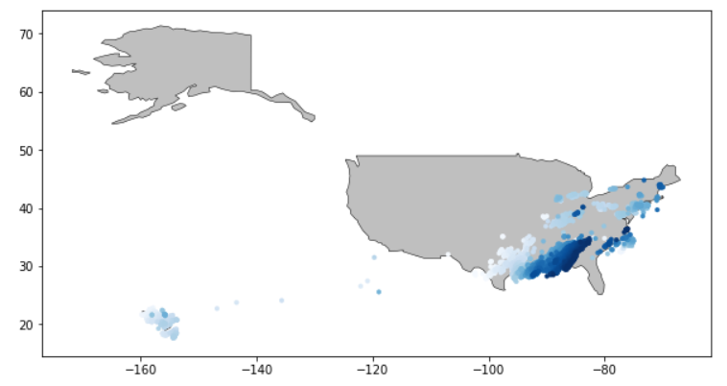
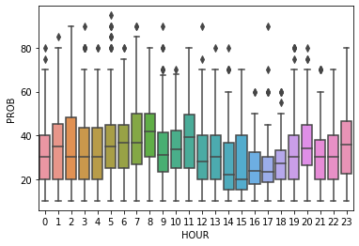
Data Visualization

Slide 5
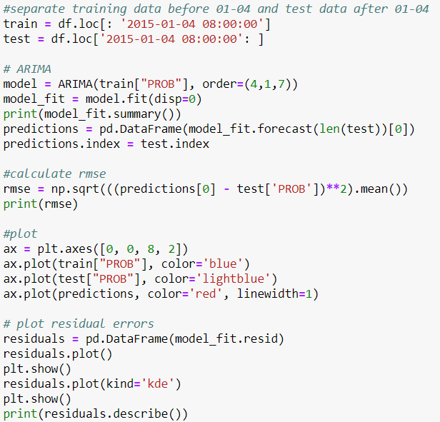
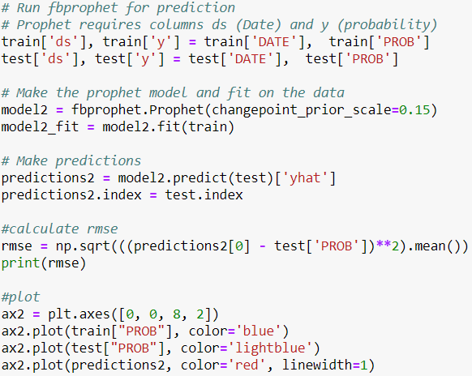
Time Series Prediction
ARIMA (AutoregRessive Integrated Moving Average) is a model that can be fitted to time series data in order to predict future points in the series.
Prophet (created by Facebook) is a procedure for forecasting time series data based on an additive model where non-linear trends are fit with yearly, weekly, and daily seasonality.

Slide 6
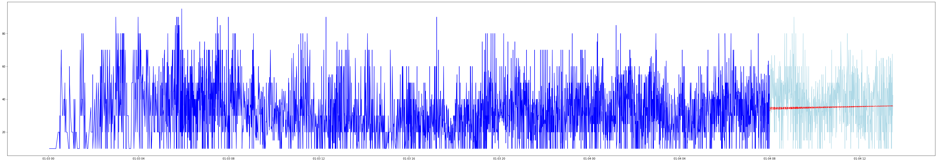
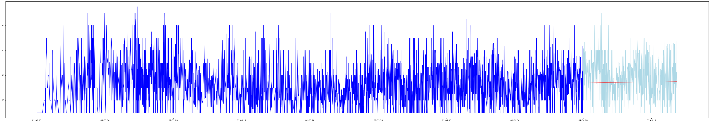
Model Results Based on Seconds
ARIMA
Prophet
Notes:
ARIMA: 15.17
Prophet: 15.33

Slide 7
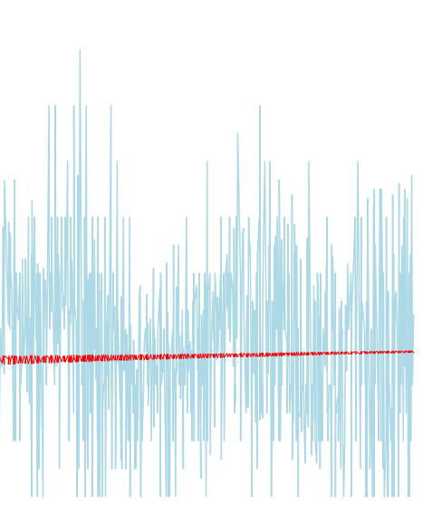
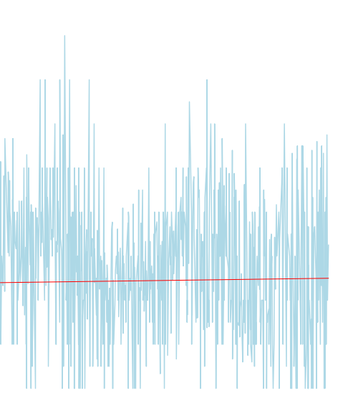
Model Results Based on Seconds
ARIMA
Prophet

Slide 8
Analysis
Statistics | Value
Mean | 33.5%
Standard Deviation | 16.2%
Range | 10%-95%
ARIMA RMSE | 15.17%
Prophet RMSE | 15.33%
There was approximately a ~15% error for both models
Errors of models are only ~0.8% better than the error of a horizontal line at the mean
Notes:
Std- differences from mean
Rmse- differences from line

Slide 9
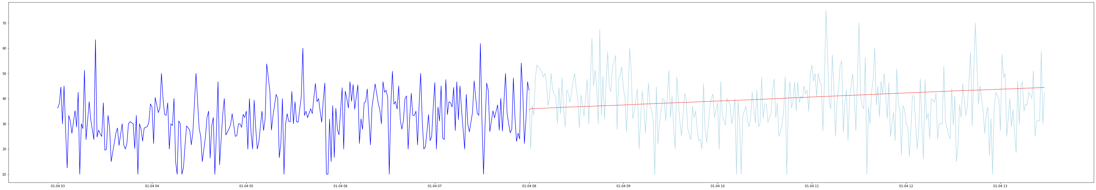
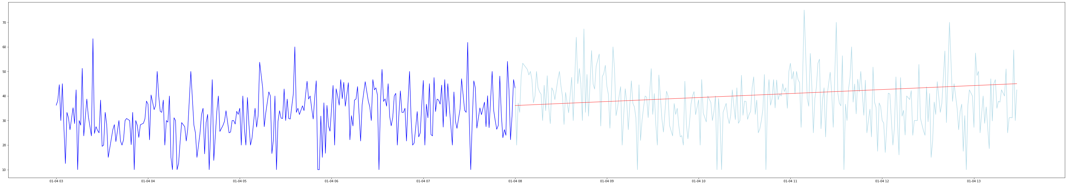
Model Results Based on Minutes
ARIMA
RMSE: 11.61%
Prophet
RMSE: 10.88%

Slide 10
Conclusion
Limitations
Total spatial consolidation - ie. hail data is being averaged for the entire US.
Data is only for January-April; subset is only for a couple of days in January.
Results may be more accurate for a longer sequence.
Data is noisy, time stamps for records are by the second.
Recommendations
Smooth out prediction and resample data to hours or days.
Change parameters of models.
Change training and test date periods.
Run models for longer time period.
Future work: these methods could be duplicated to perform time series forecasting on different datasets.

Slide 11
References
Brownlee, Jason. “How to Create an ARIMA Model for Time Series Forecasting in Python.” Machine Learning Mastery, 3 May 2020, machinelearningmastery.com/arima-for-time-series-forecasting-with-python/.
Brownlee, Jason. “What Is Time Series Forecasting?” Machine Learning Mastery, 21 Aug. 2019, machinelearningmastery.com/time-series-forecasting/.
“Hail Basics.” NOAA National Severe Storms Laboratory, www.nssl.noaa.gov/education/svrwx101/hail/.
NOAA. “Severe Weather Data Inventory.” Kaggle, 24 Oct. 2016, www.kaggle.com/noaa/severe-weather-data-inventory.
NOAA's Severe Weather Data Inventory, www.ncdc.noaa.gov/swdi/.
Lyla, Yang. “A Quick Start of Time Series Forecasting with a Practical Example Using FB Prophet.” Medium, Towards Data Science, 10 Jan. 2019, towardsdatascience.com/a-quick-start-of-time-series-forecasting-with-a-practical-example-using-fb-prophet-31c4447a2274.

