Slide 1

Building better working spaces
Presented by Dennis & Jonathan
Notes:
Hi everyone my name’s Dennis and this is Jono,
and today we’ll be talking about how we can help organisations work smarter and work better

Slide 2
Agenda
Problem description
Productivity vs. cost cutting
Our solution -- EcoCTL
Key features
Wrap-up

Slide 3

The problem
Notes:
Can you all recall a time you’ve been tired in front of a computer?
Was the lighting too poor?
Was it too cold? Too hot?
These are common problems that staff in many organisations face in today’s workforce.

Slide 4

The problem
Current temperature control systems are too simplistic
Lighting systems are not dynamic enough
They’re simple on & off switches
Notes:
Can you all recall a time you’ve been tired in front of a computer?
Was the lighting too poor?
Was it too cold? Too hot?
These are common problems that staff in many organisations face in today’s workforce.

Slide 5
Does it have to be this way?
Of course not!
MANY Studies already show: proper lighting & temperature controls are essential to nurturing productive workforces
Source:
Juslén, Henri, Marius Wouters, and Ariadne Tenner. "The influence of controllable task-lighting on productivity: a field study in a factory." Applied Ergonomics 38.1 (2007): 39-44.
Tanabe, Shin-ichi, Naoe Nishihara, and Masaoki Haneda. "Indoor temperature, productivity, and fatigue in office tasks." HVAC&R Research 13.4 (2007): 623-633.
Notes:
Of course not! Decades of study have shown that giving people: - adequate lighting
And temperature controls
Results in more productivity

Slide 6
Basic organisational goals
Improve shareholder value
Reduce fixed & variable costs
Increase Return on Assets (ROA)
Maximise productivity
Increase cash flow
Maximise profit
Corporate social responsibility
Efficiency
Notes:
And this is really important to organisations.
What do organisations fundamentally want? It’s to maximise shareholder value.
Through factors such as
Reducing costs
Improving bang for buck on assets
Getting the most out of your staff

Slide 7
Basic organisational needs
Improve shareholder value
Reduce fixed & variable costs
Increase Return on Assets (ROA)
Maximise productivity
Increase cash flow
Maximise profit
Corporate social responsibility
Efficiency
Where
Notes:
But today let’s focus on this.
Getting the most out of what you currently have.
Improving productivity whilst cutting your costs.

Slide 8
Improving productivity vs. cutting costs
They’re contradictory.
But businesses need an integrated solution which will allow them to improve workers’ productivity without increasing expenses

Slide 9
Here’s our solution
Notes:
Dennis to hand to Jono

Slide 10
Our solution
Climate
Temperature
Luminosity
An integrated environmental-control system for all offices and facilities

Slide 11
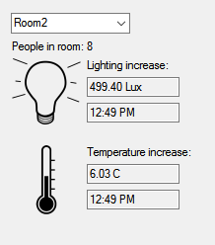
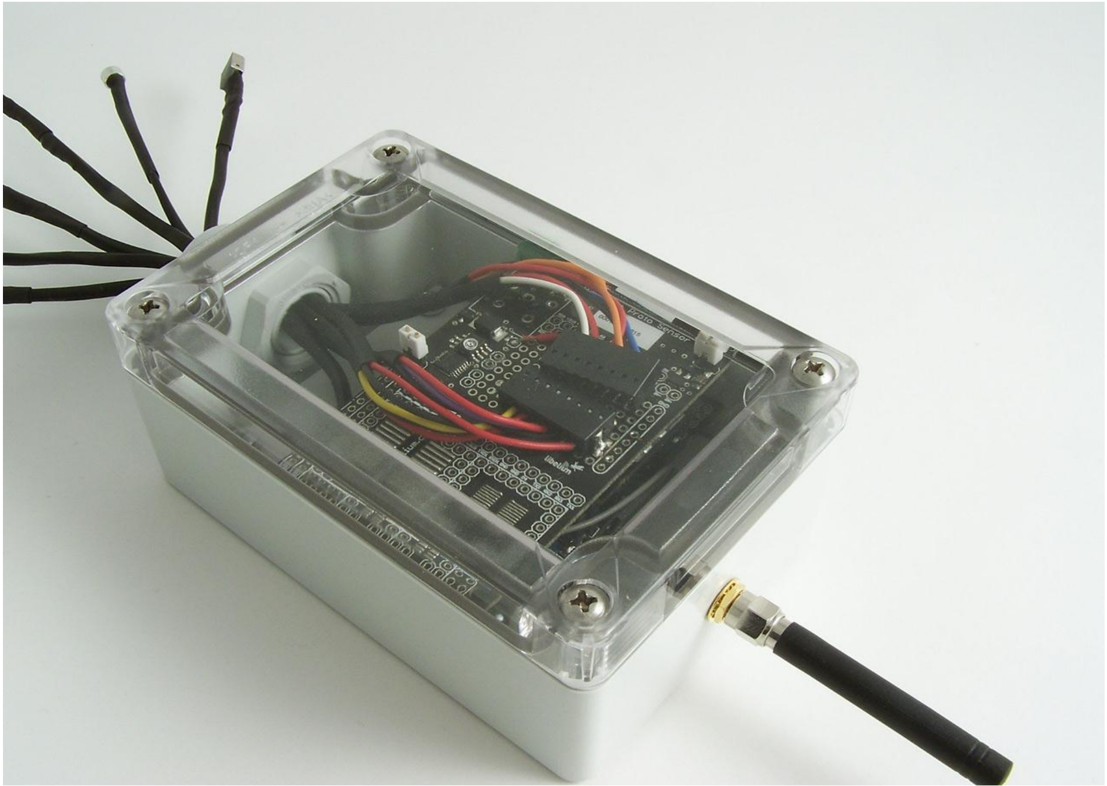
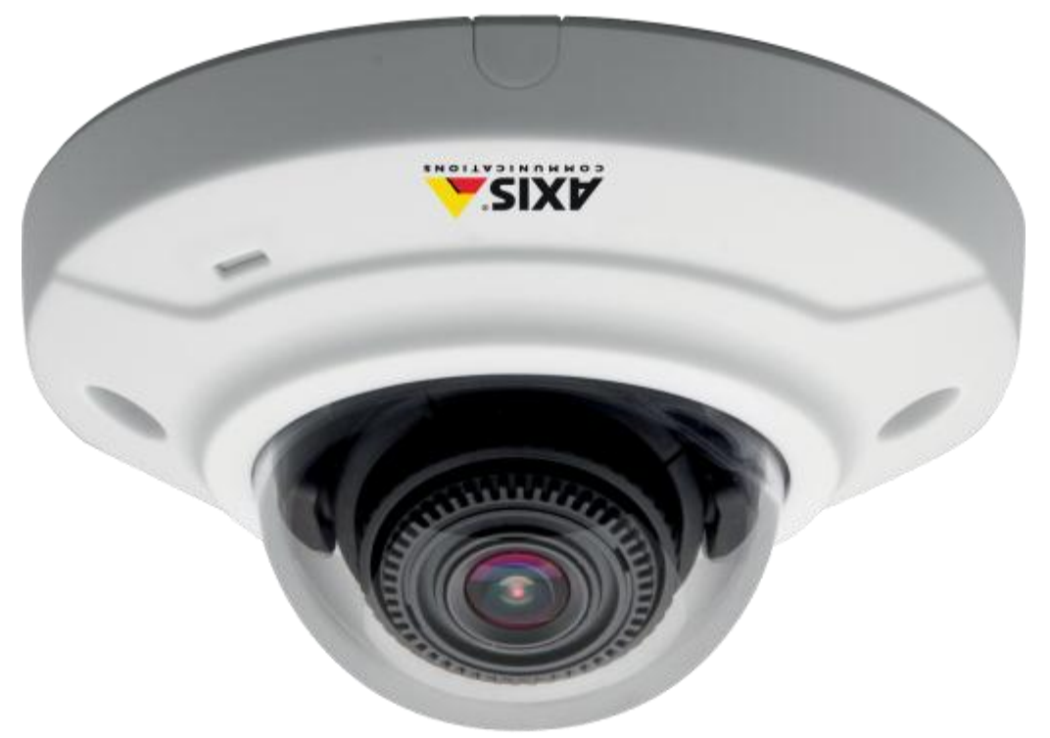
How it works
Luminosity and temperature sensors
People counters (cameras)
Graphical user interface (GUI)
Notes:
GUI connected to a desktop app remotely via 5G technology or WI-FI

Slide 12
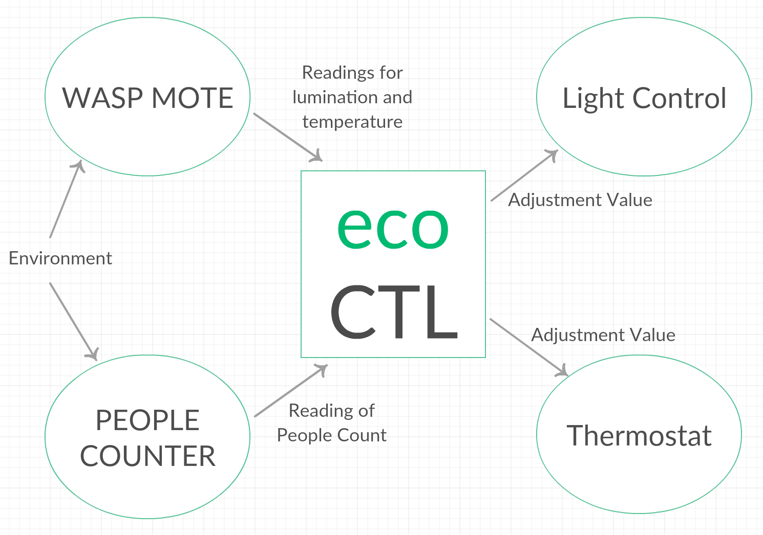
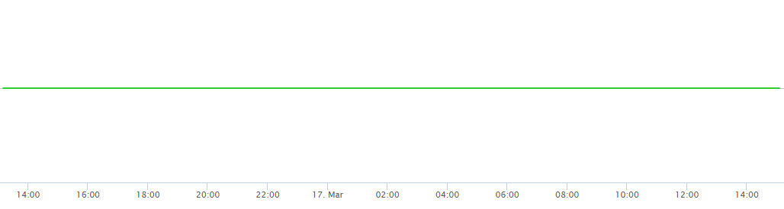
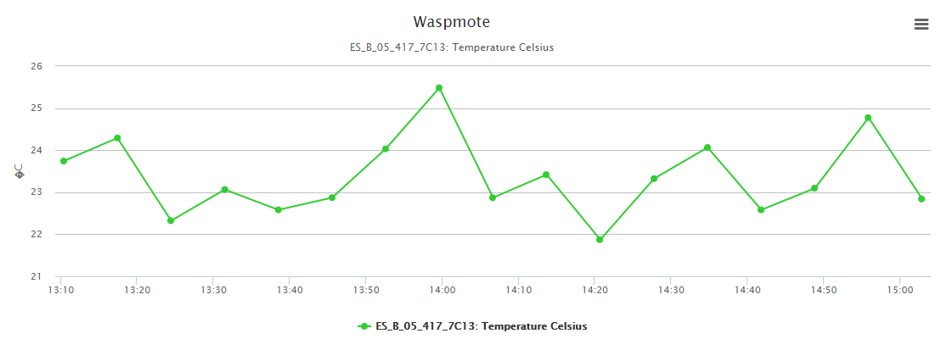
How it works
Notes:
Describe the system verbally

Slide 13
A quick demo
Notes:
Jono to hand to Dennis

Slide 14
Key features
Business Value
Scalable
Cost effective
Improves productivity
Higher employee satisfaction
Innovation
Suited all commercial environments
Societal benefit
Reduces carbon footprint
Better work force conditions
Technical merits
5G wireless integration
Increased level of automation
Non-resource intensive solution
Notes:
Suitable for all environments due to its compact nature

Slide 15

Why should YOU invest in an EcoCTL system?

