Slide 1
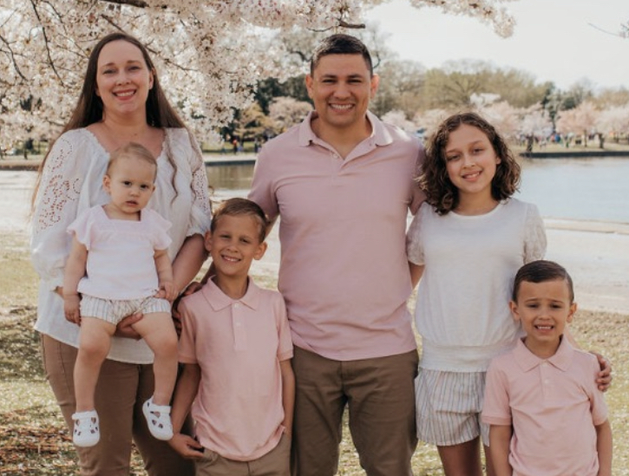
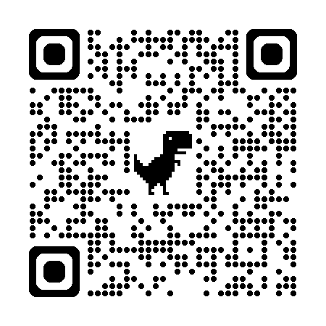
$ whoami - Follower of Christ - Devoted Husband - Loving Father - Active-Duty Marine - PhD Student (Cyber)
Early Career
Middle Career
middle Career
Current Career
Began at a helpdesk managing accounts, troubleshooting mailboxes, resolving printer issues, and handling ticketing. Later, as lead systems and network integrator, I built Microsoft Exchange servers, configured domain controllers from scratch, and developed network plans.
Led the cybersecurity compliance inspection program, auditing subordinate organizations to ensure adherence to FISMA, DODD/I, and NIST standards.
As cybersecurity manager, led vulnerability mitigation across West Coast offices and developed policies for record retention, secure asset deployment, mobile device management, and business continuity.
Planned defensive cyberspace operations, deploying global threat hunters to protect critical systems from APTs. Led threat modeling to map APT TTPs to system gaps, guiding the hunt process. Gained an advanced understanding of the toolkits to enable quick and effective use.
Hobbies: All types of fishing, spearfishing, shore fishing, kayak fishing

