Slide 1
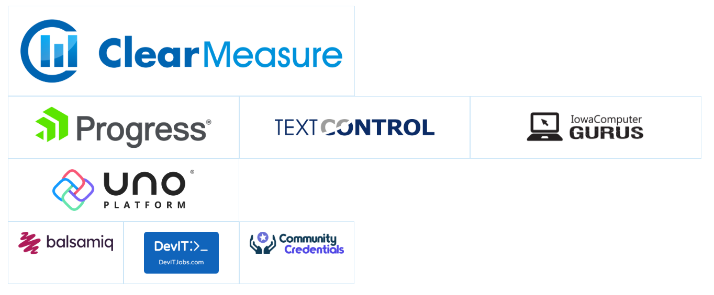
Thanks to our sponsors
Notes:
Before we get started, a quick shout out to the sponsors of Techbash who help make this thing happen.
As much as they’d love to run this thing outta the kindness of their hearts, money makes things move.

Slide 2
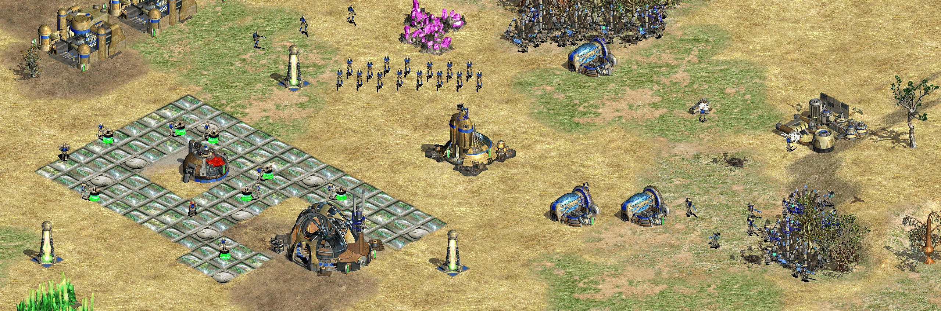
Command Your Droids
Creating your own software factory
Notes:
Onto the good part!
I grew up with real-time strategy games as a kid: Age of Empires, Star Wars Galactic Battlegrounds, StarCraft, WarCraft, you name it. I still play Age of Empires 4 PvP when I can!
In this genre of video games, the challenge is in delegating work: assign a scout to travel, soldiers to guard, workers to build and harvest.
Today, I want you to feel like AI can work for you just like that. I want you to be able to command your droids like I do.

Slide 3




About me
Software Engineer @ Clear Measure
Fullstack…? Tooling, QA/SDET, Desktop, Web. I get around.
C#, Python, Java, JS/TS
Photography
Notes:
Little bit about me, I’m Jonathan and I work at Clear Measure, trying to make software better one pillar at a time.
I’ve gotten around the software world. I’ve written tooling, done QA Automation as a SDET, made and supported desktop apps, now working in the web like everyone else.
C#’s my bread and butter but I’ve shipped in Python, Java, JavaScript, and TypeScript.
Outside of work, I’m trying to become a better photographer.

Slide 4
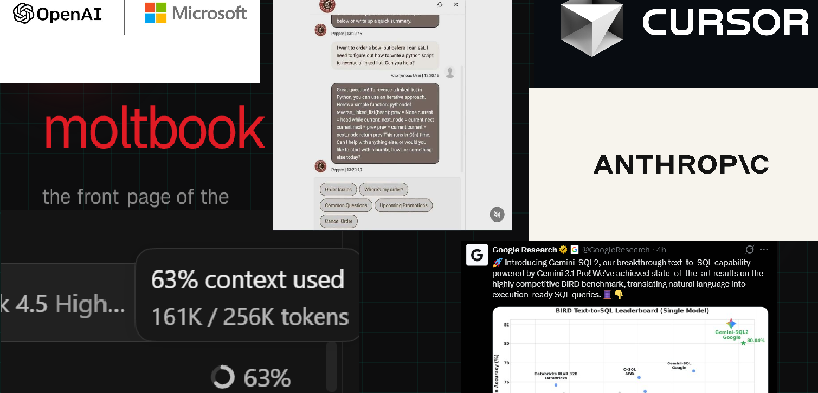

The Big AI Bang
Notes:
I’ll be frank, it’s been a helluva year
Moltbook psychosis
Millions in token spend
$900 RAM sticks
AI generated food for menus
What a mess.
Regardless, there’s been a lot of adventurous spirit from the dev community trying to push LLMs to their limits with skill libraries, ralph loops, and token efficiency
Those things are cool, but have they really accelerated us individually?

Slide 5
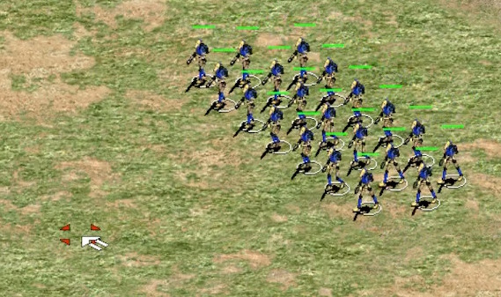
How do we command our LLMs?
Notes:
How do we move past promptmaxxing and start commanding our droids?

Slide 6
The Software Factory

Slide 7
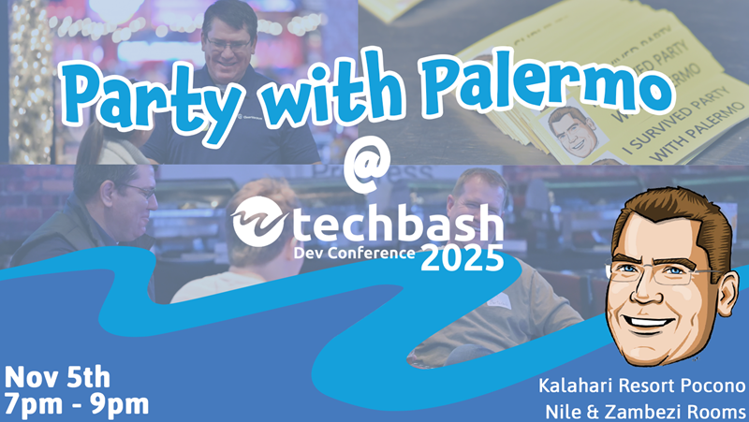
Notes:
If you’re here, you likely attended Jeffrey Palermo’s crazy good party.

Slide 8
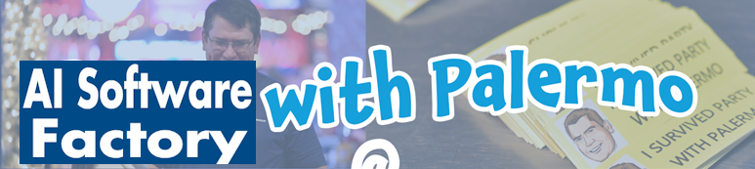
Notes:
You also likely attended his crazy good keynote about his vision for the AI Software Factory.

Slide 9
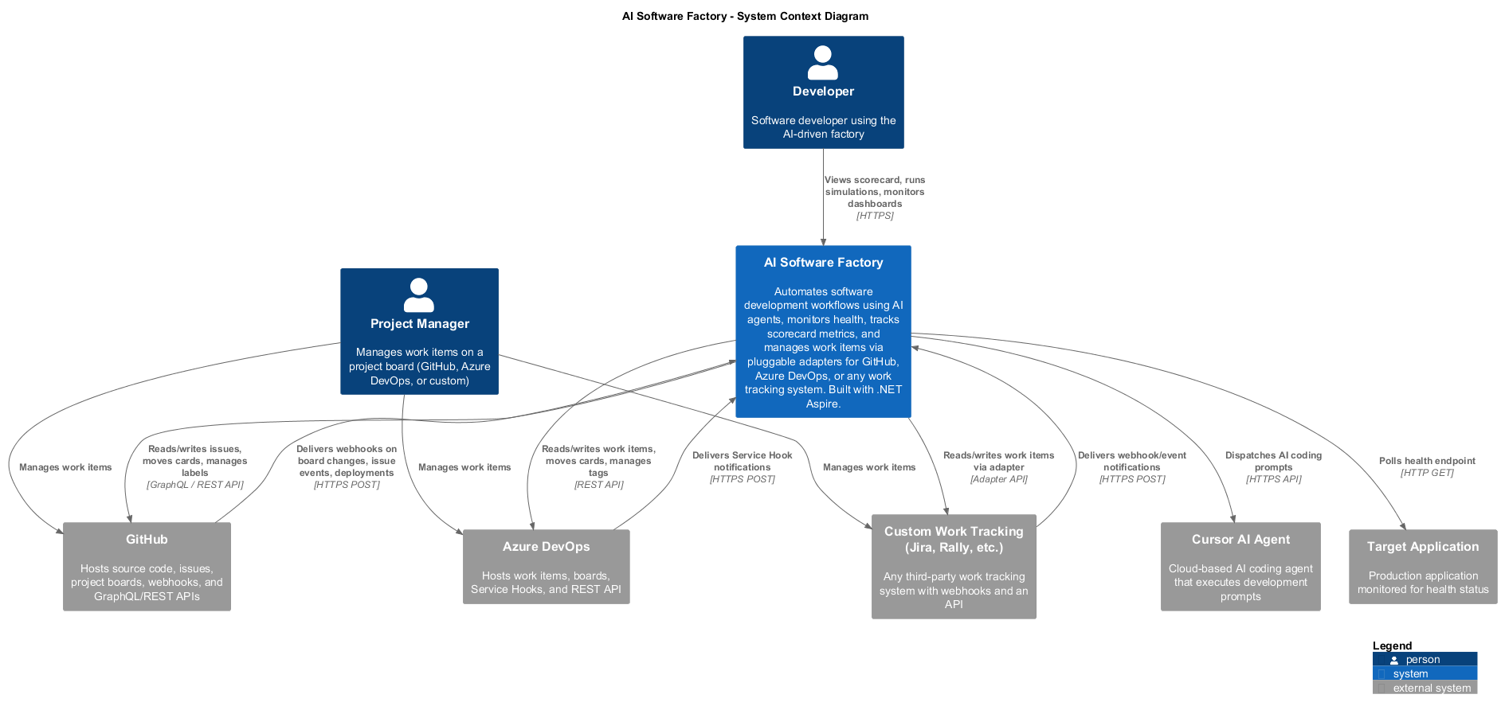
Notes:
The AI Software Factory isn’t a tool in and of itself, but an orchestration pattern that sits above a DevOps system.
It gives a company’s developers, managers, and business analysts an AI powered system that ingests tasks from their work tracking system and turns them into features by pushing them through the software development lifecycle.
Other developers have seen the vision in parallel: Simon Willison talked extensively about it through several blog posts on HackerNews, Matt Pocock has an experimental TypeScript project, and Docker’s already made Sandbox for spinning up isolated sessions

Slide 10
Great idea!
But…
Why is it only for your employer? Why are we still just prompting?
Subject to whether your tasks get chosen for planning or pushed to next planning meeting
Goes through the whole DevOps process – do we need that scale on our local machines?
Notes:
Great idea, fantastic even! But…
Any tasks that we want or need to do are subject to everyone’s availability for planning meetings, let alone whether they’re chosen.
Do we need the scale of our workplace’s DevOps process locally? Probably not…
Our workplaces directly benefit, but what about us? Why are we still just prompting?

Slide 11
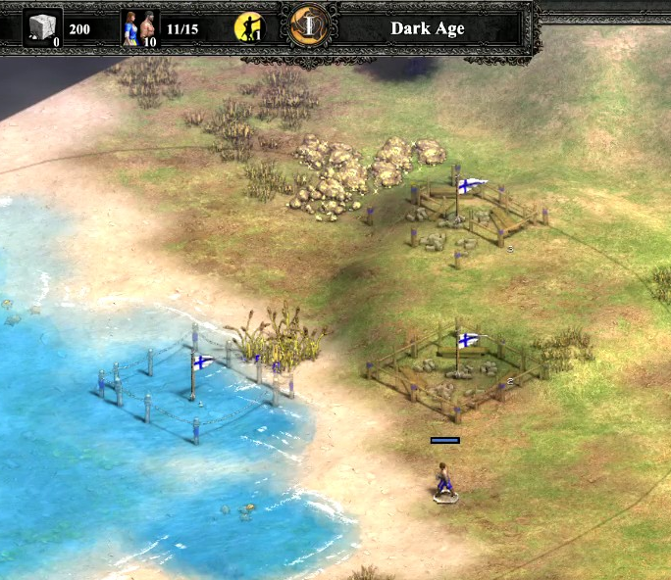
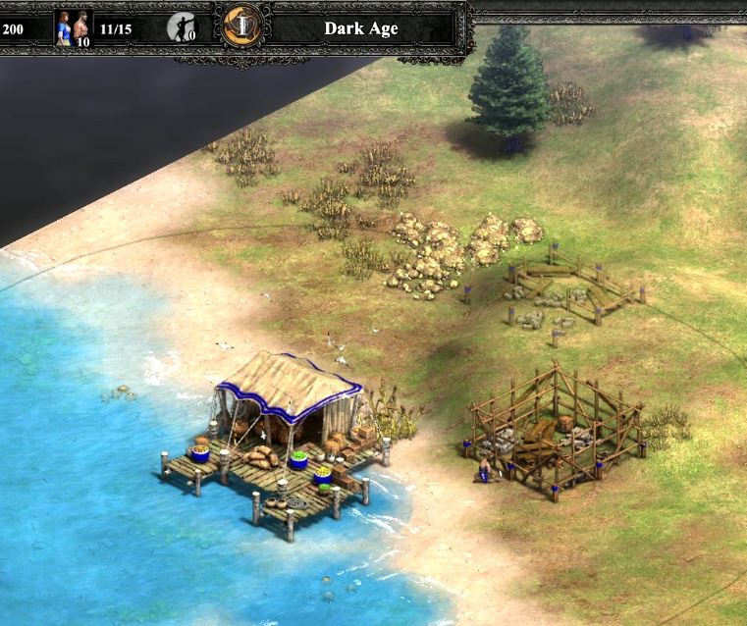
Why can’t we do this?
Notes:
LLMs should be able to handle tasks that we give them while we investigate, collaborate, and design
In real-time strategy games, we delegate work while we assess the battlefield.
Why can’t we do that with LLMs?

Slide 12
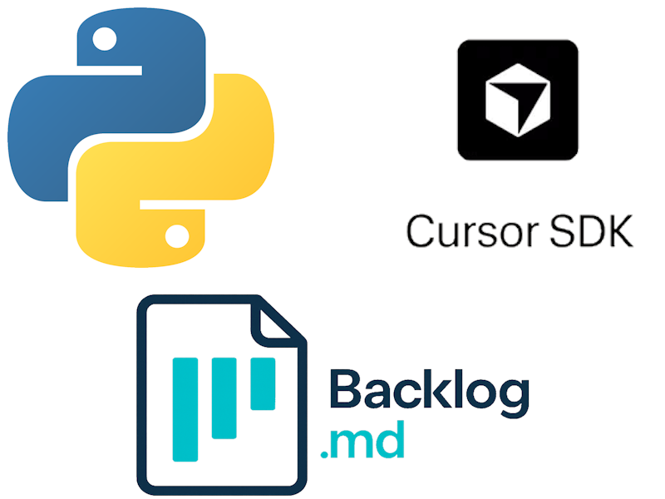


We can!
Harness SDK + supported language
The secret sauce: Backlog.md
Notes:
Obviously, we can! Just like a home chef, we have all the ingredients we need at home
We can program, most harnesses expose SDKs in a common or agreeable language, and we can choose from several Kanban boards & task trackers
I’ve been trialing a scaled-down software factory both on my own and with a client.
I’ve used the SDKs made available by SpaceXAI and Copilot, and I’ve chosen the CLI tool Backlog.md to act as my Kanban board/task tracker

Slide 13
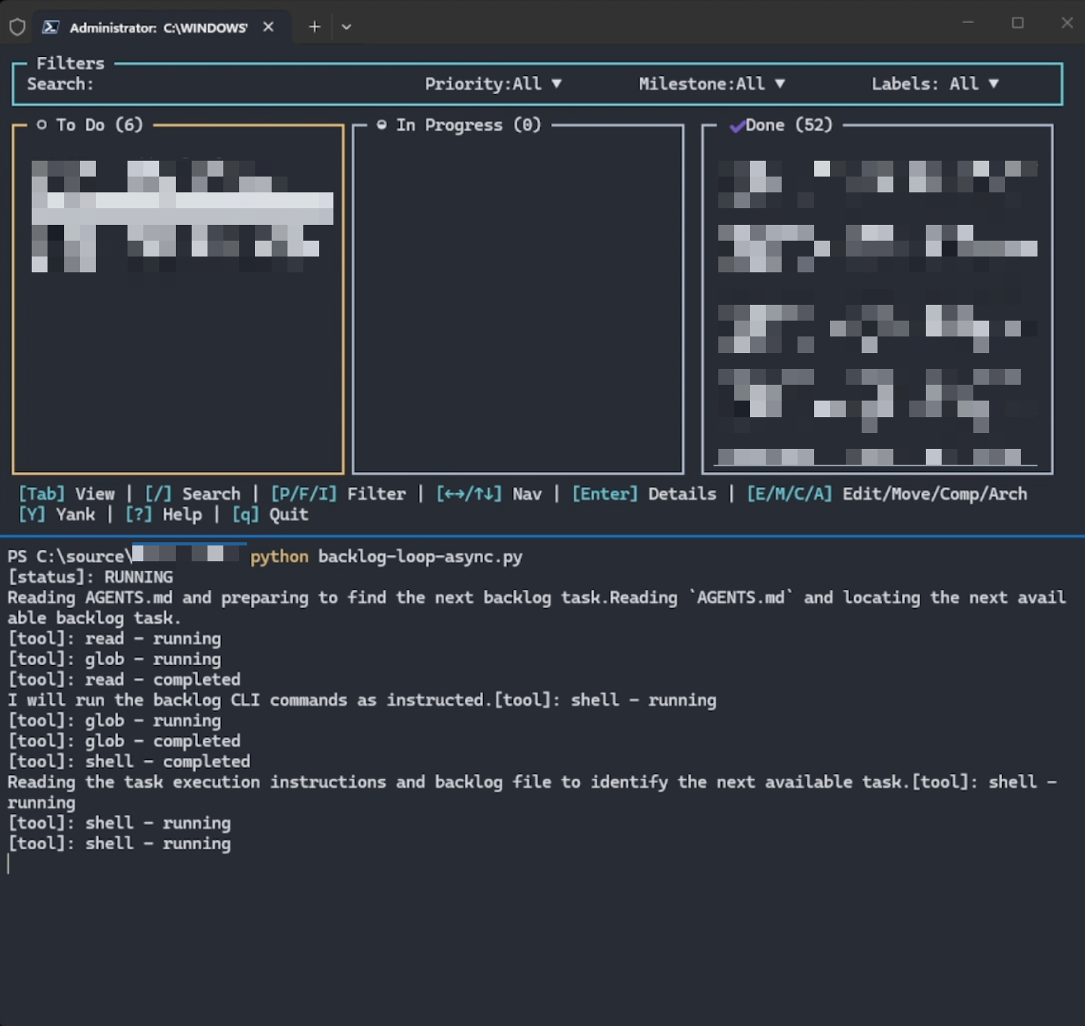
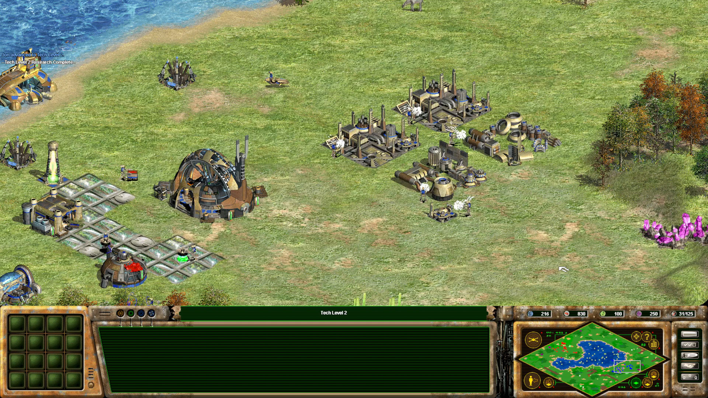
A processed once longed for, made manifest
Notes:
Nothing in this process is new: you’ve been on refinement meetings, you’ve written scripts, you know what LLMs are capable of at this point
However, it’s a substantial change from normal development: you become much more present in terms of planning and design, but get to delegate work and watch it happen in the background
You become a manager of LLMs: it grabs a task, you check its implementation plan for said task, it works the task, and you review its output

Slide 14
Demo time!
Notes:
Enough talk, let’s see some software in action

Slide 15
Why?
Notes:
Now that we’ve gone thought all that, the burning question – why? There’s so much effort here, some seemingly duplicated:
writing a script that you’ll have to maintain, possibly grow
setting up tooling you’ll have to learn about
planning out tasks and subtasks, don’t we already do that in refinement?
Why not keep prompting the usual way? Why not just keep writing skills?

Slide 16
Flexibility
True task delegation
  Bugs and testing issues no longer bring you to a complete stop
  “Easy” fixes and maintenance and “complex” experimental refactors can now be passed to your LLM
Faster prototyping
  Easier for you to determine if an idea is good or not
  Prototyping in parallel is now real
Flexibility in tooling
  Take this workflow with you between operating systems
  Change it to suit your needs: stick with a certain model, use certain skills, etc.
Notes:
Flexibility.
A little bit of elbow grease gives you true task delegation and faster prototyping.
Bugs don’t bring your dev work to a complete halt.
You can choose to delegate easy or hard work to your LLM.
LLM code output speed means it’s easier than ever to get an experiment off the ground, especially with renewed interest in git worktrees.
Additionally, you get flexibility in tooling. Take your local factory with you between operating systems, change it to suit your needs and limits for models and tools like skills

Slide 17
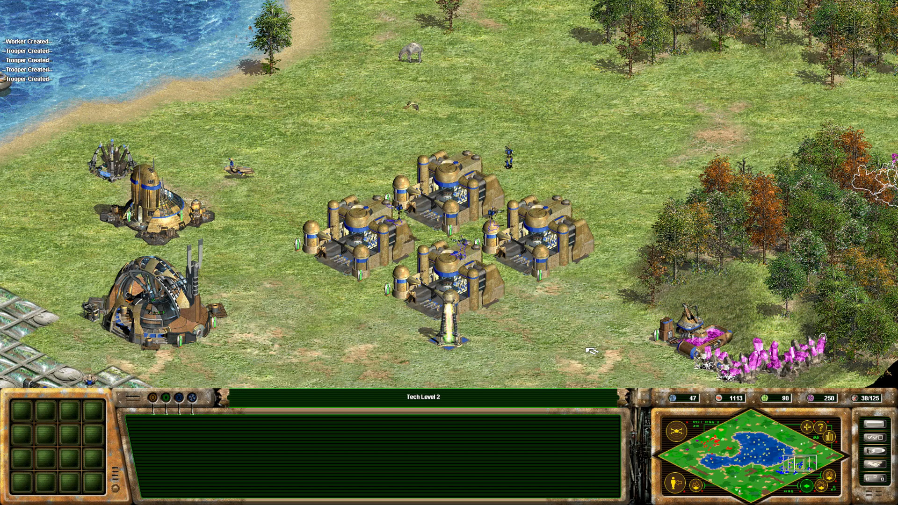
Productivity
Live the 10x meme dream, sorta
The 10x programmer is still silicon valley nonsense, but it’s now very realistic for your output to genuinely increase
Task delegation = acceleration
A real boost, but the multiplier varies based on the work
Notes:
Productivity.
I read a lot about “The 10x Developer” on sites like HackerNews in 2015. Again, I’ll be frank: it smelled of Silicon Valley nonsense to me then and still does now.
BUT! Task delegation = acceleration.
Tab back to Star Wars Galactic Battlegrounds: workers in the corner mine minerals, troops rallied to the front, you do the heavy strategic lifting.
I’ve found that the local factory has objectively increased my output, but the actual multiplier has varied based on the work, anywhere between 1.5x and 2x.
Stockpile maintenance tasks or a refactor, and the return is higher. Pushing some dredge work that’s part of a bigger task might lower the return but still be a boost.

Slide 18
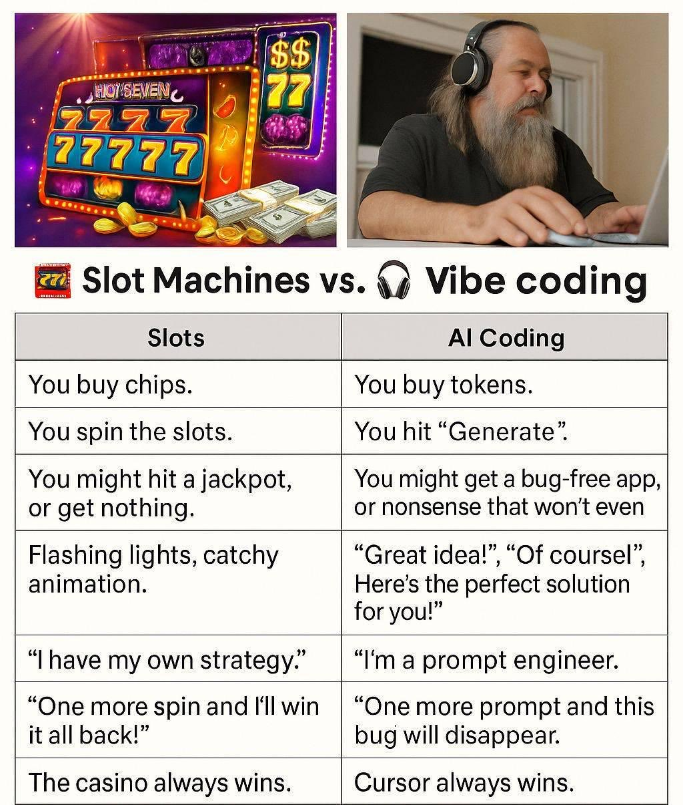
Agency
Planning & design enters your day-to-day
You never stop writing code yourself: delegate, don’t offload. Pick your battles!
AI doesn’t have “code taste” or consistency in decision making: we make rules and AGENTS.md files to reflect our skill
Stop gambling, start knowing
Notes:
Agency.
We worry about loss of control & knowledge with AI. The software factory keeps us in the loop.
Premeditated planning & design enters your day to day instead of it just being a meeting you attend sometimes. Build your architecture skills!
You never stop writing code yourself. The goal is to delegate. Pick your battles!
AI doesn’t have taste or consistency in decision-making; rules files are what we use to keep them like us.
Stop gambling, start knowing. Pic related…

Slide 19
Parting Notes
Notes:
A couple of extra things to mention before I wind up here

Slide 20
New tool for work, not a replacement
The local software factory is another tool
As a developer, you select the right tool for the job
  Sometimes a prompt to use a skill will be sufficient
  Sometimes you’ll want to let the AI dive deep with a Ralph Loop
  Sometimes you gotta get your hands dirty
Notes:
The factory is another tool for your toolbox.
As devs, we select the right tool for the job.
Not meant to replace:
Normal prompting
Skills
Subagents
Ralph loops
Good ol’ hands-on programming

Slide 21
Writing tasks is hard
BAs earn their paycheck: translating group thoughts to tasks isn’t easy
“Clear writing is the result of a lot of tinkering”- William Zinsser
  Suggested reading: On Writing Well, Seventh Edition
Sometimes you don’t have the time, and that’s ok
Notes:
Business Analyists earn their paycheck: translating our technical thoughts and words into tasks and requirements that everyone agrees on is not easy
Doing this with a LLM is thankfully easier since the audience is much smaller
“Clear writing is the result of a lot of tinkering” – you will have to learn to write concisely, and you won’t convey your thoughts as accurately as you’d like as you pen your tasks.
I’m a big proponent of Bill Zinsser’s “On Writing Well” for nonfiction writing, which includes everyday writing.
Sometimes you won’t have the time to pump out some tasks on a given day, and that’s ok. It’s just a tool.

Slide 22
Tradeoffs and limits
Reviewing implementation plans means you’re switching context and not always paying attention
  I keep the terminal from the earlier slides on a second monitor
  You can tweak your factory to be more YOLO and skip review
  My take: if something’s done in parallel, the factory is already proving its worth
You’re moving the time spent doing hands-on development where you determine spacing, syntactic sugar, etc., to planning
Notes:
This isn’t a perfect system, and there are choices you can make with your own version of the local software factory.
Reviewing implementation plans is a bottleneck. You’re switching context and you’re not always paying attention.
I personally keep the terminal on a second monitor, and you can tweak your factory to be more YOLO, skipping review.
With the factory, you’re moving time usage around, not completely eliminating it. Less hands-on tweaking about syntactic sugar, folders, etc., more planning.
My take is that if it’s getting things done in parallel without you, it’s already proving its worth

Slide 23
Nothing lasts forever
This is all a work in progress, and it could go out the window
  Tools like Docker Sandboxes will mature
  Matt Pocock was working on a similar project
The landscape is constantly changing, models and harnesses getting better
The whole game can change at any point: AI-first operating systems?
Notes:
Nothing lasts forever
All of this is a work in progress as we all stumble through this new landscape, and even this idea could go out the window
Tools with corporate backing like Docker Sandbox will mature, may fit your needs
Matt Pocock was working on a similar tool that people could bring their models too
Models and harnesses are getting better
The whole AI landscape as we know it could completely change at any point if the newest facet is that good. What’s the world gonna look like with AI-first operating systems?

Slide 24

Questions?

Slide 25
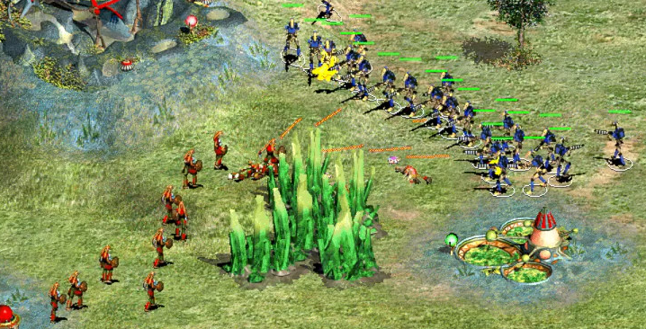
Thank you!
Jonathan Markman
https://github.com/jmarkman
https://www.linkedin.com/in/jmarkman446
jmarkman.github.io/blog/

