Slide 1
Sentiment analysis: drug reviews
Jonathan Marks

Slide 2
Business Problem
A hospital or insurance provider
Efficiently extracting numeric ratings from patients' written review.
To this end we build a model using labelled, numerically, patient reviews.

Slide 3
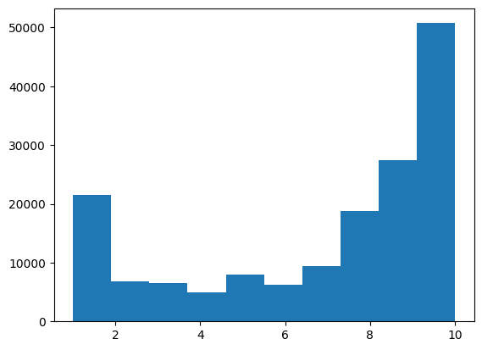
Data Understanding /Preprocessing
160,000 samples
Short paragraphs
800 and 3400 unique conditions
and drugs
Non-normal distribution of target
Text and meta-deta
The data comes from Drugs.com and is accessed through UCI's website.
(Kalummadi and Grer)
Patient ratings
count

Slide 4
Preprocessing / nlp techniques
Tokenizing
Word embeddings
TF-IDF
(Queen is to king as women is to man.)

Slide 5
RMSE cross-model comparisons
Linear regression model performs best.
 | No word embeddings (TF-IDF) | No word embeddings (TF-IDF) |  | Word embeddings
 | Baseline Decision Tree Regressor | linear regression | Random Forest Regressor | linear regression | Decision Tree Regressor
Train rmse | 3.38 | 2.84 | 3.44 | 3.03 | 3.14
Val rmse | 3.38 (3.09 w/deeper tree (5 leaves). | 2.88 | 3.44 | 3.10 | 3.22

Slide 6
Evaluation of chosen model
Linear Regression with TF-IDF | MSE | RMSE
 | 8.3 | 2.9

Slide 7
Recommendations/future work
Deployment of linear regression model
Gather insights on how patients rate drugs
“Doctor”, “horrible”, “worse”, “love”
Combine the tf-idf and word embedding models.
Use the “meta-data” as features. (i.e. the drug evaluated)

Slide 8
Thank you, questions?

