Slide 1

Analysis of housing prices

Slide 2
Business understanding
The client is a housing planner
Must set prices and wants to use market data
It is necessary to know the impact on the housing price of various real estate metrics

Slide 3
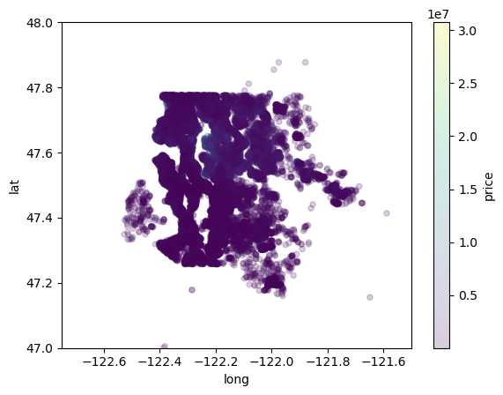
Data understanding
Housing data from a Northwestern county.
Key variables: price, square footage and quality.
Each row of data represents a different house sold.
Within past few years
About 30,000 in data set.
nearly all observations within Greater Seattle, outliers cut.
high price center zone

Slide 4
Modelling Overview: Linear regressions
Baseline model
'sqft_living’
Intermediate models:
Add new numeric variables and conservatively log transform move variables with each iteration.
to improve on linearity issue and heteroskedaticity issues and non-normality issues and to improve rsquared.
Final model:
Log all numerical variables from prior model
Add categorical variables Waterfront and Jumbo to increase rsquared.
to improve on non-normality(despite improvement) and some heteroskedaticity
Notes:
Second model:
Add to previous, variables with price correlation greater than .25 and sqft_living correlation less than .75 to increase rsquared
Third Model:
Log price/sqft living variables
Based on non-linearity issues (in residual plots and part regress) and non- normal issues in histograms
Fourth Model:
More log tranformed variables (sqft_patio,sqft_garage)

Slide 5
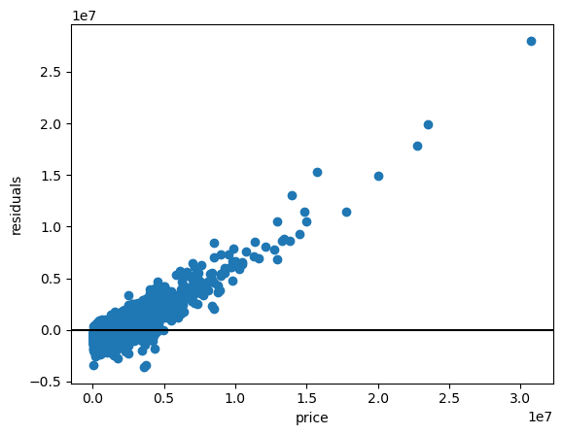
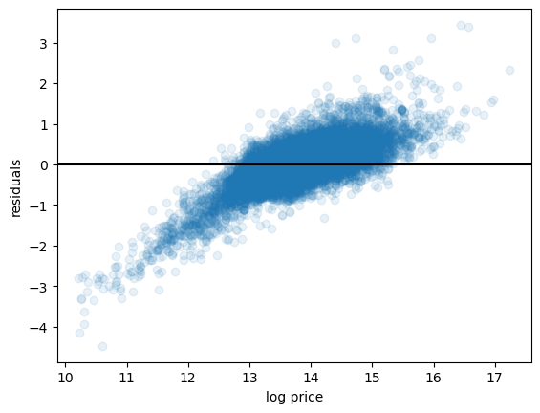
Linear regression model assumptions
Final model heteroskedacities, linearity, and normality of residuals are improved from the baseline model.
Residual histogram appears normally distributed, and is improved from previous model, however J-B test still failed suggesting non-normality.
Multicollinearity is low, all correlations below .75.

Slide 6
Final model & Results

Slide 7
Results contd.
Model Evaluation
Rsq: 0.51
This means the model accounts for 51% of the variation in the dependent variable.
Compared to baseline model of 0.38.
Mean squared error: 0.41.
This is a measure of how far off the predictions of log(price) are from the actual log(price).
Root mean squared error: 0.64
This is about the average of how far off the predictions of log(price) are from the actual log(price).

Slide 8
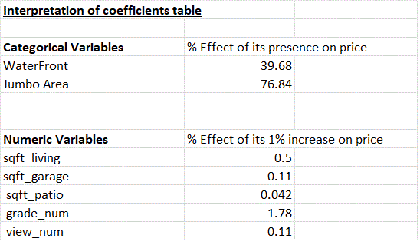
Interpretation of Coefficients

Slide 9
Recommendations
To determine a price of a house, take a similar house with about 10% less sqft of living area and add 4.85% to that price.
To determine a price of a house with a waterfront, take a similar house without a waterfront and add 39.68% to the non-waterfront price.
To determine a price of a house in the Jumbo area, take a similar house not in the Jumbo area and add 76.84% to the non-Jumbo price.

Slide 10
Next Steps
Establish a better interpretation of the root mean squared error.
Further analyze the negative coefficient of garage size variable.
Testing interaction variables (e.g. differing lot sizes and house sizes for different geographic areas.)

Slide 11
Thank you/Questions?

