Slide 1

Analysis of housing prices

Slide 2
Business understanding
The client is a housing planner
Must set prices and wants to use market data
It is necessary to know the impact on the housing price of various real estate metrics

Slide 3
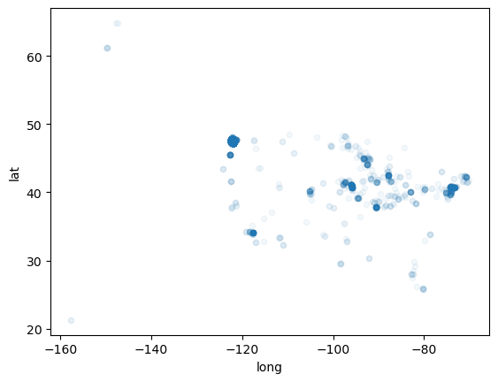
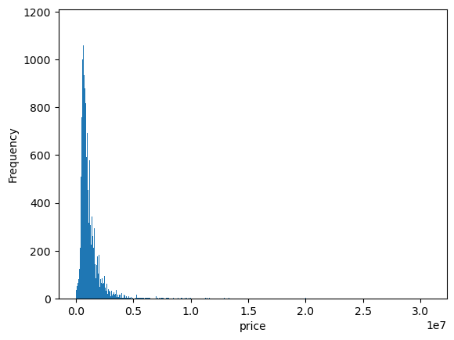
Data understanding
Housing data from a Northwestern county and from the county government.
Key data categories include price, number of rooms, various square footage metrics, and age of the house.
Each row of data represents a different house sold.
Within past few years
About 30,000 in data set.
nearly all observations within Greater Seattle

Slide 4
Modelling Overview
Baseline model
'sqft_living’
Second model:
Add to previous, variables with price correlation greater than .25 and sqft_living correlation less than .75 to increase rsquared
Third Model:
Log price/sqft living variables
Based on non-linearity issues (in residual plots and part regress) and non- normal issues in histograms
Fourth Model:
More log tranformed variables (sqft_patio,sqft_garage)
to improve on linearity issue and heteroskedaticity issues and non-normality issues and to improve rsquared.
Final model:
Log all numerical variables from prior model
Add categorical variable, Waterfront, to increase rsquared.
to improve on non-normality(despite improvement) and some heteroskedaticity

Slide 5
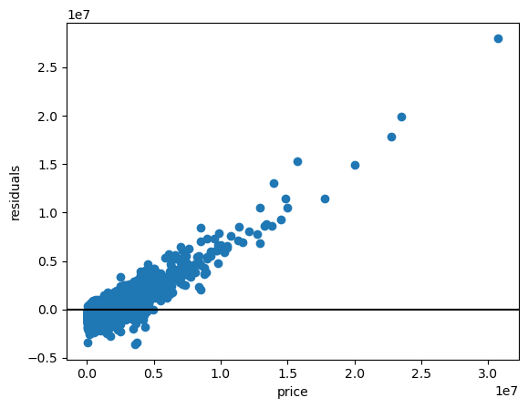
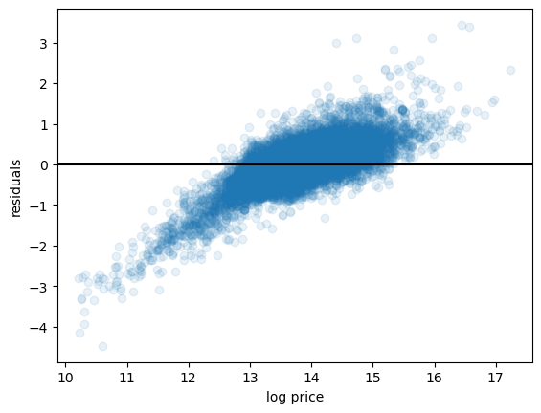
Results of iterative model process
Final model heteroskedacities, linearity, and normality of residuals are improved from the baseline model.
Residual plot appears normally distributed, and is improved from previous model, however J-B test still failed suggesting non-normality.
Multicollinearity is low, all correlations below .75.

Slide 6
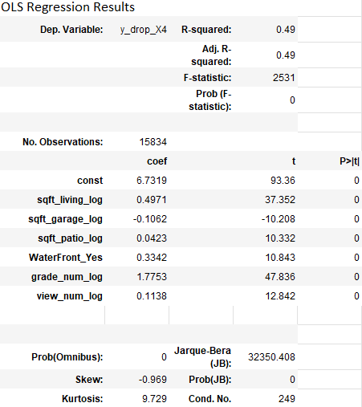
Final model

Slide 7
Results
Model Evaluation
Rsq is 0.49 compared to baseline of 0.38 and previous model of 0.46. This means the model accounts for 49% of the variation in the dependent variable.
The mean squared error of the model is about 0.42. This is a measure of how far off the predictions of log(price) are from the actual log(price).
Interpretation of coefficients: All six predictor variables significant
WaterFront properties: 39.68% in price
For each 1% increase in grade_num_log: 1.78% in price
For each 1% increase in sqft_living_log: 0.50% in price

Slide 8
Next Steps
Try to improve on rsquared/reduce small non-linearity by using the lat/long scatter map to create dummy variables for specific geographic areas (would likely be about 10).
Testing interaction variables (e.g. differing lot sizes and house sizes for different geographic areas.)

Slide 9
Thank you/Questions?

