Slide 1
ICT ASSET MANAGEMENT
ICT Asset Management System
A web and mobile solution for tracking, assigning, and reporting on organizational assets
Prepared for: [Audience] | [Date]

Slide 2
THE CHALLENGE
Asset tracking today is manual and hard to trust
• Spreadsheets and paper logs
No single source of truth for what the organization owns, or who has it.
• Slow, error-prone intake
New equipment sits undocumented until someone remembers to log it.
• No real-time visibility
Managers can't answer “what do we own?” or “who has it?” without asking around.
• Maintenance history gets lost
Repairs and servicing aren't tied to the asset, so patterns go unnoticed.
• No audit trail
When something changes, there's no record of who did it or when.
2

Slide 3
THE SOLUTION
One system, two ways to use it
Web Dashboard
Mobile App
For oversight, reporting, and full administration.
For the Asset Team, logging equipment on the spot.
• Fleet-wide visibility for admins
• Personal view for every user
• Departments, locations, maintenance
• One-click PDF reports
• Log a new asset in seconds
• Browse, search, and edit on the go
• Same live data as the web dashboard
• Works from any Android device
Both run on the same backend and database — nothing is ever out of sync.
3

Slide 4
KEY CAPABILITIES
Everything the Asset Team needs, end to end
Asset Intake & Tracking
Role-Based Access
Type, condition, model, serial number, tag, assignee, dates, and warranty — all in one form.
Admins see and manage everything; regular users see only what's relevant to them.
Departments & Locations
Maintenance History
Assets are tied to where they are and who they belong to organizationally.
Every service event is logged against the asset it belongs to.
PDF Reporting
Full Audit Trail
Generate a shareable report from the web dashboard or straight from the mobile app.
Every create, edit, and delete is recorded — who, what, and when.
4

Slide 5
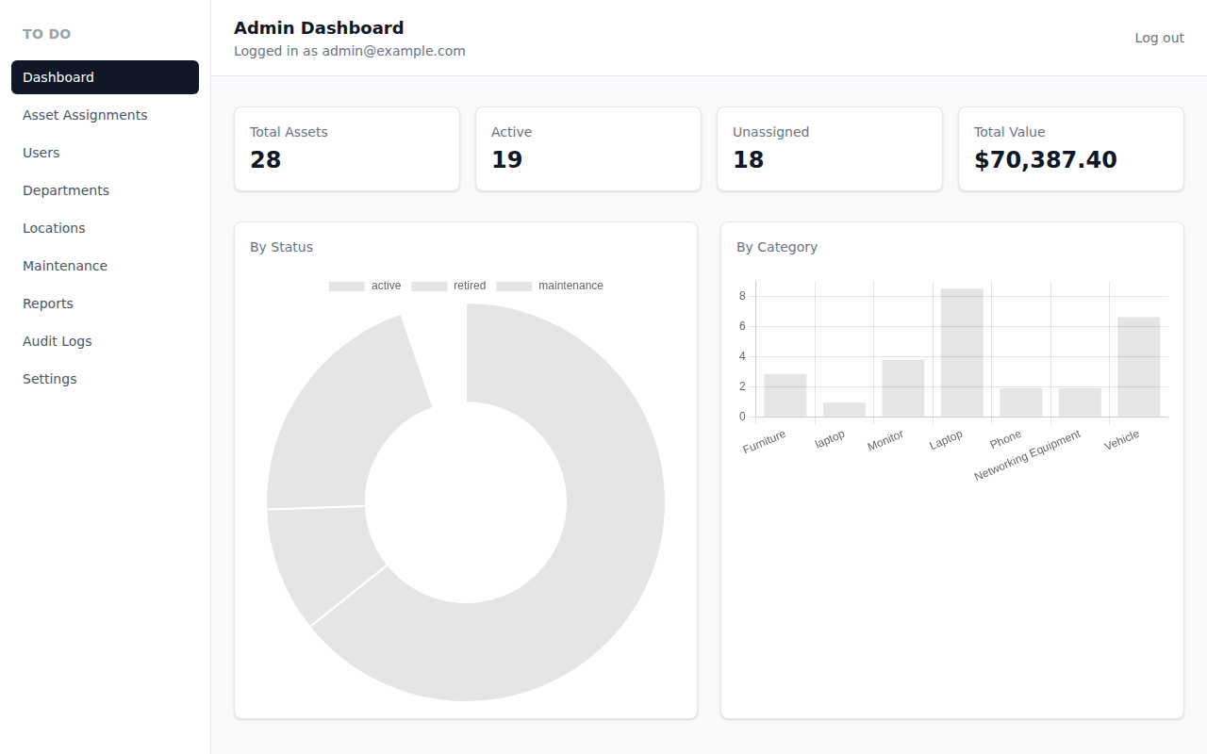
WEB APPLICATION
Admins get complete, fleet-wide oversight
• Live stats at a glance
Total assets, active count, unassigned, and total value.
• Visual breakdowns
By status and by category, updated in real time.
• Full management sidebar
Users, Departments, Locations, Maintenance, Reports, Audit Logs, Settings.
5

Slide 6
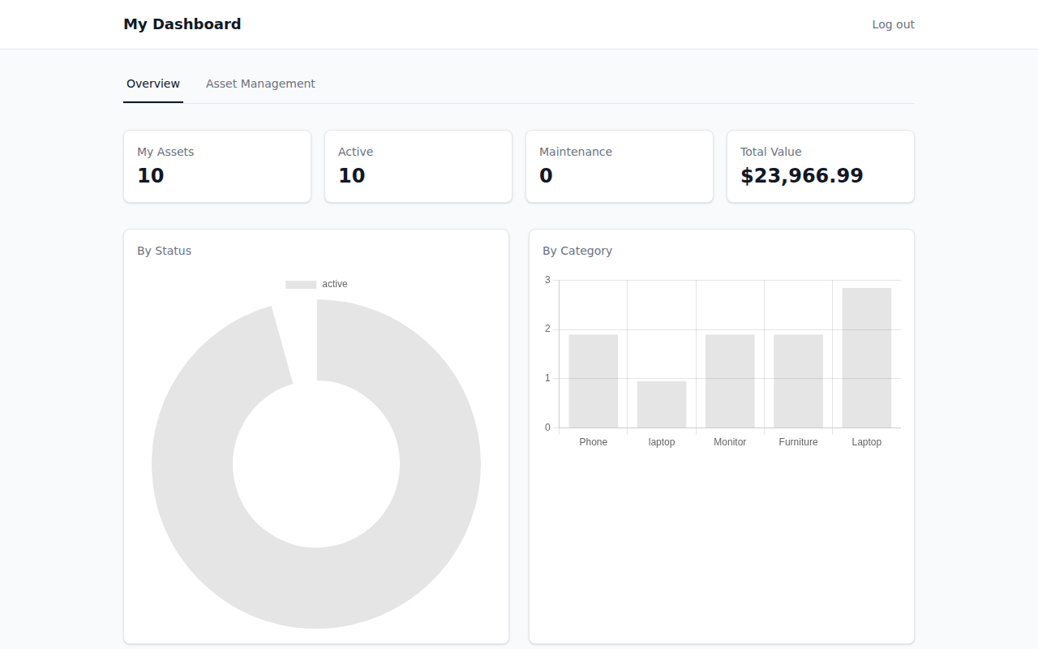
WEB APPLICATION
Regular users get a focused, personal view
• Only their own assets
No clutter from equipment that isn't theirs.
• Self-service
Log and edit their own assets without waiting on an admin.
• Same simple design language
As the admin view — consistent, low learning curve.
6

Slide 7
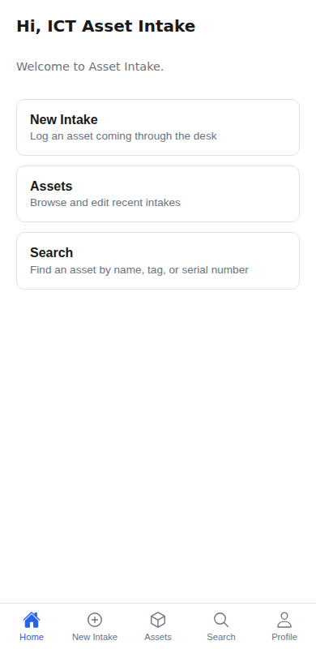
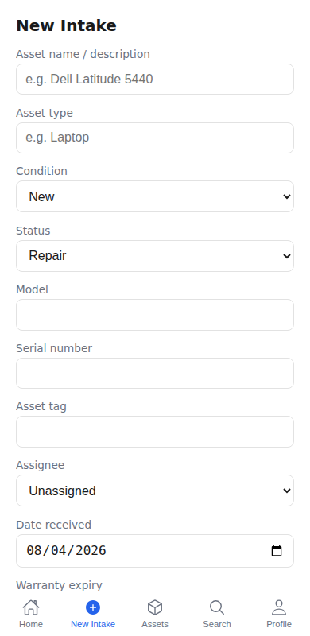
MOBILE APP
Log a new asset the moment it arrives
• Home
One tap to New Intake, Assets, or Search — nothing to hunt for.
• New Intake form
Type, condition, status, model, serial, tag, assignee, dates, and warranty.
• No more paperwork
The Asset Team logs equipment on the spot, right at the desk.
7

Slide 8
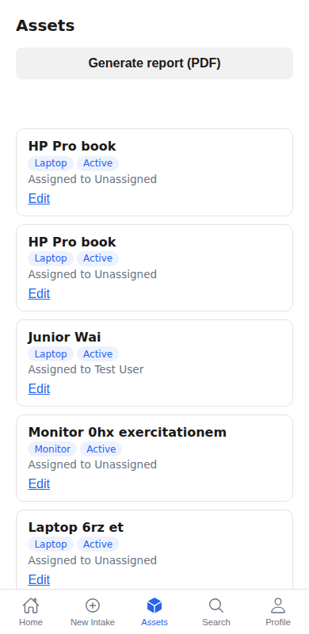
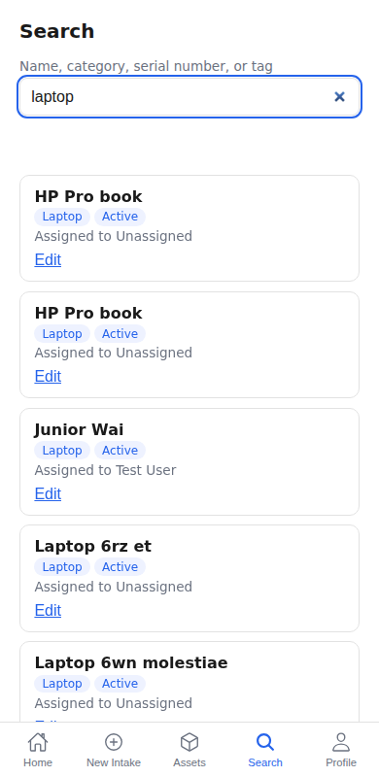
MOBILE APP
Find and update any asset in seconds
• Browse & edit
Every recent intake, with one tap to correct or update it.
• Instant search
By name, category, serial number, or asset tag.
• Generate a report
PDF export, right from the phone.
8

Slide 9
SECURITY & TRUST
Access is controlled, and every change is recorded
• One secure login
The same login screen recognizes who you are and shows the right interface.
• Controlled access
Admins manage the whole fleet; regular users only see and edit their own assets.
• Session security
Logins expire automatically after a period of inactivity.
• Complete audit log
Every asset, user, and record change is timestamped and attributed.
9

Slide 10
THE VALUE
What this means for the organization
Time saved
Accountability
Fewer lost assets
Real-time visibility
Minutes, not paperwork, to log or find an asset.
Always know who has what, and who changed what.
Nothing sits untracked between the desk and a spreadsheet.
Leadership can see the full fleet, valued and categorized, instantly.
10

Slide 11
Thank you
Questions & discussion

