Slide 1



APIM 🩷 OpenAI

Slide 2

Why we are here?
Generative AI has ignited a remarkable range of possibilities
All industry sectors are embracing AI advancements
Most AI services are utilized and accessed via APIs
It’s essential to have a well-planned API management strategy to ensure the effective use of AI services
Approaches driven by experimentation are the enablers that pave the road to success

Slide 3
AI Gateway
http://aka.ms/ai-gateway
!
AI Gateway is a concept that leverages Azure API Management features to provide key capabilities on using AI Services such as OpenAI effectively. It’s released as an open-source project without warranty of any kind.

Slide 4



AI Gateway objectives
Aims to accelerate the experimentation of advanced AI use cases
Ensures control and governance over the consumption of AI services
Paves the road for a confident deployment of Intelligent Apps into production

Slide 5





AI Gateway toolchain
VS Code
Jupyter Notebooks
Python
Bicep
Azure CLI
Powered by VS Code running locally or in the cloud with GitHub Codespaces
Jupyter Notebooks structures the step-by-step instructions
Python scripts define the variables and execute OpenAI API calls directly or with SDKs
Bicep defines the infrastructure as code needed for the lab in a declarative way
Azure CLI handles authentication with Azure and issues commands to the control plane

Slide 6
Request forwarding
Playground to try forwarding requests to either an Azure OpenAI endpoint or a mock server
APIM uses the managed identity (user or system assigned).
APIM is authorized to consume the Azure OpenAI API through Role Based Access Controls.
Zero impact on consumers using the API directly, with SDKs or orchestrators like LangChain. Just need to update the endpoint to use the APIM endpoint instead of Azure OpenAI endpoint.
Keyless approach: API consumers use the APIM subscription keys, and the Azure OpenAI keys are never used.

Slide 7
Backend circuit breaking
Playground to try the built-in backend circuit breaker functionality of APIM to either an Azure OpenAI endpoint or a mock server
Azure OpenAI endpoint is configured as an APIM backend, promoting reusability across APIs and improved governance.
Circuit breaking rules define controlled availability for the OpenAI endpoint.
When the circuit breaks, APIM stops sending requests to OpenAI.
Handles the status code 429 (Too Many Requests) and any other status code sent by the OpenAI service.
Doesn’t need any policy configuration. The rules are just properties of the backend.
New product feature

Slide 8
Backend pool load balancing
Playground to try the built-in load balancing backend pool functionality of APIM to either a list of Azure OpenAI endpoints or mock servers
Spread the load to multiple backends, which may have individual backend circuit breakers.
Shift the load from one set of backends to another for upgrade (blue-green deployment).
Currently, the backend pool supports round-robin load balancing.
Doesn’t need any policy configuration. The rules are just properties of the backend.
New product feature

Slide 9
Advanced load balancing
Playground to try the advanced load balancing (based on a custom APIM policy) to either a list of Azure OpenAI endpoints or mock servers
Loads the load balancer configuration from a named value property.
Uses backends to enable the combination with the built-in circuit breaking feature or chaining with the backend pool.
The policy doesn't have to be changed to add/modify endpoints or configure the load balancer.
Dynamically supports any number of OpenAI endpoints.
Support advanced properties like priority or weights to give priority to Provisioned Throughput Unit (PTU) instances.

Slide 10
Response streaming
Playground to try response streaming with APIM and Azure OpenAI endpoints to explore the advantages and shortcomings associated with streaming
The client application receives the completions in chunks as it's being generated.
Might improve the user experience for intelligent apps with a ChatGPT interface.
Streaming responses doesn't include the usage field to tell how many tokens were consumed.
You sacrifice for now APIM built-in logging .
Streaming in a production application makes it more difficult to moderate the content of the completions, as partial completions may be more difficult to evaluate.

Slide 11
Vector searching
Playground to try the Retrieval Augmented Generation (RAG) pattern with Azure AI Search, Azure OpenAI embeddings and Azure OpenAI completions
Implements the popular RAG pattern
Uses Azure AI Search as a vector store
Uses OpenAI to generate the embeddings
Supports key word search, hybrid search and semantic ranking.
OpenAI completion is generated based on the user prompt and the AI search results.
All the APIs from OpenAI and AI Search are served trough APIM without using keys.

Slide 12
Built-in logging
Playground to try the built-in logging capabilities of API Management
The requests are logged into Application Insights and metrics available in Azure Monitor.
Doesn’t need any policy configuration.
Enables tracking request/response details and token usage with the provided notebook.
Metrics from the Azure OpenAI service might be correlated to provide a holistic view on service usage.
The notebook can be easily customized to accommodate specific use cases.
Enables the creation of Azure dashboards for a single pane of glass monitoring approach.

Slide 13
SLM self-hosting
Playground to try the self-hosted phy-3 Small Language Model (SLM) trough the APIM self-hosted gateway with OpenAI API compatibility.
The APIM self-hosted gateway is a containerized version of the default managed gateway.
Useful for scenarios where we need to self-host an open-source model from platforms such as Hugging Face.
In this playground we have used Phi-3 that is a SLM suited to try on a laptop.
Both APIM self-hosted gateway and the phy-3 could run on docker containers or in a Kubernetes cluster.

Slide 14
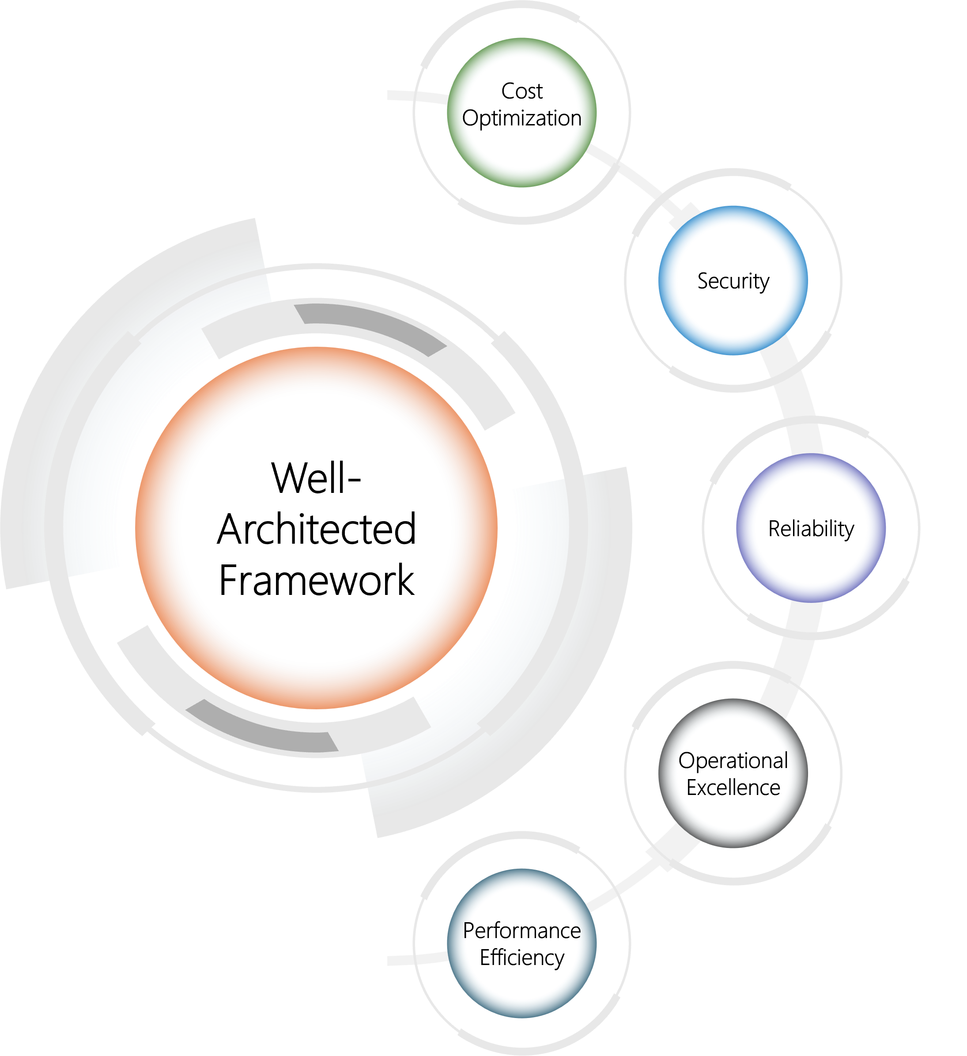
Built with Well-Architected Framework principles
Zero-trust approach and keyless strategy for Azure OpenAI
Redundancy and capable of handling variable usage spikes
Elasticity and mechanisms to distribute the load to multiple endpoints
Observability to continuously improve quality and user experience
Cost control mechanisms to track token usage and allocate costs
https://learn.microsoft.com/en-us/azure/well-architected/

Slide 15

Summary
The AI Gateway concept provides a range of labs that enables the experimentation of AI Services supported by an API management strategy.
The experimentation will feed the design architecture and the landing zone that will go into production.
The labs are based on Jupyter Notebooks to enable documented and actionable instructions, Python scripts, Bicep IaC and APIM policies.
There is a backlog of experiments that we plan to implement to take this work further and enable more advanced use cases. Stay tuned ☺

Slide 16
Thank you
http://aka.ms/ai-gateway

