Slide 1
State Management and Provisioners
Subtitle or speaker name

Slide 2
Recap
Bigger picture around IaC
Terraform
Core Workflow
Config Options, Expressions, Functions
Dependency Management and Imports
Local and Remote Modules
State Management
Remote State Management using Azure Blob Storage
Niche Topics
Workspaces and Provisioners
DevOps with Terraform
Notes:
Talk about tailoring Lab time according to customer requirements.

Slide 4
Remote State

Slide 5
Terraform State
Terraform must store state about your managed infrastructure and configuration.
Local State
Remote State
Local state is fragile and not fit for production. (or anything outside local environment)
Notes:
Learning the language constructs is vital for writing cleaner code
This state is used by Terraform to map real world resources to your configuration, keep track of metadata, and to improve performance for large infrastructures.
Remote state backed by a reliable cloud storage is the way to go. (terraform cloud and enterprise provide state management out of the box)

Slide 6
State File Fundamentals
State files are required to manage a resource past day 1
State files can contain secrets
Local state files cannot be used for a team size of >1
Continuous Delivery pipelines need access to state files
State file locking is important
Granular permissions are not supported with open source Terraform
If outputs are required, full state file access is required
State files contain multi-cloud data that can be mined

Slide 7
State File Scaling and Security
Remote State must be used
For Azure: Blob Storage or Terraform Cloud / Enterprise
Blob Storage structure
Single storage account with a single container
Single storage account with multiple containers
Storage account per subscription, resource group or resource
Terraform Cloud / Enterprise granular security
View runs, but no access to state file
Only access to outputs and not full state file
Use principle of least privilege and automate creation
Use Zero-Trust: OpenID Connect or Managed Service Identity

Slide 8
terraform backend block - remote state setup for community version
# main.tf
terraform {
backend "azurerm" {
resource_group_name = "<rg-name>"
storage_account_name = "<sg-acct-name>"
container_name = "<container-name>"
key = "terraform.tfstate" # default state file name
}
}
# Running an init will create a remote backend.
terraform init
Notes:
Setting up remote state using Azure blob storage
Remote state backed by a reliable cloud storage is the way to go. (terraform cloud and enterprise provide state management out of the box)

Slide 9
Partial config with terraform backend
# main.tf
terraform {
backend "azurerm" {
resource_group_name = "<rg-name>"
container_name = "<container-name>"
key = "terraform.tfstate" # default state file name
}
}
# Pass the partial config args during the init
terraform init -backend-config="storage_account_name=<sg-account-name>"
Notes:
Cannot use variables here because this happens at init stage
https://github.com/hashicorp/terraform/issues/13022

Slide 10
Remote State using Azure Storage
Demo
Notes:
https://docs.microsoft.com/en-us/azure/developer/terraform/store-state-in-azure-storage

Slide 11
Local Workspaces

Slide 12
Terraform Workspaces
Provides a way to separate out .tfstate files by their own space/directory
Initially, terraform creates just one workspace called “default”
Remote backends such as AzureRM support having multiple workspaces
Provides isolation during plan, apply and destroy
Similar to feature branches in version-control
Workspaces does not warrant complete isolation use-cases. See https://www.terraform.io/docs/state/workspaces.html#when-to-use-multiple-workspaces
Notes:
https://www.terraform.io/docs/state/workspaces.html

Slide 13
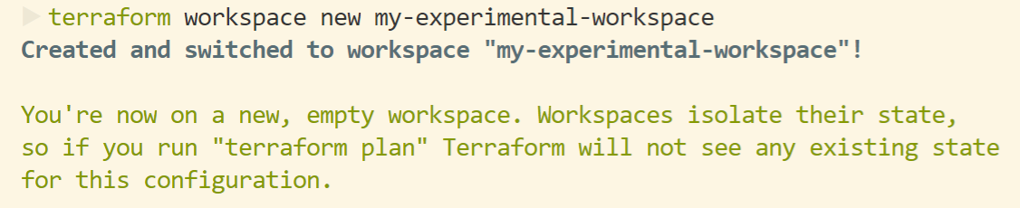
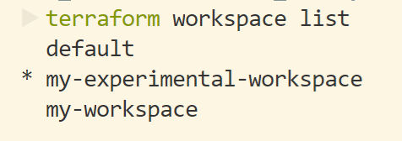

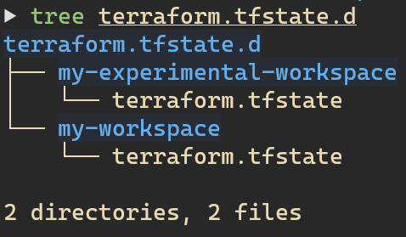
Workspace Management
Notes:
https://www.terraform.io/docs/state/workspaces.html

Slide 14
Workspaces
Demo

Slide 15
Provisioners

Slide 16
Provisioners are a Last Resort
Can be used to model specific actions on the local machine or on a remote machine in order to prepare servers or other infrastructure objects for service. (can also be used with a null_resource)
Introduced in terraform as a measure of pragmatism, knowing that there will always be certain behaviours that can't be directly represented in Terraform's declarative model.
Built-in Provisioners
File
Local-exec
Remote-exec
Chef
and more..
Use Provisioners as a last resort as they add complexity and uncertainty.
Notes:
https://www.terraform.io/docs/provisioners/index.html

Slide 17
Provisioners
Demo

Slide 18

Ask
Discuss
Comment

