Slide 1
Open Up Your Open Source Modules
Joelle Tori Maslak - JMASLAK
Simple ways to help people want to contribute to your module
https://bit.ly/2MEhP5k
The Perl Conference 2018 Salt Lake City, UT, USA

Slide 2
Contributor Question #1 How do I contribute?
Create a CONTRIBUTING or similar file
“How can I find things you want me to do?”
Do you have any special rules you want me to follow?
Encourage non-functional contributions
“todo” tests
Bug reports
Docs
Meta-stuff
Notes:
Special rules: * Don’t break old stuff
* Talk to me on big stuff
Meta stuff:
* dist.ini / distzilla
* idiomatic usage

Slide 3
Contributor Question #2 What can I do?
Have a publicly available “todo” list. Name it “TODO” and put it in your top level directory.
Let people know what your low hanging fruit might be.
Let them know the not-so-low hanging fruit too, if you want.

Slide 4
Contributor Question #3 Code of Conduct
Let people know you have their back
You don’t need to invent your own version. Just use the Contributor Covenant!
dist.ini:
[ContributorCovenant]
The markdown version is convenient – name it CODE_OF_CONDUCT.md
https://www.contributor-covenant.org/

Slide 5
Some of us also… Let people change their names/emails
If someone changes names, add them to .mailmap
Format:
CANNONICAL NAME <email@example.com>
CANNONICAL NAME <new@example.com> <old@example.com>
Notes:
Also works when you forget to set your name/email in old commits.
Let’s people use git shortlog. Also useful later.

Slide 6

And for YOUR .gitconfig
“git log” will use .mailmap if you do the following:
Notes:
This enables git to use .mailmap for “git log”

Slide 7
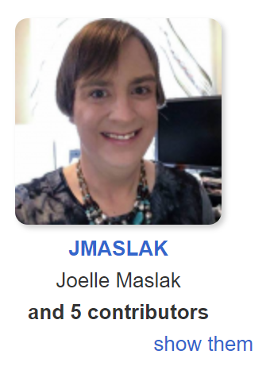
Give Contributors Credit
Dist::Zilla::Pluggin::Git::Contributors
Uses .mailmap (remember that?)
In dist.ini: [Git::Contributors] include_authors=1 order_by=commits

Slide 8
Summary
Create 3 files:
CONTRIBUTING
TODO
CODE_OF_CONDUCT
And let people change their name:
Project-level .mailmap
Your personal .gitconfig
And give them credit
[Git::Contributors]
include_authors=1
order_by=commits
Slides: https://bit.ly/2MEhP5k

Slide 9
THANK YOU!
Slides: https://bit.ly/2MEhP5k
Joelle Maslak <jmaslak@antelope.net>
CPAN: JMASLAK

