Slide 1
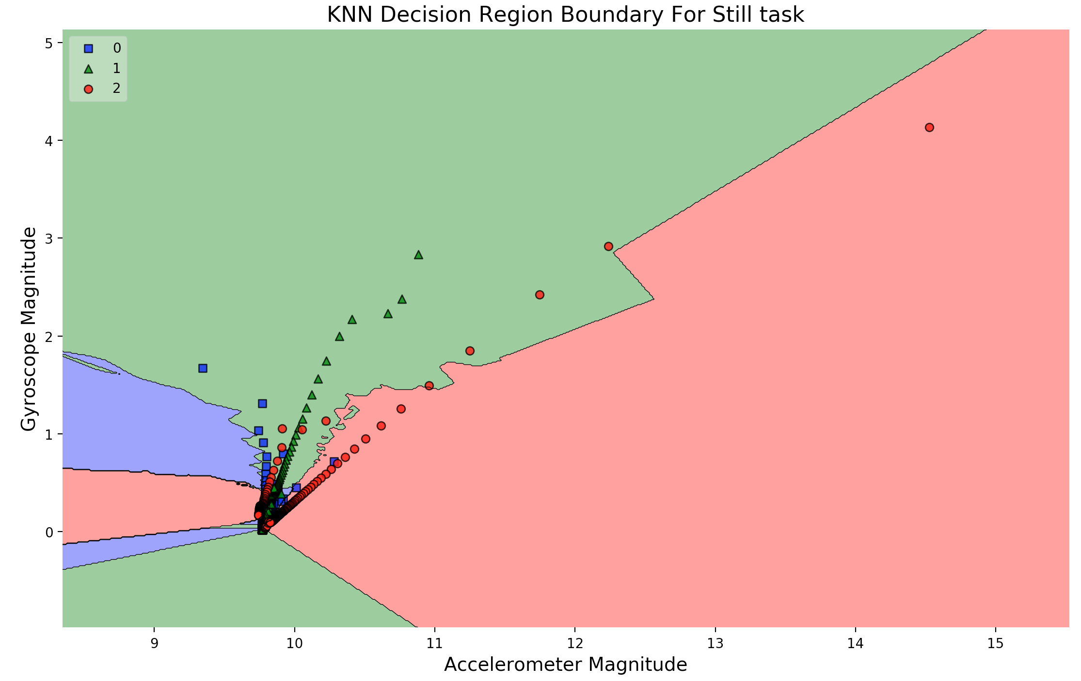
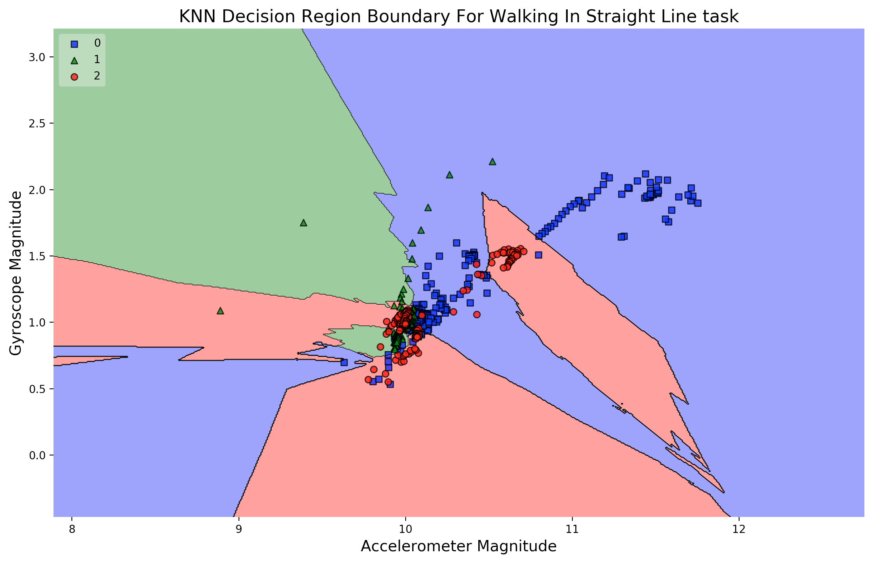
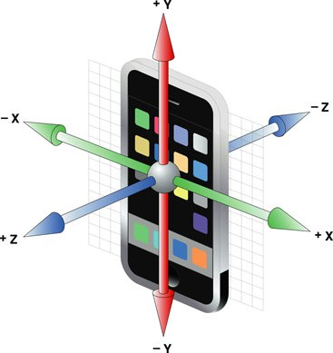
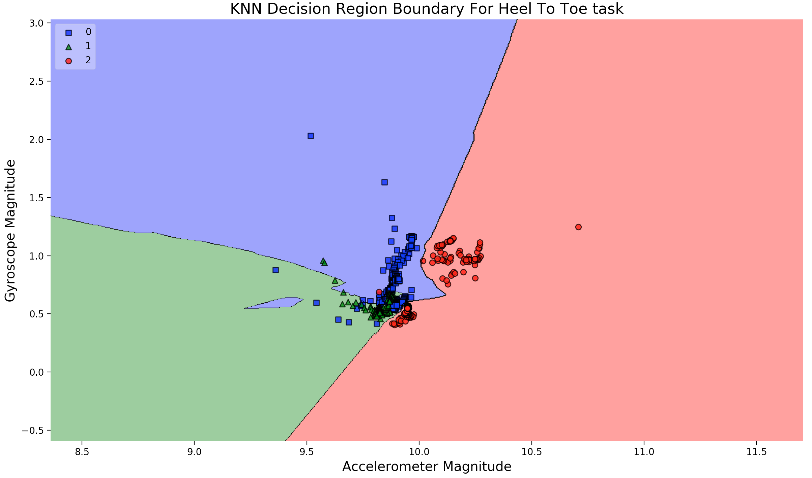
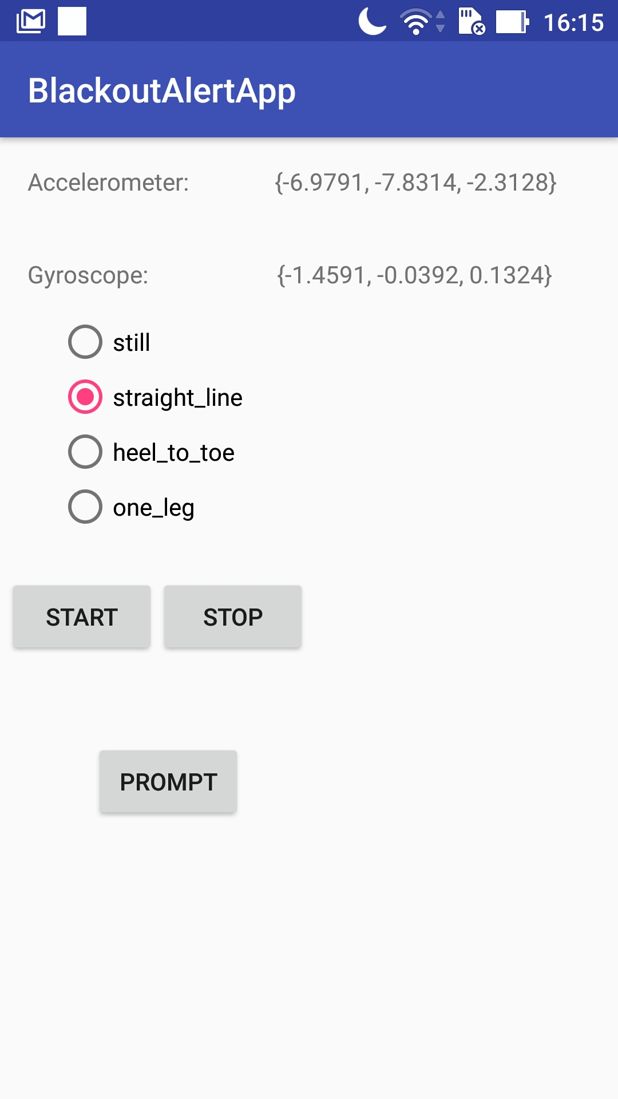
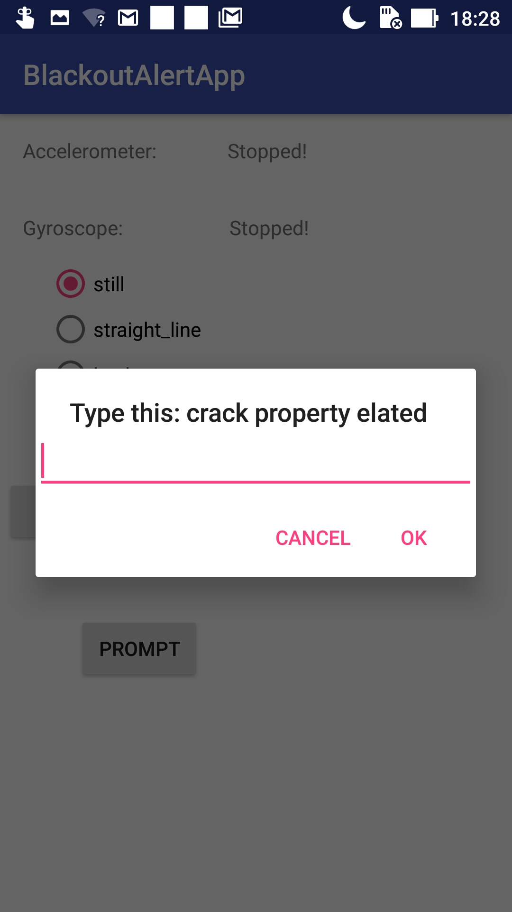
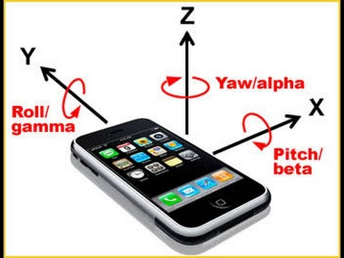
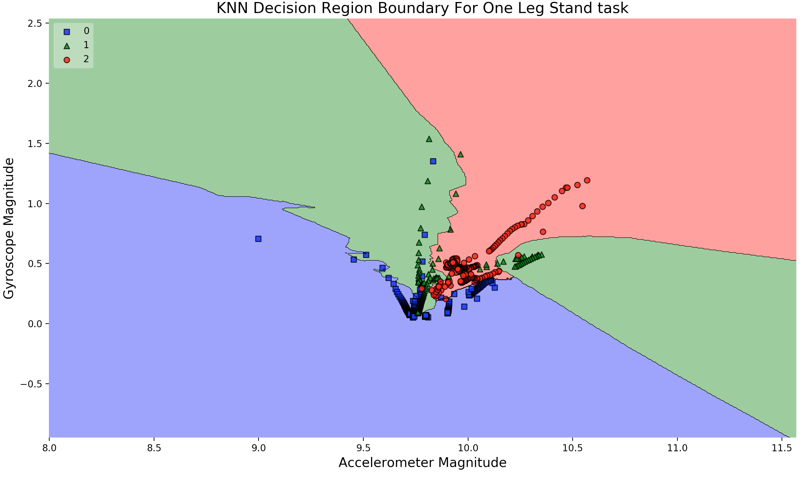
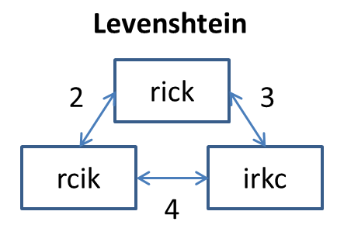
BlackoutAlert
Phone Application for Classifying Intoxication Level
Faadhil Moheed (fm363), Julian Massarani (jm2249)
INFO 4120 - Ubiquitous Computing, Cornell University, Ithaca, NY, 14853
MOTIVATION AND GOALS
Motivation:
Drinking especially on college campuses can have serious and life threatening repercussions. For example, college students in particular tend to walk home after parties, and an individual who has had too much to drink may not be in the right state of mind to arrive home safely. We have created an android application that combines various smart phone sensors (accelerometer, gyroscope, user prompts) with a machine learning model that classifies one’s level of intoxication through ubiquitous sensing capabilities. The data gathered through the phone sensors in particular can allow us to display to the screen information regarding the current state of the user and help them make more informed decisions about their current intoxication level. Having a phone application that runs in the background, especially during periods when students tend to party (Friday/Saturday nights), that specifically monitor for sudden changes in orientation or direction can ultimately help save people from serious or potentially fatal injuries.
Goals:
Impact: People often underestimate how intoxicated they are, and this application would allow them to assess their intoxication level and hopefully make more informed decisions on what to do next.
Contribution and Benefits: School officials/organizations could use the application to gather data about college nightlife. They could use the data to provide better care for students in need of medical attention.
METHODS
Data Collection:
Currently, the application in its early stages serves as our data collection platform. Below are some screenshots taken from the UI itself:
Data Collection Process:
The general process we followed to obtain data is as follows:
We would open the app and hand the tester the phone
The tester would press the “Start” button and conduct the task → the “Start” triggers both the accelerometer and gyroscope to begin recording data
After the task is finished, the user would hit the “Stop” button, which would save the recorded data to a text file
After all physical tasks were complete, the user would push the “Prompt” button, randomly generating a three word phrase for the users to copy → the tester would not be able to use backspace or autocorrect
Controls:
Each tester would run through the above set of tasks twice, the first round would be to emulate a “sober” state, and the second round would require users to wear the “drunk goggles” to emulate a “drunk” state.
Features:
We are applying a supervised learning approach with three main features:
Accelerometer: this sensor measures
the value of a change in velocity for
all axes (x, y, z). Direction does not matter
much in this case, so we computed
the magnitude of the acceleration
vector to use in our model.
This is particularly useful for recording
sharp changes in motion or
subtle and periodic motion patterns
(such as stumbling while intoxicated).
Gyroscope: while the accelerometer
can show a change in movement,
the gyroscope reveals whether
the orientation of the
individual has changed. Again, our goal was to capture
overall postural sway, so we used the magnitude of the
gyroscope vector as our second feature.
Three Word Prompt: Although not currently integrated with our model, the typing accuracy of users who are intoxicated tends to greatly differ from the accuracy of users who are sober. In order to simulate this, the app has the ability to prompt the user with a randomly generated three word string. The user input along with the “correct” string is recorded, and we then compute the minimum edit distance between the two strings using the Levenshtein Distance Algorithm. This allows us to to quantifiably determine how many mistakes were made when the user tried to enter the input string, which we use as our third feature and final feature for classification.
RESULTS AND EVALUATION
Number of testers: 10 (1 sober, 1 “drunk”, 1 drunk goggles)
The plots for each activity are as follows:
Key: (0 = sober, 1 = “drunk”, 2 = drunk goggles or “coma”)
Stand Still – Classifier Accuracy: 81.30%
Straight Line – Classifier Accuracy: 71.95%
Heel To Toe – Classifier Accuracy: 94.71%
One Leg Balance – Classifier Accuracy: 92.29%
Evaluation
The One Leg Balance and Heel To Toe models appear to be our best predictors. This can be seen by both the high accuracy score as well as the separation of data into three decision regions. The others performed well, but the data overall appears to be overfitted due to limited data and/or outliers (which we hope to remove in the future). Precision and recall scores for each task were within +/- 3 of accuracy.
Future Work:
All of the classification thus far was from data collected in a controlled setting. For the future, we are going to find a way to combine our 4 models to run in the background, and classify a user’s intoxication level while they are performing any activity.
In order to train our machine learning model, we needed to collect data from users conducting very specific tasks. The tasks we chose are the following:
Stand still (~1 minute)
Walk in a straight line and back (~30 seconds)
Walk heel to toe and turn around (~30 seconds)
Balance on one leg (~30 seconds)
Type a randomly generated prompt

