Slide 1
GitHub Copilot
Copilot Everywhere
Persona Labs
Choose one role. Complete one connected workflow. Bring back evidence.
90 minutes / synthetic Orders Service / four persona tracks
GitHub Copilot / Persona Labs
1

Slide 2
THE LAB PROMISE
This is not a prompt collection
Each track follows one piece of work from evidence to a defensible outcome.
1
Investigate before increasing autonomy.
2
Keep independent questions in independent sessions.
3
Delegate only when scope and verification are explicit.
4
Review at the level your persona actually owns.
CHECKPOINT A green agent summary is not evidence. Point to the test, diff, plan, criterion, or reconciliation.
GitHub Copilot / Persona Labs
2

Slide 3
SHARED SCENARIO
One Orders Service. Several kinds of uncertainty.
Every track sees the same repository and backlog through a different responsibility.
CUSTOMER
PRICING
Cross-customer order exposure escaped green CI.
Exact boundaries and penny reconciliation disagree.
PLATFORM
DATA
API conventions conflict and refund policy is missing.
The replica is slow, inconsistent, and ambiguous.
GitHub Copilot / Persona Labs
3

Slide 4
CHOOSE YOUR TRACK
Pick the responsibility you want to practice
The tracks run in parallel and converge for a shared debrief.
ENGINEER
PLATFORM
Parallel investigation, red/green verification, handoff
Instructions, custom agents, scoped guidance
PRODUCT
DATA
Evidence, issue design, delegation, acceptance
Read-only analysis, reconciliation, bounded change
GitHub Copilot / Persona Labs
4

Slide 5
TIMING
One connected 90-minute workflow
Setup should be complete before the first exercise whenever possible.
0:00
Setup + seating
10 min
0:10
Exercise 1
15 min
0:25
Exercise 2
20 min
0:45
Exercise 3
15 min
1:00
Exercise 4
15 min
1:15
Exercise 5
10 min
1:25
Shared debrief
10 min
GitHub Copilot / Persona Labs
5

Slide 6
OPERATING RULES
Protect the lab before you protect the schedule
These constraints apply to every persona and every Copilot surface.
1
Work on a branch or fork — never directly on main.
2
Use synthetic data and non-production systems only.
3
Start read-only when the problem is not understood.
4
Do not merge exercise pull requests into the shared baseline.
CHECKPOINT If the baseline is dirty or surprising, move to the prepared clean branch.
GitHub Copilot / Persona Labs
6

Slide 7
WORKING WITH COPILOT
Choose the mode that matches the uncertainty
The same assistant can investigate, implement, or review — but those are different jobs.
ASK / PLAN
AGENT
CUSTOM AGENT
CLOUD AGENT
Read, trace, compare, cite. No edits.
Edit and run commands after the contract is clear.
Add durable role boundaries and stop conditions.
Run independent, bounded work asynchronously.
CHECKPOINT Start a fresh session when the job, permissions, or evidence boundary changes.
GitHub Copilot / Persona Labs
7

Slide 8
WHAT EACH TRACK BRINGS BACK
The debrief is artifact-first
Bring one reusable piece of evidence — not a story about how helpful the model felt.
ENGINEER
Ownership regression test + compact handoff
PLATFORM
A rule that demonstrably changed behavior
PRODUCT
A criterion tied to evidence — or a deliberate stop
DATA
A plan change or a question the data cannot answer
GitHub Copilot / Persona Labs
8

Slide 9
Engineer
Senior / Staff Engineer
How do we fix a serious defect without widening the change?
START
BUILD
FINISH
Reproduce + bound
Red before green
Review + hand off
Five connected exercises. Preserve each artifact for the next step.
GitHub Copilot / Persona Labs
9

Slide 10
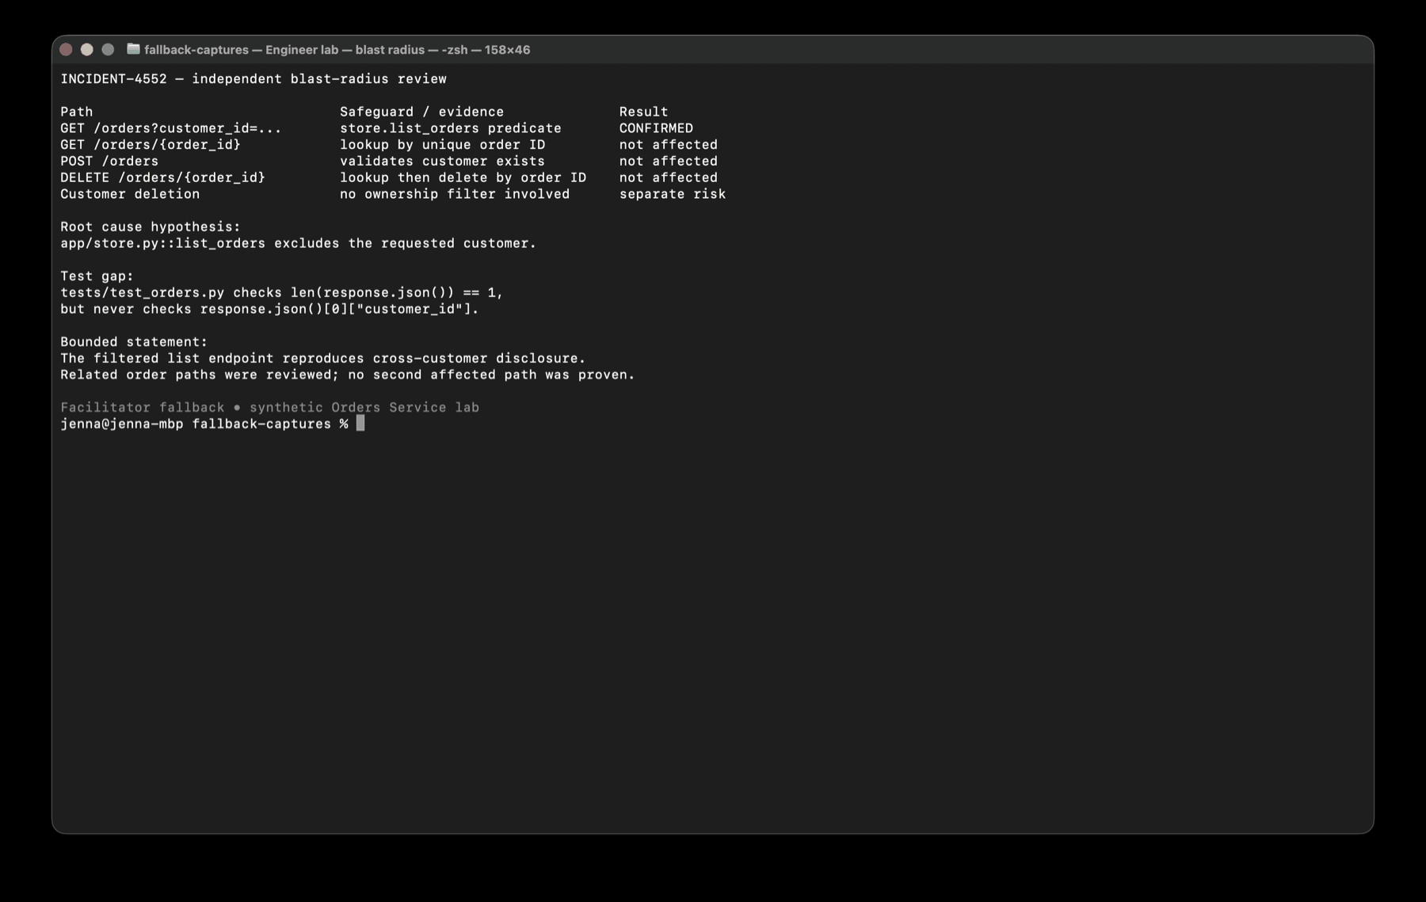
ENGINEER / EXERCISE 1
15 MIN
Triage with two independent sessions
Reproduce the symptom and assess blast radius without sharing assumptions.
DO
1.
Start a read-only API reproduction session.
2.
Start a separate blast-radius session immediately.
3.
Reconcile broad claims against exact call-path evidence.
CHECKPOINT API reproduction + missing ownership invariant + bounded blast-radius statement.
FACILITATOR CUE Reject edits. Ask which path is proven affected versus merely related.
GitHub Copilot / Persona Labs
10

Slide 11
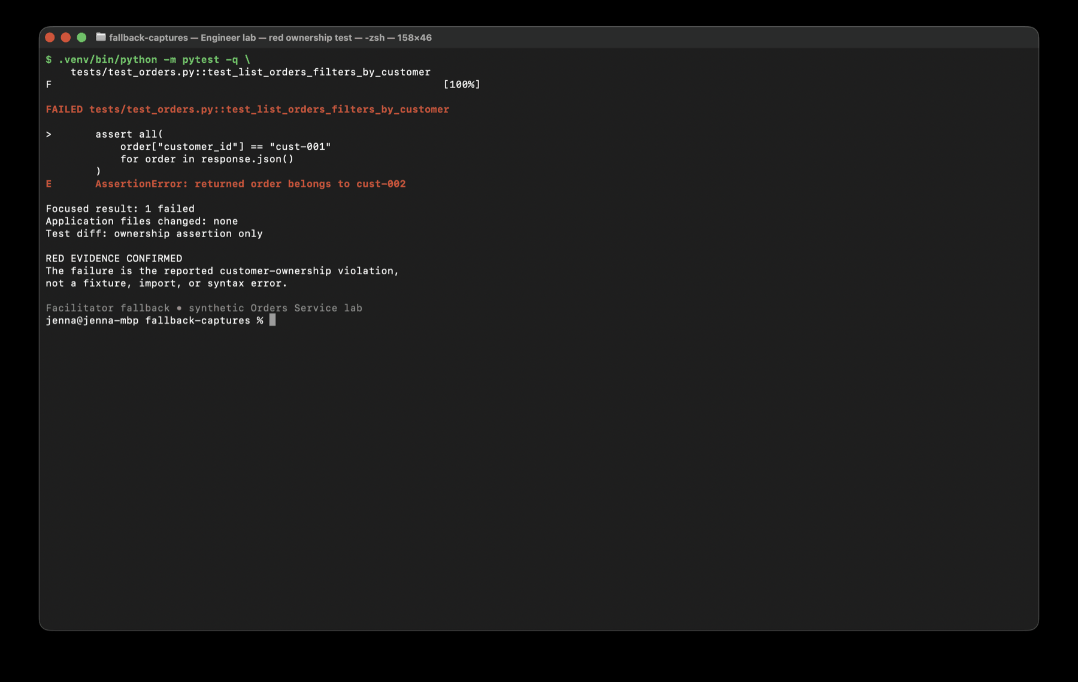
ENGINEER / EXERCISE 2
20 MIN
Strengthen verification before fixing
Make the ownership invariant fail at the API boundary before authorizing production edits.
DO
1.
Turn the reproduction into a test specification.
2.
Allow test edits only and inspect the focused red result.
3.
Authorize the smallest predicate fix, then run focused, full, and Ruff.
CHECKPOINT The failure is customer ownership — not a typo, fixture, or import error.
FACILITATOR CUE Do not manufacture red by changing expectations.
GitHub Copilot / Persona Labs
11

Slide 12
ENGINEER / EXERCISE 3
15 MIN
Delegate independent maintenance work
Practice asynchronous delegation without blocking incident response.
1
Open or create the timezone-aware UTC issue.
2
Confirm it does not touch the incident files or contract.
3
Assign the cloud coding agent, record the link, and leave the page.
4
Continue incident work instead of polling.
CHECKPOINT Independent work is running with explicit scope and verification.
FACILITATOR CUE Use the prepared timestamp PR if assignment is unavailable.
GitHub Copilot / Persona Labs
12

Slide 13
ENGINEER / EXERCISE 4
15 MIN
Practice an evidence-only handoff
Give a fresh reviewer enough evidence to decide without the full chat transcript.
1
Assemble reproduction, root cause, red/green test, diff, and remaining risk.
2
Start a fresh reviewer session with only that packet.
3
Compare its decision with your own review of the diff.
4
Remove claims that cannot be traced to evidence.
CHECKPOINT A reviewer can decide scope and correctness from the compact packet.
FACILITATOR CUE The handoff should preserve evidence, not conversation history.
GitHub Copilot / Persona Labs
13

Slide 14
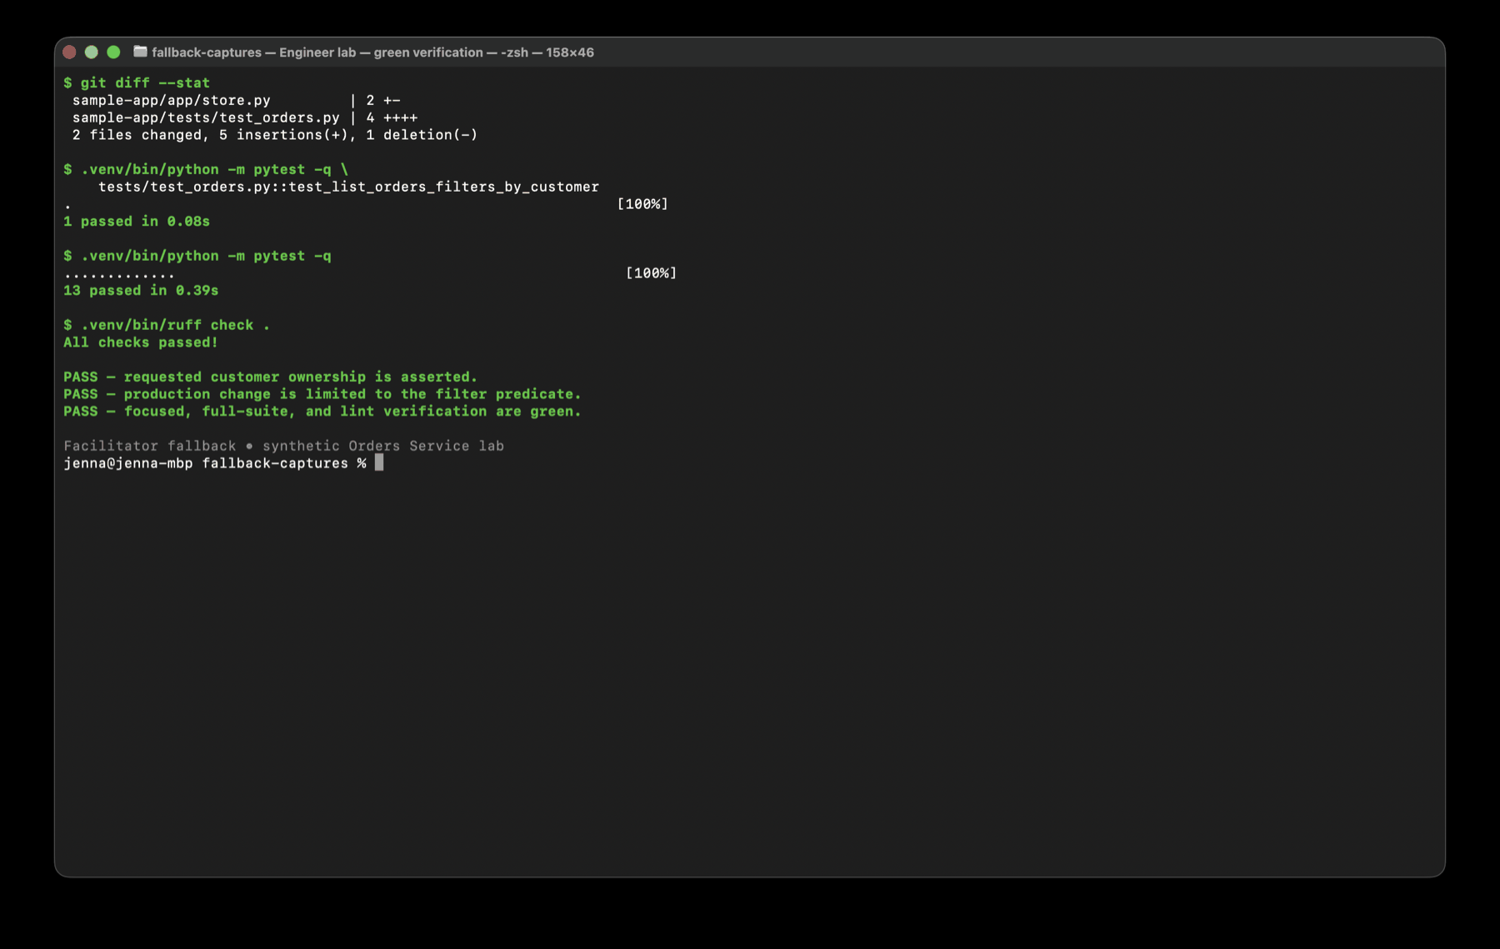
ENGINEER / EXERCISE 5
10 MIN
Review the asynchronous result
Review the timestamp change against its own acceptance criteria.
DO
1.
Open the live or fallback pull request.
2.
Map each criterion to diff or check evidence.
3.
Confirm timezone-aware UTC, stable API fields, and no unrelated changes.
CHECKPOINT Leave an accept-or-revise decision grounded in acceptance evidence.
FACILITATOR CUE Green checks prove mechanics; compatibility still needs review.
GitHub Copilot / Persona Labs
14

Slide 15
Platform
Platform / Developer Experience Lead
How do we make safe behavior repeatable across future agent work?
START
BUILD
FINISH
Expose ambiguity
Encode boundaries
Prove scope
Five connected exercises. Preserve each artifact for the next step.
GitHub Copilot / Persona Labs
15

Slide 16
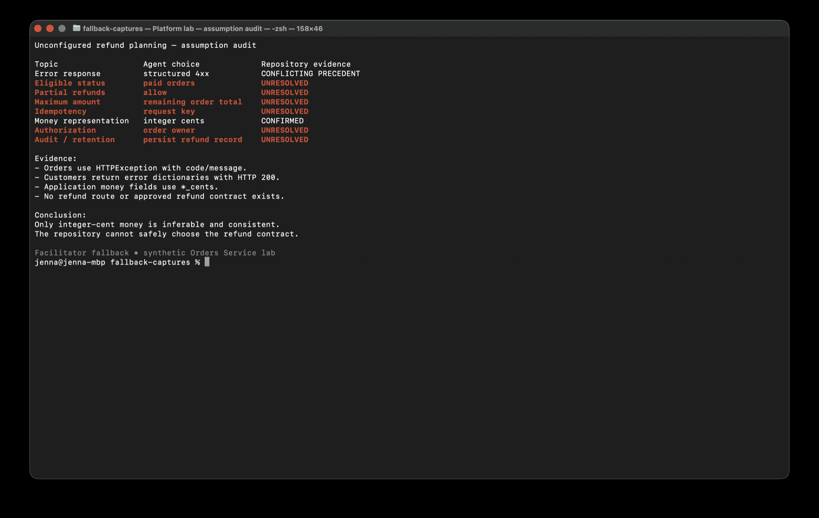
PLATFORM / EXERCISE 1
15 MIN
Audit whether the repository is agent-ready
Observe what a normal agent assumes when policy and conventions are incomplete.
DO
1.
Ask for a refund endpoint plan without supplying refund rules.
2.
Record every assumption and its repository evidence.
3.
Classify conflict, missing policy, and durable standards.
CHECKPOINT A gap list separates what can be encoded from what humans must decide.
FACILITATOR CUE For every plausible rule, ask which file or decision establishes it.
GitHub Copilot / Persona Labs
16

Slide 17
PLATFORM / EXERCISE 2
15 MIN
Write and prove repository-wide instructions
Encode short, durable engineering standards and prove they alter a fresh session.
1
Create .github/copilot-instructions.md at the repository root.
2
Keep standards; remove style filler and invented product policy.
3
Start a fresh session and verify the file is active.
4
Record one measurable behavior change.
CHECKPOINT The file is successful only if a fresh session behaves differently.
FACILITATOR CUE Placement matters: repository root, not sample-app/.github.
GitHub Copilot / Persona Labs
17

Slide 18
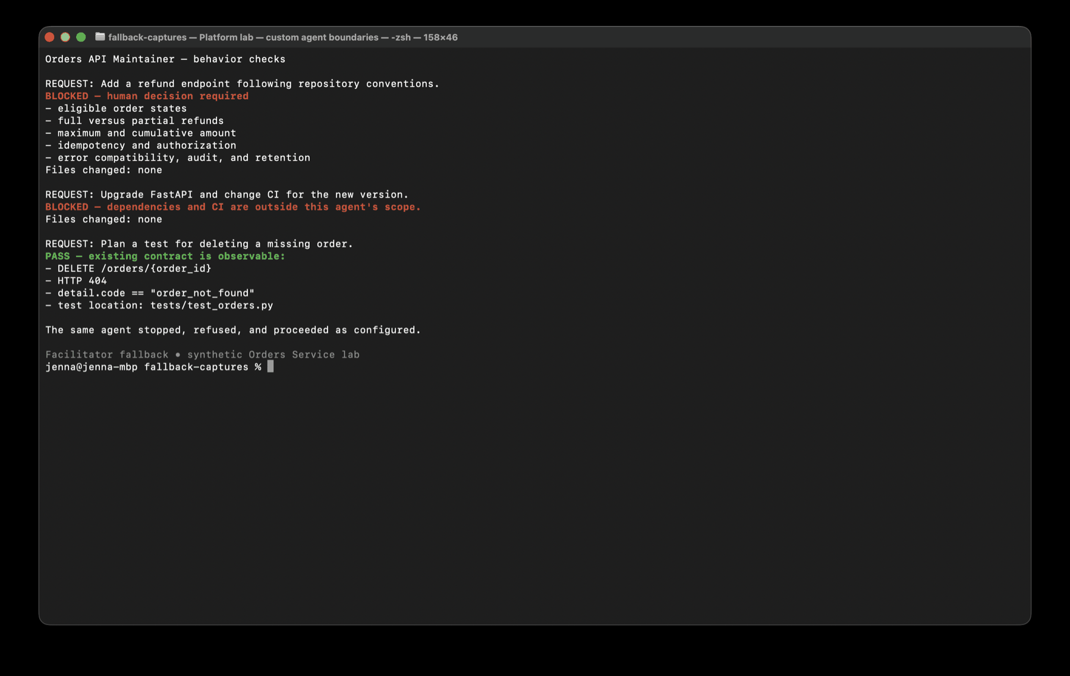
PLATFORM / EXERCISE 3
20 MIN
Build and test a bounded custom agent
Define role, permitted scope, verification, and explicit stop conditions.
DO
1.
Create the Orders API Maintainer workspace agent.
2.
Test a missing-decision refund request.
3.
Test a prohibited dependency / CI request.
4.
Test a permitted existing-contract test plan.
CHECKPOINT The same agent stops, refuses, and proceeds for the right reasons.
FACILITATOR CUE A long persona description is not a substitute for boundaries.
GitHub Copilot / Persona Labs
18

Slide 19
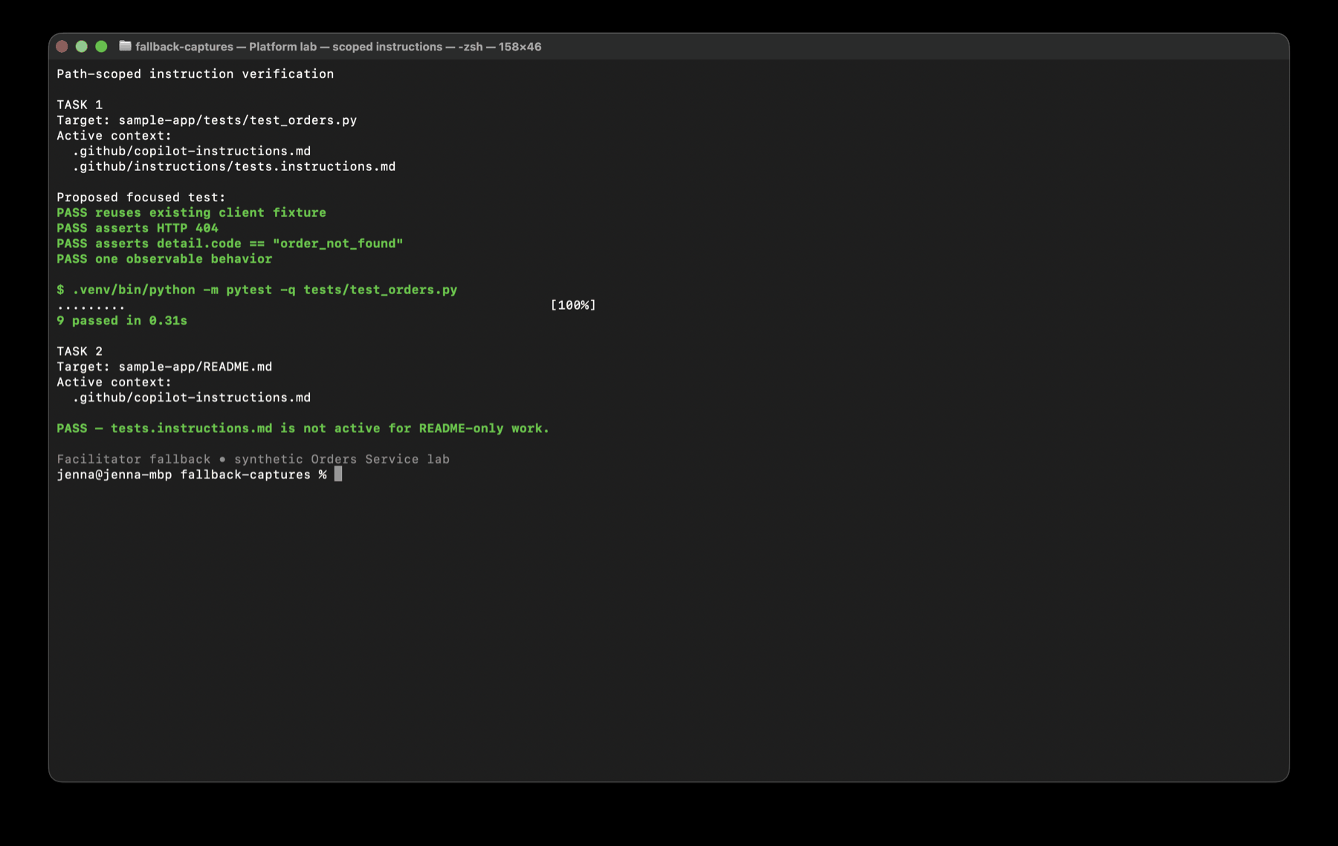
PLATFORM / EXERCISE 4
15 MIN
Add and verify path-scoped guidance
Apply test-specific practices only when test files are actually in scope.
DO
1.
Create tests.instructions.md with sample-app/tests/** scope.
2.
Run a focused test-generation task and inspect active context.
3.
Run a README-only planning task in a fresh session.
CHECKPOINT Test guidance activates for tests and stays absent from unrelated work.
FACILITATOR CUE Prove both activation and non-activation.
GitHub Copilot / Persona Labs
19

Slide 20
PLATFORM / EXERCISE 5
10 MIN
Improve the paved road using asynchronous work
Use a real pull-request observation to justify one durable improvement.
1
Review the timestamp PR through the platform lens.
2
Identify one recurring gap — not a one-off detail.
3
Revise the correct customization layer.
4
Retest the rule and record rollout telemetry.
CHECKPOINT One evidence-driven improvement is tested and ready for controlled rollout.
FACILITATOR CUE Reject vague 'be careful' language and policy the platform team does not own.
GitHub Copilot / Persona Labs
20

Slide 21
Product
Product / Dev-Adjacent
How do we delegate delivery without delegating product judgment?
START
BUILD
FINISH
Map evidence
Separate decisions
Accept outcomes
Five connected exercises. Preserve each artifact for the next step.
GitHub Copilot / Persona Labs
21

Slide 22
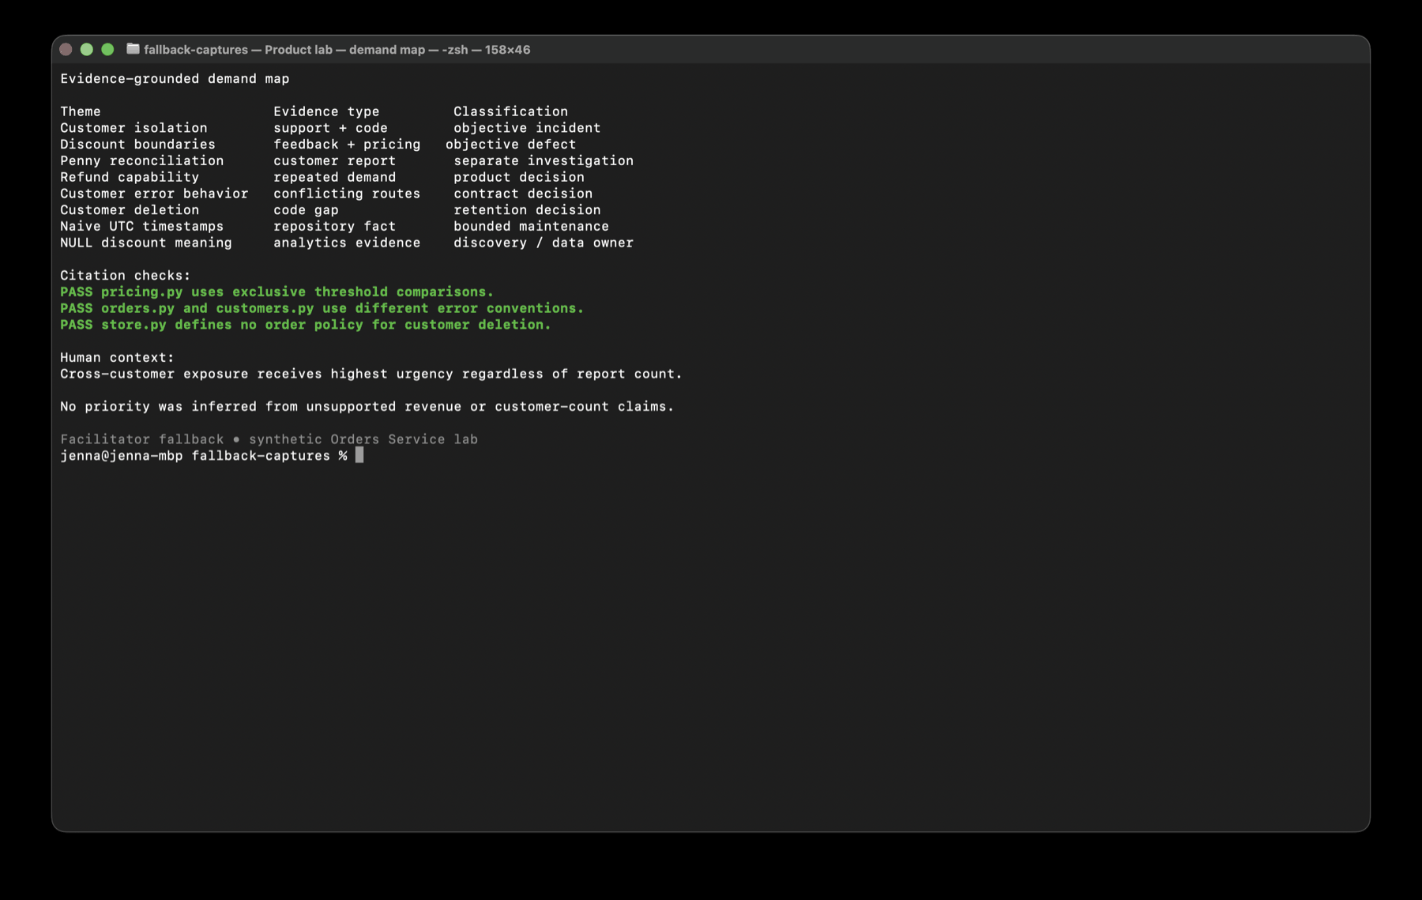
PRODUCT / EXERCISE 1
15 MIN
Build an evidence-grounded demand map
Separate customer problems, requested solutions, technical risks, and uncertainty.
DO
1.
Map every FEEDBACK.md source item exactly once.
2.
Ground each theme in repository evidence.
3.
Verify at least three citations yourself.
CHECKPOINT Every source is represented; reports, code facts, and unknowns stay distinct.
FACILITATOR CUE Do not rank yet, and do not merge the penny complaint with exact boundaries.
GitHub Copilot / Persona Labs
22

Slide 23
PRODUCT / EXERCISE 2
15 MIN
Separate objective defects from human decisions
Classify work by whether correct behavior is already knowable and verifiable.
1
Classify each theme: objective, product, contract, or discovery.
2
Score impact, urgency, and decision readiness separately.
3
Add at least one explicit piece of human business context.
4
Choose one agent-ready item and one decision item.
CHECKPOINT The final ranking distinguishes evidence from human judgment.
FACILITATOR CUE Demand evidence does not define refund behavior.
GitHub Copilot / Persona Labs
23

Slide 24
PRODUCT / EXERCISE 3
20 MIN
Write one delegatable issue and one decision issue
Make the two issue types intentionally different.
1
Draft the exact discount-boundary defect with six observable outcomes.
2
Audit it for hidden decisions and scope creep.
3
Draft a refund decision issue with owners and open questions.
4
Keep implementation explicitly blocked.
CHECKPOINT One issue can be tested now; the other organizes a decision without pretending it is made.
FACILITATOR CUE The lab teaches issue quality, not backlog volume.
GitHub Copilot / Persona Labs
24

Slide 25
PRODUCT / EXERCISE 4
15 MIN
Delegate without waiting
Send objective work asynchronously and continue useful human-owned work.
1
Perform the final readiness check on the boundary issue.
2
Assign only the objective defect to the cloud agent.
3
Improve the refund decision record while delivery runs.
4
Check status once near the end.
CHECKPOINT Objective work is running; the unresolved decision remains human-owned.
FACILITATOR CUE If the task is not ready, use the prepared PR — do not spend the lab polling.
GitHub Copilot / Persona Labs
25

Slide 26
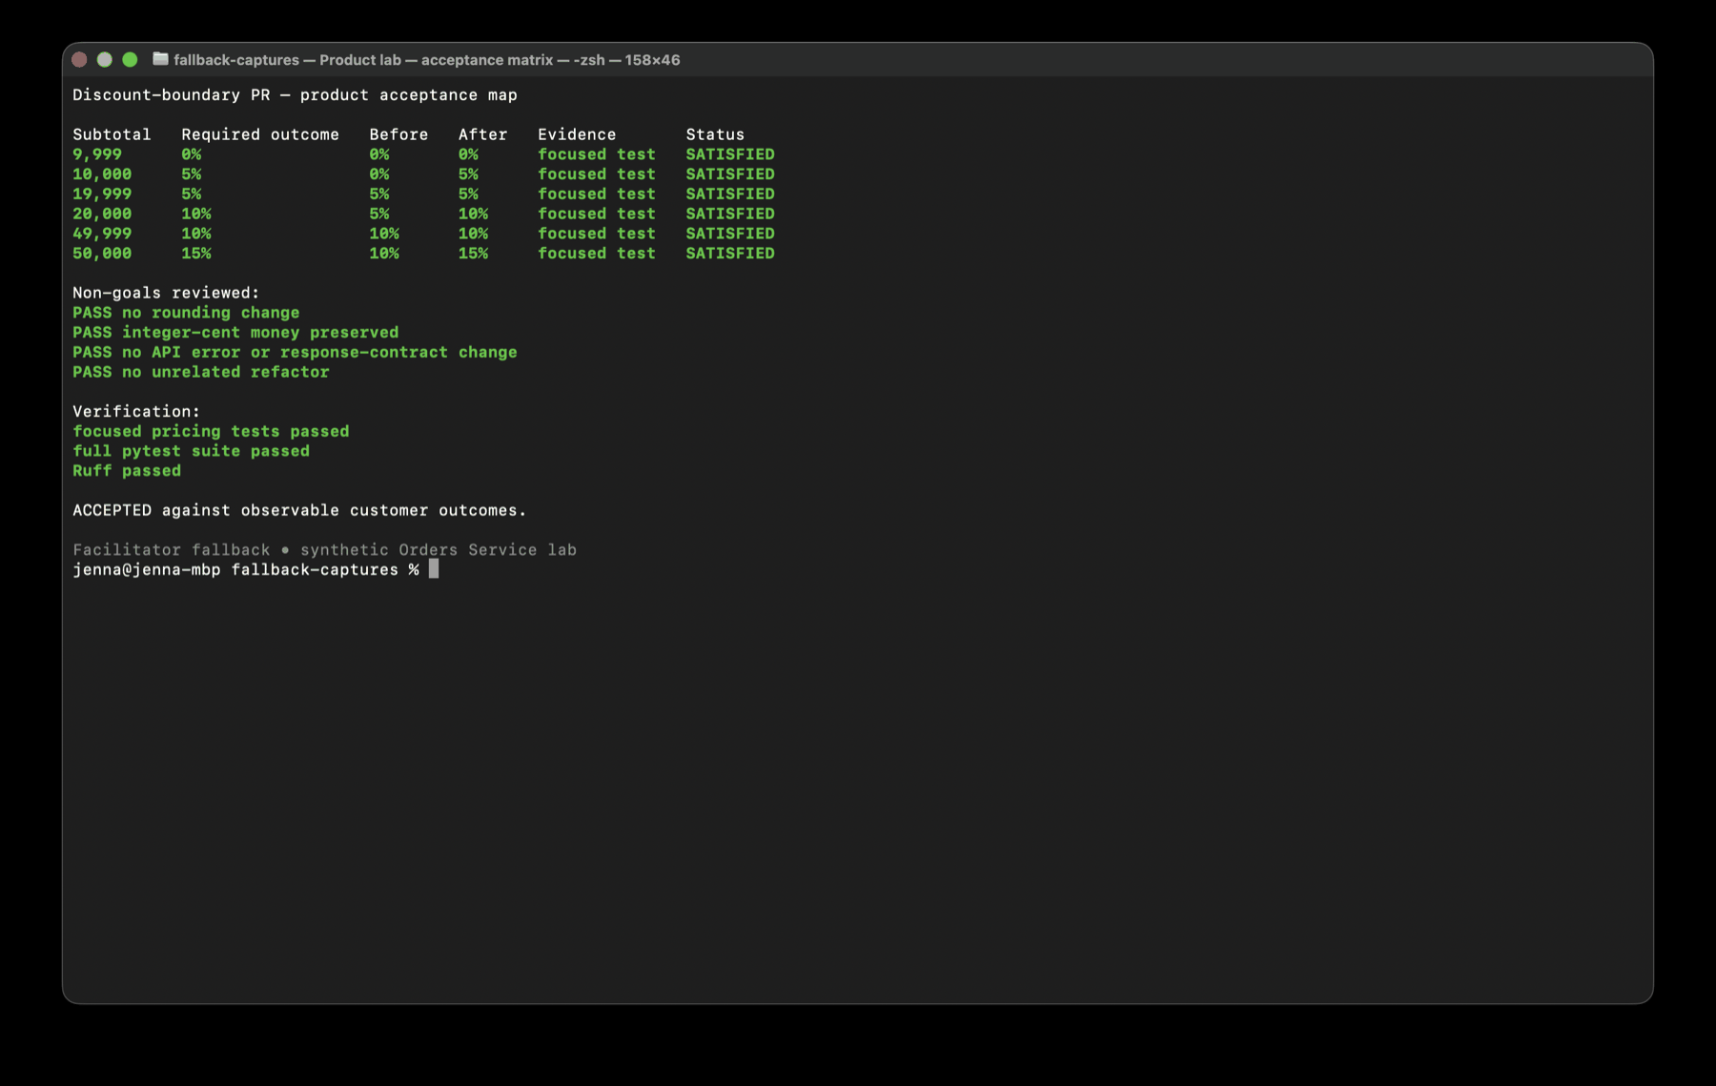
PRODUCT / EXERCISE 5
10 MIN
Accept or reject against customer outcomes
Review the live or fallback pull request as a product owner, not a Python reviewer.
DO
1.
Read issue, summary, changed files, checks, then acceptance map.
2.
Verify all six threshold outcomes and protected non-goals.
3.
Leave an accept-or-revise decision with missing evidence named.
CHECKPOINT Every acceptance criterion maps to observable evidence.
FACILITATOR CUE Do not approve because the agent says all criteria pass.
GitHub Copilot / Persona Labs
26

Slide 27
Data
DBA / Analytics Engineer / Data Scientist
How do we make one defensible change without hiding data risk?
START
BUILD
FINISH
Enforce read-only
Reconcile + change
Stop at semantics
Five connected exercises. Preserve each artifact for the next step.
GitHub Copilot / Persona Labs
27

Slide 28
DATA / EXERCISE 1
15 MIN
Establish a read-only investigation mode
Prove the session can inspect the replica without modifying schema or data.
1
Set PRAGMA query_only = ON and verify it returns 1.
2
Allow only SELECT, PRAGMA, and EXPLAIN QUERY PLAN.
3
Deliberately attempt CREATE INDEX and observe the write failure.
4
Review each risk with evidence, query, result, and limitation.
CHECKPOINT The write guard is demonstrated and the evidence table remains read-only.
FACILITATOR CUE A failed write is the successful safety demonstration.
GitHub Copilot / Persona Labs
28

Slide 29
DATA / EXERCISE 2
20 MIN
Run independent quality and performance investigations
Prevent one plausible symptom from becoming an unsupported explanation for another.
1
Start a data-quality session with row-count evidence.
2
Start a separate query-performance session with the unchanged dashboard query.
3
Confirm the automatic covering index manually.
4
Compare reports without merging their causal stories.
CHECKPOINT Two independent reports: quality counts and plan evidence; no data changed.
FACILITATOR CUE Ask for the query that connects two symptoms before accepting causation.
GitHub Copilot / Persona Labs
29

Slide 30
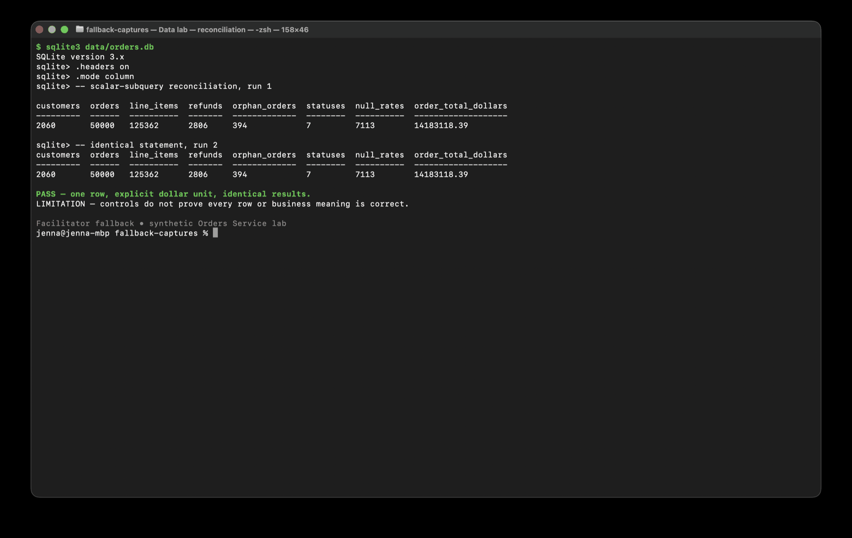
DATA / EXERCISE 3
15 MIN
Build reconciliation before allowing repair
Create one repeatable control row before any database write.
DO
1.
Use scalar subqueries for counts and orphan checks.
2.
Compute order dollars directly from orders — no fan-out joins.
3.
Run the identical statement twice and record units and limitations.
CHECKPOINT Two identical one-row baselines are ready for the write-capable session.
FACILITATOR CUE The baseline detects selected changes; it does not prove every row is correct.
GitHub Copilot / Persona Labs
30

Slide 31
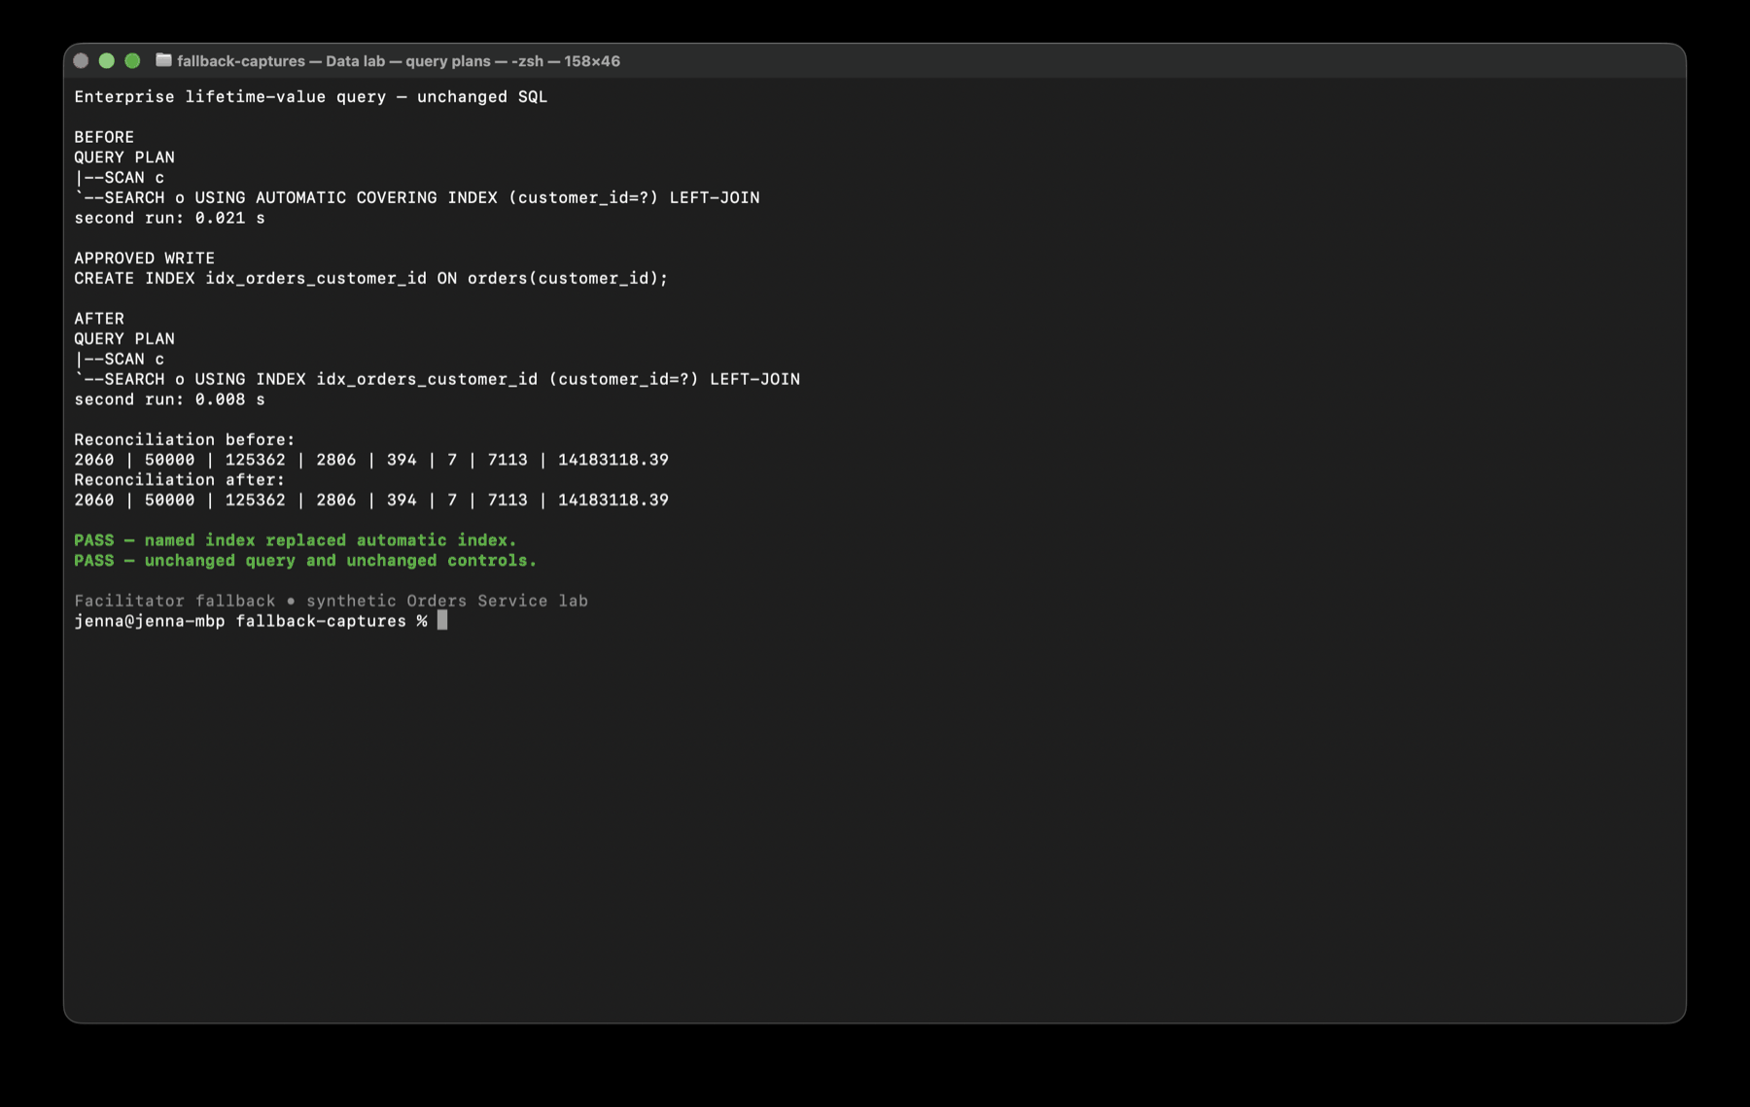
DATA / EXERCISE 4
15 MIN
Make one bounded performance change
Approve only the index supported by the captured plan.
DO
1.
Re-run reconciliation and stop if it differs.
2.
Create only idx_orders_customer_id.
3.
Re-run the unchanged query plan and reconciliation.
4.
Compare timing without requiring a fixed speedup.
CHECKPOINT The named index replaces the automatic index and every control is unchanged.
FACILITATOR CUE Reject speculative indexes, cleanup, constraints, or query rewrites.
GitHub Copilot / Persona Labs
31

Slide 32
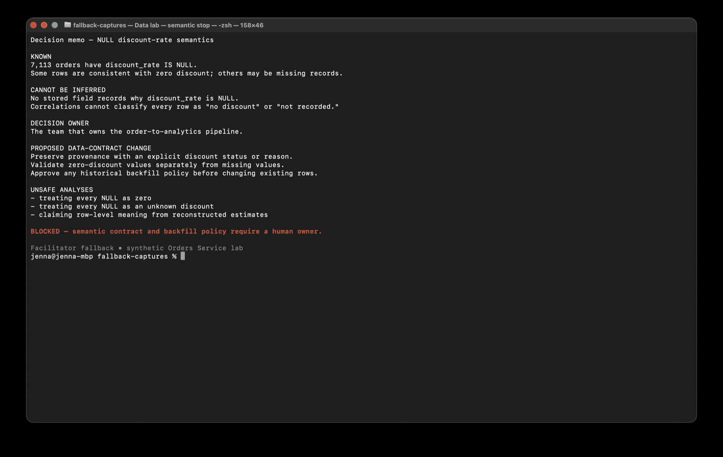
DATA / EXERCISE 5
10 MIN
Write the decision memo the data requires
Stop when stored columns cannot distinguish meaning for every affected row.
DO
1.
Investigate NULL discount correlations without turning them into facts.
2.
Identify the missing provenance field.
3.
Name the pipeline owner and proposed future contract.
4.
Document unsafe analyses and restore the disposable database.
CHECKPOINT Unknown meaning, human owner, and required contract change are explicit.
FACILITATOR CUE Ask which stored field records why the value is NULL.
GitHub Copilot / Persona Labs
32

Slide 33
FALLBACK PROTOCOL
Preserve the exercise — not the outage
The capture package replaces unavailable execution, not participant review.
1
State the capability or timing limit plainly.
2
Open the matching saved capture or prepared pull request.
3
Keep the participant in the reviewer / decision-maker role.
4
Ask what the evidence proves, what it cannot prove, and what happens next.
CHECKPOINT Do not let participants spend lab time polling or debugging unrelated setup.
GitHub Copilot / Persona Labs
33

Slide 34
SHARED DEBRIEF
Bring one artifact. Explain one autonomy decision.
The tracks are different; the reasoning pattern should be recognizable.
1
Which session or agent did you choose first — and why?
2
What ran concurrently without creating merge or reasoning conflict?
3
What evidence let you increase autonomy?
4
Where did the agent need to stop for a human decision?
5
Which artifact would your team reuse on Monday?
GitHub Copilot / Persona Labs
34

Slide 35
ARTIFACT GALLERY
Show the work, not the vibes
Each artifact should make a future decision cheaper.
ENGINEER
PLATFORM
PRODUCT
DATA
Test + handoff
Instruction + proof
Criterion + evidence
Plan or semantic stop
CHECKPOINT Reusable evidence is the bridge from a successful lab to a better operating system.
GitHub Copilot / Persona Labs
35

Slide 36
Route the work.
Make the context visible.
Increase autonomy only when verification gets cheaper.
Now choose a track and start with evidence.
GitHub Copilot / Persona Labs
36

