Slide 1
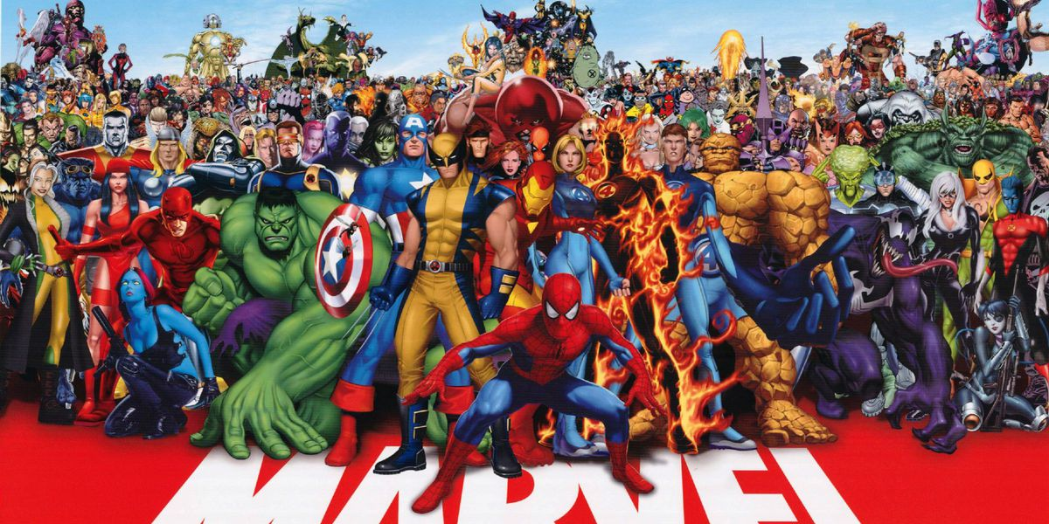
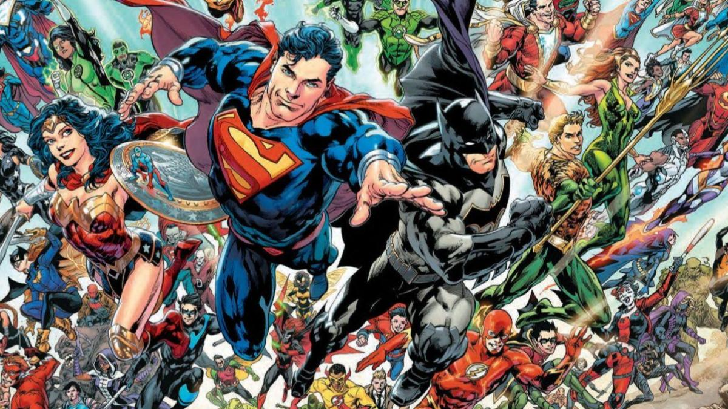
Hero or Villain?
Predicting Superhero Alignment
By Jason Masurovsky
GWU Data Analytics and Visualization Bootcamp
January 2021

Slide 2
Topic Choice
Comics have been around since 1930s
In the past decade, DC and Marvel have skyrocketed film adaptations
Recent years, datasets on comic books and characters have been uploaded and open to the public
Few data viz projects have been made and not many have focused on using machine learning

Slide 3
Research Questions Dataset
Can we classify a superhero as good or evil based off their physical characteristics, superpowers, and abilities?
Is there a bias in the dataset?
Which features are most influential?
All the datasets were found on Kaggle
Kaggle is webportal for the data science community
Hosts a wide range of datasets and tooltips as open data
Source data: https://www.kaggle.com/dannielr/marvel-superheroes
“Characters_stats.csv”, “marvel_characters_info.csv”, and “superheroes_power_matrix.csv”

Slide 4
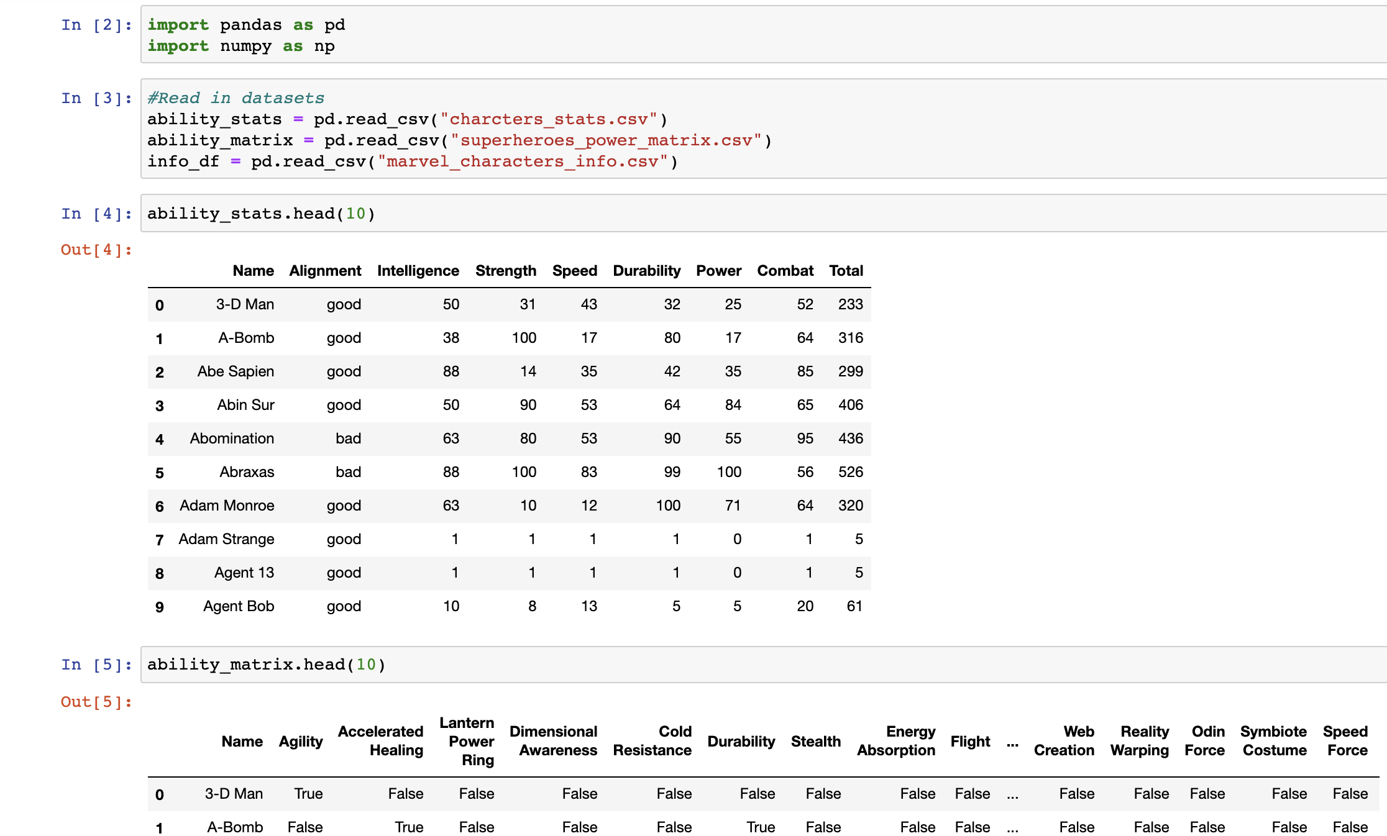
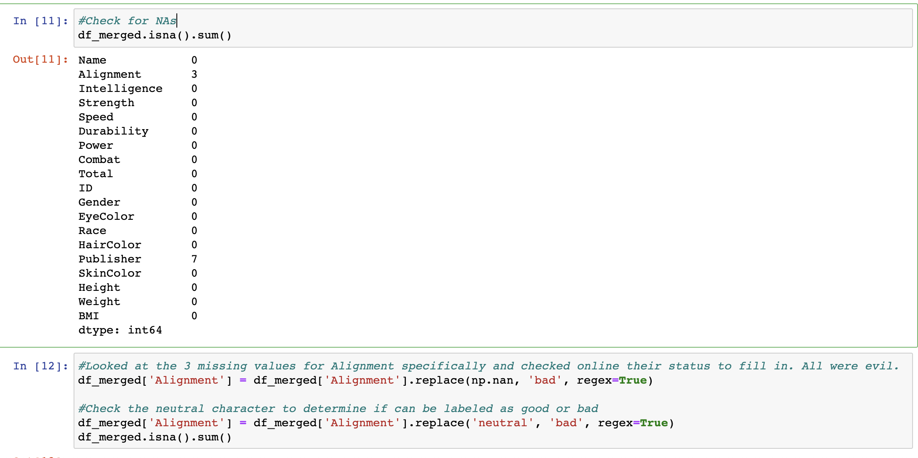
Data Cleaning
Missing values
Alignment
Duplicates
Names
Convert height, weight to feet and lbs.
Create a BMI field
Delete any unnecessary fields
517 characters in final dataset

Slide 5
Data Analysis
Completed in jupyter notebooks using Python and in Tableau
Target variable: Alignment (good or evil)
Distribution count of alignment
Grouped by gender, race, superpower
Average ability stats and gen label
Pearson Correlation on character stats such as strength, power, durability, combat, speed, intelligence
Determine those that are highly correlated to be removed

Slide 6
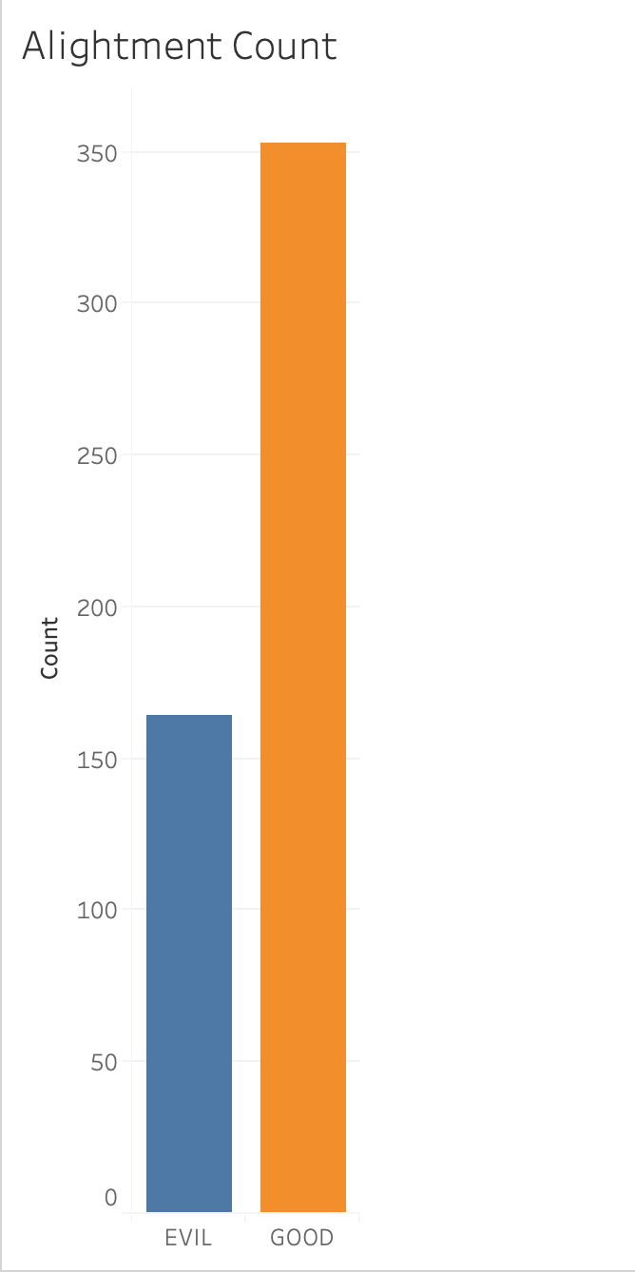
Data Analysis
Breakdown of character alignment
353 good characters
164 evil characters

Slide 7
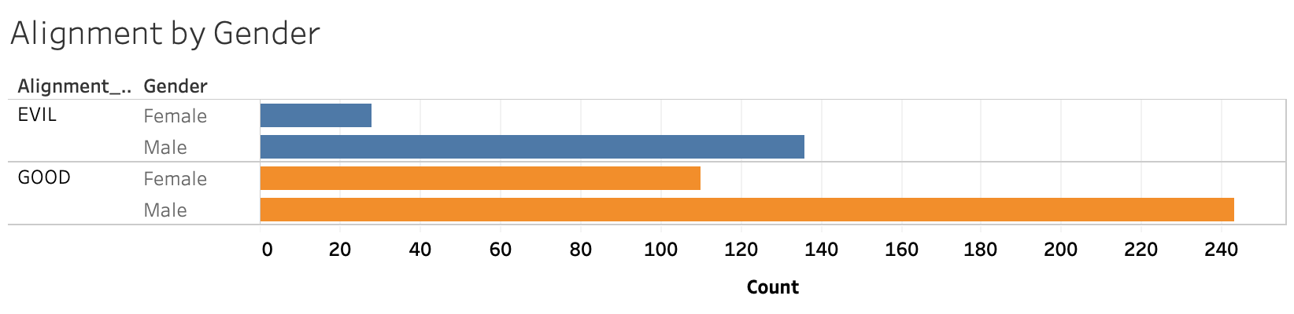
Data Analysis
Breakdown of character alignment by gender
Good: 243 male, 110 female
Evil: 136 male, 28 female

Slide 8
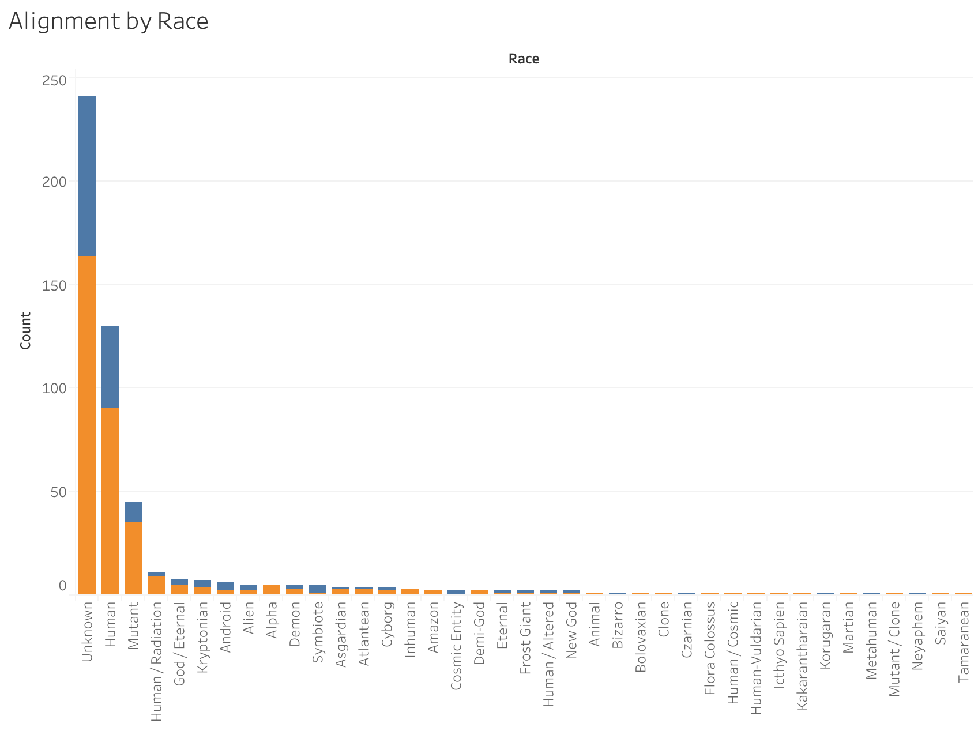
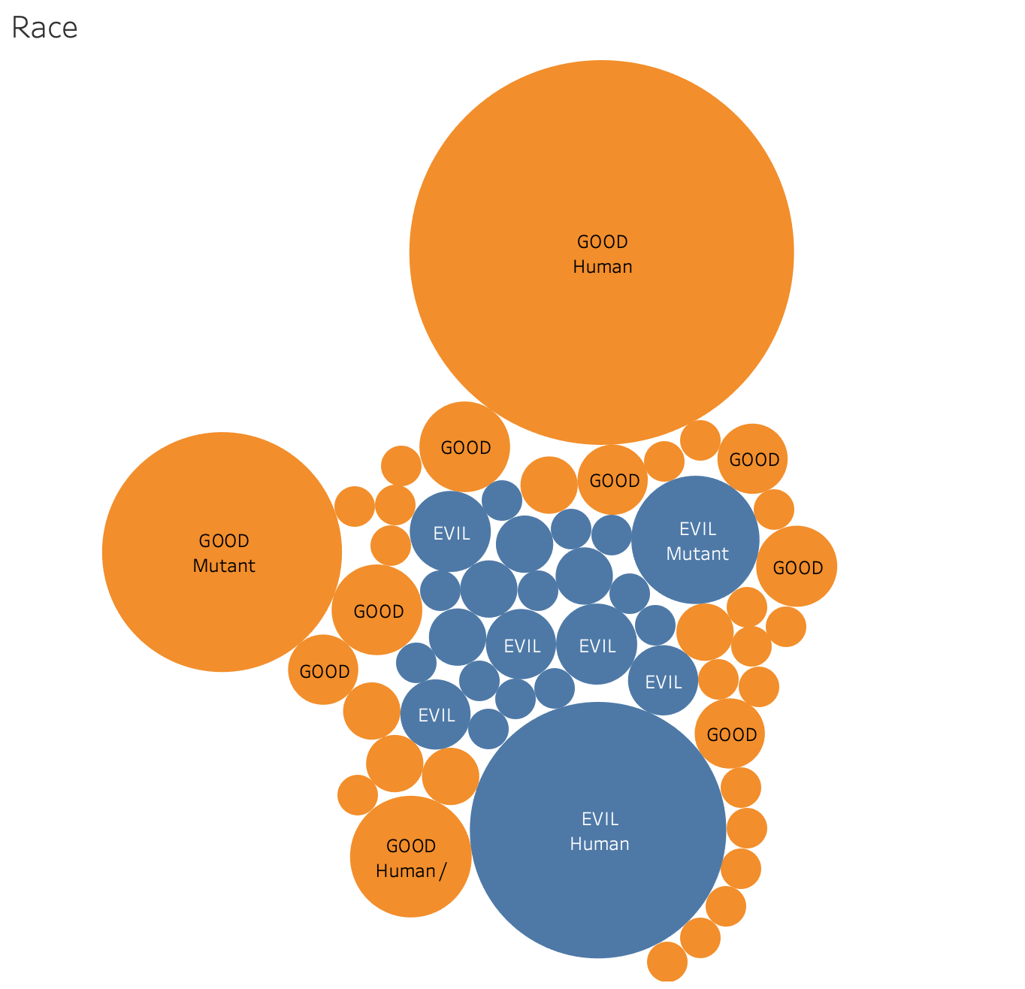
Data Analysis
Breakdown of good and evil characters by their race
Good chunk of data is Unknown, Human, and Mutant

Slide 9
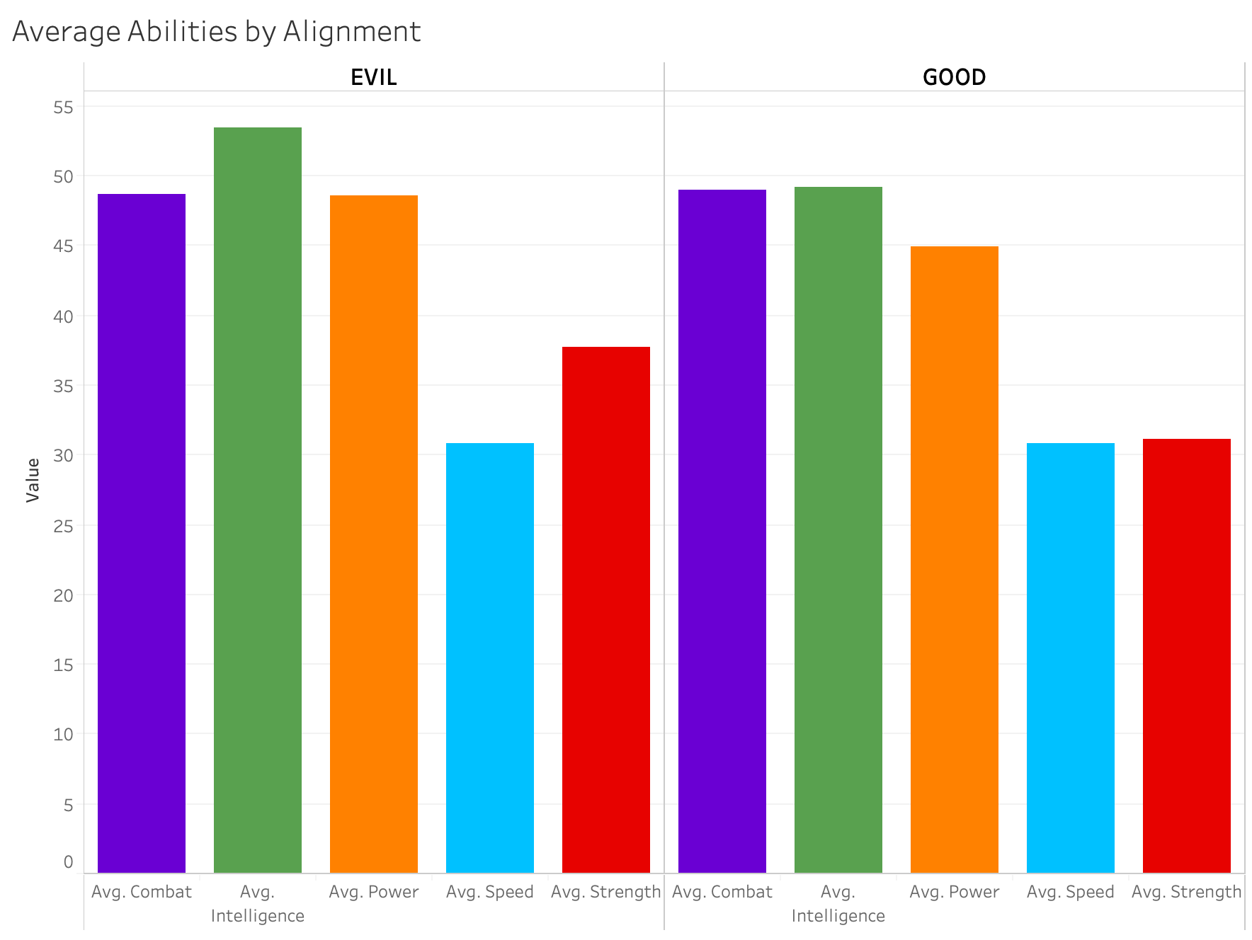
Data Analysis
For all characters.. intelligence, power, and combat have the highest values

Slide 10
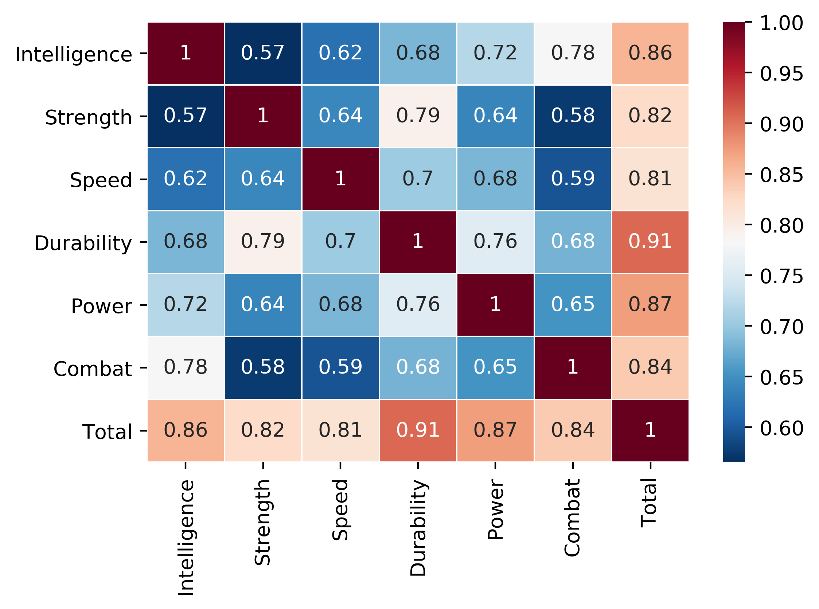
Data Analysis
Pearson correlation matrix of character abilities
Strength and Durability

Slide 11
Machine Learning Models
Classifying a character as good or evil using “Alignment” as target variable
Logistic Regression
Random Forest Classifier
Decision Tree
Support Vector Machine (SVM)
Compare models

Slide 12
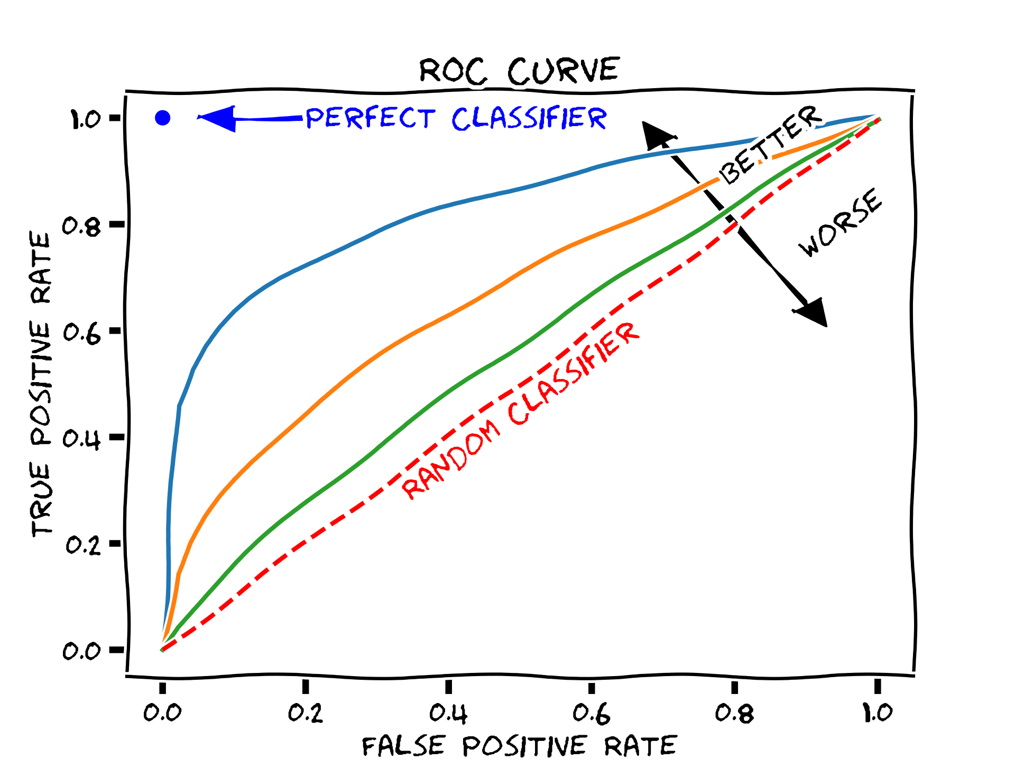
ML data pre-processing
Remove highly correlated features
Convert ‘Alignment’ and ‘Gender’ to binary variables represented as 1 and 0
Get only true dummy values for race, hair color, eye color and of superhero abilities (agility, invisibility, web creation, and so on)
Convert superhero matrix (strength, power, intelligence, etc..) as weights by label encoding using adaptive binning (range from 0-3 using IQRs)
ROC (receiver operating characteristic) curve to visualize classification results

Slide 13
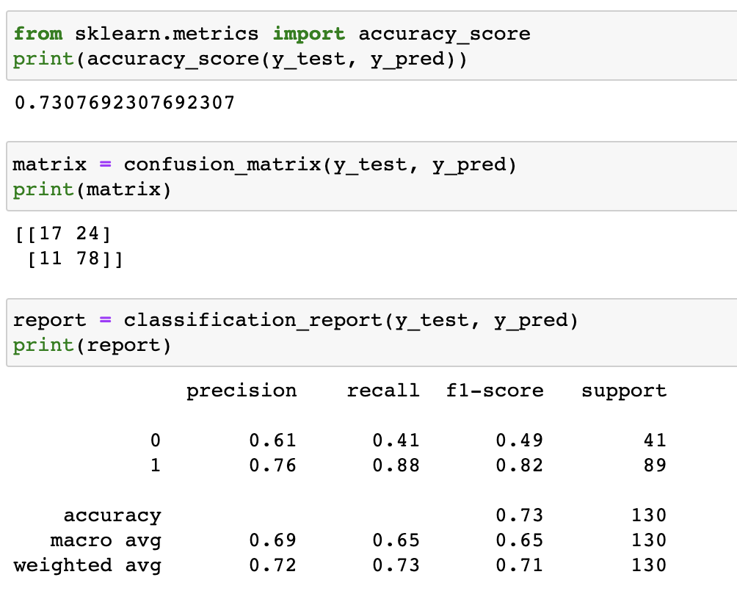
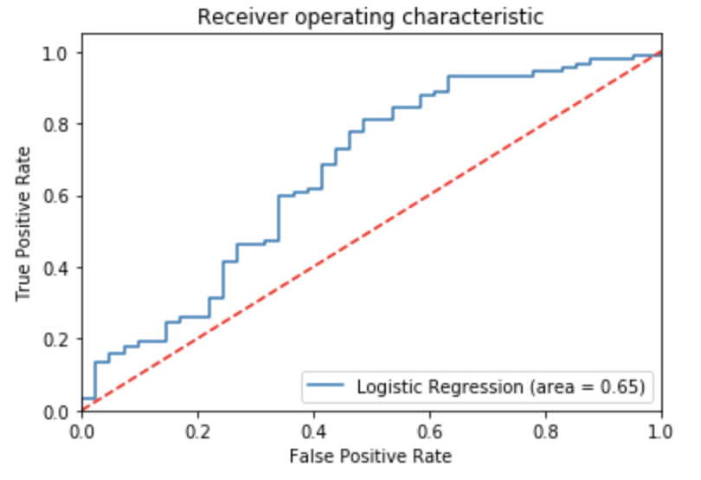
Logistic Regression Results

Slide 14
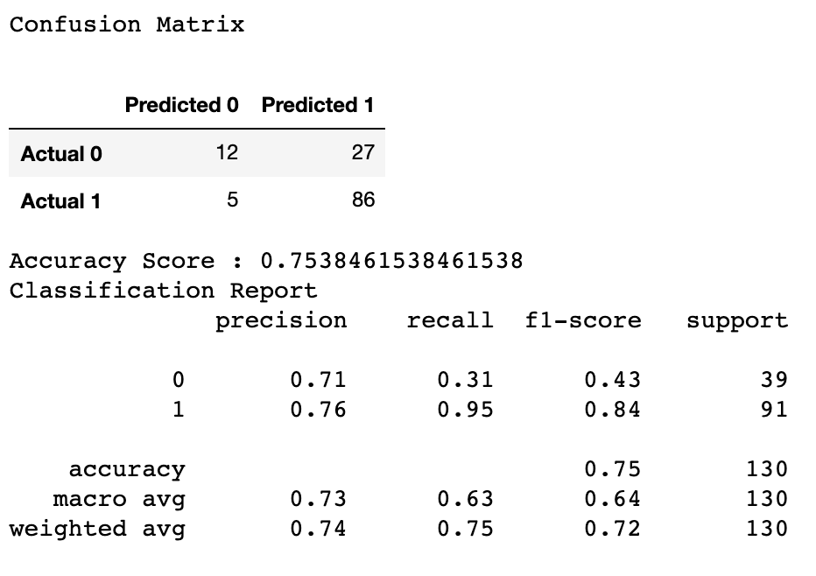
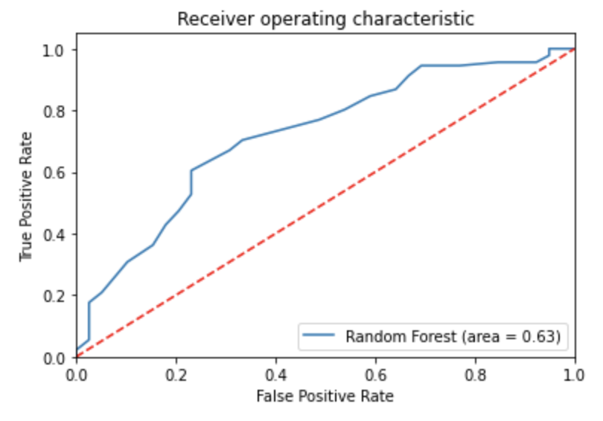
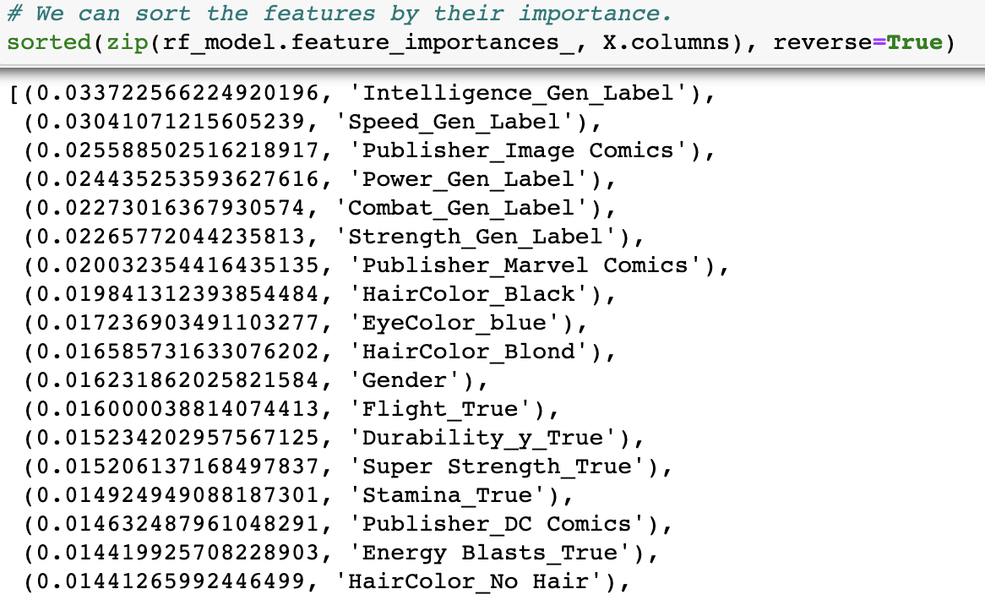
Random Forest Classifier Results

Slide 15
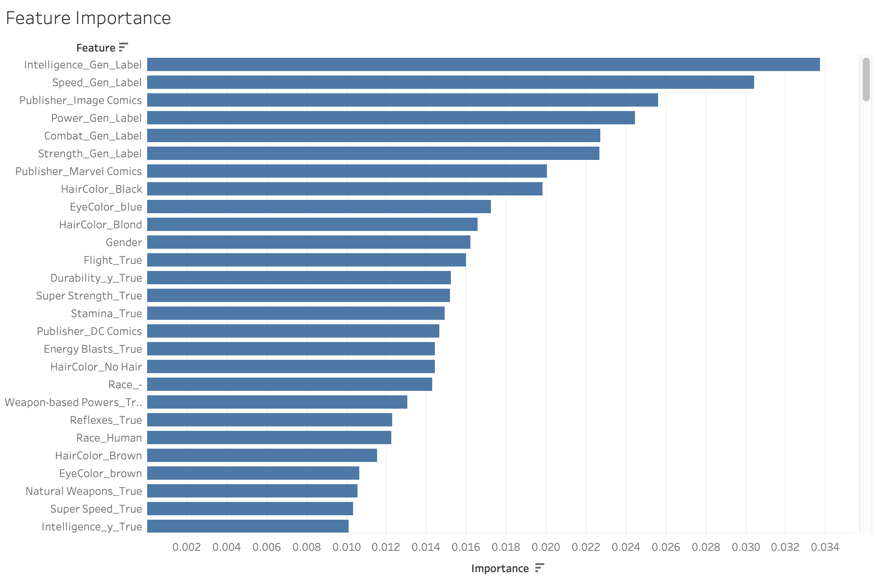
Random Forest Classifier Results

Slide 16
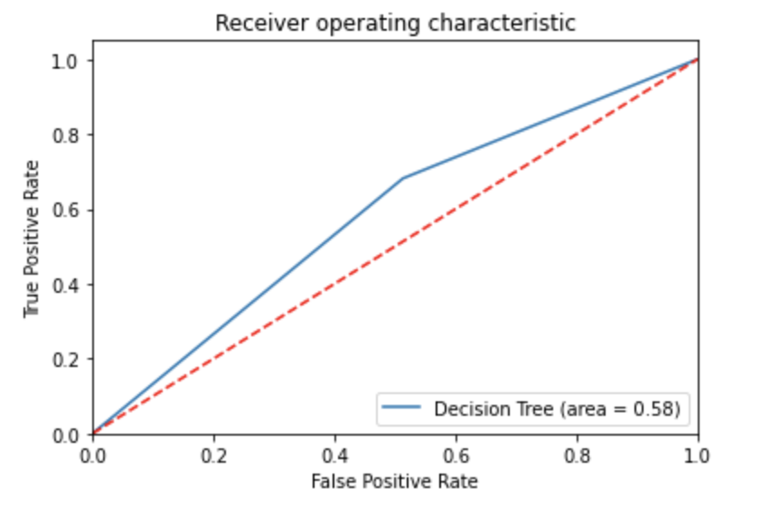
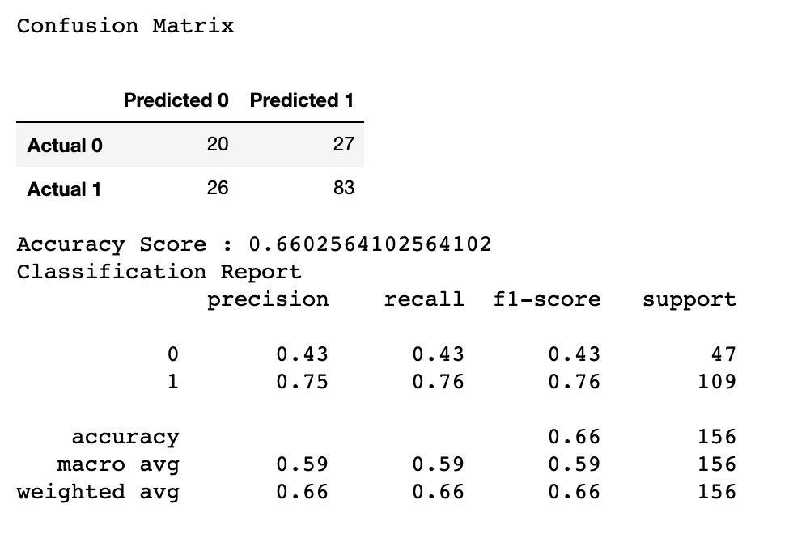
Decision Tree Results

Slide 17
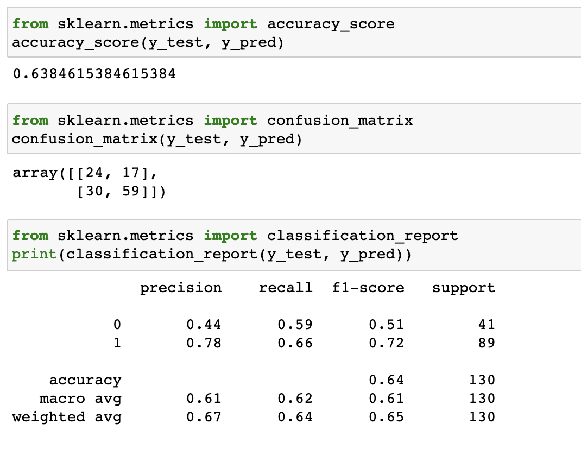
Support Vector Machine Results

Slide 18
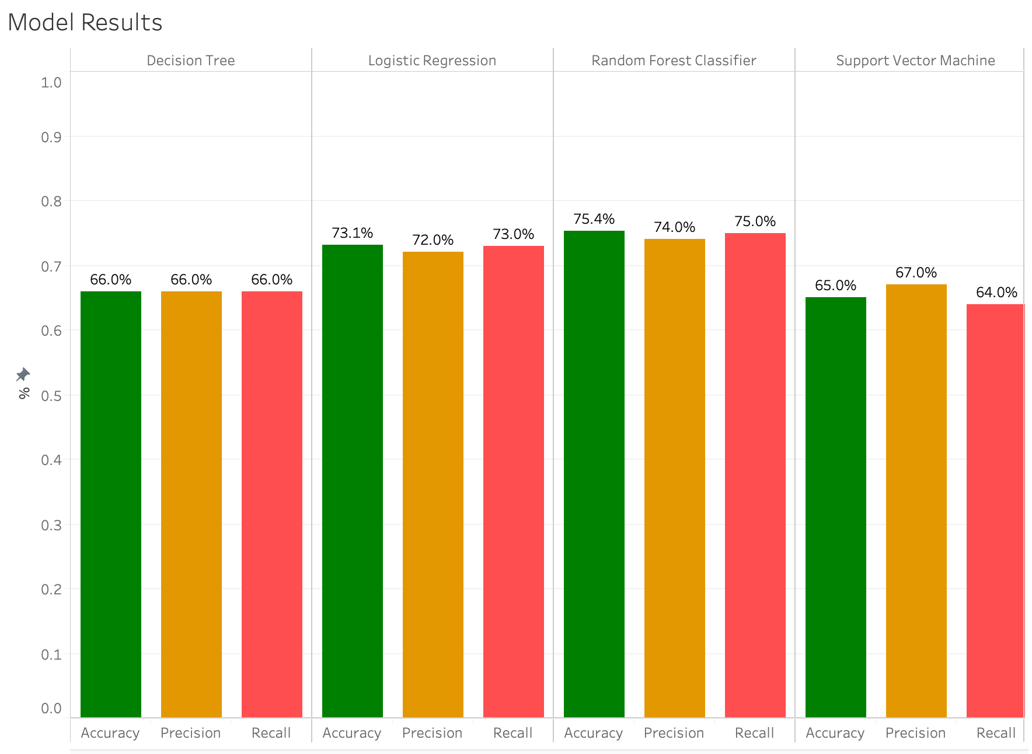
Model Results
Random forest classifier and Logistic regression were stronger models
SVM and decision tree were weaker models

Slide 19
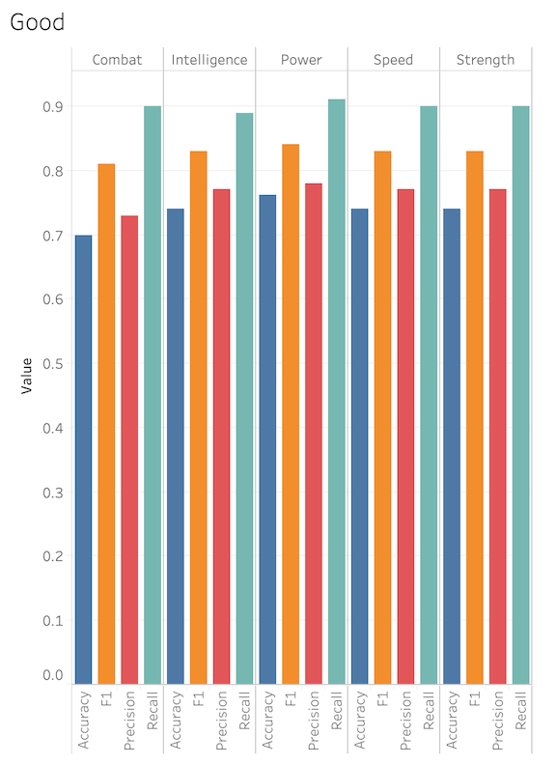
Abilities model results
Good characters showed a well-balanced model results when predicted as good for individual abilities

Slide 20
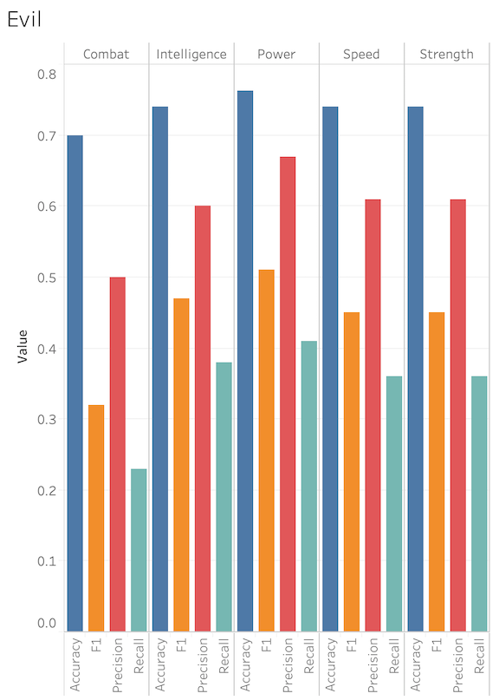
Abilities model results
Intelligence and Power showed stronger results as predictors for evil characters

Slide 21
Conclusion
75% accuracy predicting a comic book character as good or evil (somewhat strong)
Imbalance in the dataset
Over half are good and male characters
Can be explained by history of comic books’ bias towards male characters
Evil characters are better classified based off of intelligence and/or power

Slide 22
Future Work
Increase # of characters in database
Create tiers based off of character ability stats
Investigate similarities using k-means clustering
Relationship between ability stats using linear regression

Slide 23
Tableau Dashboard
Link to dashboard

