Slide 1
Predicting Superhero Alignment
By Jason Masurovsky

Slide 2
Topic Choice Dataset
Comics have been around since 1930s
In the past decade, DC and Marvel have skyrocketed film adaptations
Recent years datasets on comic books and characters have been created and open to the public
Few data viz projects have been made and not many have focused on using machine learning
All the datasets were found on Kaggle
Kaggle is webportal for the data science community
Hosts a wide range of datasets and tooltips as open data
Source data: https://www.kaggle.com/dannielr/marvel-superheroes
Downloaded “characters_stats.csv”, “marvel_characters_info.csv”, and “superheroes_power_matrix.csv”

Slide 3
Research Questions
Can we classify a superhero as good or evil based off their physical characteristics abilities?
Do we see a bias in the data?
Can we cluster superheroes based off abilities to explore and uncover similarities between those that are good and evil?
What superhero abilities have statistical significant influence on one another and by how much?

Slide 4
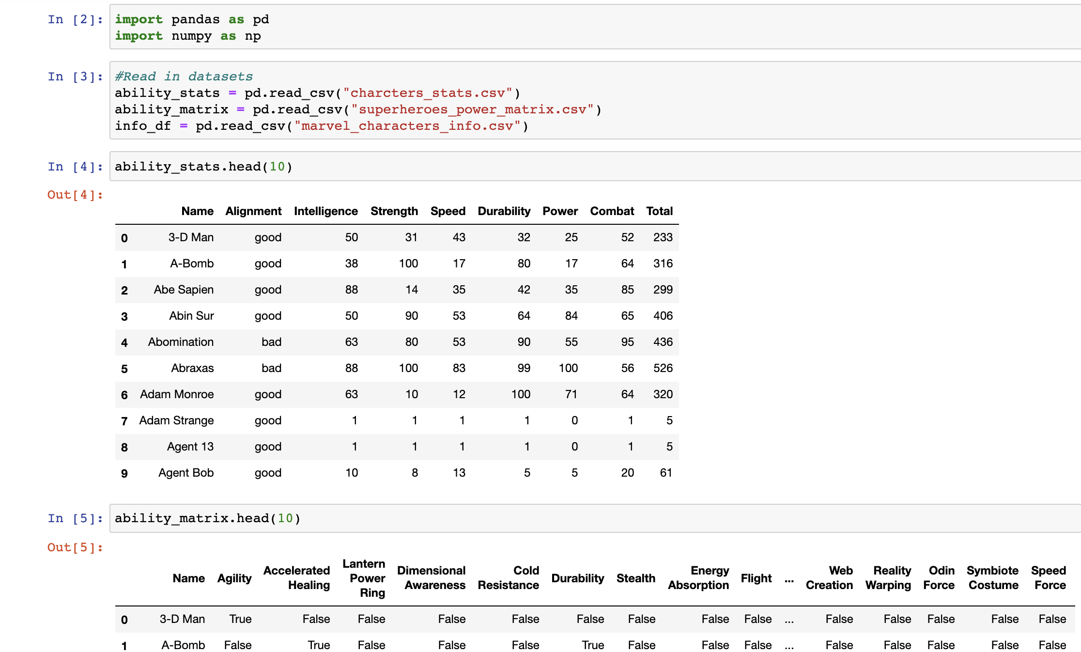
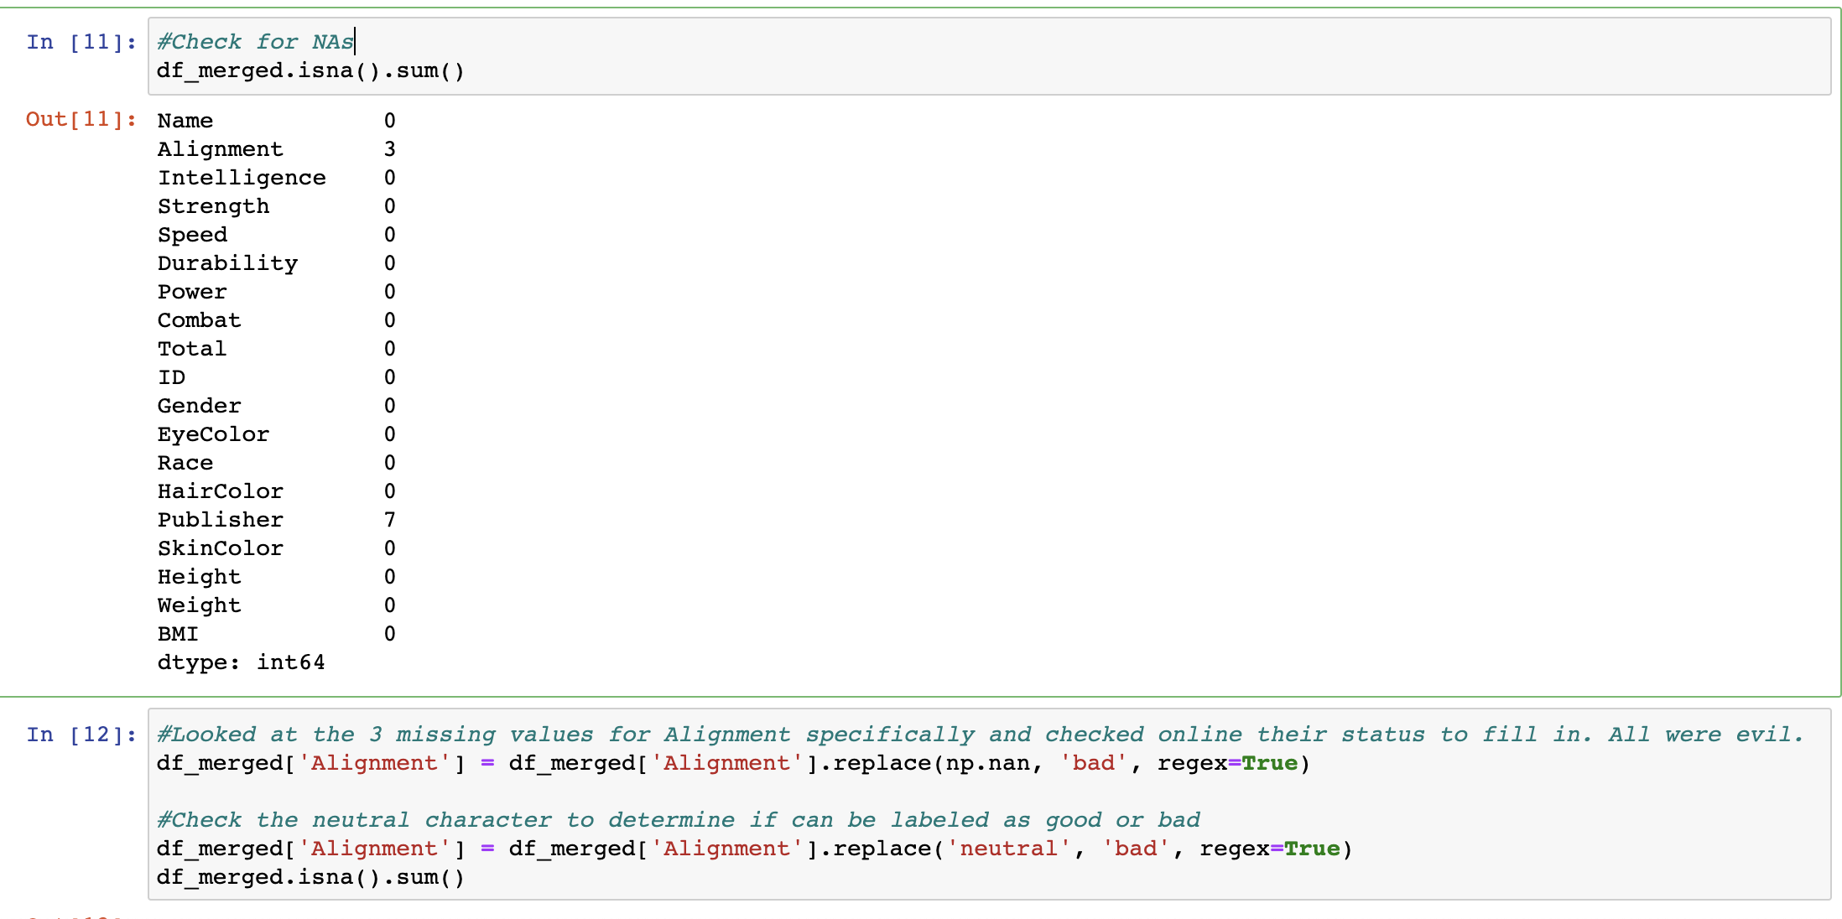
Data Cleaning
Import dependencies and read datafiles
Check for NaNs
Alignment had a few
Check for duplicates
Names had a few
Convert height, weight to feet and lbs.
Create a BMI field
Convert Alignment to binary
Merge for a final dataset to be used in the analysis
Delete any unnecessary fields

Slide 5
Data Analysis
Completed in jupyter notebooks using Python and Tableau
Target variable: Alignment (good or evil)
Display distribution count of alignment
Grouped by gender, race
Pearson Correlation on character stats such as strength, power, durability, combat, speed, intelligence
Are any highly correlated?

Slide 6
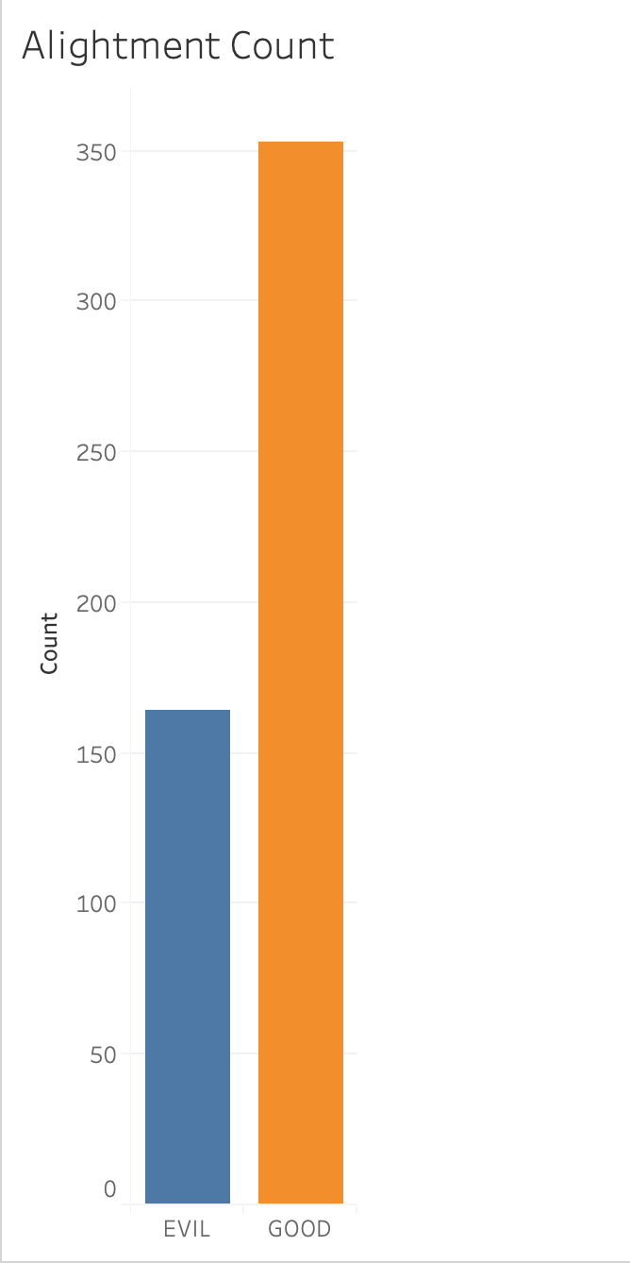
Data Analysis
Breakdown of character alignment
353 good characters
164 evil characters

Slide 7
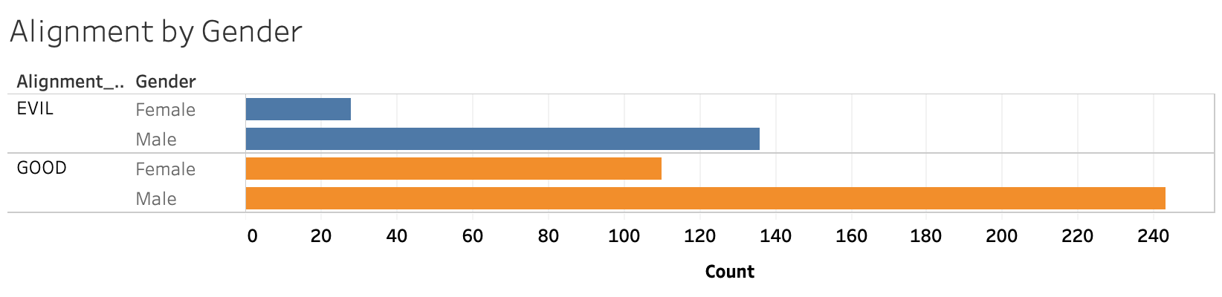
Data Analysis
Breakdown of character alignment by gender
Good: 243 male, 110 female
Evil: 136 male, 28 female

Slide 8
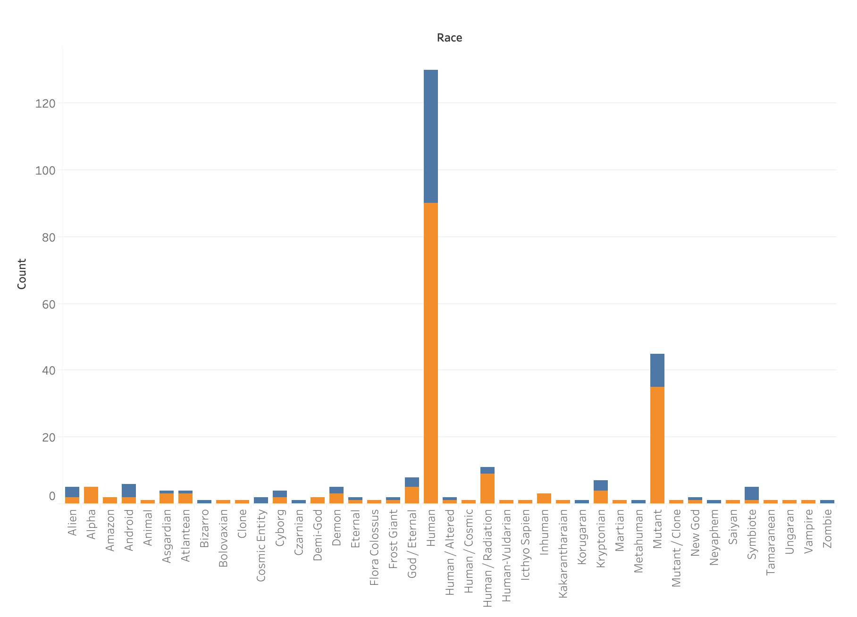
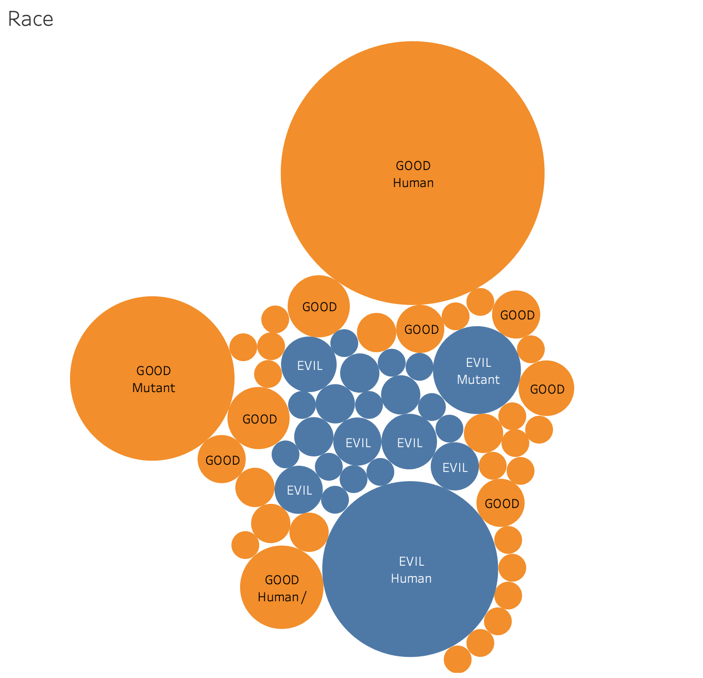
Data Analysis
Stacked bar plot and bubble chart count breakdown of good and evil characters by their race

Slide 9
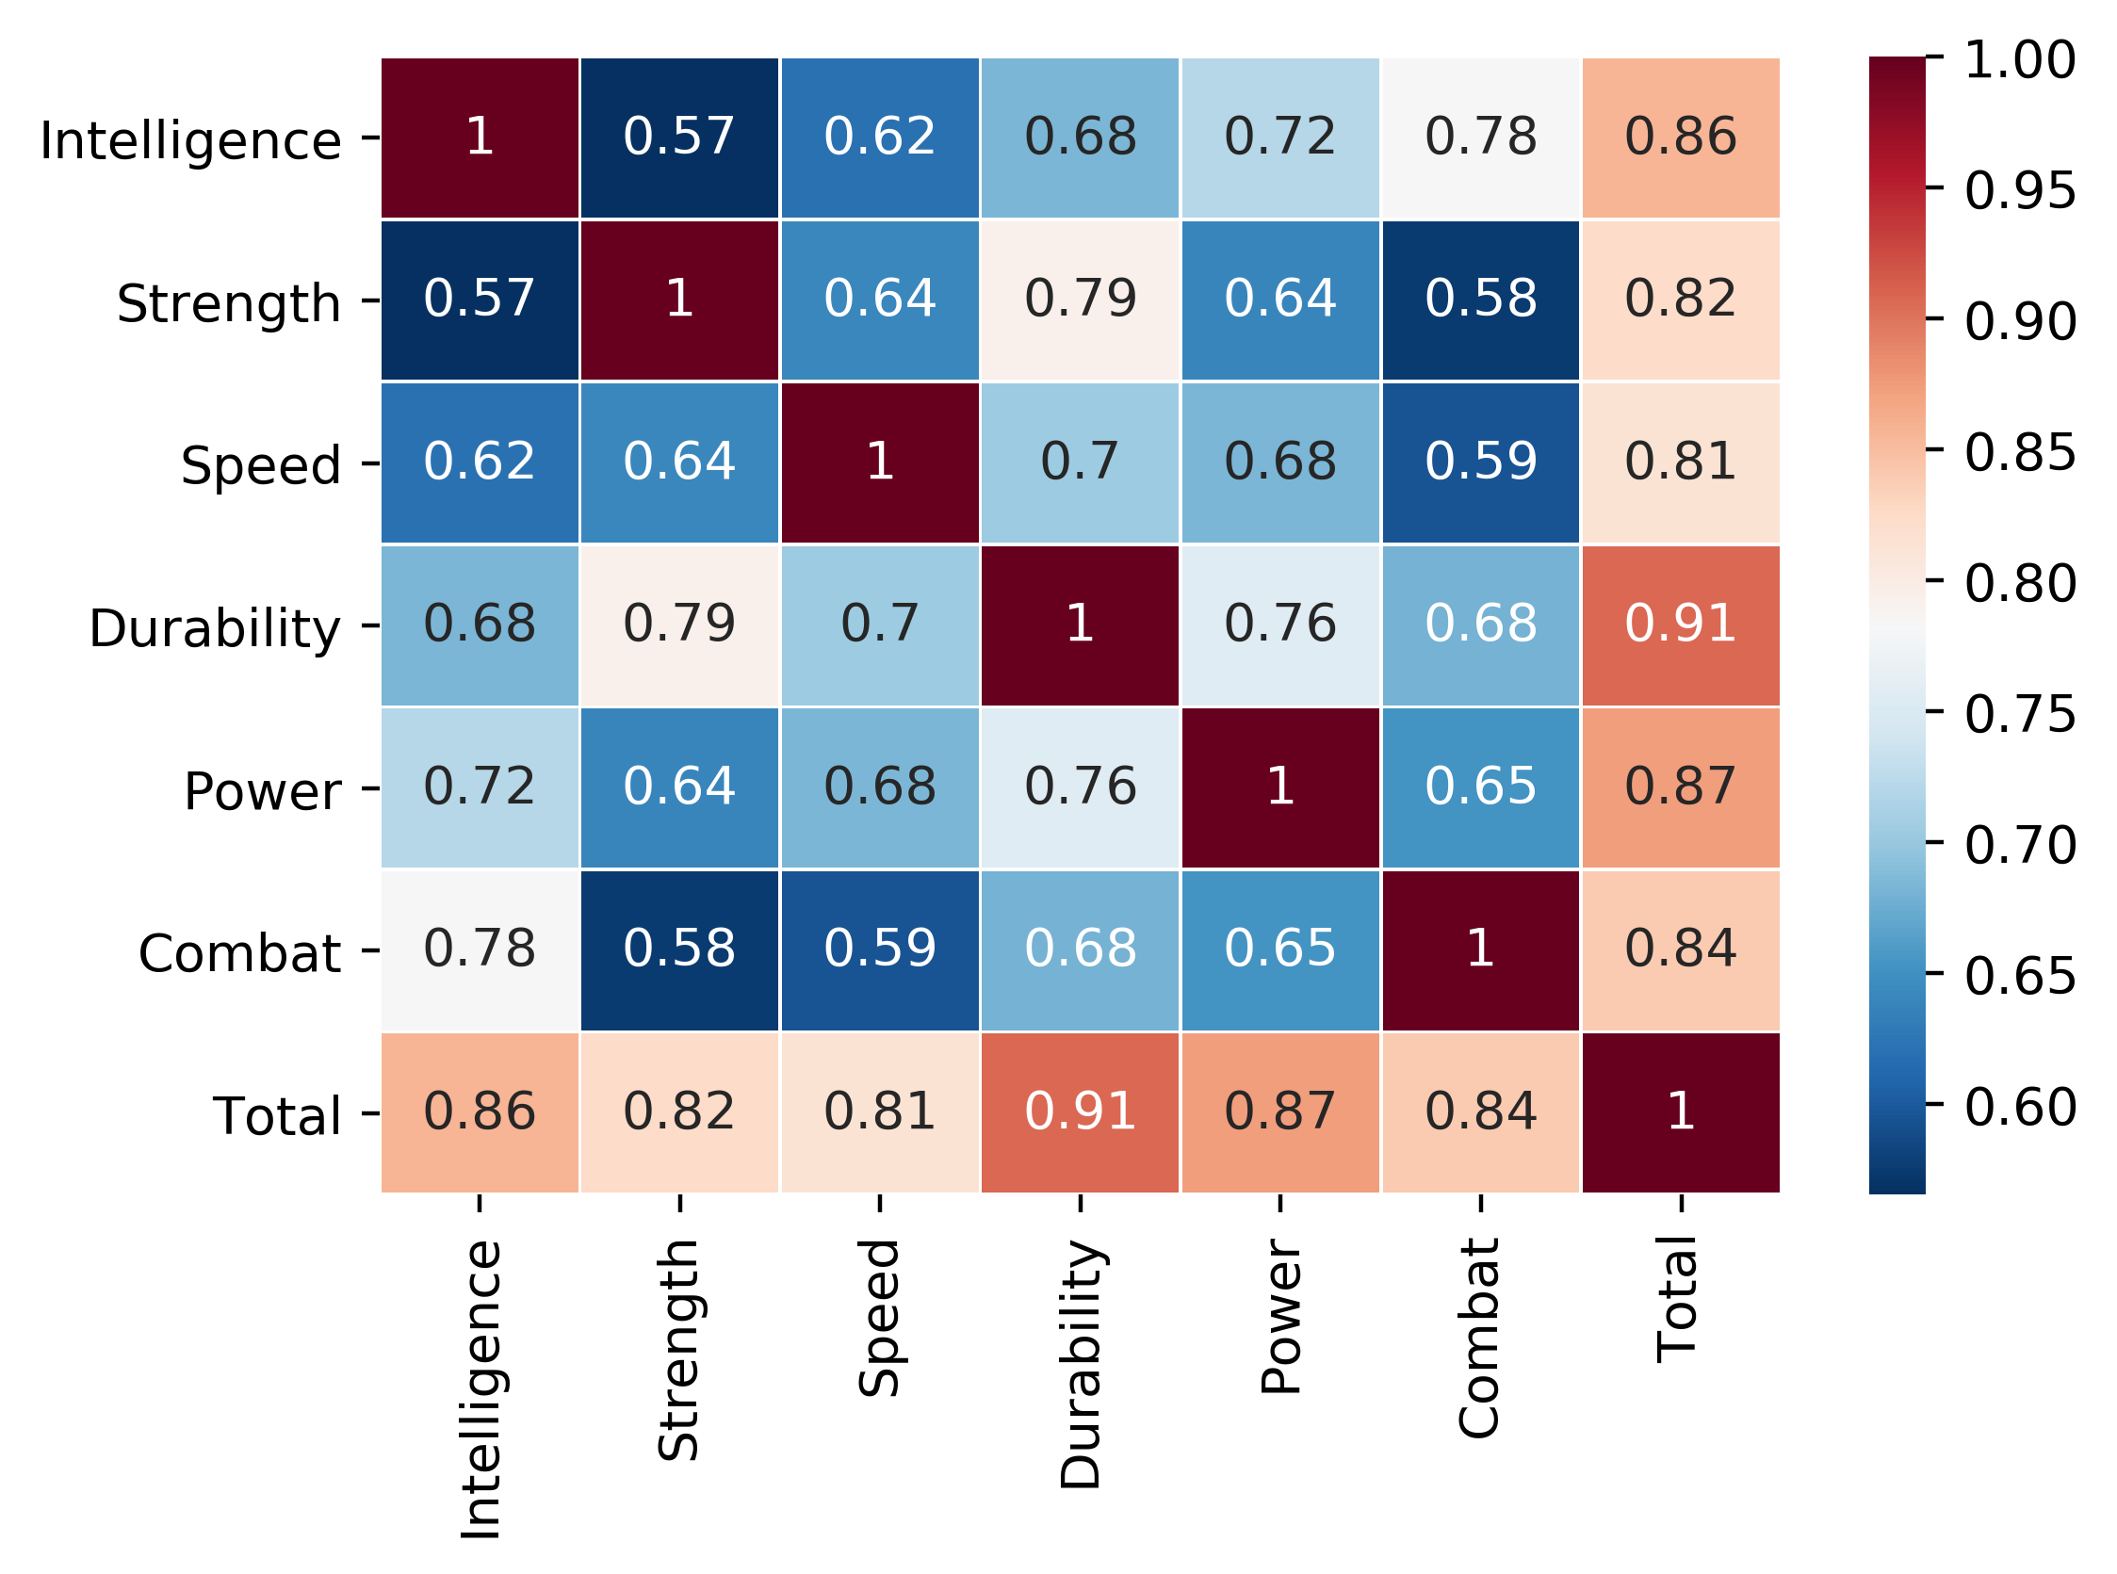
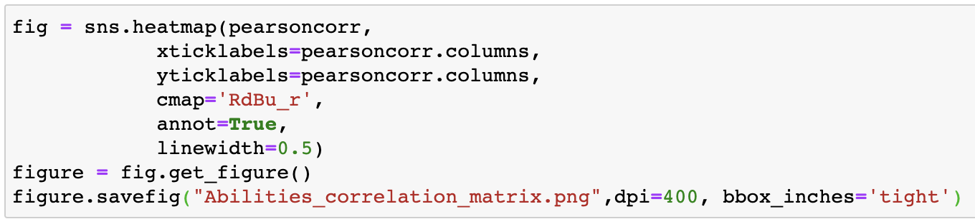
Data Analysis
Pearson correlation matrix/heatmap of character abilities
Check for highly correlated variables
Strength and Durability

Slide 10
Machine Learning Models
Classifying a character as good or evil using “Alignment” as target variable
Logistic Regression
Random Forest Classifier
Decision Tree
Support Vector Machine (SVM)
Compare models
Cluster characters into different “classes”
K-means

Slide 11
ML data pre-processing
Remove highly correlated features
Convert ‘Alignment’ and ‘Gender’ to binary variables represented as 1 and 0
Get only true dummy values for characteristics of characters (race, hair color, eye color) and of superhero abilities (agility, invisibility, web creation, and so on)
Place weights on superhero matrix (strength, power, intelligence, etc..) by label encoding using adaptive binning (range from 0-3 using IQRs)

Slide 12
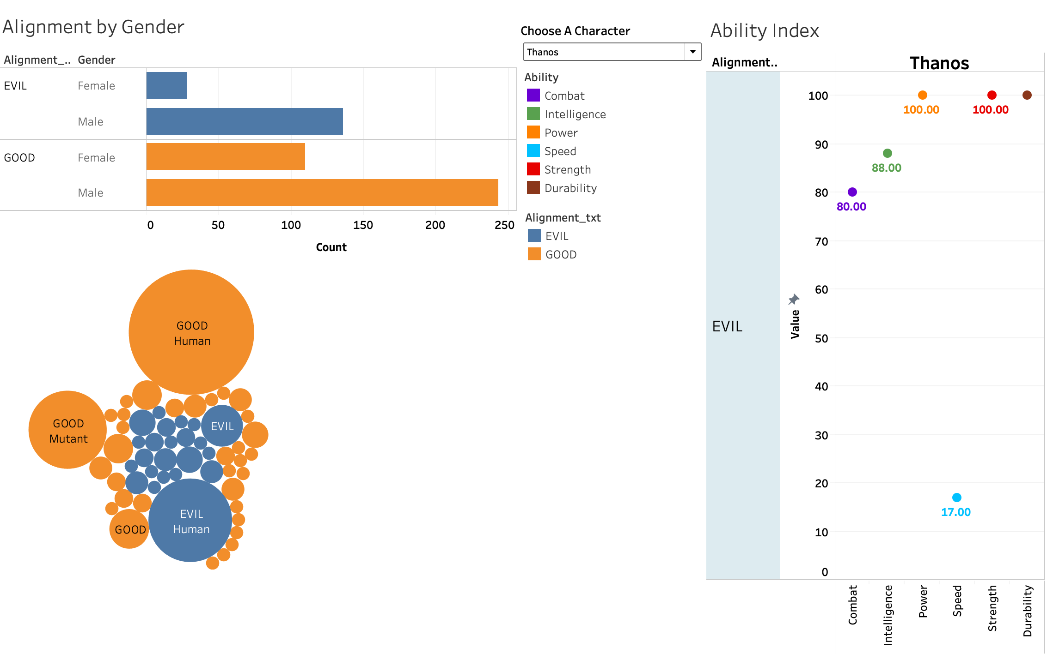
Dashboard Blueprint
Created in Tableau
Displays count of alignment by gender and race
An interactive ability matrix that filters by character and showing character alignment
Blank space in middle = k-means clustering results, classification model results (accuracy, confusion matrix, report)

