Slide 1
CertOps Studio
AI-Native Certification Builder for Enterprise AI Platforms.
Joseph Mata
Notes:
Hi everyone. I’m going to walk you through the CertOps Studio, an AI-native certification builder designed to solve a growing challenge in enterprise AI adoption.

Slide 2



AI Adoption
50–60% of organizations adopting AI
~25% achieving scaled impact
- McKinsey & Company
Notes:
CLICK
Organizations today are rapidly adopting AI tools such as Microsoft Copilot, Claude, and otherI platforms. But adoption is not the same as proficiency.
CLICK
According to McKinsey & Company, while over half of organizations are adopting AI, only about a quarter have actually scaled it to deliver meaningful business impact. A big part of that gap comes down to how people are using these tools.

Slide 3

Challenges
Fragmented Knowledge Base
Exams Test In Isolation
Documentation
AI Policy
Videos
Guidelines
Security
Learning Paths
Notes:
As a Senior AI Enablement Manager, I see two core challenges.
CLICK
First, the learning ecosystem for ai tools are fragmented.
CLICK CLICK CLICK
Content exists across documentation sites, videos, and training paths.
CLICK
Second available learning platforms test knowledge of tools in isolation.
CLICK
They don’t take into account an organization's AI policy , Approved use cases and restriction
or Security and governance constraints.
If only there was system that enablement leads could use generate certification programs that are tailored to how AI tools should be used within our organization
SITE
Behold, Cert Ops Studio, an AI-powered platform that builds certification programs and delivers adaptive exams. You provide the content and the system generates a complete, structured program ready for learner assessment, analytics, and deployment.
the studio has five main workflows: The first is is build.
Here you add a program name and a short description of the audience and what it should cover. alongside uploaded internal and external content. Using that information CertOps generates six artifacts
The first is the blueprint or over all 5the artifacts generated.
the first is the Competency Framework which defines the domains the certification covers, the specific skills within each domain, and what novice, competent, and expert performance looks like for each skill.
The second Learning Progression which maps out how a learner should prepare for the certification. It covers, suggested activities, estimated time, prerequisites, and success criteria.
the third are artifact Performance Tasks Hands-on, projects that test whether a learner can apply their knowledge in realistic scenarios. Each of which are accompanied by scoring guides.
Next are a pool of exam questions that our automated exam will draw from. It contains both multiple-choice and open-ended questions. Each item includes the correct answer, scoring notes, and which domain/skill it maps to.
After making any edits well save our program and move on to configuring our exam agent
Configure
We can customize how the exam agent behaves when learners take the test.
You can adjust how the agent scores open-ended responses, it's summary style as well, as create custom welcome and farewell messages to mirror company language.
You can set the pass/fall rate thresholds, define what score counts as "expert," "competent," or "novice." , and how many questions the exam administers with minimums per domain
Test
This is the learner-facing experience, the adaptive exam.
The learner enters their name and selects a saved certification program.
The exam begins in a conversational chat interface. Questions appear one at a time.
The system evaluates each answer in real time and selects the next question based on the learner's performance so far.
this means two learners taking the same certification will see different questions in different orders and at different difficulty levels.
When the exam ends, the learner sees their results: pass/fail, scores by domain, a narrative summary of strengths and gaps, and recommended next steps.
Deploy
when you're ready to share head to dploy section to Download all the generated content for stakeholders.
Share direct link to the exam lor embed it to an LMS of your choice.
You can upload additional material knowledge base for when your ready to rebuild neever or varied version
Once distributed head over to analyze
Analyze
to get a Summary view of learner attempts.
we have Pass/fail distribution, score distribution, domain performance, and learner results

Slide 4
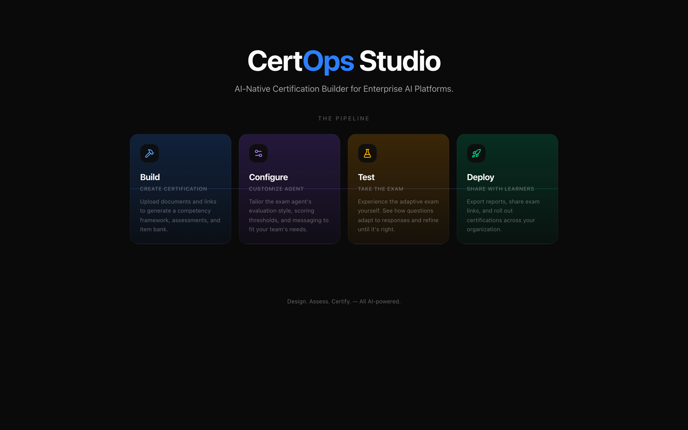
Notes:
Test
This is the

Slide 5
Notes:
Open strong. One sentence intro, then straight into the problem. Don’t fumble with ‘can you see my screen’ — just go.

Slide 6
Notes:
Open strong. One sentence intro, then straight into the problem. Don’t fumble with ‘can you see my screen’ — just go.

Slide 7
Next Steps
Notes:
CLICK
Organizations today are rapidly adopting AI tools such as Microsoft Copilot, Claude, and other enterprise AI platforms. But adoption is not the same as proficiency.
CLICK
According to McKinsey & Company, while over half of organizations are adopting AI, only about a quarter have actually scaled it to deliver meaningful business impact. A big part of that gap comes down to how people are using these tools.

Slide 8

Questions
Notes:
Open strong. One sentence intro, then straight into the problem. Don’t fumble with ‘can you see my screen’ — just go.

Slide 9
Thank You
Notes:
Close strong. Open for questions. Have the live app ready.

