Slide 1




Fall Prevention Through the Use of Assistive Technology

Slide 2
Presenters:
Diane M. Collins, PhD, OTR/L
University of Pittsburgh
dmcst84@pitt.edu
Jim Osborn
Carnegie Mellon University
Oz@cmu.edu

Slide 3
The Epidemiology of Falls
Falls are the leading cause of serious injury among the American elderly.
According to the CDC, more than $19 billion is spent annually to treat older Americans for the adverse effects of falls.
An estimated 80% of the elderly have a chronic condition, and about 40% have some form of activity limitation caused by chronic conditions.

Slide 4
The Epidemiology of Falls
An anticipated one in three (33%) persons over the age of 65 years is a risk for falls annually.
Two-thirds of those who fall (66%) will fall again within six months.
42% of extended-care facility admissions result from one or more falls among this population.

Slide 5
The Epidemiology of Falls
This population is susceptible to injuries from falls due to:
  Decreased bone density
  Diminished muscle tone
  Decreased strength
  Limited flexibility
  Slowed reaction times
  Sensory impairments (vision & hearing)

Slide 6
Warning Signs
You should assess your consumers primarily for decreases in function.
- Rely on rehab professionals to alert you when functional performance declines.
How does this translate to your jobs?

Slide 7
Environmental Obstacles to Successful Aging in Place
Does your consumer have difficulty climbing stairs around his or her home?
Does your consumer seem less able to buy/carry groceries or remember all of the steps in meal preparation?
Is it difficult for your consumer to get into or out of his or her bathtub?

Slide 8
Environmental Obstacles to Successful Aging in Place
Does your consumer fatigue easily when walking long distances?
Can your consumer walk fast enough to cross a major city street before the light changes?
Is your consumer less communicative with family members?

Slide 9
Falls Can Ruin Your
Consumer’s Life
200,000 fracture hips each year
  About half die within 12 months
  One hip fracture is estimated to cost on average $70,000.00 US for surgical/rehab/extended care facility costs
Huge cost in suffering and dollars

Slide 10
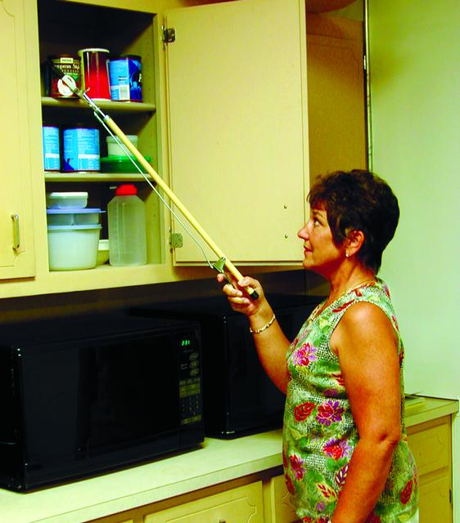
Assistive Technology Can Help!
We start with low-tech, low cost devices that are easily accessible.
  Reachers to prevent use
  of step stools that can
  result in falls

Slide 11
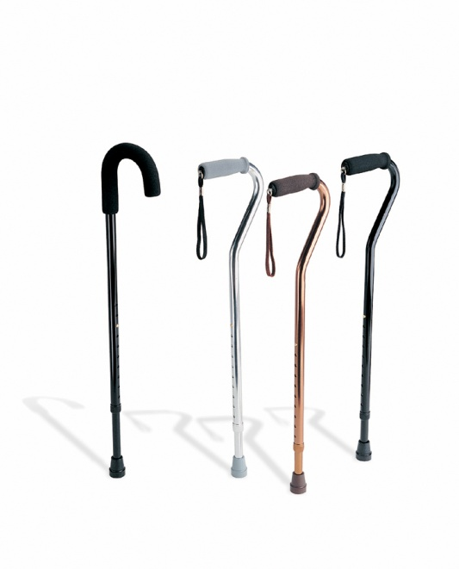
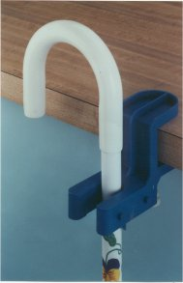
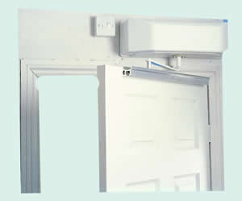
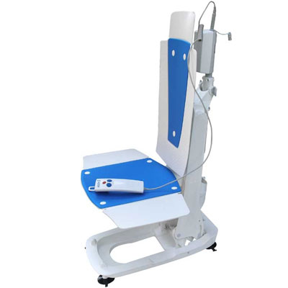

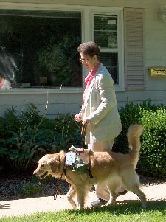

Slide 12
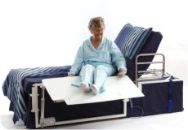
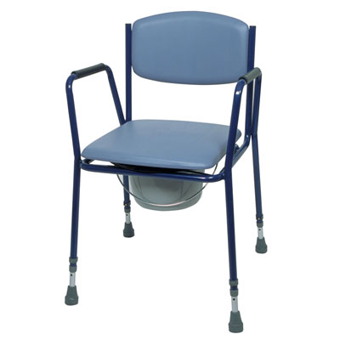
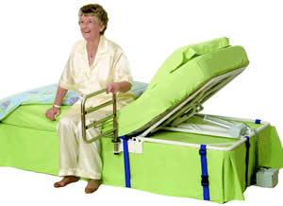
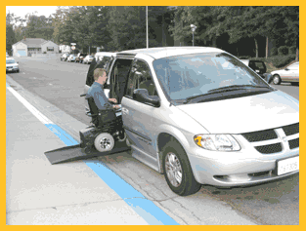
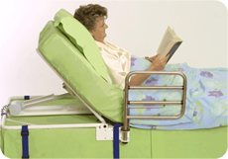

Slide 13
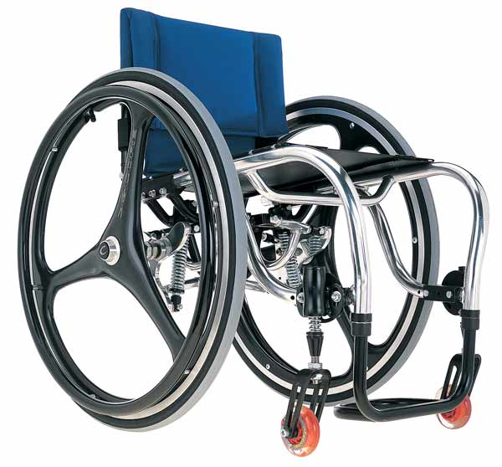
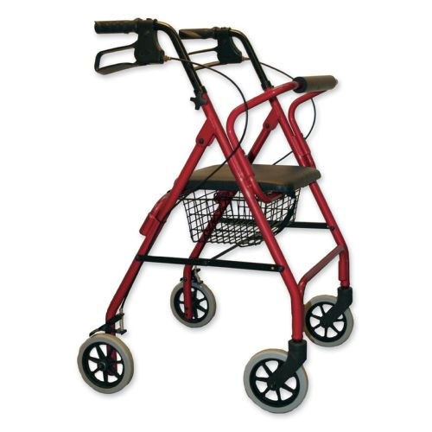
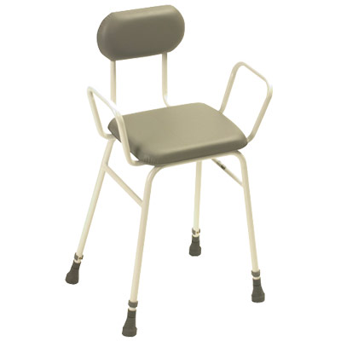
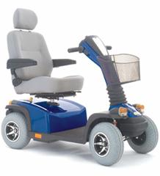
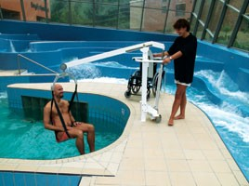

Slide 14
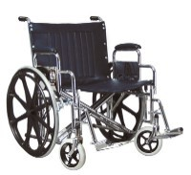
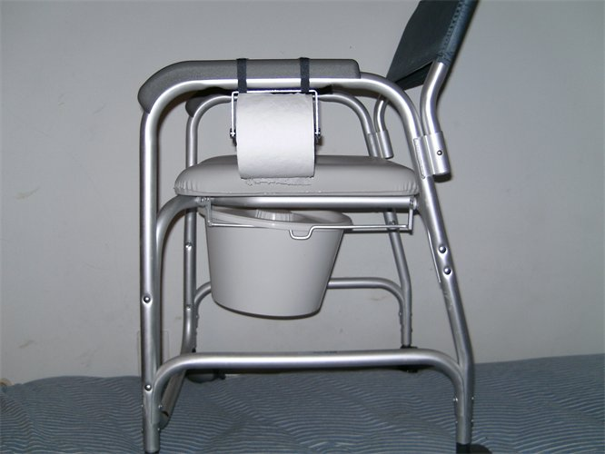
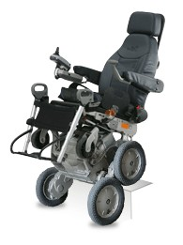
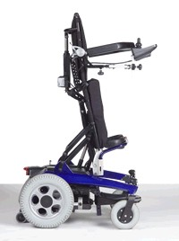
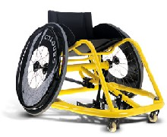

Slide 15
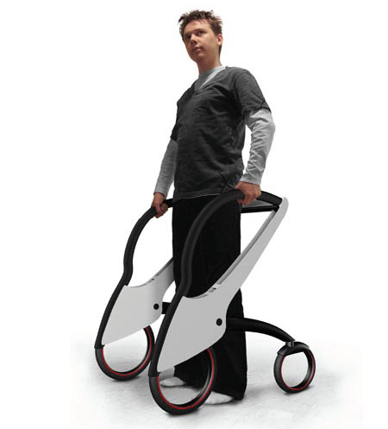
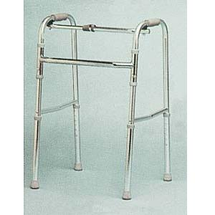
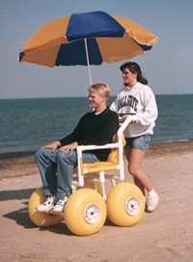
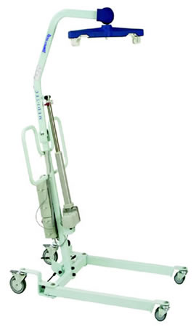
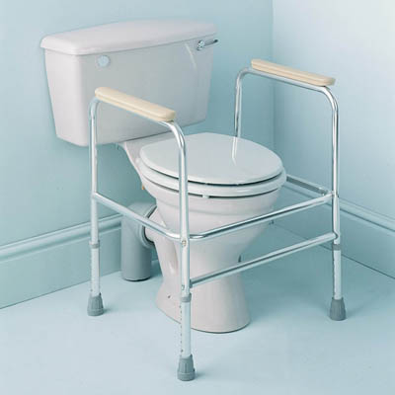
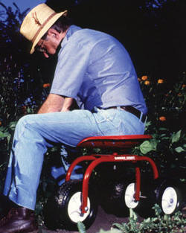

Slide 16
IMPORTANT NOTICE
Most falls happen
in the bathroom.
Keep floors dry and be careful.

Slide 17
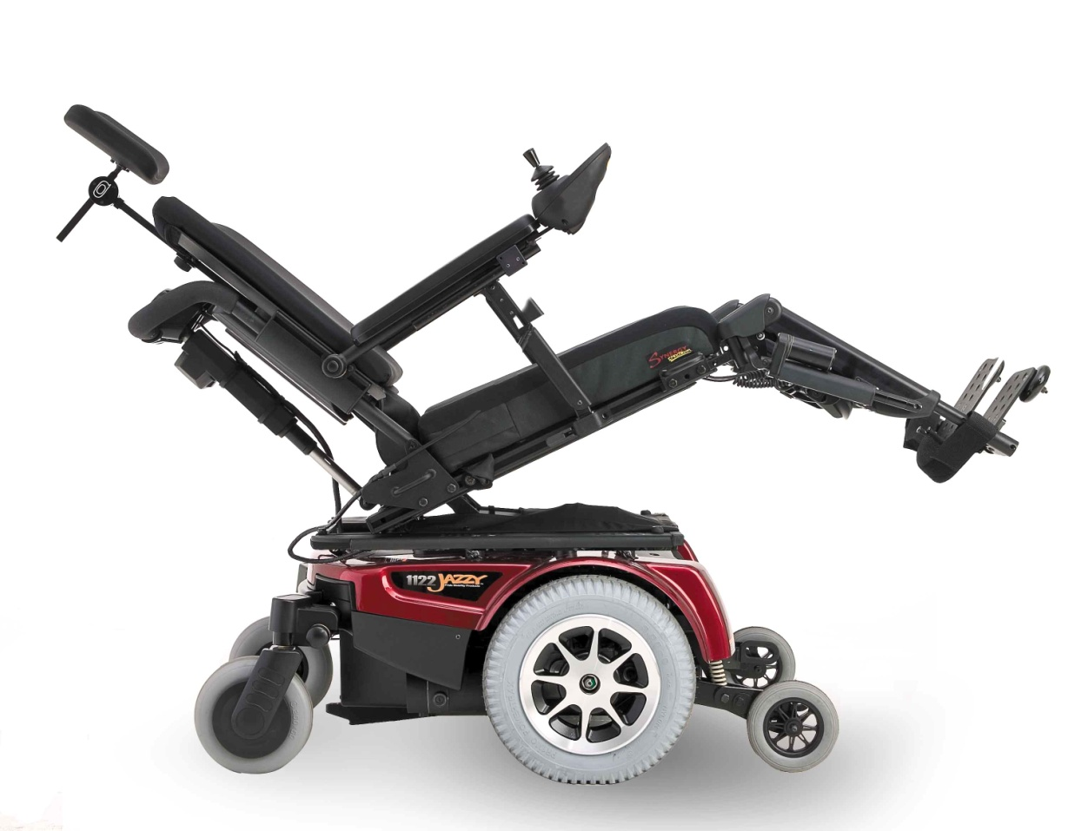

Slide 18

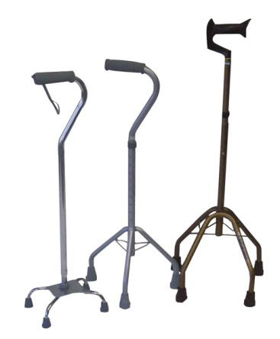
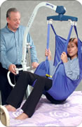
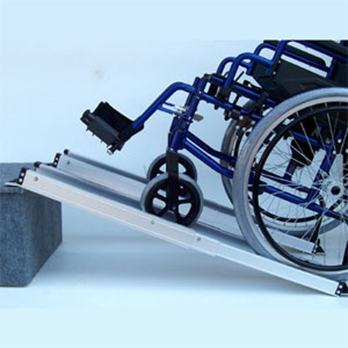
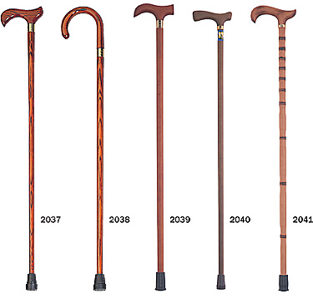

Slide 19
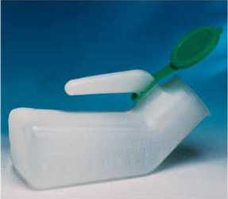
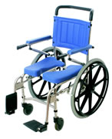
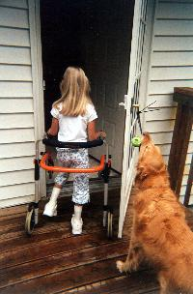
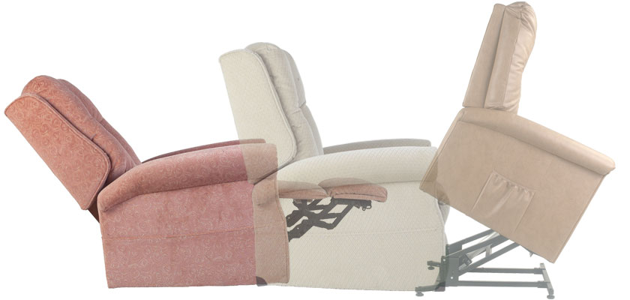

Slide 20
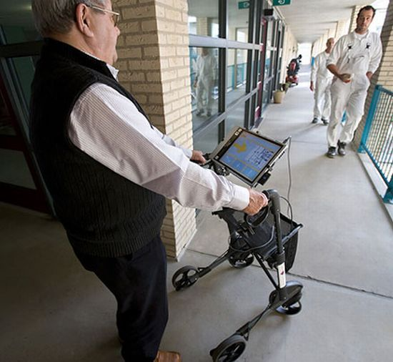
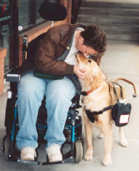

Slide 21
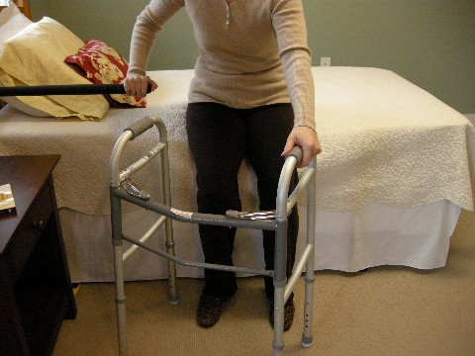
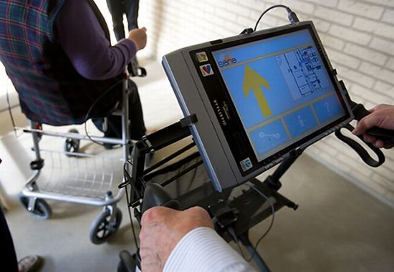
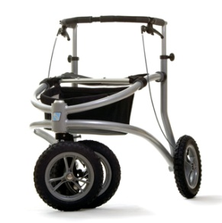
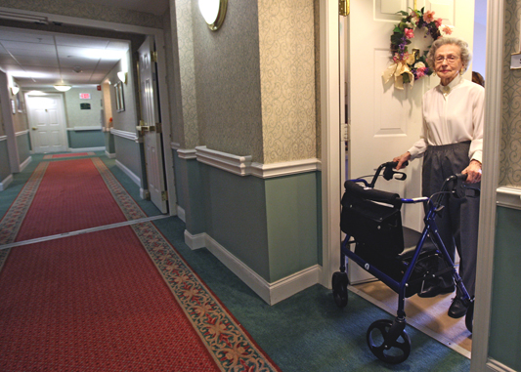
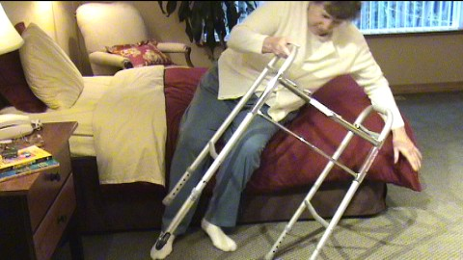

Slide 22
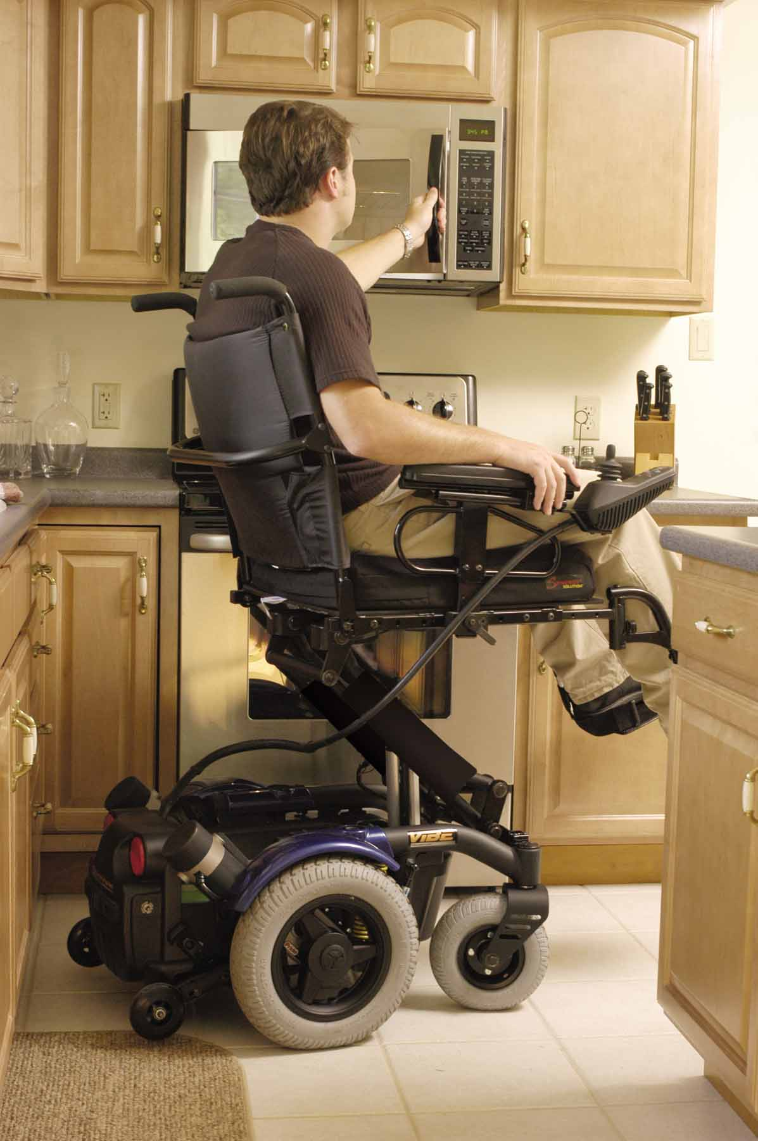
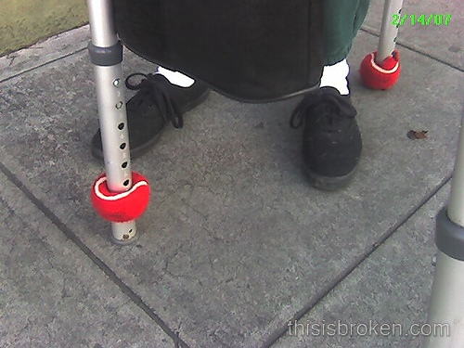

Slide 23
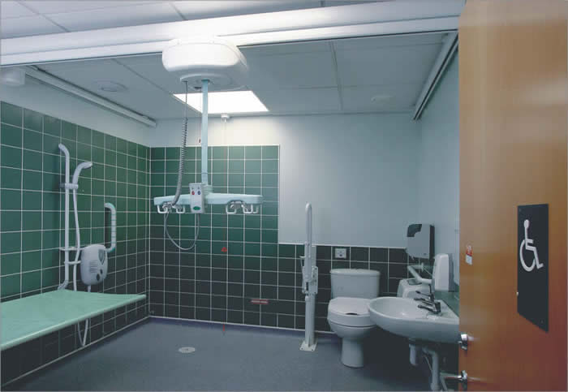

Slide 24
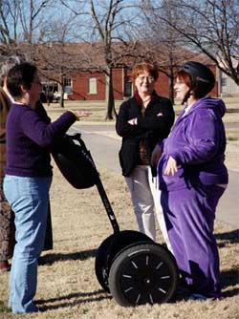
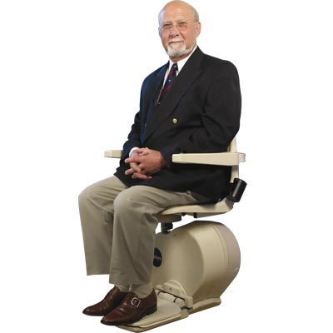

Slide 25
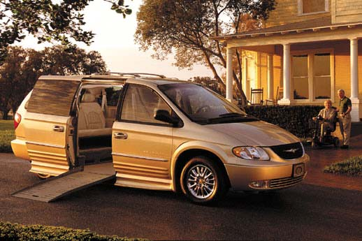
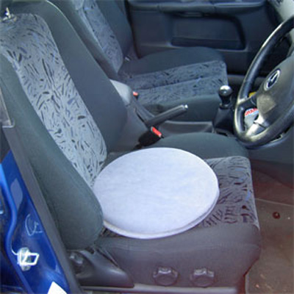

Slide 26


Slide 27




Slide 28





Slide 29





Slide 30



Slide 31

Standard (K0001)
  Heavy > 36 lbs
  Limited dimensions
  Non-adjustable
  Sling upholstery
  Indoor use
  Multiple-user transport
  Low cost
  Hemi height possible
Invacare Tracer EX2

Slide 32

Lightweight Manual Wheelchair
Standard Hemi (K0002)
  Lower seat height (17” to 18”)
Lightweight (K0003)
  Weight 34–36 lbs
  Patient cannot self-propel
  a K0001
K0001–3
  Short-term use
Sunrise Quickie Guardian 3000 (K3)
Notes:
Requires seat height because of shorter stature or to enable the patient to place his/her feet on the ground
Short-term implies 3 months
Rentals for the first 9th month then consumer can either accept the wheelchair and let Medicare pay for it or they can continue to let Medicare rent it for them

Slide 33

High-Strength Lightweight
  A little lighter (< 34 lbs)
  More sizes available
  Limited adjustability
  Appropriate when
    Used less than 2 hours/day
    Users are less active and agile
  Certificate of medical necessity
  Long-term use
Invacare Action Patriot

Slide 34


Ultra-Lightweight (K0005)
  Very light (20–30 lbs)
  Fully adjustable or customizable fixed frame
  Quick release axles
  Rigid or folding
  Active, full-time, long-term users
  Certificate of medical necessity
  Individual consideration
    Description of patient’s routine activities
    Describe features which are needed compared with K0004
Invacare Action A4
Quickie Ti Titanium
Notes:
Individual consideration might include info on pt’s diagnosis, abilities and limitations as they relate to the equipment e.g., degree of independence/dependence, frequency and nature of activities the pt performs, the duration of the condition the expected prognosis and past experience using similar equipment
Seldom approved by Medicare – pt can submit claim for K5 and medical necessity for K4 and pay the difference for the K5
Routine activities include types of activities the pt usually encounters and whether or not the patient is fully independent in the use of a wheelchair.

Slide 35

Rigid Frame Ultralite
Rigid frame
Very light
Adjustable
Considered K0005 by Medicare or Custom by other payers

Slide 36

Power Add-On Units
Code manual wheelchair as K0001 to K0008
Code unit as K0460 or K0108
Adds motors, batteries, and electronics onto a manual wheelchair
Performs like a power wheelchair
Newer models allow for more programming and specialty controls

Slide 37


Heavy Duty Wheelchairs
Heavy duty (K0006)
  > 250 lbs
  Or severe spasticity
Extra Heavy Duty (K0007)
  > 350 lbs
  Heavy (100 lbs)
Wheelchairs of Kansas Wizz-ard
Regency XLC

Slide 38






Powered Mobility Devices

Slide 39
Basement & Integral Garage
Is the furnace checked each year?
Does the hot water heater have any rust or leaks?
Do you know how to turn off the
main water valve?
Is the Circuit breaker box
(or fuse box) in good condition?

Slide 40
General Safety
Do you have a
fire emergency exit plan?
Is there a fire extinguisher
on each level of home?
Are the fire extinguisher
“charges” up to date?
Is the fireplace flue
cleaned & inspected regularly?
Notes:
Hint for space heaters. Tip switch on electrcial heaters.
Kerosene space heaters not recommended.

Slide 41
General Safety, 2
Are space heaters carefully maintained?
Hint…
Turn space heaters off
when not in the room!
Hint…
Space heaters should
automatically shut off
if tipped over.

Slide 42
General Safety, 3
Hint…
Mark raised doorsills with safety tape.
Hint…
Keep low-rise tables, footrests and plants away from pathways.

Slide 43
General Safety (Hints)
Hint…
Keep Cell or cordless phones
  Well charged
  Nearby at all times.
  Programmed to call emergency help and/or 911
Hint…
Keep fire, police, ambulance numbers near all telephones (and in speed dial)

Slide 44
A WORD OF ADVICE
If you become less able to get around, consider moving to a more convenient and safer home. Recognize when it’s time to move!

