Slide 1
Where should the operator launch after Las Vegas?
Enter Miami, Los Angeles, Phoenix and San Francisco first, then Houston, Tampa, Orlando and Atlanta; hold New York and Chicago until the rules change.
Strategy team readout | 25 US metros scored | data as of 2026-11-06

Slide 2
Five criteria decide where a robotaxi launch works
35
25
20
15
5
weight, balanced case
weight, balanced case
weight, balanced case
weight, balanced case
weight, balanced case
Market demand
Operating conditions
Regulatory readiness
Competitive intensity
Charging cost
Population, density, ride-hail use, no-car households, airport traffic
Rain, snow and extreme-heat days
State AV rules (tier 0-3) and a new operator's path to paid service
Who already operates or has announced
Commercial electricity price
25 candidate metros, each scored 0-100. Metrics are percentile-ranked, except competitor crowding, which is min-max scaled.
Las Vegas is scored as a benchmark, not ranked.
Sources: Census ACS 2024 5-year, NHTSA SGO, NOAA GHCN-Daily, EIA, FAA, researched seed files as of 2026-11-06
2

Slide 3
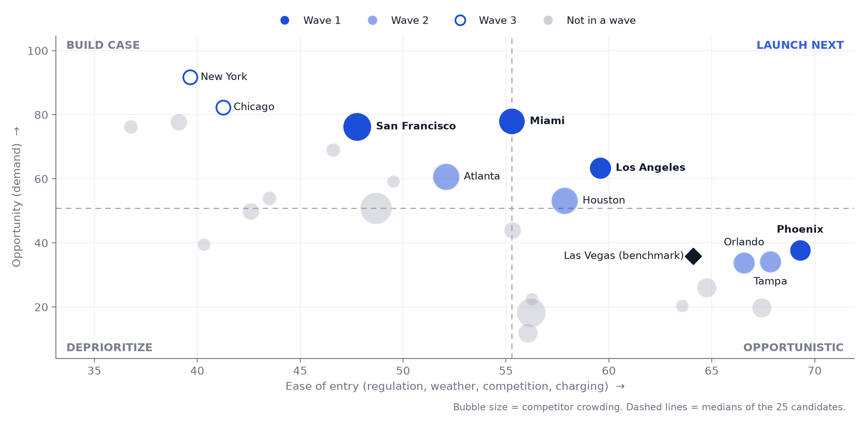
Miami, Los Angeles, Phoenix and San Francisco are the top-scoring metros where driverless service is already allowed
Sources: Census ACS 2024 5-year, NHTSA SGO, NOAA GHCN-Daily, EIA, FAA, researched seed files as of 2026-11-06
3

Slide 4
Launch in three waves, gated by regulation and proof
Wave 1
Wave 2
Wave 3
Start now: 2 launch, 2 start permits
After wave 1 proves the playbook
When the law changes
Miami
launches first
Phoenix
launches first
Los Angeles
California: permits now, paid service after
San Francisco
California: permits now, paid service after
only just clears the 50% gate (54%)
Houston
Tampa
Orlando
Atlanta
New York
Chicago
Tier 2+ rules, top-5 in at least half of weight draws
Tier 2+ rules, top 10; validate weather
Top-10 demand, driverless service not yet allowed
Timing is indicative: sequence follows evidence gates, not calendar dates
Sources: Census ACS 2024 5-year, NHTSA SGO, NOAA GHCN-Daily, EIA, FAA, researched seed files as of 2026-11-06
4

Slide 5
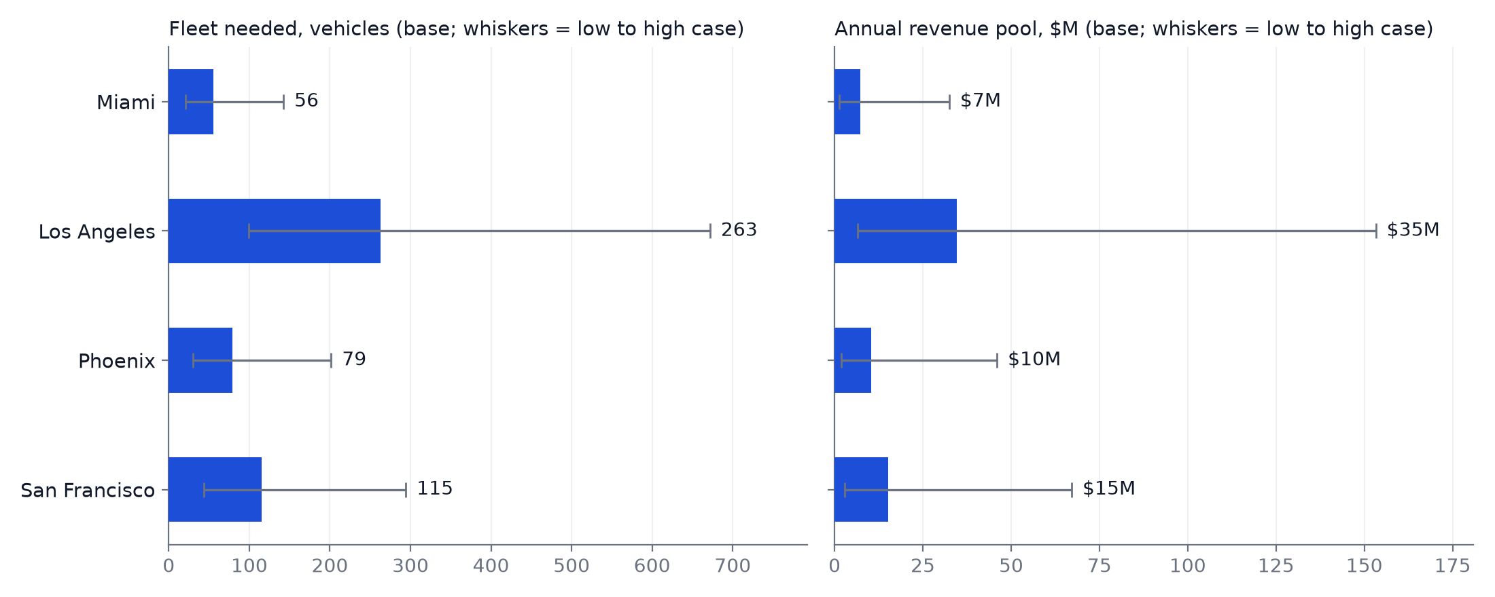
Wave 1 needs 56-263 vehicles per metro for a $7M-$35M annual revenue pool
Wave 1 metros, base case: 3% capture of ride-hail trips, $20 fare. Demand and revenue are for the principal-city launch area, not the whole metro, which is why Miami's pool is small despite ranking #1. Payback is assumption-driven: about 2.3-2.4 years in every metro because fare, utilization and cost per mile are national assumptions (only the power price varies).
Sources: Census ACS 2024 5-year, NHTSA SGO, NOAA GHCN-Daily, EIA, FAA, researched seed files as of 2026-11-06
5
Notes:
Chart metros (wave 1 only): Miami, Los Angeles, Phoenix, San Francisco

Slide 6
Regulation, weather and crowding are the three risks to manage
RISK
EVIDENCE
MITIGATION
Regulation
2 of the top 10 are in Tier 0-1 states; CA permits are slow for a new entrant
Engage regulators early; file in slow-permit states during wave 1; hold wave 3 until the law changes
Weather
Rain on ~64-92 days a year in Miami, Atlanta, Orlando, Tampa and Houston; 40 C+ on ~89 days a year in Phoenix
Storm and heavy-rain validation, plus heat validation, before public launch
Competition
Miami, Los Angeles, Phoenix and San Francisco already have operators (crowding 1.3-2.5)
Enter with a service or cost edge. Phoenix has the fewest operators, but Waymo's largest service area (315 sq mi)
Sources: Census ACS 2024 5-year, NHTSA SGO, NOAA GHCN-Daily, EIA, FAA, researched seed files as of 2026-11-06
6

Slide 7
Appendix: methodology and sources
METHOD
SOURCES
• Percentile rank of each metric across 25 metros, except competitor crowding (min-max scaled)
• Pillar score = weighted mean of its sub-scores
• Total = weighted mean of five pillars
• Opportunity = demand; ease = other four pillars
• Monte Carlo: 10,000 weight draws (Dirichlet, seed 42)
• Demand: two anchors, Chicago and NYC, calendar 2025
• Unit economics: labeled assumptions, benchmarked to public references (Obi fares, Morgan Stanley vehicle cost, AAA operating cost)
• Census ACS 2024 5-year (2020-2024)
• FAA CY2025 enplanements
• NOAA GHCN-Daily airport stations, 2016-2025
• NHTSA SGO ADS reports to Sep 2026 (activity only)
• EIA commercial price, Jan-Aug 2026
• Researched seed files: AV rules, new-entrant paths, competitors (as of 2026-11-06)
• Chicago TNP and NYC TLC trip counts
Inputs validated against Census estimates, NYC TLC and Chicago trip data; all competitor and regulation sources re-checked 2026-11-06 (docs/validation.md)
NHTSA reports have no mileage: never used as crash rates. Full method in the methodology note
Sources: Census ACS 2024 5-year, NHTSA SGO, NOAA GHCN-Daily, EIA, FAA, researched seed files as of 2026-11-06
7

