Slide 1
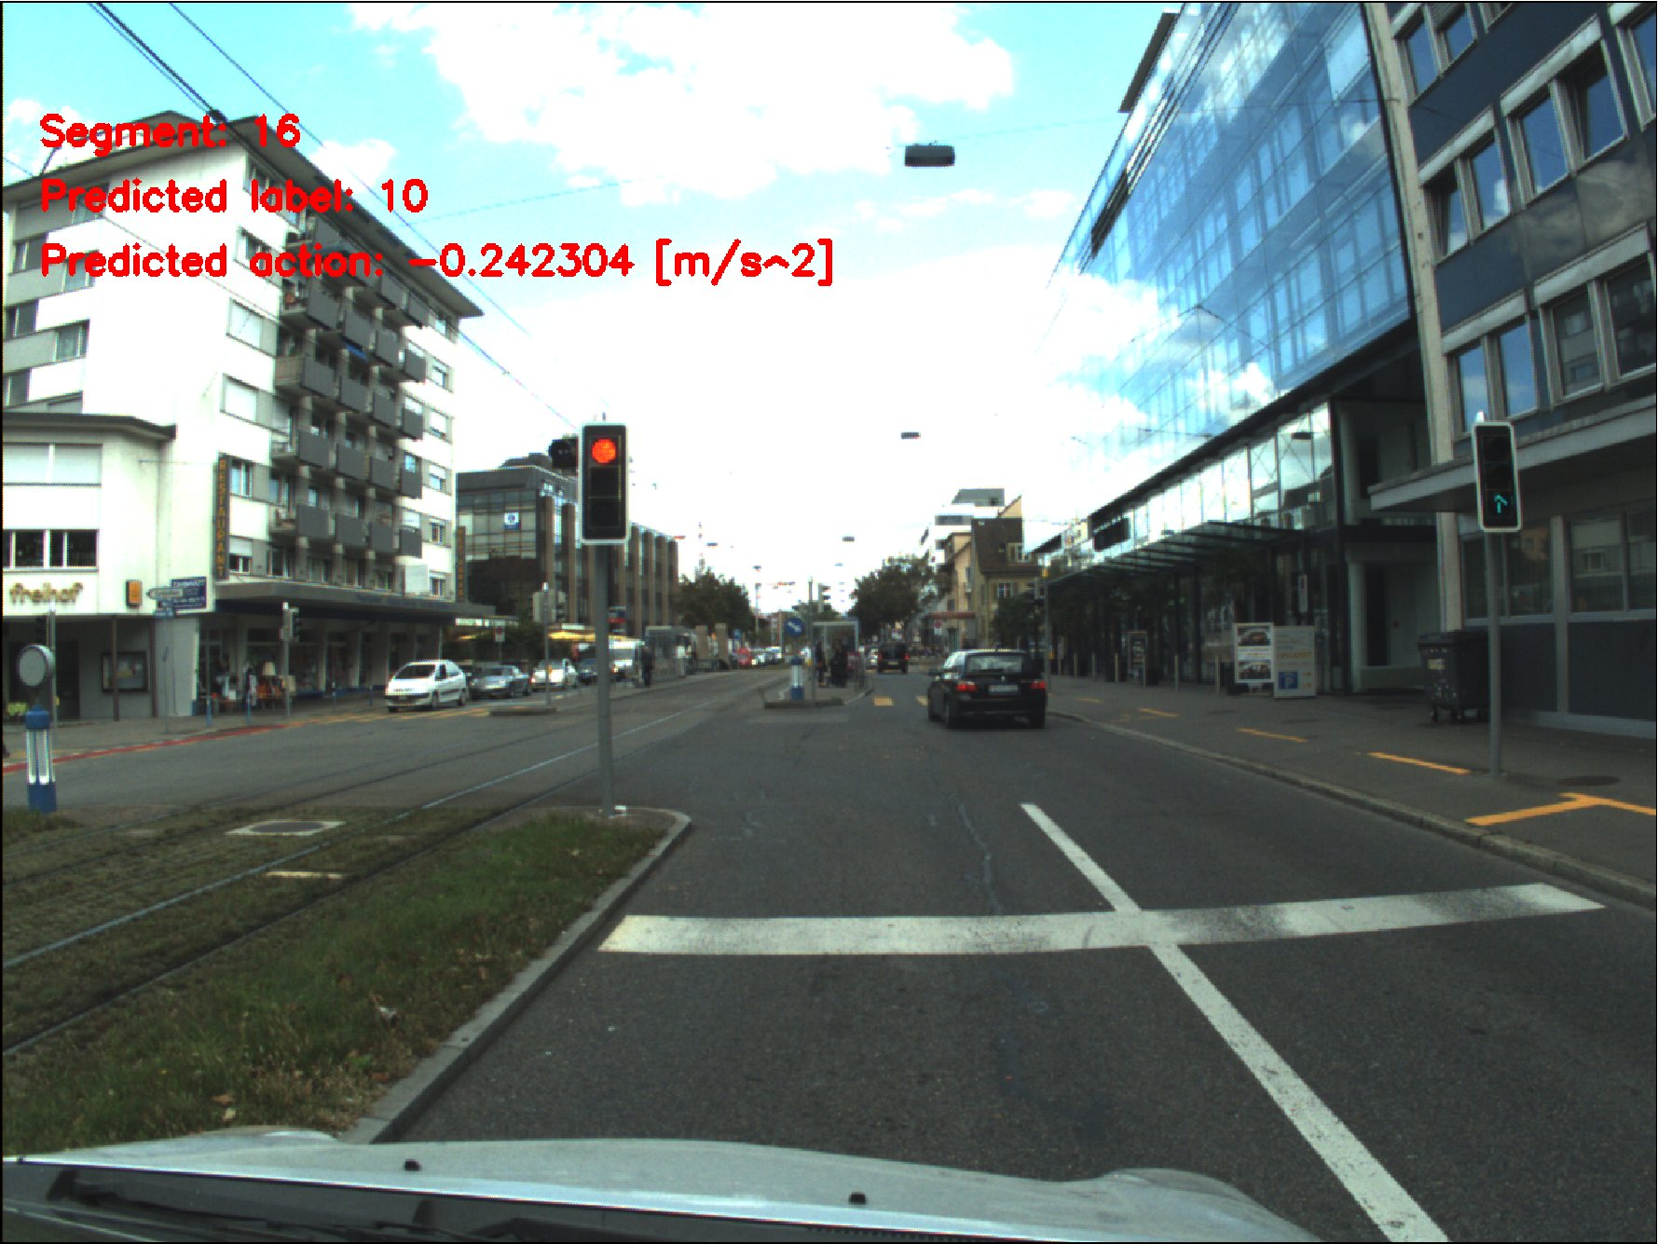
Bayesian On-line Learning of Driving Behaviors
Jérôme Maye, Rudolph Triebel, Roland Siegwart
Autonomous Systems Lab, ETH Zurich, Switzerland
Luciano Spinello
Social Robotics Lab, University of Freiburg, Germany
Bayesian on-line method for predicting driving actions based on IMU and camera data
IMU data is processed into segments corresponding to motion primitives
Traffic situation models are learned from these segments using camera data
Action prediction model is associated to each traffic situation model

