Slide 1
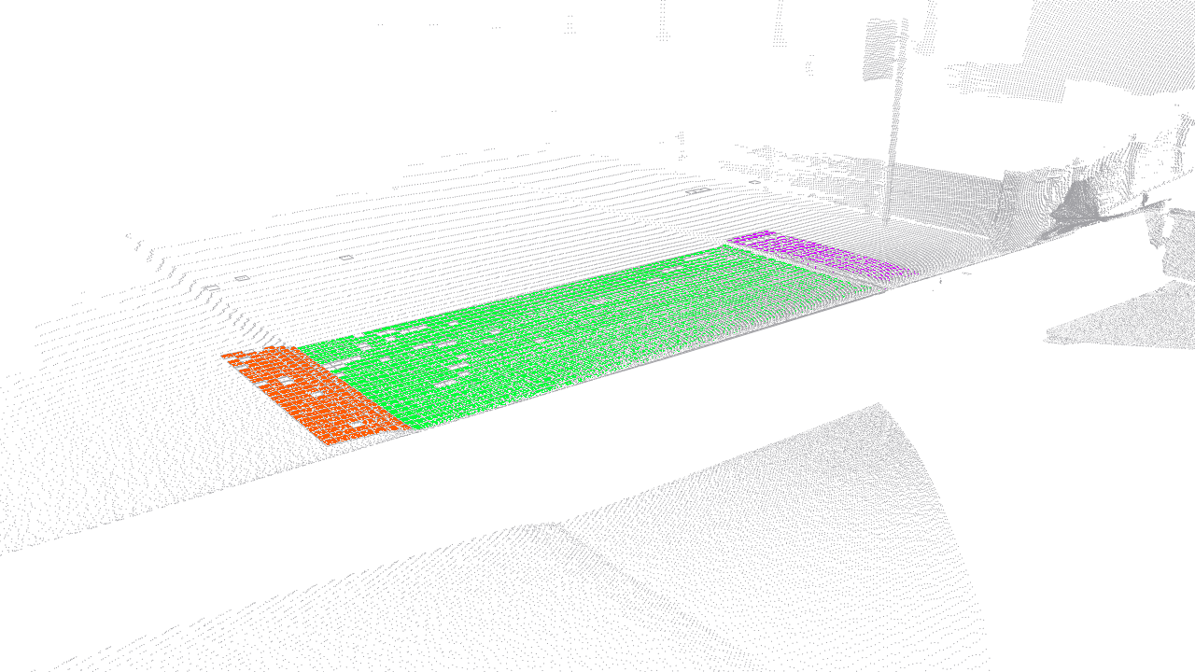
Curb Detection for a Pedestrian Robot in Urban Environments
Jérôme Maye, Ralf Kaestner, and Roland Siegwart
Autonomous Systems Lab, ETH Zurich, Switzerland
Unsupervised approach to curb detection in 3D range data for a mobile robot
Piecewise planar modeling of the environment and curbs at plane intersections
View- and configuration-independent
Fitting mixtures of linear regressions using Conditional Random Fields (CRF)
Fully probabilistic model

