Slide 1
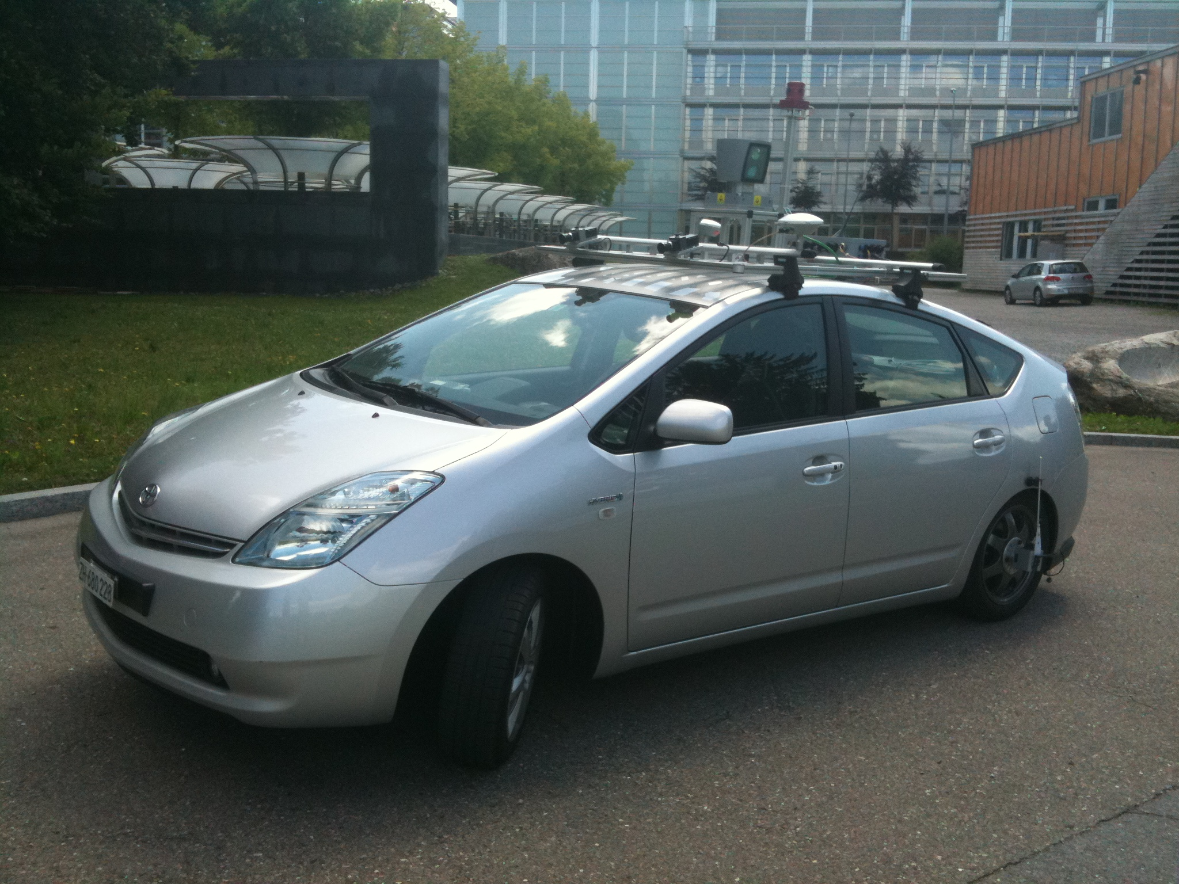
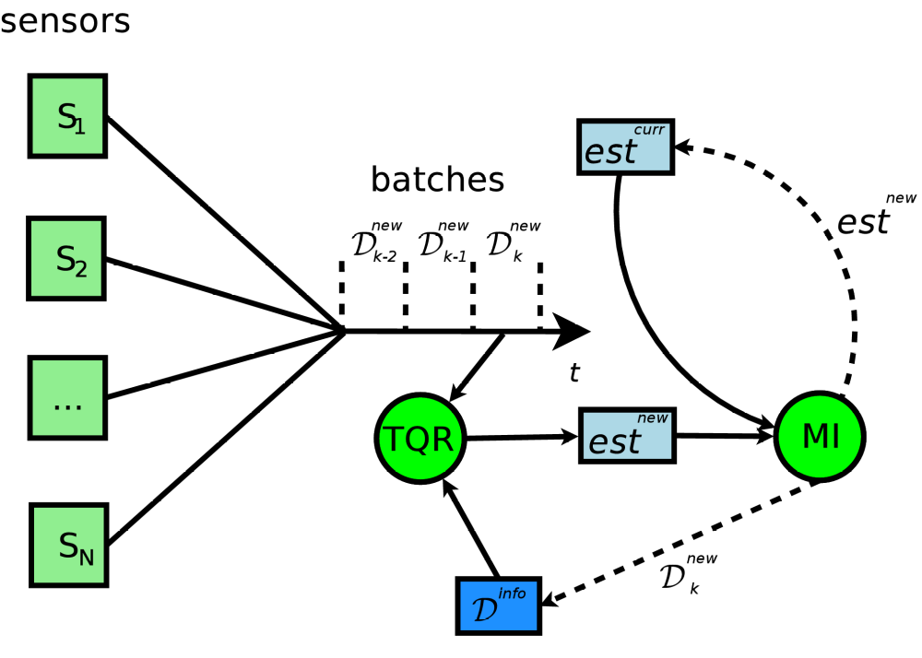
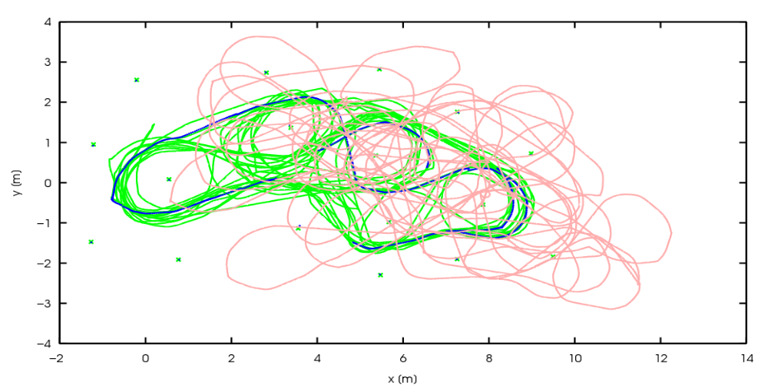
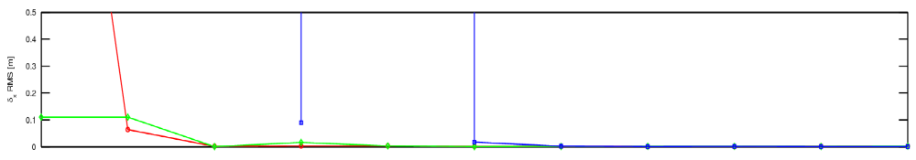
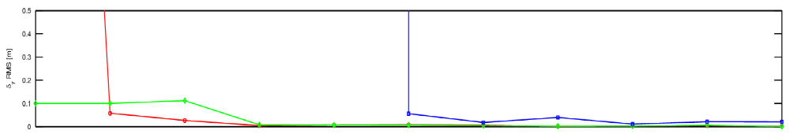
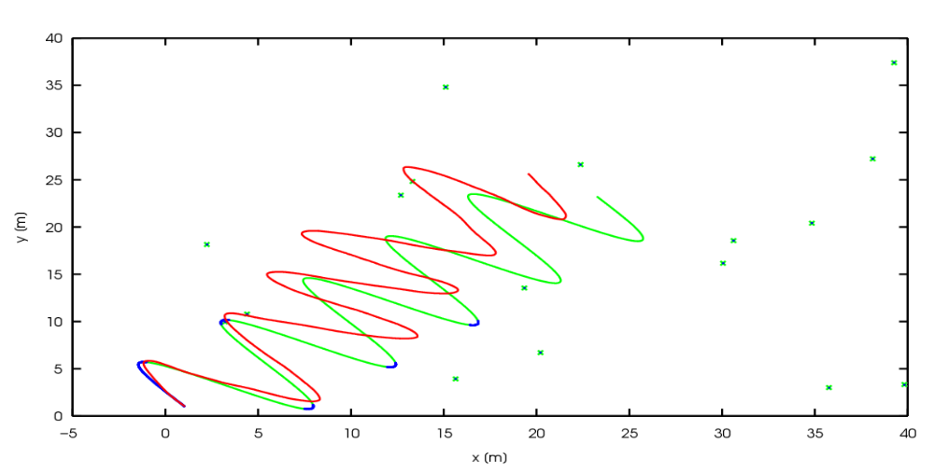
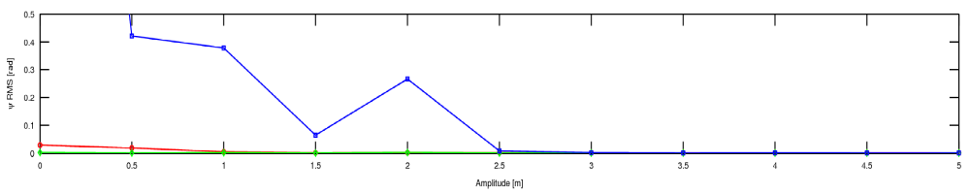
Self-supervised Calibration for Robotic Systems
Motivation
Overview
Every robotic system has some set of parameters needed for state estimation, planning, or control, e.g., scale factors or sensor locations.
Parameters may change over time due to vibration or thermal expansion.
Parameters must be inferred from the data.
Normal operation may result in unobservable directions in parameter space.
Unobservable directions in parameter space may appear observable in the presence of noise.
Generic algorithm for self calibration of robotic systems
Based on a nonlinear least squares fomulation
Incoming sensor stream is processed online and in batches of predefined length.
Information theoretic scheme identifies and stores batches of informative measurements.
Truncated QR decomposition detects unobservable directions in parameter space and locks them during optimization.
Method
Gauss-Newton Optimization
Maximum a Posteriori (MAP) formulation
Nonlinear least squares problem
Iterative solution of a least squares problem leads to the estimated optimal solution.
Truncated QR Decomposition
Least squares problems can be solved via matrix decomposition.
Unobservable directions in parameter space yield a rank deficient matrix.
Rank defiency in least squares problem induces large sensitivity in the solution.
Rank-revealing matrix decompositions such are SVD or QR can be used in a truncated manner to lock rank deficient columns.
Selection of Informative Measurements
A set of informative measurement batches is maintained throughout the calibration procedure.
An incoming batch is added to the informative set if it passes a mutual information test.
Gaussian distributions yield a convenient analytical formulation of the mutual information.
Results
Experimental Setup
Differential robot moving on a plane
Odometry measurements
Laser rangefinder (LRF) measuring position of landmarks
Goal: find the rigid 2D transformation (x, y, ψ) between the robot's center and the LRF while driving
Real-world Data
20 minutes of robot driving amongst a forest of tubes, aka landmarks
Ground truth from a motion capture system for the poses of the robot and the landmarks
LRF transformation from a measuring tape
Comparable results as for a standard batch least squares methods but with only 10% of the available data
Simulated Data
Sine wave path with varying amplitude
100 repetitions for each amplitude
Comparison of EKF, LS, and our method
Our method returns exploitable results under all conditions using a subset of the data.
Jérôme Maye, Paul Furgale, Roland Siegwart {jerome.maye, paul.furgale, roland.siegwart}@mavt.ethz.ch

