Slide 1
Graph Coloring
Sruthi Jogi, Jesse Bannon.

Slide 2
Outline
Vertex Coloring + DSATUR
Implementation Preliminary
Pseudocode
Experimental Results

Slide 3
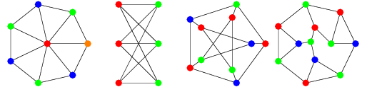
Vertex Coloring
A vertex coloring is an assignment of labels or colors to each vertex of a graph such that no edge connects two identically colored vertices

Slide 4
Degree of Saturation Algorithm (DSATUR)
Sequential coloring, dinamically chooses the vertex to color next, picking one that is adjacent to the largest number of distinctly colored vertices
Degree of saturation of a vertex v, deg_{s}(v), number of different colors already assigned to the vertices adjacent to v

Slide 5
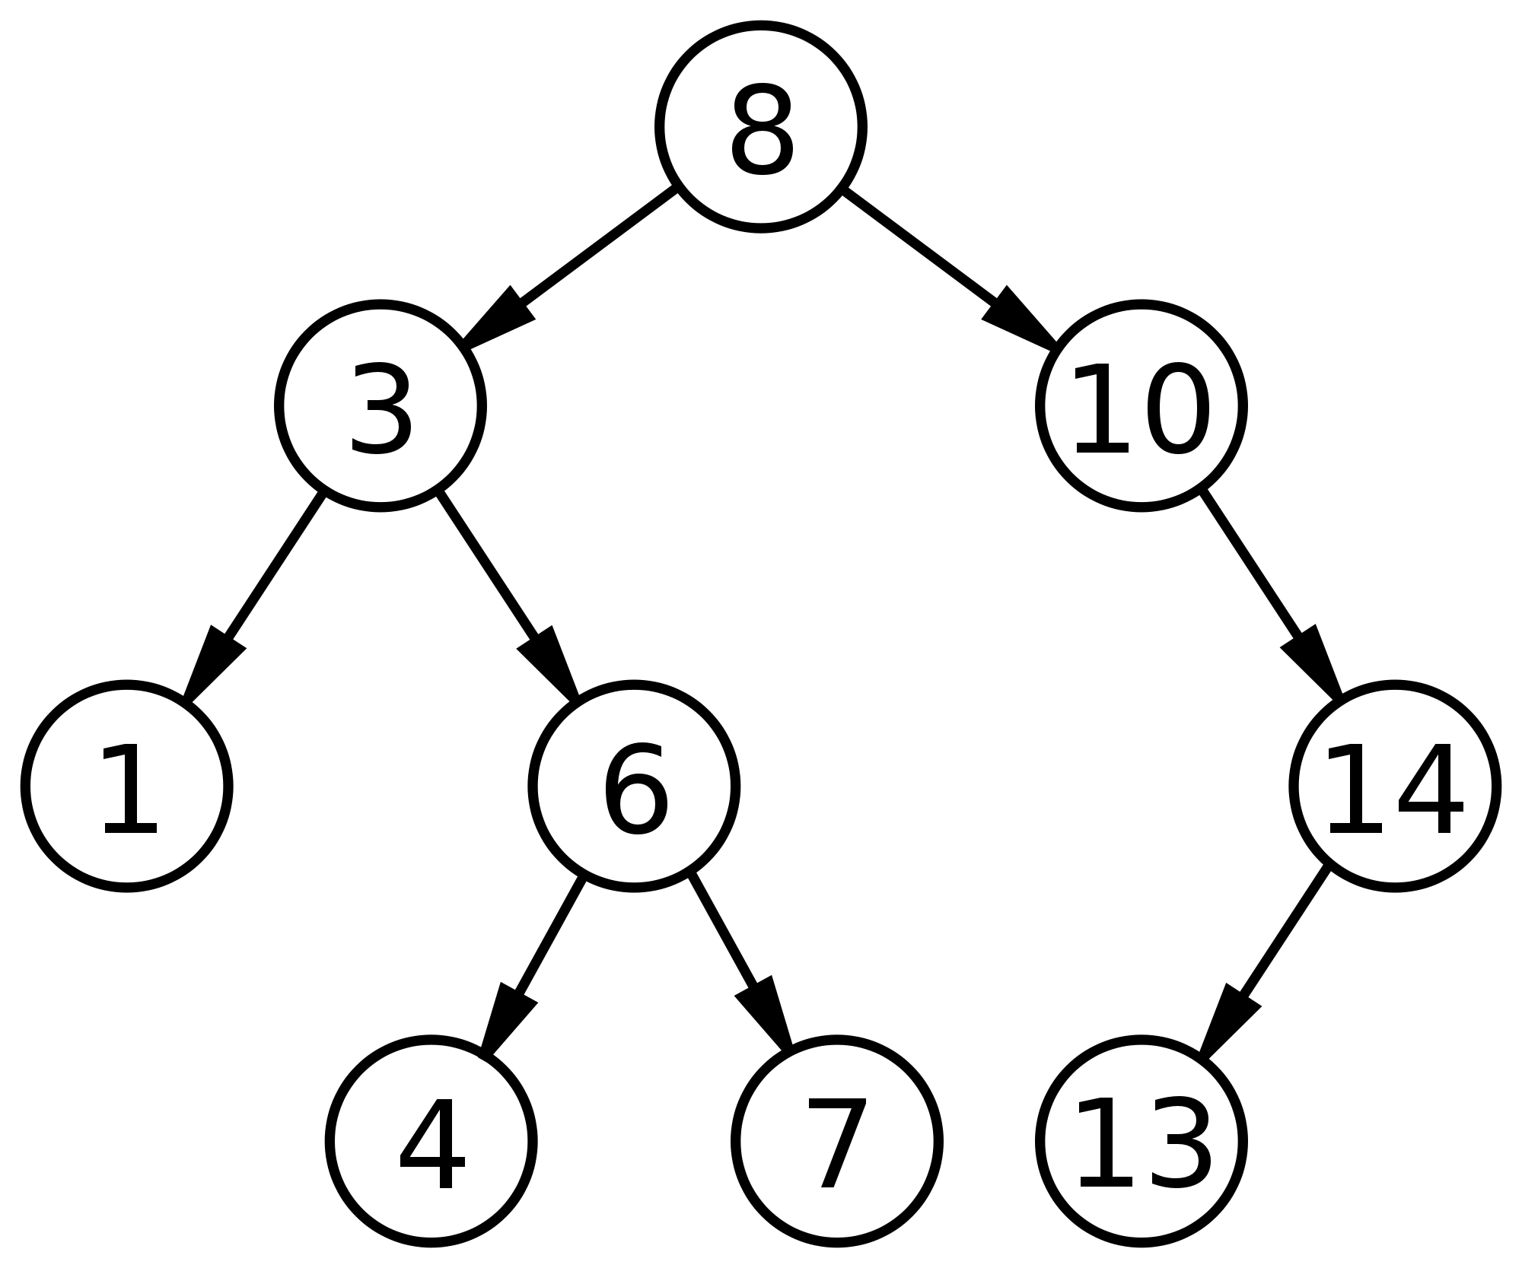
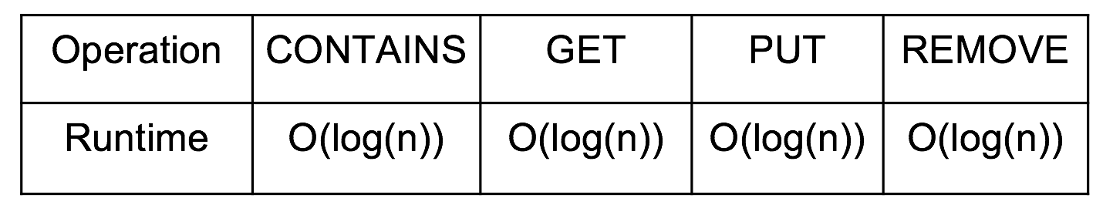
Implementation Preliminary
Naïve implementation of Brélaz’s Dsatur algorithm has 𝑂(|𝑉|² ⋅|𝐸|).
We achieve O(|V|log|V|⋅|𝐸|) using graph adjacency list, TreeMaps, and HashSets TreeMap Characteristics

Slide 6
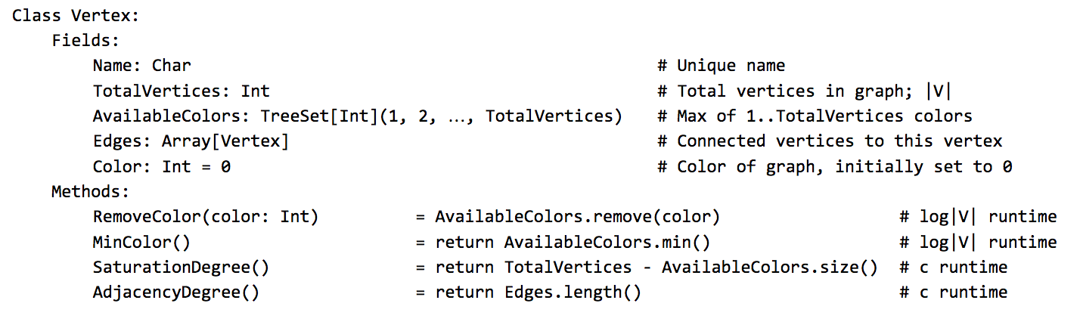
Vertex Psuedo-code

Slide 7
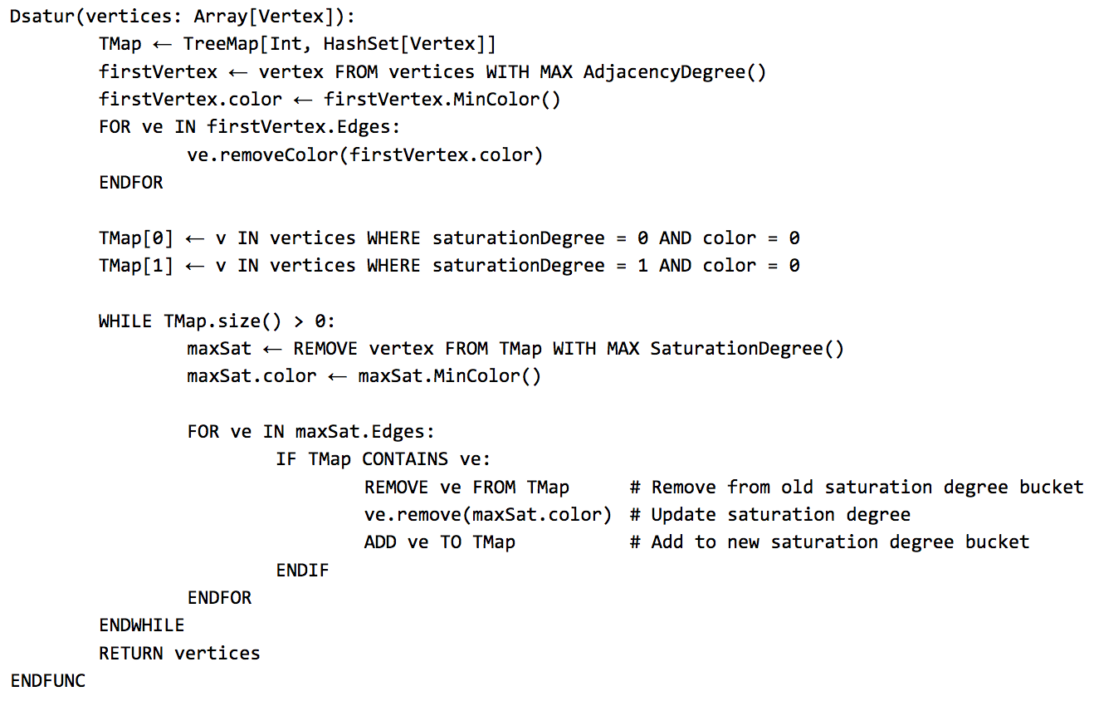
Implementation Psuedo-code

Slide 8
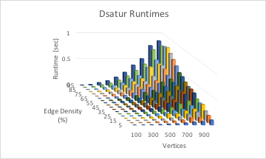
Experimental Results
Runtimes; {100, 200, …, 1000} X {5, 10, …, 95} vertices and edge density %

Slide 9
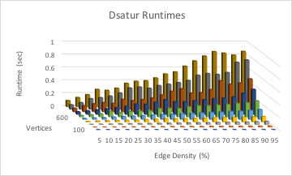
Experimental Results
Runtimes; {100, 200, …, 1000} X {5, 10, …, 95} vertices and edge density %

Slide 10
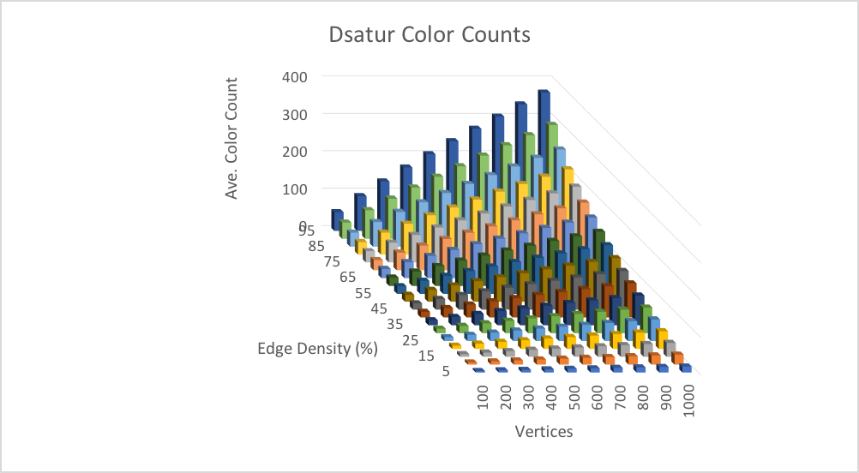
Experimental Results
Color Count; {100, 200, …, 1000} X {5, 10, …, 95} vertices and edge density %

Slide 11
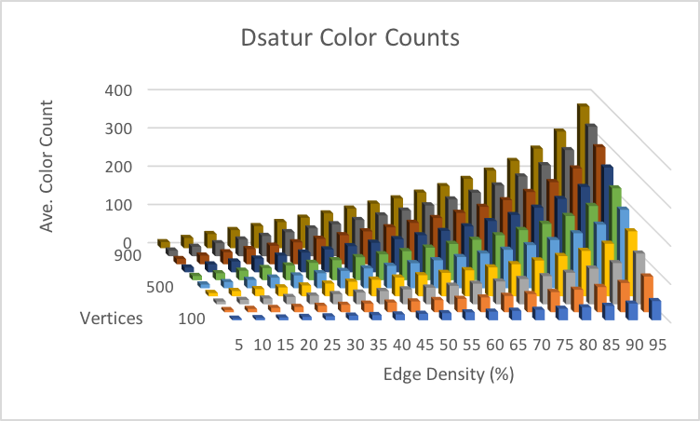
Experimental Results
Color Count; {100, 200, …, 1000} X {5, 10, …, 95} vertices and edge density %

Slide 12
Questions?

